Slide 1
Smart Reservoir
Within e-advertisement app

Slide 2
Team
Vsevolod Pus'
Stanislav Melnik
Roman Veselyak
Bogdan Nazar
Volodimir Popovich
Ivan Sapiga
Mentor
Mykhailo Struchinskyi

Slide 3
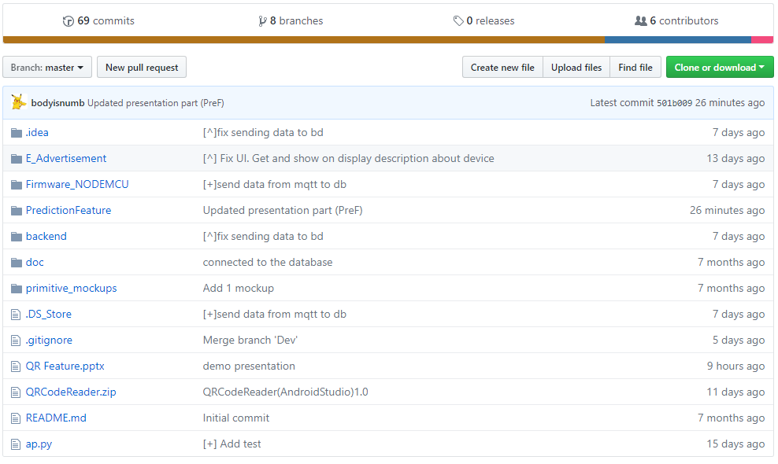
GitHub

Slide 4
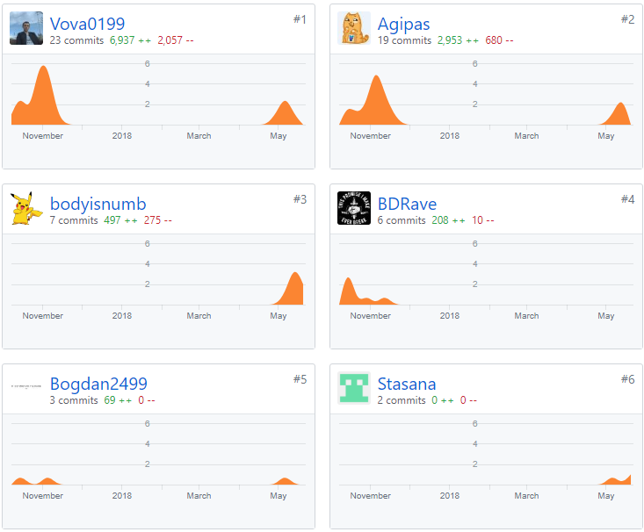
GitHub

Slide 5
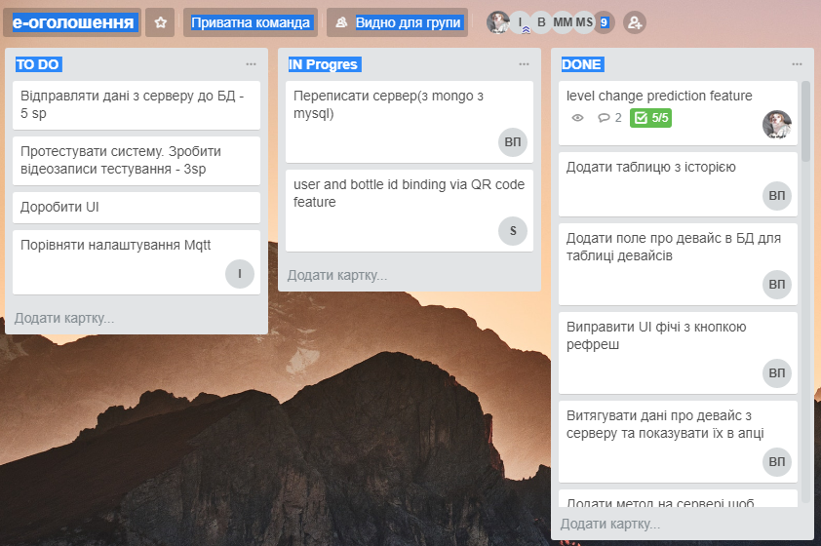
Trello

Slide 6
Completed Work

Slide 7
Prediction Feature
With Python3.6

Slide 8


Technologies
Idea
To predict level change using previous data stored in Data Base

Slide 9
Realisation

Slide 10
Demo

