Slide 1
Smart Reservoir
Within e-advertisement app

Slide 2
Team
Vsevolod Pus'
Stanislav Melnik
Roman Veselyak
Bogdan Nazar
Volodymyr Popovych
Ivan Sapiga
Mentor
Mykhailo Struchinskyi

Slide 3



Project overview
Our service is created to control water level in your bottle within android app

Slide 4
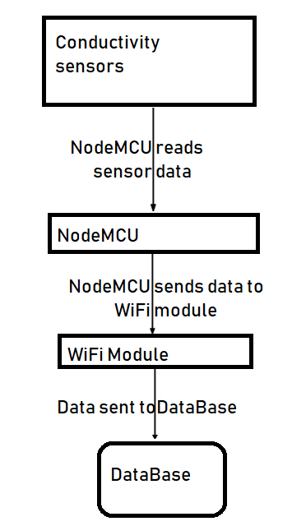
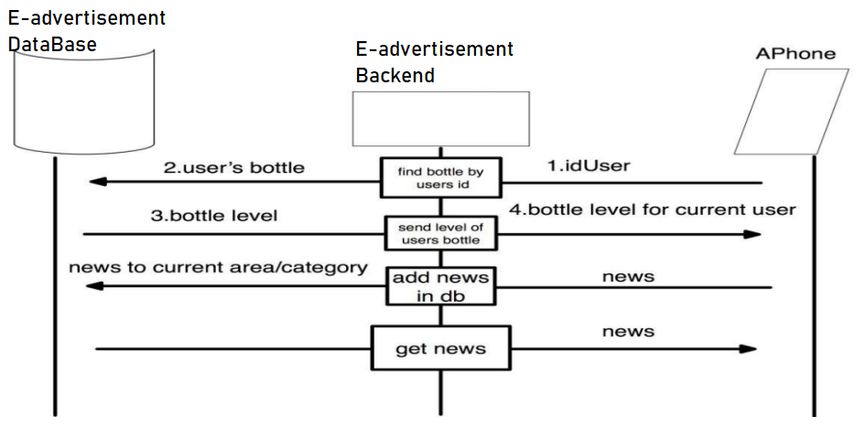
Dataflow

Slide 5
How does it work

Slide 6
Features
Refresh level’s all your devices in android app
Level change prediction
Encrypted communication channel
Future Features
Binding user and bottle id via QR code
Increase test coverage

Slide 7



idea
Posibility to refresh current level in android app
Technologies

Slide 8


Technologies
Idea
To predict level change using previous data stored in Data Base

Slide 9

idea
Encrypt communication chanel
Technologies

Slide 10


Tests
For greater productivity, as well as avoiding errors, many tests have been written that involve a large number of cases.

Slide 11

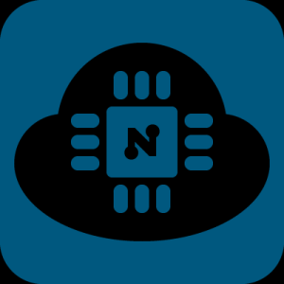
NodeMCU
To create out project was used NodeMCU microcontroller, so firmware was written from zero.

Slide 12

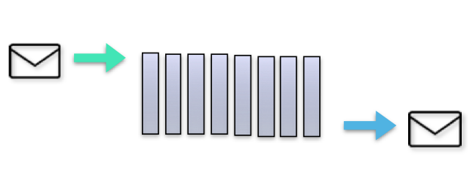
Message Broker(RabbitMQ)
We used RabbitMQ to manage a workload queue,providing reliable storage and guaranteed message delivery.

Slide 13
Advantages and disadvantages

Slide 14

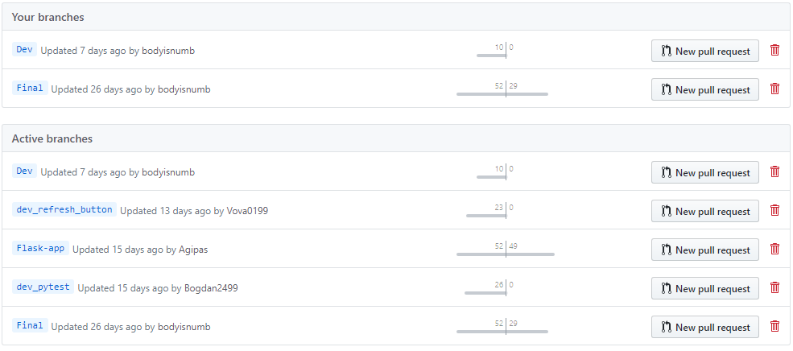

Slide 15
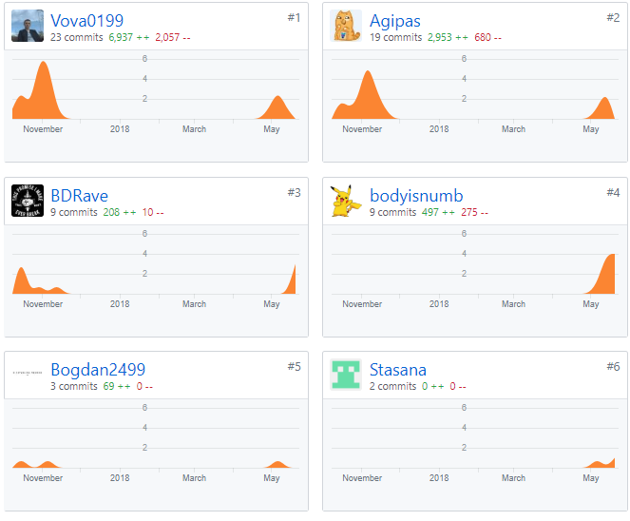
Team progress

Slide 16
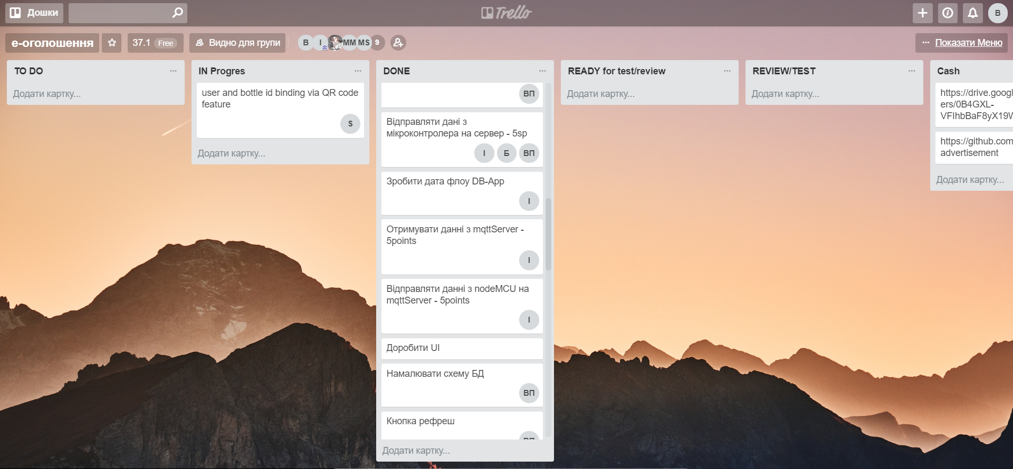
Trello

Slide 17





Technologies
MySQL
Android Studio
Flask
PyTest
RabbitMQ
Python
ArduinoIDE

Slide 18
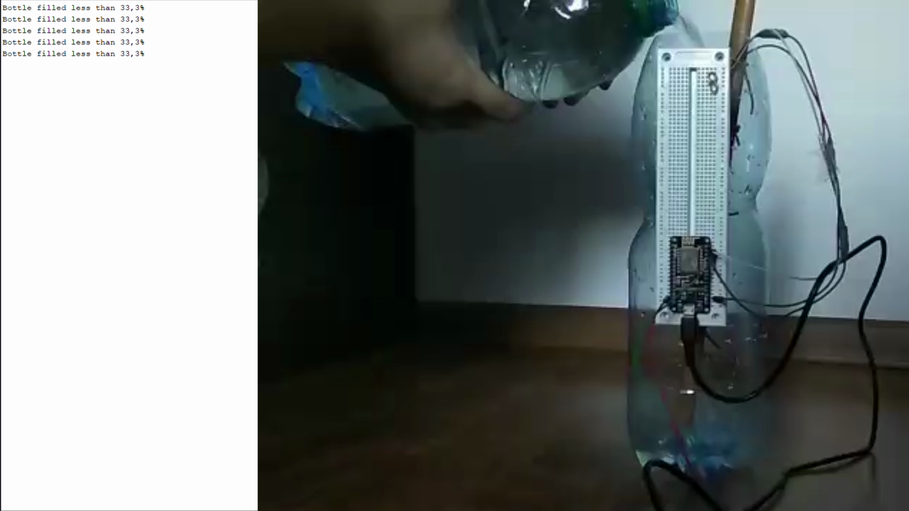

Slide 19
Thanks for attention
Any questions?

