Slide 1
Smart Reservoir
Within e-advertisement app

Slide 2
Team
Vsevolod Pus'
Stanislav Melnik
Roman Veselyak
Bogdan Nazar
Volodimir Popovich
Ivan Sapiga
Mentor
Mykhailo Struchinskyi

Slide 3
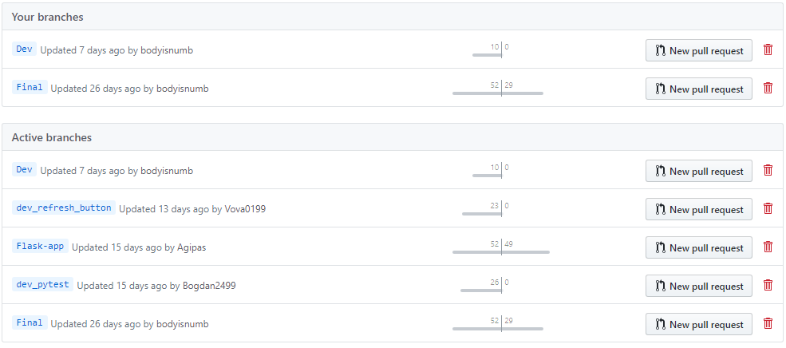
GitHub

Slide 4
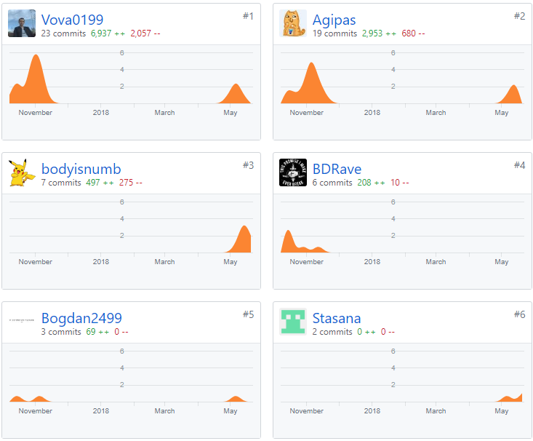
Team Contribution

Slide 5
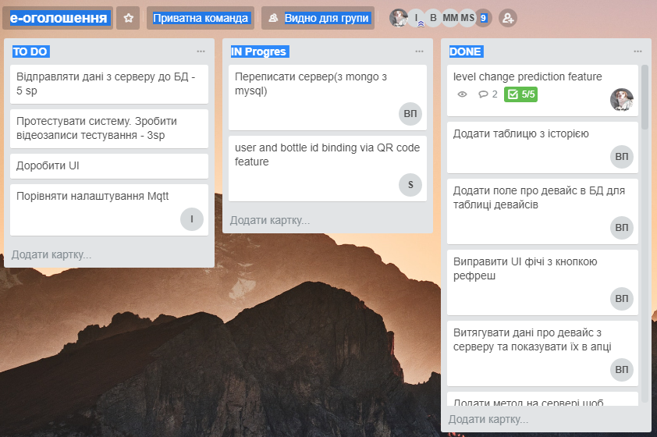
Trello

Slide 6
Completed Work

Slide 7
Technologies

Slide 8
How it works

Slide 9
Features
Prediction Feature
QR-code feature

Slide 10
Prediction Feature
With Python3.6

Slide 11


Technologies
Idea
To predict level change using previous data stored in Data Base

Slide 12
Realisation

Slide 13
QR-Code Feature

Slide 14


Technologies
Idea
user and bottle id binding via QR code feature

Slide 15
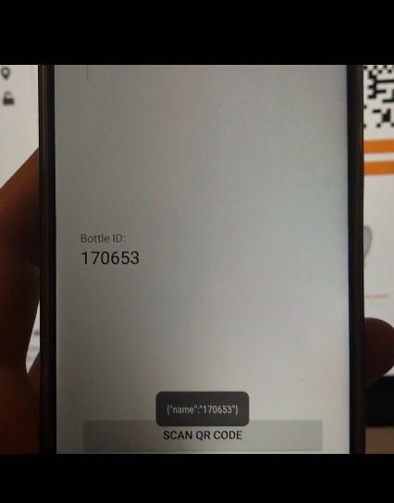
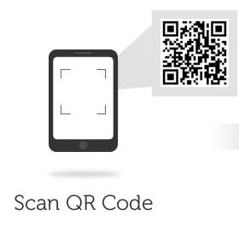
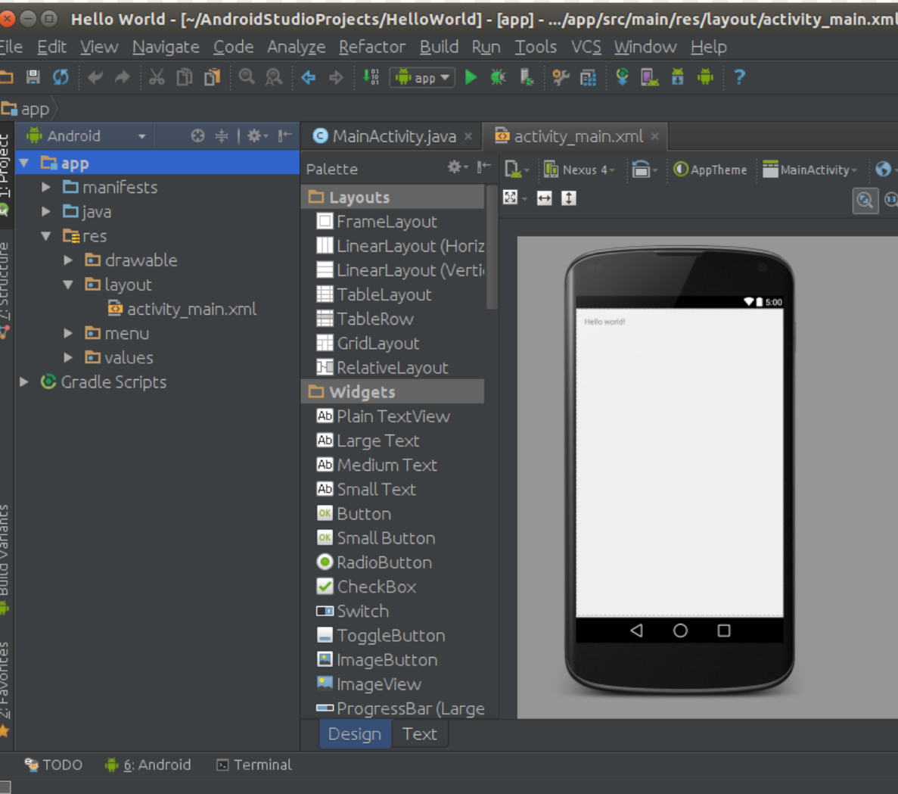
Realisation

Slide 16
DataFlow

Slide 17
Demo

