Slide 1
Smart Reservoir
Within e-advertisement app

Slide 2
Team
Vsevolod Pus'
Stanislav Melnik
Roman Veselyak
Bogdan Nazar
Volodimir Popovich
Ivan Sapiga
Mentor
Mykhailo Struchinskyi

Slide 3



Project overview
Our service is created to control water level in your bottle within android app

Slide 4
Dataflow

Slide 5
Dataflow

Slide 6
How does it work

Slide 7
Features
Refresh level in android app
Level change prediction
Encrypted communication channel
Future Features
Binding user and bottle id via QR code
Increase test coverage

Slide 8


idea
Posibility to refresh current level in android app
Technologies

Slide 9


Technologies
Idea
To predict level change using previous data stored in Data Base

Slide 10

idea
Encrypt communication chanel
Technologies

Slide 11

Tests
For greater productivity, as well as avoiding errors, many tests have been written that involve a large number of cases.

Slide 12
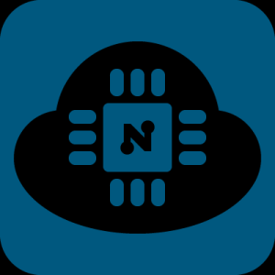
NodeMCU
To create out project was used NodeMCU microcontroller, so firmware was written from zero.

Slide 13
Message Broker(RabbitMQ)
We used RabbitMQ to manage a workload queue,providing reliable storage and guaranteed message delivery.

Slide 14
Advantages and disadvantages

Slide 15
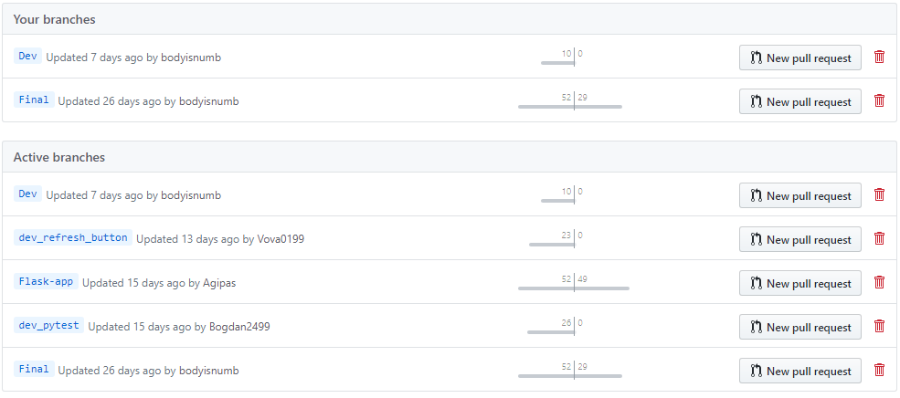
GitHub

Slide 16
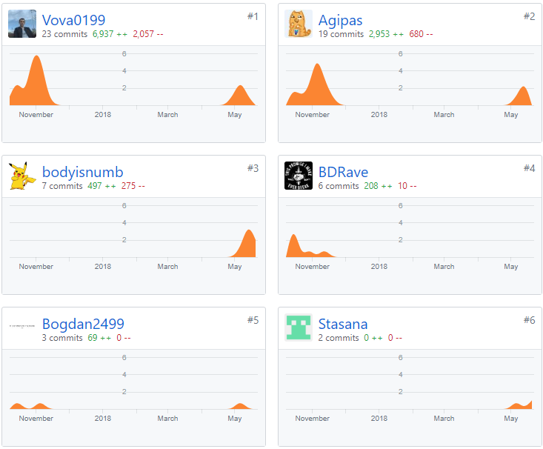
Team progress

Slide 17
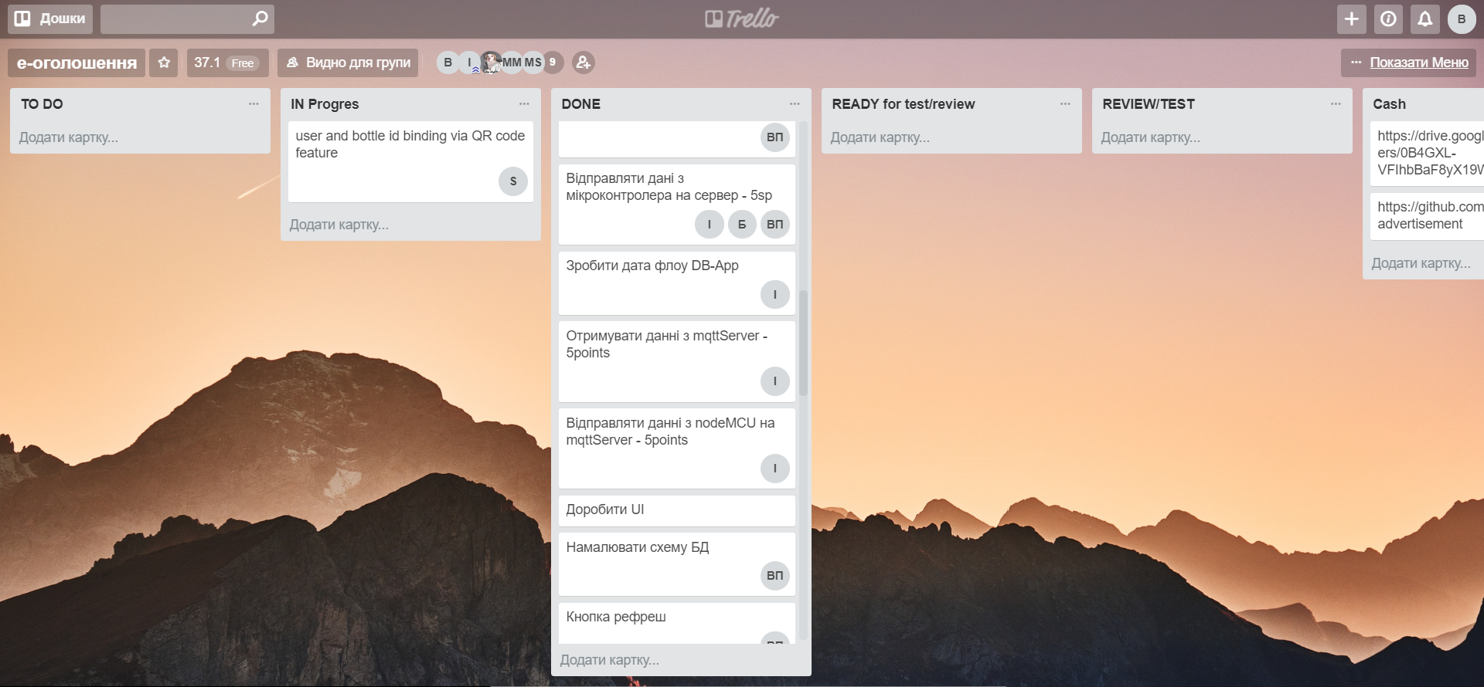
Trello

Slide 18







Technologies
MySQL
Android Studio
Flask
PyTest
RabbitMQ
Python
ArduinoIDE

Slide 19
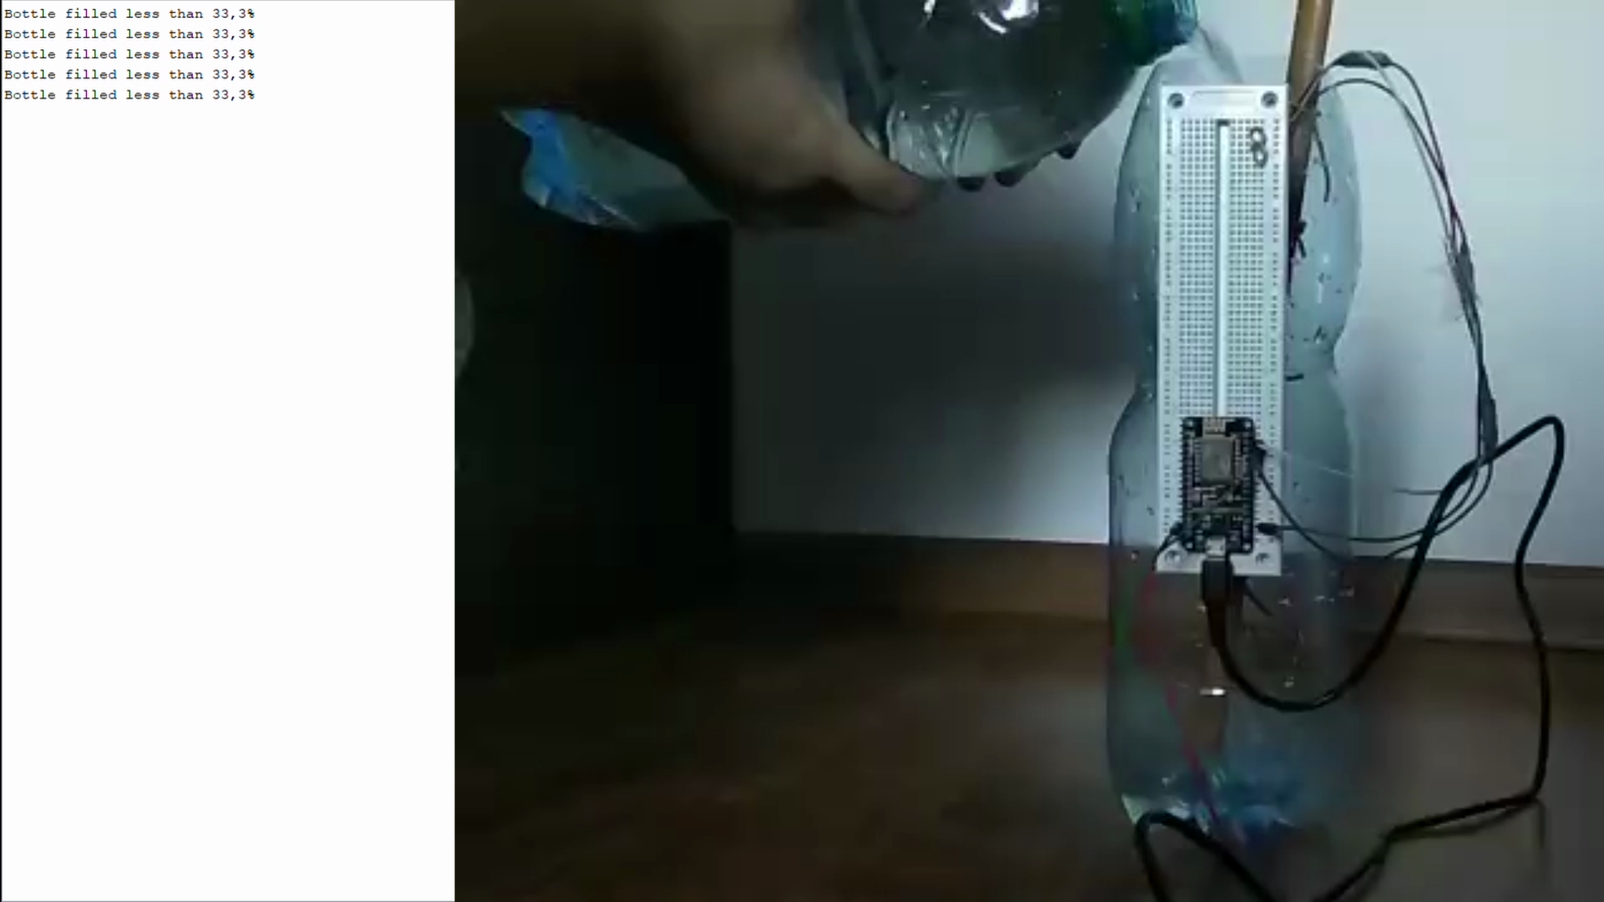

Slide 20
Thanks for attention
Any questions?

