Slide 1
Smart Reservoir
Within e-advertisement app

Slide 2
Team
Vsevolod Pus'
Stanislav Melnik
Roman Veselyak
Bogdan Nazar
Volodimir Popovich
Ivan Sapiga
Mentor
Mykhailo Struchinskyi

Slide 3



Project overview
Our service is created to control water level in your bottle within android app

Slide 4
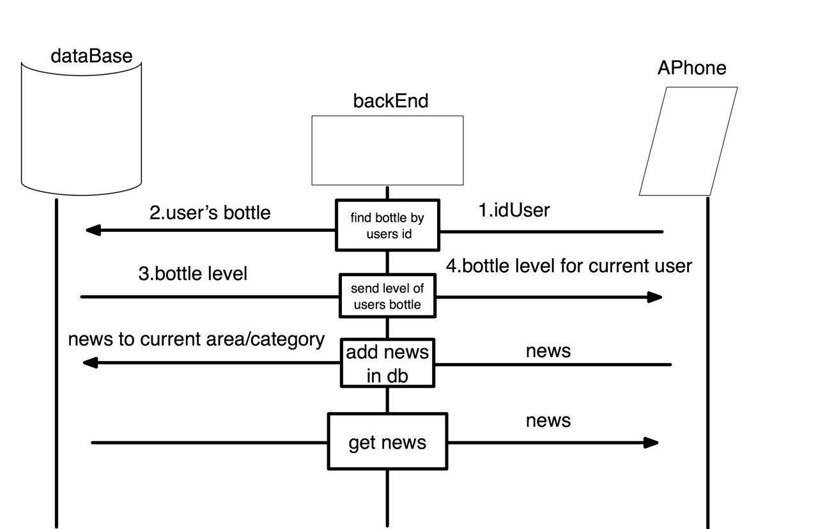
Dataflow

Slide 5
Features
Refresh level in android app
Level change prediction
Future Feature
Binding user and bottle id via QR code

Slide 6


idea
Posibility to refresh current level in android app
Technologies

Slide 7


Technologies
Idea
To predict level change using previous data stored in Data Base

Slide 8
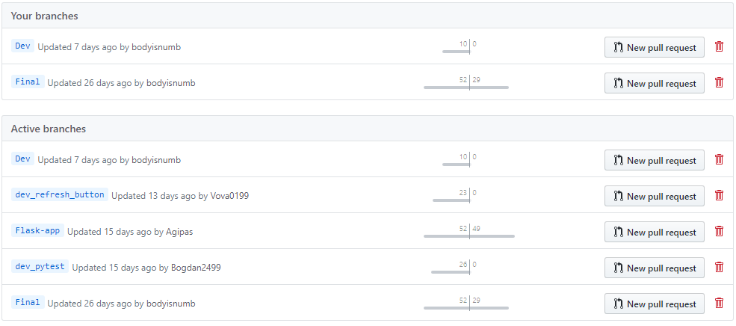
GitHub

Slide 9
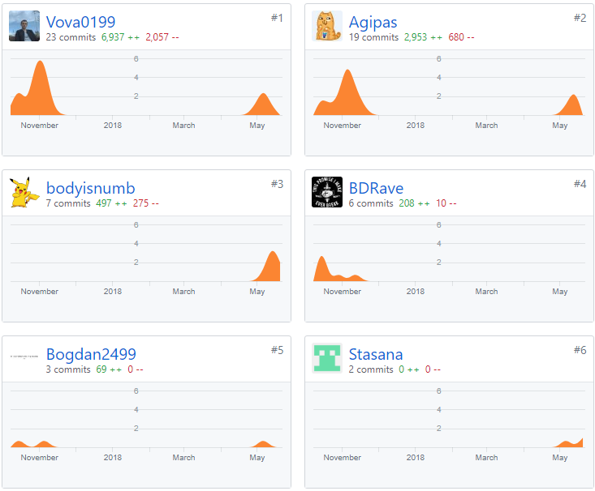
Team progress

Slide 10
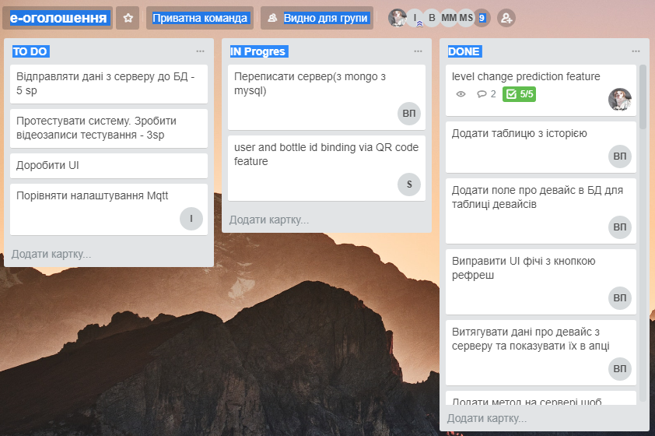
Trello

Slide 11
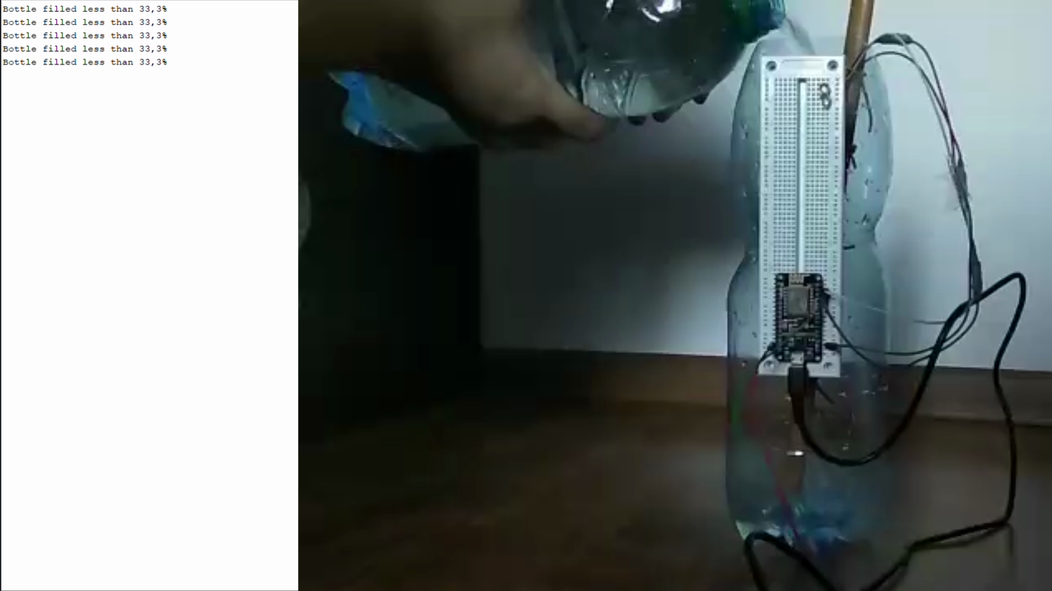

Slide 12
Thanks for attention
Any questions?

