Slide 1
Smart Reservoir
Within e-advertisement app

Slide 2
Team
Vsevolod Pus'
Stanislav Melnik
Roman Veselyak
Bogdan Nazar
Volodimir Popovich
Ivan Sapiga
Mentor
Mykhailo Struchinskyi

Slide 3



Project overview
Our service is created to control water level in your bottle within android app

Slide 4
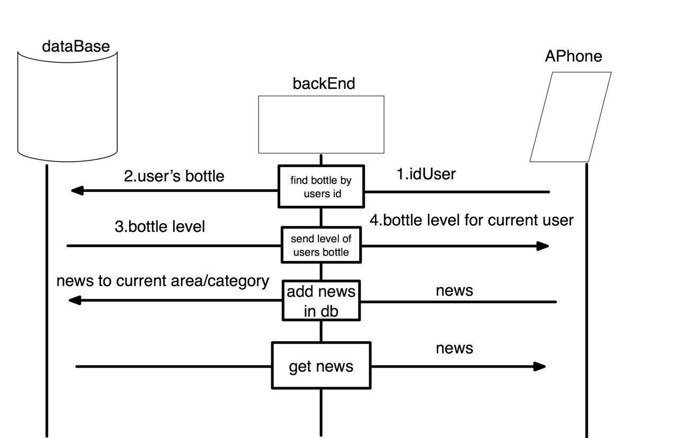
Dataflow

Slide 5
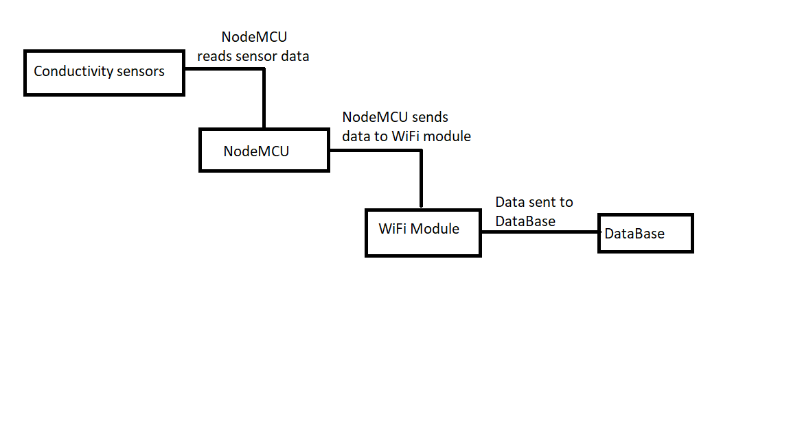
Dataflow

Slide 6
Features
Refresh level in android app
Level change prediction
Encrypted communication channel
Future Feature
Binding user and bottle id via QR code
Increase test coverage

Slide 7


idea
Posibility to refresh current level in android app
Technologies

Slide 8


Technologies
Idea
To predict level change using previous data stored in Data Base

Slide 9

idea
Encrypt communication chanel
Technologies

Slide 10

Tests
For greater productivity, as well as avoiding errors, many tests have been written that involve a large number of cases.

Slide 11
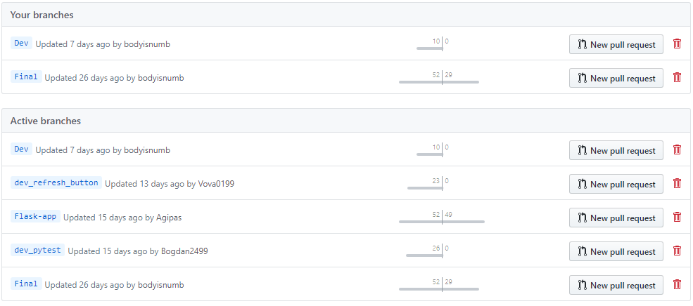
GitHub

Slide 12
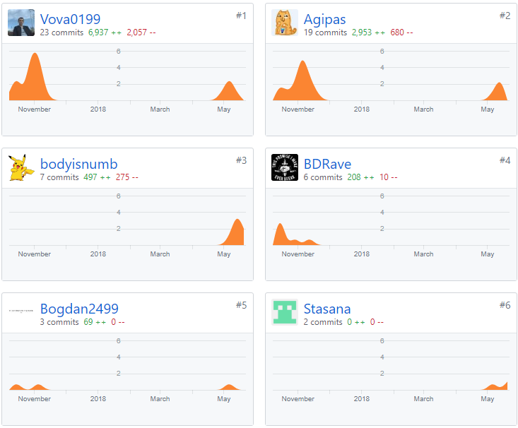
Team progress

Slide 13
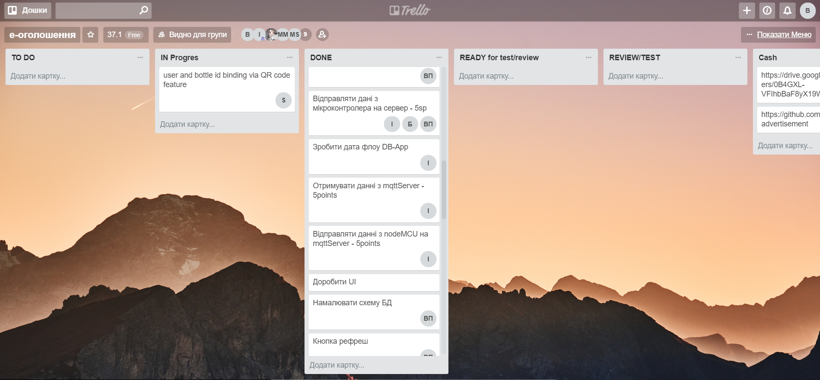
Trello

Slide 14
Technologies
MySQL
Android Studio
Flask
PyUnit
MQTT
RabbitMQ

Slide 15
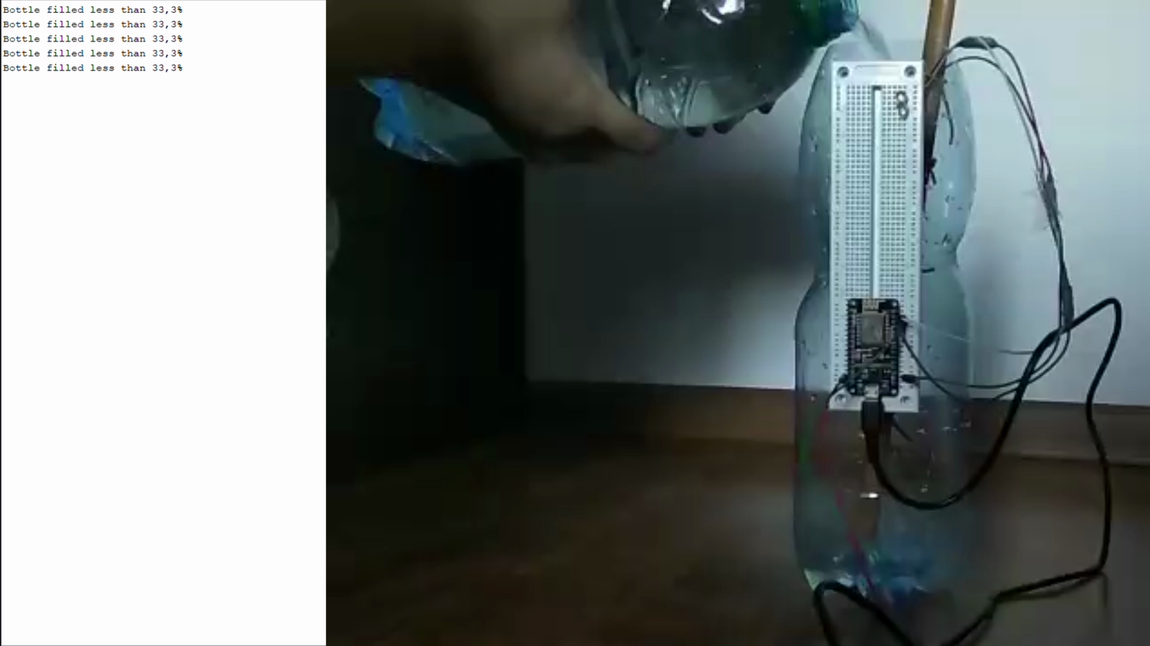

Slide 16
Thanks for attention
Any questions?

