Slide 1
JAVA Programming
Presented by: Ma Myint Myint

Slide 2
Day 26
Session 9

Slide 3
Layout Managers
A layout manager allows the java programmer to develop graphical interfaces that will have a common appearance across the heterogeneous internet.
These are layout managers that the programmer may choose from:
Flow Layout
Box Layout
Grid Layout
Circle Layout
Border Layout
Card Layout
Gridbag Layout

Slide 4
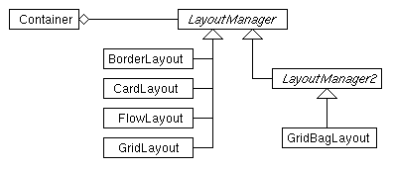
Hierarchy of Layout Managers

Slide 5
Flow Layout
Flow layout is layout components row by row from left to right.
It is the default layout manager for a panel.
The flow layout manager lines the components horizontally until there is no more room and then starts a new row of components.
When the user resizes the container, the layout manager automatically reflows the components to fill the available space.
The following example shows the demonstration of flow layout of components.
Usage:
setLayout(new FlowLayout());

Slide 6
Example
import javax.swing.*;
import java.awt.*;
public class layoutTest extends JFrame
{JButton b1=new JButton("Yellow");
JButton b2=new JButton("Blue");
JButton b3=new JButton("Red");
JButton b4=new JButton("Green");
JButton b5=new JButton("Orange");
JButton b6=new JButton("Cyan");
public layoutTest()
{this.setSize(290,200);
JPanel p=new JPanel();
// p.setLayout(new FlowLayout(FlowLayout.LEFT)); (OR)
// p.setLayout(new FlowLayout(FlowLayout.RIGHT )); (OR)
// p.setLayout(new FlowLayout(FlowLayout.CENTER )); // Default is CENTER

Slide 7
Example
p.add(b1);
p.add(b2);
p.add(b3);
p.add(b4);
p.add(b5);
p.add(b6);
this.setDefaultCloseOperation(JFrame.EXIT_ON_CLOSE);
this.setContentPane(p);
this.show();
}
public static void main(String[] args)
{
new layoutTest();
}
}

Slide 8
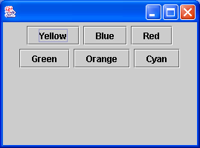
Output

Slide 9
BorderLayout
Properties of a Border Layout Manager
More flexible in permitting programmer placement of components of different sizes (such as panels, canvases and text areas).
Border areas adjust to accommodate the placement of a component. The center consists of what’s left over.
Usage:
setLayout(new BorderLayout());
add(new JButton("North"), BorderLayout.NORTH);

Slide 10
BorderLayout
North
West
Center
East
South

Slide 11
Border Layout
Example – A BorderLayout with a Label in North, a Scrollbar in South, a Panel containing a Checkboxgroup in West, a List in East, and a Canvas in Center.
Border Layout Example
o Red
o Blue
o Green
o Black
o White
Rectangle
Oval
Line
Fill
Background

Slide 12
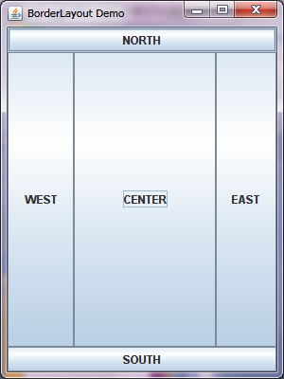
Border Layout (Example)

Slide 13
package GUI;
import javax.swing.*;
import java.awt.*;
import java.awt.event.*;
public class BorderLayoutTest extends JFrame {
public BorderLayoutTest()
{
JFrame f=new JFrame("BorderLayout Demo");
f.setSize(300,400);
f.setDefaultCloseOperation(JFrame.EXIT_ON_CLOSE);
Container c=f.getContentPane();
c.setLayout(new BorderLayout());
JButton b1=new JButton("SOUTH");
JButton b2=new JButton("NORTH");
JButton b3=new JButton("EAST");
JButton b4=new JButton("WEST");
JButton b5=new JButton("CENTER");

Slide 14
c.add(b1,BorderLayout.SOUTH);
c.add(b2,BorderLayout.NORTH);
c.add(b3,BorderLayout.EAST);
c.add(b4,BorderLayout.WEST);
c.add(b5,BorderLayout.CENTER);
f.setVisible(true);
}
public static void main(String[] args)
{
new BorderLayoutTest();
}
}

Slide 15
GridLayout
Components expand or contract in size to fill a single grid cell. Panels, canvases, and Lists are resized to fit into a grid cell.
Components are placed in the container in order from left to right and top to bottom.
Usage:
setLayout(new GridLayout(row, col));

Slide 16
Grid Layout
name
address
e-mail

Slide 17
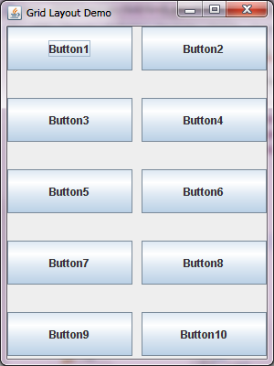
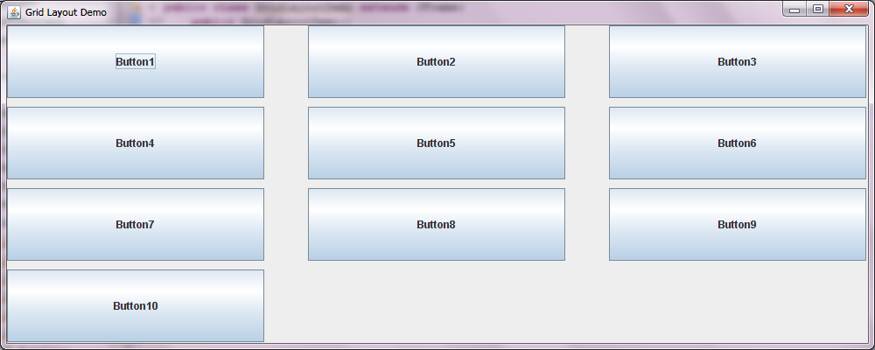
Grid Layout (Example)
f.setSize(1000,400);
c.setLayout(new GridLayout(4,3,50,10));
f.setSize(300,400);
c.setLayout(new GridLayout(5,2,10,30));

Slide 18
package GUI;
import javax.swing.*;
import java.awt.*;
public class GridLayoutDemo extends JFrame{
public GridLayoutDemo()
{
JFrame f=new JFrame("Grid Layout Demo");
f.setSize(300,400);
f.setDefaultCloseOperation(JFrame.EXIT_ON_CLOSE);
f.setVisible(true);
Container c=f.getContentPane();
c.setLayout(new GridLayout(5,2,10,30));
for(int i=1;i<=10;i++)
{
c.add(new JButton("Button"+i));
}
}
public static void main(String[] args)
{
new GridLayoutDemo();
}
}

Slide 19
CardLayout
A card layout is a group of components or containers that are displayed one at a time.
Usage:
void add(Component com, String name)
CardLayout View Components are
void first(container)
void last(container)
void next(container)
void previous(container)
void show(Container, String name)

Slide 20
Card Layout
Card Layout Construction
The Applet contains an ordered listing (array) of cards in one of its panels
Card Panel

Slide 21
GridBag Layout
The grid bag layout manager is a flexible layout manager that aligns components horizontally and vertically, without requiring that the components be the same size.
Each grid bag layout manager uses a rectangular grid of cells, with each component occupying one or more cells (called its display area).
Each component in a grid bag layout is associated with a set of constraints contained within a GridBag-Constraints instance that specifies how the component is to be laid out within its display area.

Slide 22
Example
import java.awt.*;
import java.util.*;
import java.applet.Applet;
public class GridBagEx1 extends Applet {
protected void makebutton(String name,
GridBagLayout gridbag,
GridBagConstraints c) {
Button button = new Button(name);
gridbag.setConstraints(button, c);
add(button);
}
public void init() {
GridBagLayout gridbag = new GridBagLayout();
GridBagConstraints c = new GridBagConstraints();
setFont(new Font("Helvetica", Font.PLAIN, 14));
setLayout(gridbag);
c.fill = GridBagConstraints.BOTH;
c.weightx = 1.0;
makebutton("Button1", gridbag, c);
makebutton("Button2", gridbag, c);
makebutton("Button3", gridbag, c);

Slide 23
Example
c.gridwidth = GridBagConstraints.REMAINDER;
makebutton("Button4", gridbag, c);
//end first row
c.weightx = 0.0; //reset to the default
makebutton("Button5", gridbag, c); //another row
// next-to last in row
c.gridwidth = GridBagConstraints.RELATIVE;
makebutton("Button6", gridbag, c);
c.gridwidth = GridBagConstraints.REMAINDER; //end row
makebutton("Button7", gridbag, c);
c.gridwidth = 1; // reset to the default
c.gridheight = 2;
c.weighty = 1.0;
makebutton("Button8", gridbag, c);
c.weighty = 0.0; //reset to the default
// end row
c.gridwidth = GridBagConstraints.REMAINDER;
c.gridheight = 1; // reset to the default
makebutton("Button9", gridbag, c);
makebutton("Button10", gridbag, c);
resize(300, 100);
}

Slide 24
Example
public static void main(String args[]) {
Frame f = new Frame("GridBag Layout Example");
GridBagEx1 ex1 = new GridBagEx1();
ex1.init();
f.add("Center", ex1);
f.pack();
f.show();
}
}

Slide 25
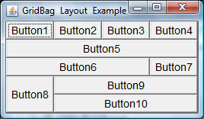
Output

Slide 26
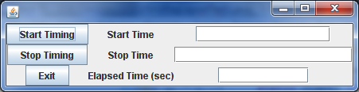
GridBag layout test2

Slide 27
Example 2
import java.awt.GridBagConstraints;
import java.awt.GridBagLayout;
import javax.swing.JButton;
import javax.swing.JFrame;
import javax.swing.JLabel;
import javax.swing.JTextField;

Slide 28
public class GridBagLayoutTest1 extends JFrame{
static JButton startButton=new JButton();
static JButton stopButton=new JButton();
static JButton exitButton=new JButton();
static JLabel startLabel=new JLabel();
static JLabel stopLabel=new JLabel();
static JLabel elapsedLabel=new JLabel();
static JTextField startTF=new JTextField(10);
static JTextField stopTF=new JTextField(10);
static JTextField elapsedTF=new JTextField(10);

Slide 29
public GridBagLayoutTest1()
{
getContentPane().setLayout(new GridBagLayout());
GridBagConstraints gridConstraints=new GridBagConstraints();
startButton.setText("Start Timing");
gridConstraints.gridx=0;
gridConstraints.gridy=0;
getContentPane().add(startButton,gridConstraints);

Slide 30
stopButton.setText("Stop Timing");
gridConstraints.gridx=0;
gridConstraints.gridy=1;
getContentPane().add(stopButton,gridConstraints);
exitButton.setText("Exit");
gridConstraints.gridx=0;
gridConstraints.gridy=2;
getContentPane().add(exitButton,gridConstraints);
startLabel.setText("Start Time");
gridConstraints.gridx=1;
gridConstraints.gridy=0;
getContentPane().add(startLabel,gridConstraints);
stopLabel.setText("Stop Time");
gridConstraints.gridx=1;
gridConstraints.gridy=1;
getContentPane().add(stopLabel,gridConstraints);

Slide 31
elapsedLabel.setText("Elapsed Time (sec)");
gridConstraints.gridx=1;
gridConstraints.gridy=2;
getContentPane().add(elapsedLabel,gridConstraints);
startTF.setText("");
startTF.setColumns(15);
gridConstraints.gridx=2;
gridConstraints.gridy=0;
getContentPane().add(startTF,gridConstraints);

Slide 32
stopTF.setText("");
stopTF.setColumns(20);
gridConstraints.gridx=2;
gridConstraints.gridy=1;
getContentPane().add(stopTF,gridConstraints);
elapsedTF.setText("");
gridConstraints.gridx=2;
gridConstraints.gridy=2;
getContentPane().add(elapsedTF,gridConstraints);
pack();
//setVisible(true);
}

Slide 33
public static void main(String[] args)
{
new GridBagLayoutTest1().setVisible(true);
}
}

Slide 34
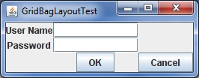
Gridbag layout test3

Slide 35
Example 3
package J2SE1;
import javax.swing.*;
import java.awt.*;
import java.awt.Event.*;
public class GridBagLayoutTest2 extends JFrame{
JLabel l1=new JLabel("User Name");
JLabel l2=new JLabel("Password");
JTextField t1=new JTextField(10);
JTextField t2=new JTextField(10);
JButton b1=new JButton("OK");
JButton b2=new JButton("Cancel");

Slide 36
public GridBagLayoutTest2()
{
super("GridBagLayoutTest");
//setVisible(true);
Container c=getContentPane();
c.setLayout(new GridBagLayout());
GridBagConstraints gb=new GridBagConstraints();
gb.gridx=0;
gb.gridy=0;
c.add(l1,gb);
gb.gridx=1;
gb.gridy=0;
c.add(t1,gb);

Slide 37
gb.gridx=0;
gb.gridy=1;
c.add(l2,gb);
gb.gridx=1;
gb.gridy=1;
c.add(t2,gb);
gb.gridx=1;
gb.gridy=2;
c.add(b1,gb);
gb.gridx=2;
gb.gridy=2;
c.add(b2,gb);
pack();
setVisible(true);
}

Slide 38
public static void main(String[] args)
{
new GridBagLayoutTest2();
}
}

Slide 39
Thank you!!!

