Slide 1

Traffic Simulator
By:
TeamDiversity

Slide 2

Agenda:
Brief concepts
Diagram
Demo
Works On

Slide 3
Brief Concepts
Aims of this program
Scope
Schedule

Slide 4
Brief Concepts : Aims
To Develop
To Compare: Fixed and Congestion Control
To Examine: Emergency

Slide 5
Brief Concepts: Scope
Road: multiple lanes
Left-Lanes
Car and Bus
Driver Behaviour: cautions, reckless, or normal

Slide 6
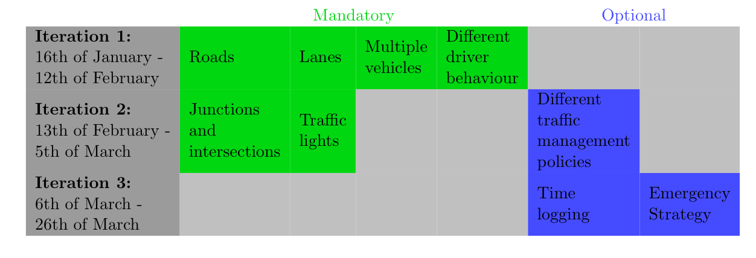
Brief Concepts : Schedule

Slide 7
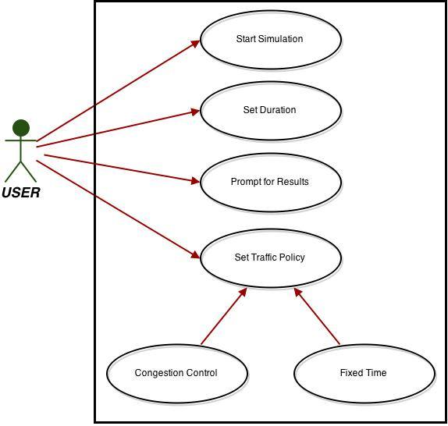
Diagram: Use Case

Slide 8
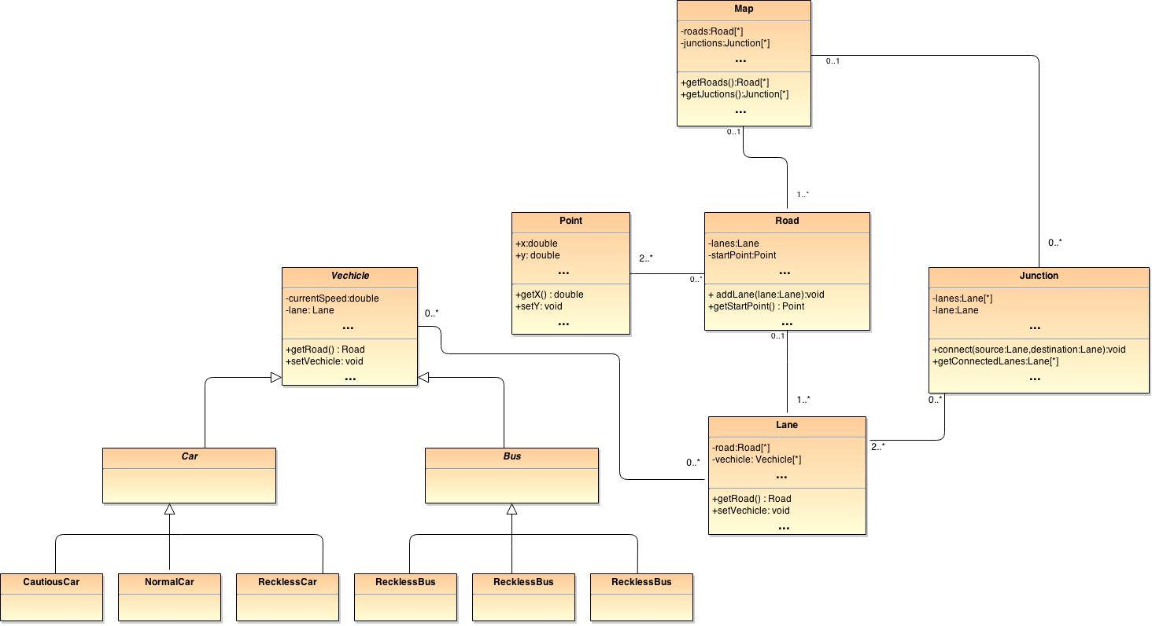
Diagram: Class

Slide 9
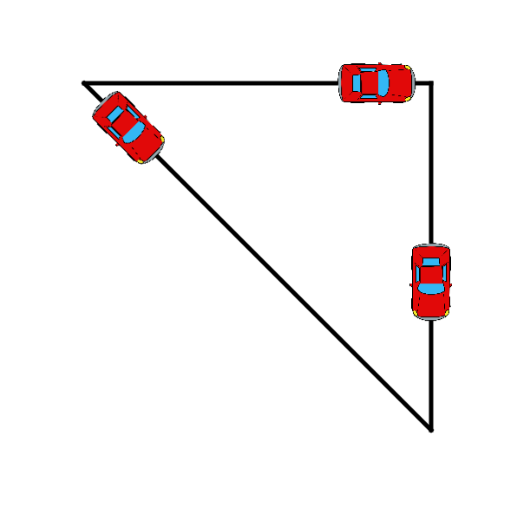
Diagram: Graphic

Slide 10
Demo
LET’S SEE!!

Slide 11
Works On:
Traffic Light
Junction
Multiple Lanes
Ambulance
Behaviour

Slide 12
Summary
Brief concepts
- Aim
- Scope
- Schedule
2. Program Diagram
Demo
Works On

Slide 13
Any questions?

Slide 14
Our Team: TeamDiversity
Balazs Kiss
Eddy Mukasa
Yukolthep Visessmit
Pongsakorn Riyamongkol
Snorri Hannesson

