Slide 1

An android app that acts as an assistant for university students
TEAM HAWKEYE

Slide 2
Content
Introduction
scope
Problem
Solution
How the application works
Benefits
conclusion

Slide 3
Introduction
An assistant for university students
Simply to use
A user friendly interface
Several important features for the students

Slide 4
Scope
Students’ attendance for the lectures
Assignment and tutorial marks
Students’ GPA
What can effect to GPA

Slide 5
Problem
Most of students can’t get full marks for attendance.
How will it effect to the final result ?
No any concern about calculating assignment and tutorial marks.
There is an effect on attendance marks, assignment and tutorial marks for the GPA.

Slide 6
The solution is “MEMENTO”

Slide 7
How the application works
Students can log with their university ID number and the password.
Can view their attendance percentage for each subject.
Can view how much percentage of attendance they can gain from further lectures.
Can view their marks for assignments and tutorials for each subject.
Can view the finalized GPA or semester-wise GPA.
Can view the time table.
This will remind the students when they have a lecture.

Slide 8
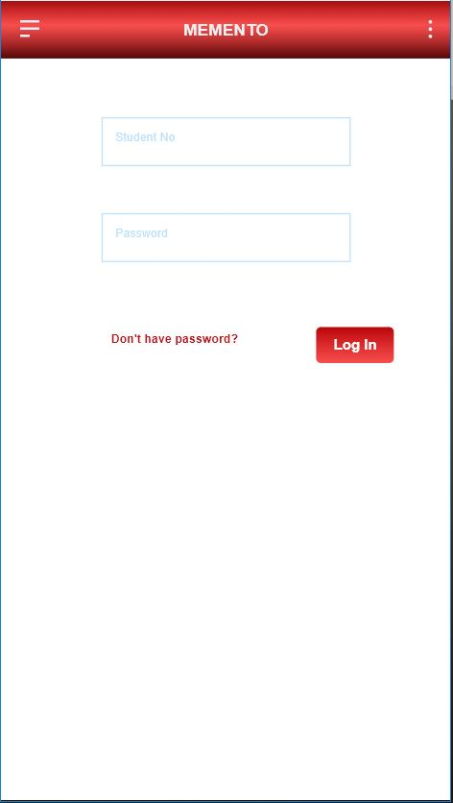
Login screen

Slide 9
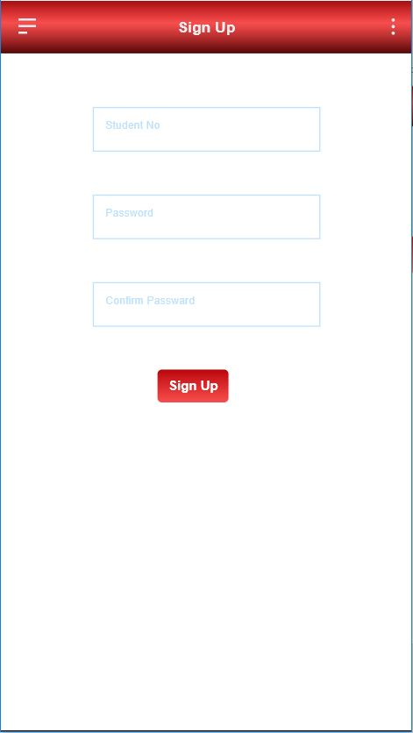

Slide 10
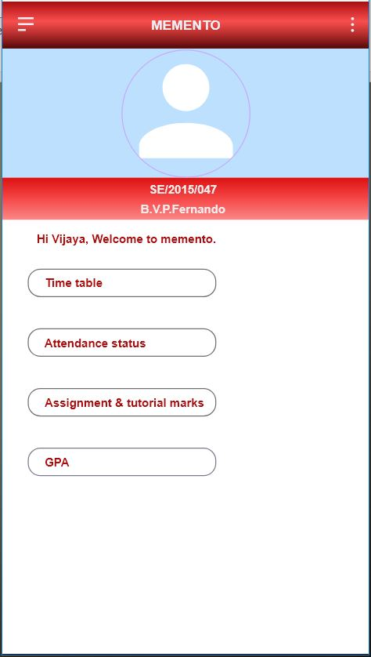
Profile

Slide 11
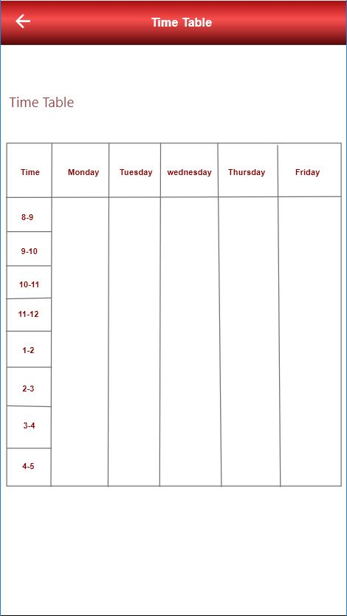

Slide 12
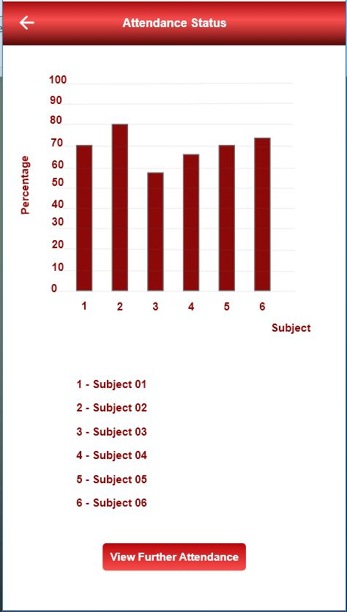

Slide 13
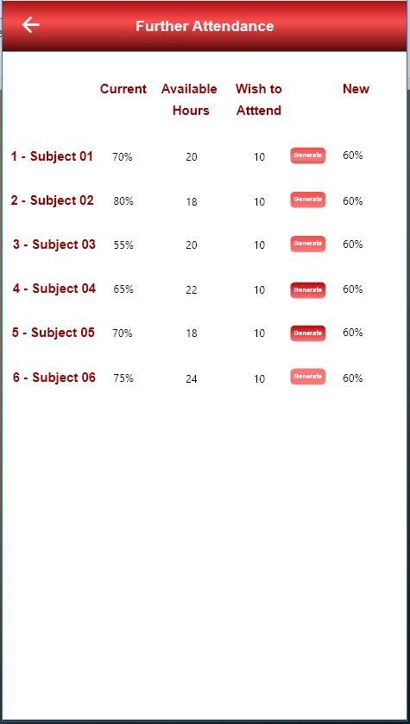

Slide 14
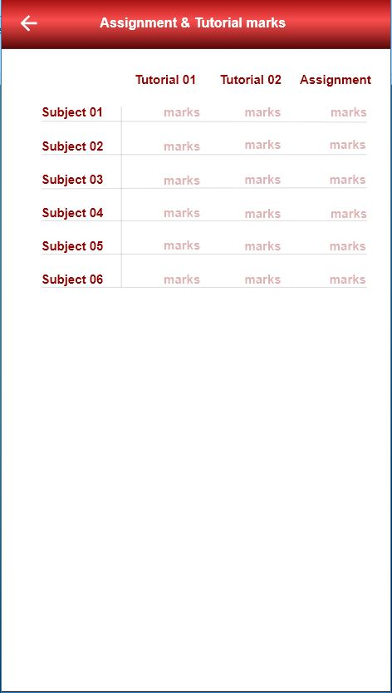

Slide 15
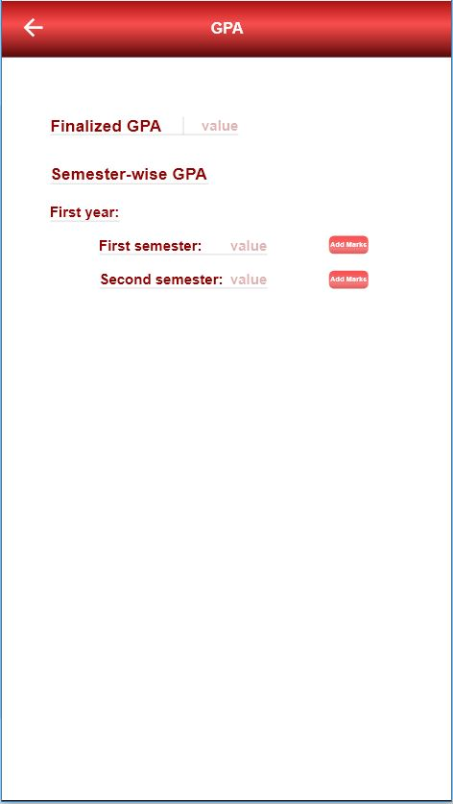

Slide 16
Benefits
Students can manage lecture times.
Can get the full marks for attendance.
Can get the marks of assignments and tutorials for each subject.
Can get an idea of the status in which they are, before the exam.
Can calculate current GPA and built their own plans to get a first class degree.

Slide 17
Team Hawkeye
SE/2015/047 - B.V.P.Fernando
SE/2015/038 - Prabath Weerapana
SE/2015/022 - M.S.Muthumala

Slide 18
THANK YOU!

