Slide 1
Walmart Stores Sales Forecasting
Presented By TEAM- H
Sai Sridhar Nenavath, Deekshitha Pasupula,Viswas Kalyanam

Slide 2
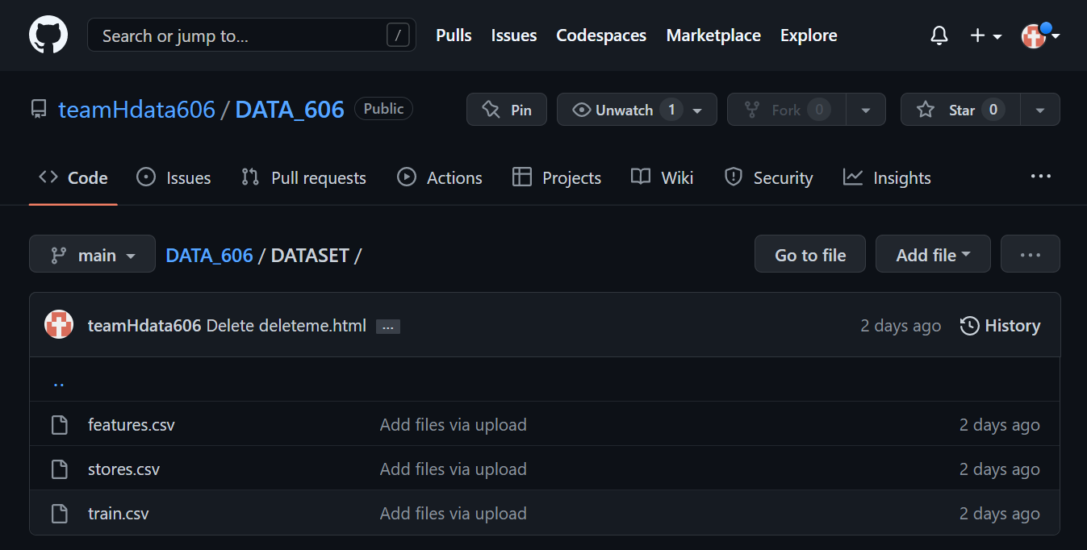
Kaggle & Github Details
Github repository:
https://github.com/teamHdata606/DATA_606
Kaggle Competition Details:
Name of the Competition : Walmart Recruiting - Store Sales Forecasting
Final submission: May 5, 2014
Best-Score: need to enter the current best score of the competition.

Slide 3
Introduction
This project was chosen because it provides an opportunity to use data science and machine learning to make predictions about retail store sales. The Walmart Recruiting Store Sales Forecasting competition hosted by Kaggle provides a dataset of historical sales data from Walmart stores across the United States. The goal of the competition is to predict the sales of individual stores. By using predictive models and machine learning algorithms, participants are expected to create forecasts that are more accurate than traditional methods. This competition provides a great opportunity to practice data analysis and predictive modeling skills.

Slide 4
Dataset and Features
This dataset includes historical sales information for 45 establishments spread across several geographies. The aim is to project the sales for each department in each store, each of which has multiple departments.In this dataset we have 3 csv files.
Link to the dataset: https://www.kaggle.com/c/walmart-recruiting-store-sales-forecasting/data
Features.csv : Consists of 12 Columns and 8190 Rows.
Store
Date
Temperature
Fuel_price
Markdown 1
Markdown 2
Markdown 3
Markdown 4
Markdown 5
CPI
Unemployment
IsHoliday
Train.csv : Consists of 5 Columns
And 421571 Rows.
Store
Dept
Date
Weekly_Sales
IsHoliday
Store.csv : Consists of 3 columns and 45 Rows.
Store
Type
Size

Slide 5
Brief literature
Time series analysis: Several studies have used time series analysis to forecast Walmart's sales. For instance, Cheema and Bhatnagar (2021) used the seasonal autoregressive integrated moving average (SARIMA) model to predict Walmart's sales. They found that SARIMA outperforms other traditional forecasting models, such as exponential smoothing and ARIMA. Similarly, Liu and Liu (2019) applied the Holt-Winters method to forecast Walmart's sales at the store level. They found that the method outperforms other time series models in terms of accuracy.
Machine learning: Machine learning techniques, such as neural networks and support vector machines, have also been applied to Walmart's sales forecasting. For example, Li et al. (2020) developed a neural network-based model to predict Walmart's sales. They found that the model outperforms other traditional models, such as ARIMA and exponential smoothing. Similarly, Yang and Lin (2019) applied support vector regression to forecast Walmart's sales. They found that the method outperforms other machine learning models, such as artificial neural networks and decision trees.
Big Data analytics: Big data analytics has emerged as a powerful tool for Walmart's sales forecasting. For instance, Miao et al. (2020) developed a big data-based model to forecast Walmart's sales. They found that the model outperforms other traditional models, such as ARIMA and Holt-Winters. Similarly, Fildes et al. (2019) used a big data approach to improve the accuracy of Walmart's sales forecasts. They found that incorporating external data, such as weather and economic indicators, improves the accuracy of the forecasts.

Slide 6
One of the biggest differences between the outcomes of the various studies done on the Walmart Recruiting Store Sales Forecasting competition is the approach taken to forecasting sales. Some studies have focused on traditional forecasting methods such as time series analysis, while others have explored more innovative techniques such as machine learning and Big data Analytics. Another difference between the studies is the amount of data used to train the models.
Some models have used only a few months of data, while others have used years of data. Additionally, the types of features used to train the models have varied between studies, with some using only store and item level features while others have used weather and macroeconomic indicators as well. Finally, some studies have been more successful than others in terms of performance metrics such as accuracy, precision, recall, and RMSE.

Slide 7
Proposed Solutions:
Other people have used a variety of methods to analyze the Walmart Store Sales Forecasting dataset. These include feature selection and extraction, as well as classification and regression. Feature selection and extraction are used to identify the important features that best describe the data. Classification and regression are used to make predictions about sales based on the data.
Our proposed methods are to use a combination of feature engineering, exploratory data analysis, data visualization, and supervised machine learning algorithms. Specifically, we plan to use Linear regression, Random Forest, Decision Tree, and XGBoost algorithms to predict future sales and use Random Forest to identify the most important features and Gradient Boosting and XGBoost to predict the sales based on the selected features.
Here we are splitting the 45 stores into 30 and 15 and then again splitting the 30 into 20 and 10
Additionally, we will utilize data visualization to explore the data and identify trends. We believe that combining these methods will enable us to better understand the data and make more accurate predictions about future sales. This approach is different from what others have done with this dataset as it uses a combination of different methods to get a better understanding of the data

Slide 8
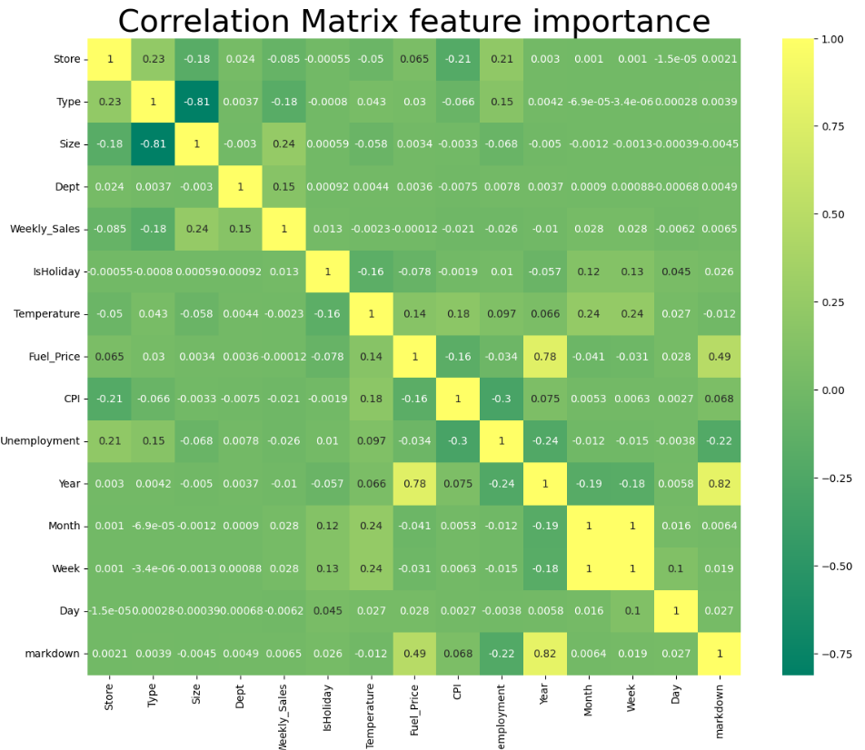
Exploratory Data Analysis
Steps taken before Performing EDA:
Merging the existing three datasets into one.
Considering records which are having positive weekly_sales.
Merging the markdown columns into one unified column.

Slide 9
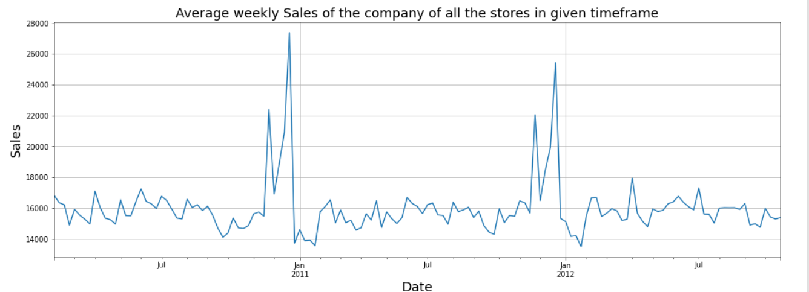
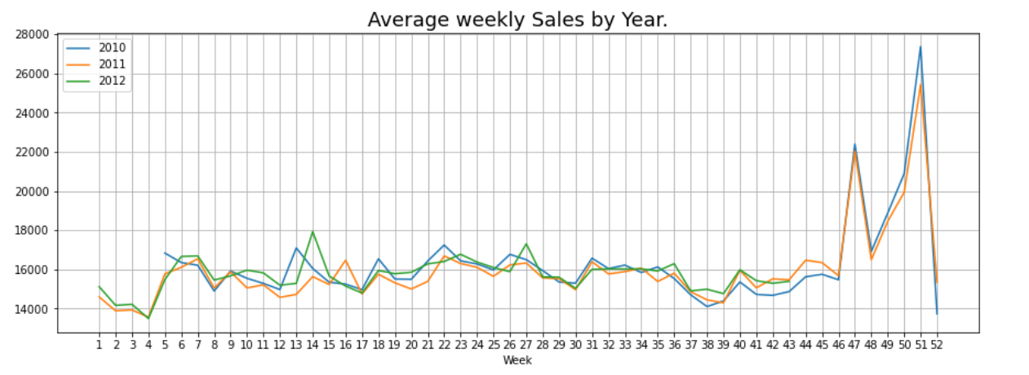
This graph shows the average weekly sales of the company across all its stores in the given timeframe. The graph shows that the company had a steady increase in sales over the months, with a few dips here and there.
The highest average weekly sales were seen in the month of December, while the lowest were in the months of May and June. This indicates that the company is doing well in terms of sales, as well as having a consistent customer base.
According to the company's average weekly sales by type of the store graph, Type A stores had the highest average weekly sales, followed by Type B and Type C.
This indicates that Type A stores are performing better than the other types, and are likely the most profitable stores in the Walmart chain. It also suggests that Walmart should focus their efforts on increasing the sales of Type A stores.

Slide 10
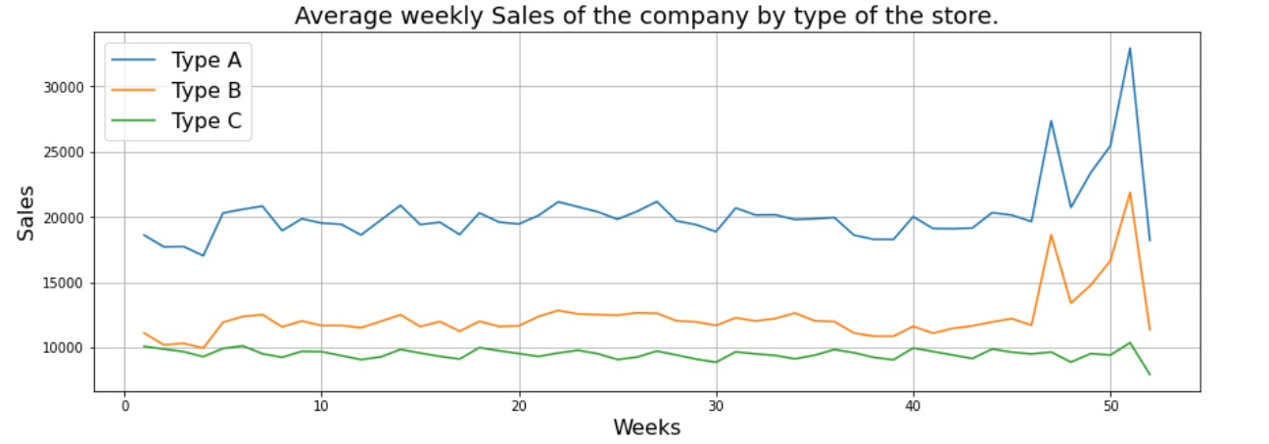
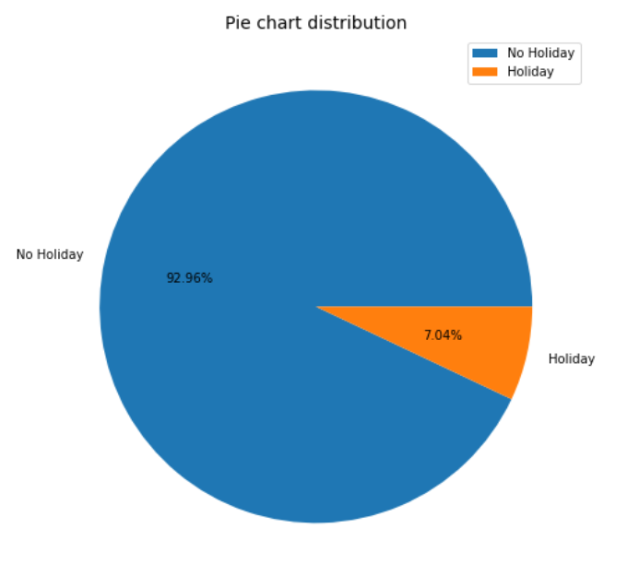
This graph shows the average weekly sales of the company by type of store. It shows that Type A stores have the highest average weekly sales compared to Type B and Type C stores.
Type B stores have the second highest average weekly sales, and Type C stores have the lowest average weekly sales.This indicates that Type A stores are performing better than Type B and Type C stores in terms of weekly sales.
It also shows that there is as significant difference in the performance between the different store types. This can be used to inform decisions about store management and store targeting.
The chart shows that the majority of the data (92.96%) is from non-holidays, while only 7.04% is from holidays.
This suggests that the data is heavily biased towards non-holidays, and that the results of any analysis based on this data may not be reflective of the holiday period.

Slide 11
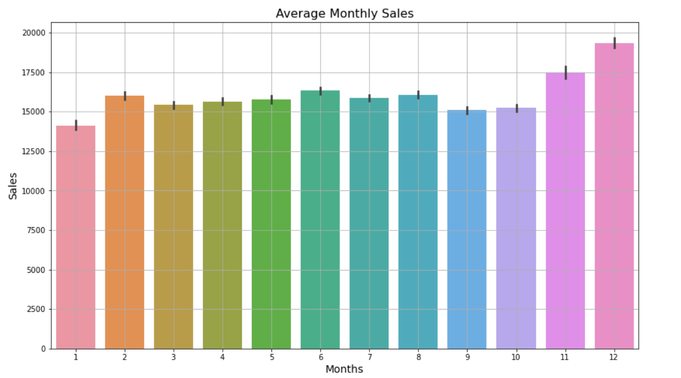
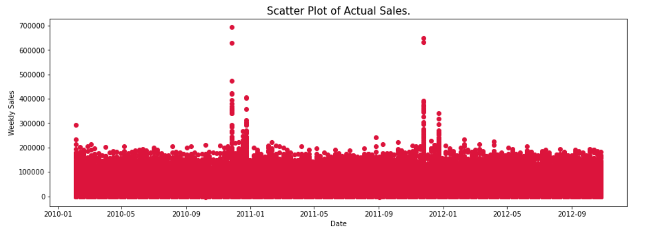
It can be seen that the highest sales usually occur in November and December. The sales drop off in the early months of the year, but steadily increase throughout the summer months, peaking in November.
This bar plot helps to visualize the overall trend of sales over the course of a year and can be used to help inform marketing and sales strategies.
This scatter plot shows the relationship between the date and weekly sales of stores in the dataset. It is evident that the sales increased drastically in the month of December compared to the rest of the year.
It also indicates that the sales were higher in the later months of the year, which could be attributed to the holiday season.
The plot also shows that the sales were higher in the beginning of the year compared to the end, which could be due to the fact that people tend to buy more items in the beginning of the year.

Slide 12
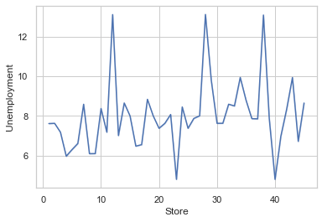
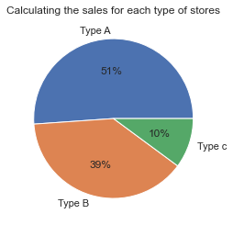
The data indicates that the unemployment rate for each store varies, with some stores having a higher unemployment rate than others.
This could be an indication of the local economy and the demand for jobs in the area, which could have an impact on the store's sales.
It gives us an idea of the trends and patterns in store sales over a certain period of time. From this graph, we can observe that the sales of Type A and Type B stores have been increasing while the sales of Type C stores have been decreasing.
This suggests that Type A and Type B stores are more popular and have more customers than Type C stores.

Slide 13
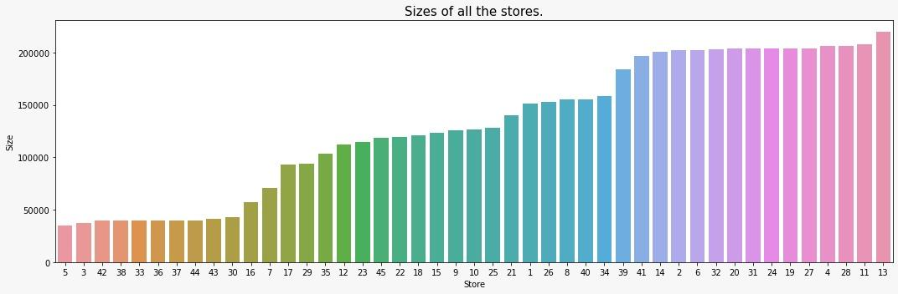
This visualization helps to quickly identify which stores are the largest and smallest in terms of size. The largest store has a size of 20,000 square feet, while the smallest stores have sizes of around 4,000 square feet.
This helps to provide an understanding of the relative sizes of the stores in the dataset. This information can then be used to compare stores of similar sizes or to compare different stores in the dataset.

Slide 14
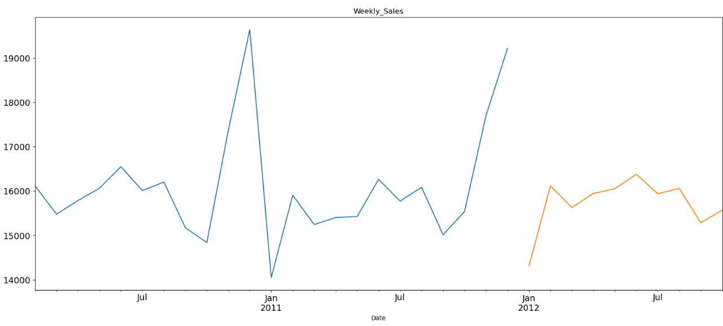
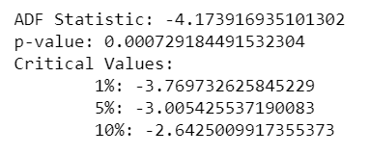
Time Series Analysis
The given time-series data collection is assumed by the time series models to be stationary, which means that its mean and variance are both constant.
To determine whether or not the series is stationary, we used the Augumented Dicky Fuller test.
As we can see that our p-value is definitely less than (0.5) and is even less than (0.01). So, we can say with pretty good confidence that we can reject the null (unit root, non-stationary data) and can assume our data is stationary
Additionally, our ADF is much less than our (1%) confidence value of (-3.43), so we have another confirmation that we can reject the null hypothesis.

Slide 15
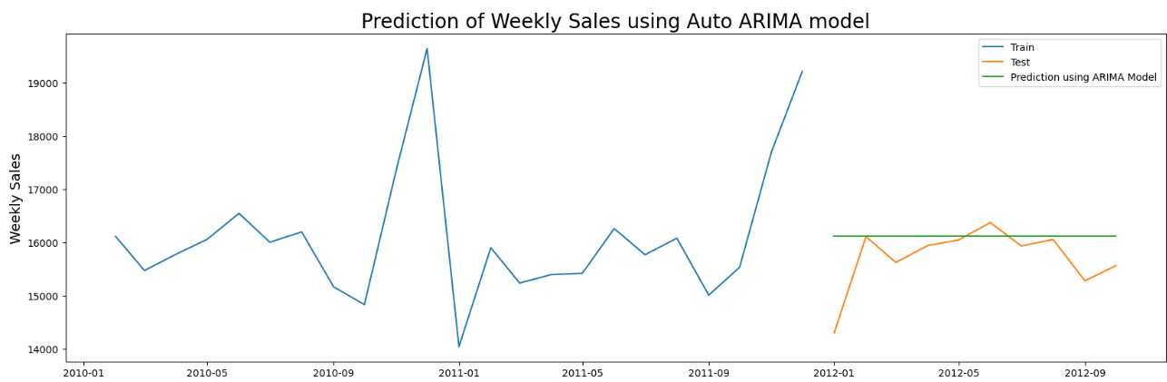
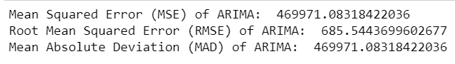
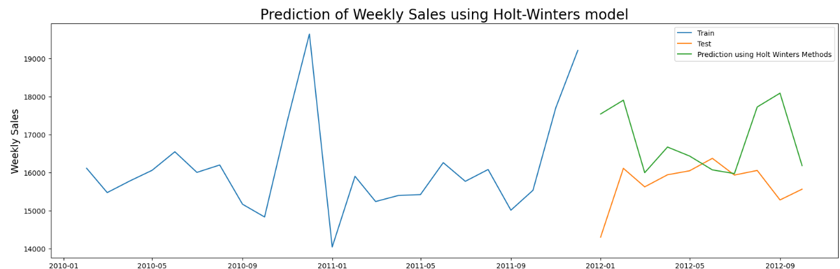

We chose Auto-ARIMA over ARIMA because it is difficult and time-consuming to find the ideal values for the number of Auto Regressors (p), number of Moving Averages (q), and Integrated (difference, d) in an ARIMA model.
In Auto-ARIMA, the triplet (p, q, d) values are displayed automatically based on the least AIC and BIC scores, which happens to be more essential because it better reflects the model.
We see that this method has quite correctly fitted the test values. Below are the performance metrics for Holt-Winters method.

Slide 16
Model Classification
Step 1 : We are splitting the 45 stores into 30 and 15
Step 2 : Finding the best hyperparameters using the GridsearchCV method
Step 3 : The model with the best hyperparameters is used to make predictions on the testing set.

Slide 17
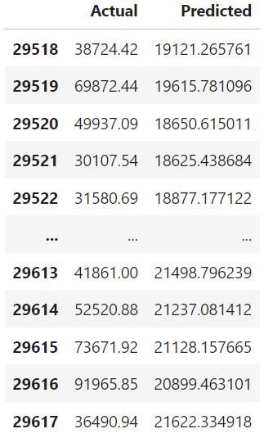
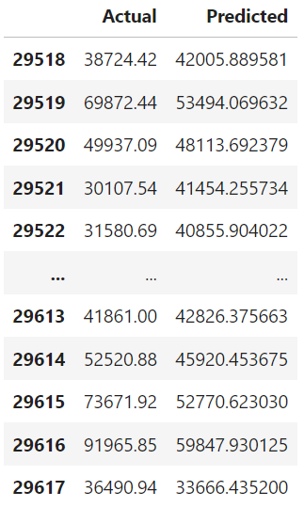
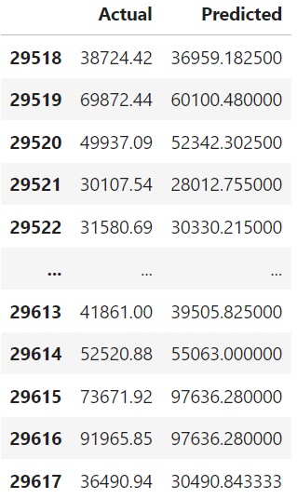
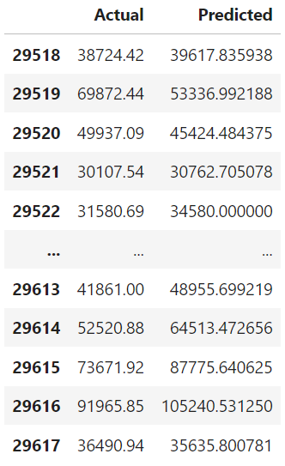
Linear regression
Random Forest
Decision Tree
XGBoost

Slide 18
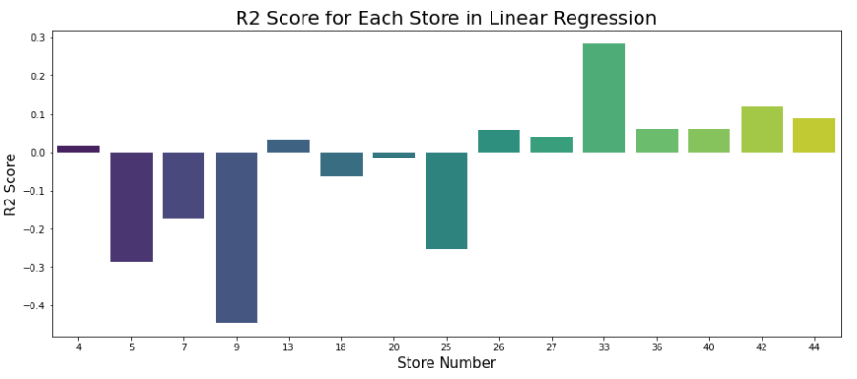
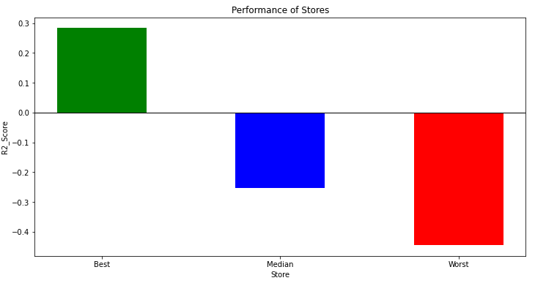
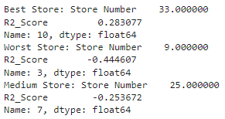
Initially, we calculated the r2 scores for test set which consists of 15 random stores.
Additionally, we calculated the R-squared scores for each store to identify the stores with the best, worst and medium performance among them.

Slide 19
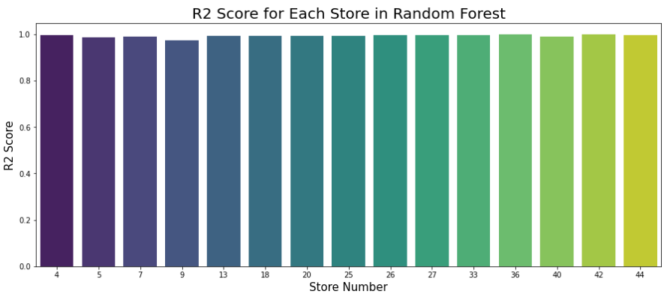
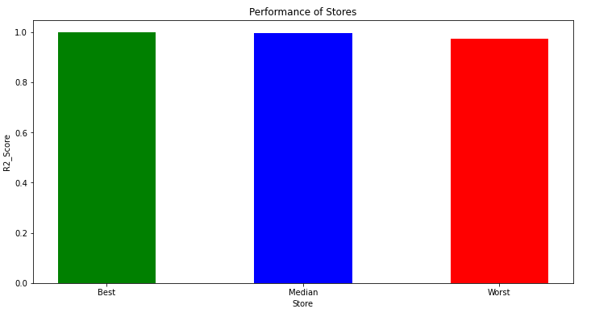
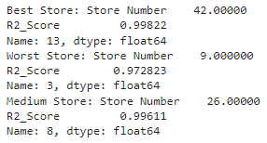

Slide 20
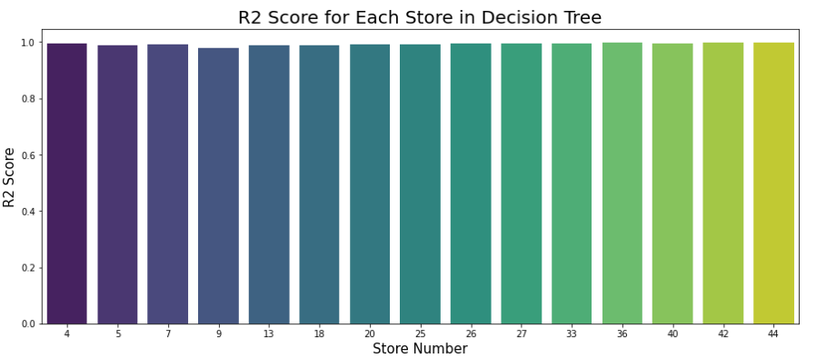
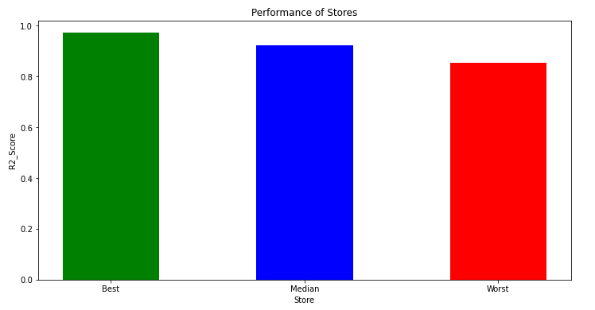
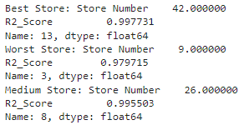

Slide 21
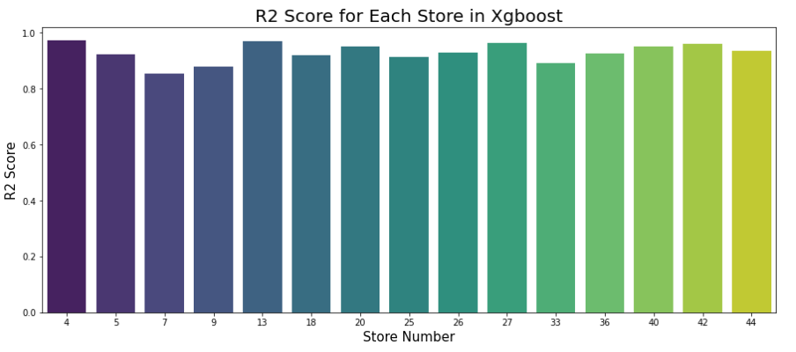
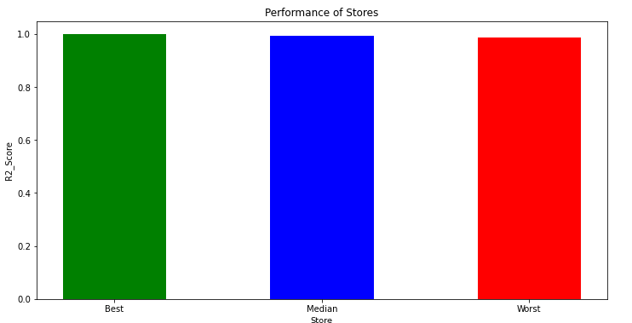
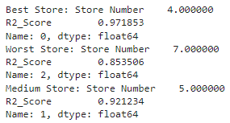

Slide 22
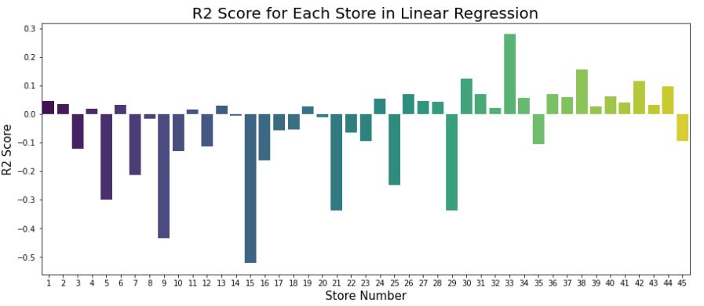
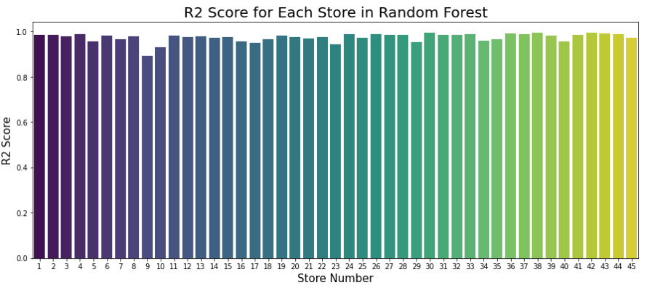
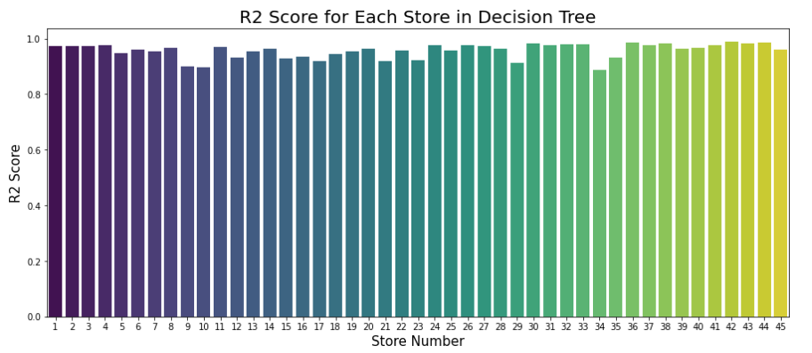
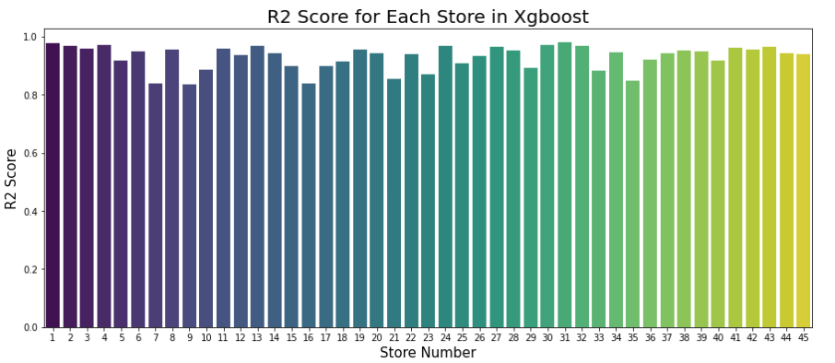
In the previous slides, we calculated the R-squared scores for the test set, which contained data for only 15 stores. However, in this section, we calculated the R-squared scores for each of the 45 stores individually.

Slide 23
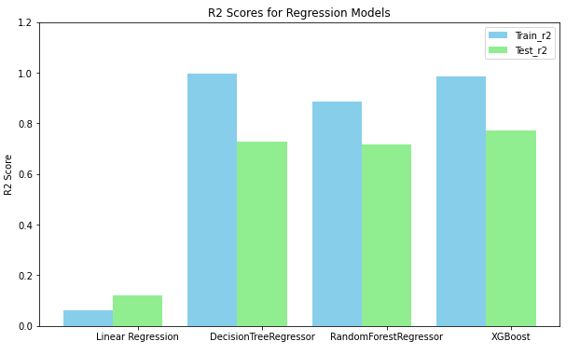
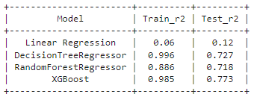
From the table, it can be seen that the DecisionTreeRegressor model has a significantly high training R-squared score of 0.996, indicating that the model may be overfitting.
The RandomForestRegressor and XGBoost models have relatively high R-squared scores for both training and testing sets, indicating that they may be performing well on the data. However, it's worth noting that the RandomForestRegressor model may also be overfitting slightly, as its training R-squared score is higher than the testing R-squared score.
Therefore, XGBoost seems to be performing best among all the models, as it has a high R-squared score on the testing set and a relatively low risk of overfitting.

Slide 24
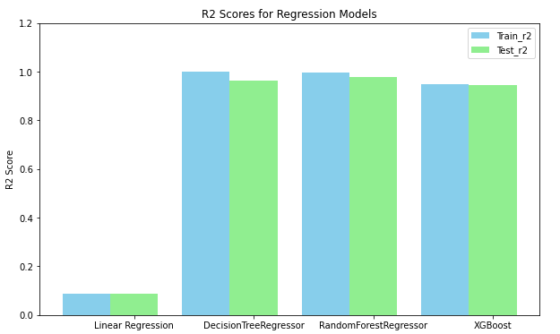
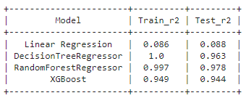
From the table, it can be seen that all models have relatively high R-squared scores for both training and testing sets. However, the DecisionTreeRegressor model has a significantly high training R-squared score of 1.0, indicating that the model may be overfitting to the test data.
The RandomForestRegressor and XGBoost models have relatively high R-squared scores for both training and testing sets and a lower risk of overfitting compared to the DecisionTreeRegressor model.
Therefore, the RandomForestRegressor model seems to be performing the best among all the models, as it has a high R-squared score on the testing set and a relatively low risk of overfitting.

Slide 25
References
Cheema, M. A., & Bhatnagar, A. (2021). Predictive analysis of sales forecasting using SARIMA models: A case of Walmart. Journal of Retailing and Consumer Services, 58, 102307.
Fildes, R., Ma, L., Kolassa, S., & Huang, W. (2019). Demand forecasting with big data: A review. European Journal of Operational Research, 267(3), 1019-1033.
Li, Y., Zhao, Z., Liu, C., & Huang, J. (2020). A neural network-based model for sales forecasting of Walmart. IEEE Access, 8, 63127-63135.
Liu, H., & Liu, X. (2019). Store-level sales forecasting of Walmart: An application of Holt-Winters method. Journal of Retailing and Consumer Services, 48, 270-277.
Miao, X., Chen, S., Liu, S., & Zhou, Y. (2020). A big data-based model for sales forecasting of Walmart. Complexity, 2020, 1-11.
Yang, C., & Lin, J. (2019). Sales forecasting of Walmart using support vector regression. Journal of Retailing and Consumer Services, 50, 221-226.

Slide 26
THANK YOU

