Slide 1

Linux

Slide 2
Content
Introduction
Windows VS. Linux
Linux Commands
Bash

Slide 3
What is Linux?
Linux is an open source operating system
Different distributions (or known as distros)
Most common one is Ubuntu
Introduction

Slide 4
Usage
Servers
Development
Embedded Systems
Desktop
Introduction

Slide 5
What is an OS?
software that manages computer hardware and software resources
Ensures running programs don’t interfere with each other
Process Management
Memory Management
File System Management
Device Management
Security and Access Control
User Interface
Introduction

Slide 6
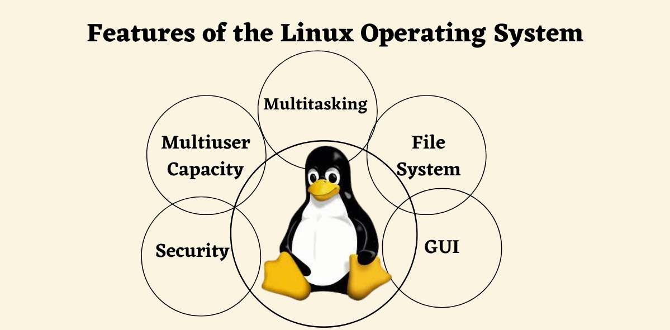
Features
Introduction

Slide 7
Naming
Named after Linus Torvalds
Combo of Linus + Unix
Developed it in 1991
Initially was named: Freax
Combo of: Free, Freak, Unix
Introduction

Slide 8

Windows VS. Linux

Slide 9
Which is better?
Linux and Windows.
Each has its own set of unique features
advantages and disadvantages.
While it is difficult to say which one is the better choice
it is not as difficult to answer which is the better choice given your needs.
Windows VS. Linux

Slide 10
Licensing
Windows
Closed Source
Need to Purchase a License to use it
Linux
Open-Source
Free or Low Cost
Windows VS. Linux

Slide 11
User Interface
Windows
Known for its user-friendly GUI
Customization: allows some customization, but is limited
Linux
variety of desktop envs: GNOME, KDE, XFCE
users normally use CLI extensively
UI is highly customizable
Windows VS. Linux

Slide 12
Software Support
Windows
Wide Compatibility
Limited Open Source software
Linux
Limited Proprietary software
Rich in open source software
Windows VS. Linux

Slide 13
Security
Windows
Target for malware
Improved security over the years, with features like UAC
Linux
Strong Security
Open Source Advantage
Windows VS. Linux

Slide 14
Performance
Windows
Resource Intensive
Optimized for GUI
Linux
Efficient and Lightweight
Scalable Performance
Windows VS. Linux

Slide 15
Other differences
File System and Management
Updates and Software Management
Community and Support
Use Cases
Windows VS. Linux

Slide 16
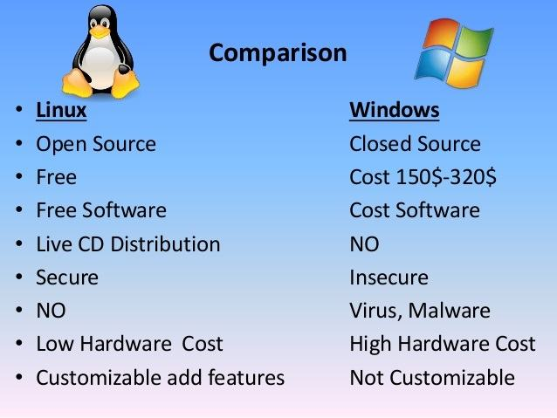
Quick Comparison
Windows VS. Linux

Slide 17

Linux Commands

Slide 18
Terminal
The Terminal is a text-based interface
where all commands in Linux are run
Usage:
File Management
Process Management
Text Manipulation
Package Management
Networking
Run:
Let’s Open a terminal
Right click -> new terminal window
Linux Commands

Slide 19
pwd command
Get current working directory
Always returns the “Absolute Path”
Linux Commands

Slide 20
ls command
Used for listing files and directories
Usage:
‘ls’ – list the files in current directory
‘ls file/folder name’ – list the files / folders per the given input
‘ll’ – not a standard command it is an alias to ‘ls –l’
Linux Commands

Slide 21
ls command options
-r : reverse the order of listing
-l : use long listing format
-t : sort by modification time, newest first
-a : do not ignore entries starting with .
-d : list directories themselves, not their contents
Combining options
Linux Commands

Slide 22
history command
Used for list and use the command history used so far
!n
!!
!-n
-c option
Linux Commands

Slide 23
Permission Categories
User (Owner)
Group
Others
Linux Commands

Slide 24
Permission Types
Read (r)
Write (w)
Execute (x)
Linux Commands

Slide 25
Changing Permissions
chmod command
Examples:
Add Permission: chmod u+x file_name
(add execute permission for the owner)
Remove Permission: chmod g-w file_name
(remove write permission for the group)
Set Exact Permissions: chmod u=rwx,g=rx,o=r file_name
(set permissions exactly)
Linux Commands

Slide 26
Changing Permissions (numbers)
Permissions can also be represented using octal numbers
Each permission type has a numeric value:
Read (r) = 4
Write (w) = 2
Execute (x) = 1
Combine these values to set permissions:
7 = rwx (4+2+1)
6 = rw- (4+2)
5 = r-x (4+1)
4 = r-- (4)
Example:
chmod 755 file_name
Linux Commands

Slide 27
mkdir command
Creates a new directory
Usage:
mkdir [options] directory_name
Create multiple directories at once
Linux Commands

Slide 28
rmdir command
Removes a directory
What happens in case the directory exists?
What if it exists and has some files and folders?
What if it doesn’t exist?
Removing multiple directories
Using relative / absolute path
Linux Commands

Slide 29
cd command
cd = Change Directory
Changes the current directory to the given one
Relative path / Absolute path
The ‘..’ directory
The ‘/’ directory
The ‘~’ directory
Linux Commands

Slide 30
echo command
Display a line of text to the terminal
Usage:
echo [options] [string]
Example:
echo Hello, World!
echo -e "Line 1\nLine 2"
Linux Commands

Slide 31
Redirection >
redirection is a technique used to change the default input and output sources for commands
Example:
echo “Hello MST World!” > “mst.txt”
types of redirection:
> Overwrite Redirection
>> Append Redirection
2>&1 Redirects the standard error to the standard output
Linux Commands

Slide 32
touch command
Creates a new empty file
Usage:
touch [options] file_name
Creating multiple files
What happens if the file exists?
Linux Commands

Slide 33
cat command
concatenates and displays the contents of files
Usage:
cat [options] [file...]
Concatenate Multiple files
Example:
redirect output to new file
cat file1.txt file2.txt > combined.txt
Create a New File
cat > newfile.txt
Display line numbers
cat –n file.txt
Linux Commands

Slide 34
less command
Linux is a pager program used for viewing the contents of a file one screen at a time
View multiple files
-N : show line numbers
Navigation:
Scroll up/down [one line / one page]
Go To begin/end
Search forward/backward
q - quit
Linux Commands

Slide 35
grep command
Search for some data inside files
grep “Hello” mst.txt
grep –l “Hello” *
here * means all files, since it is used as a wildcard
-i: case insensitive
-c: count
-r: recursively
Linux Commands

Slide 36
Pipelining |
Used to redirect the output of the current command to the input of the next command
Syntax:
command1 | command2 | command3
Example:
cat mst.txt | grep “Hello”
Linux Commands

Slide 37
The ‘;’ separator
Can be used in order to run multiple commands in one line
Example: cat mst1.txt; cat mst2.txt
Linux Commands

Slide 38
cp command
Used to copy files / directories
cp mst.txt folder/mst2.txt
-r: recursive
Linux Commands

Slide 39
rm command
removes files / directories
rm mst.txt
-r: recursive
Linux Commands

Slide 40
Process related commands
ps
top
kill
jobs
fg
bg
Linux Commands

Slide 41
Network & package management commands
ping
curl
wget
netstat
ss
apt / dnf
Linux Commands

Slide 42
vi text editor
i – insert
dd – delete current row
:q! – quit
:wq! – write then quit
/ - searches forward in the file
? – searches backward in the file
Linux Commands

Slide 43
Other commands
wc –l
head
tail
more
Linux Commands

Slide 44

Bash

Slide 45
What is Bash?
Short for Bourne Again Shell
Command-Line Shell & Scripting language
Widely used in Unix-like OS and macOS
Default Shell for many Linux distros
Known for its versatility and Powerful features
Bash

Slide 46
Key Features
Command Line Interface
Scripting Language
Interactive Features
Command History
Tab Completion
Job Control
Pipes and Redirection |, >, <
Variables and Control Structures
Aliases and Functions
Bash

Slide 47
Basic Usage
Create a new file with extension .sh
Include a shebang (#!/bin/hash) at the top
Write the commands
Make the file executable
Run the file
Bash

Slide 48
Key Commands and Concepts
Viewing Bash Version
Setting and Using Variables
Creating Aliases
Using Job Control
Scripting (Example)
Bash

Slide 49
Script
Live Example(s)
Bash

Slide 50
Thank You !!

