Slide 1
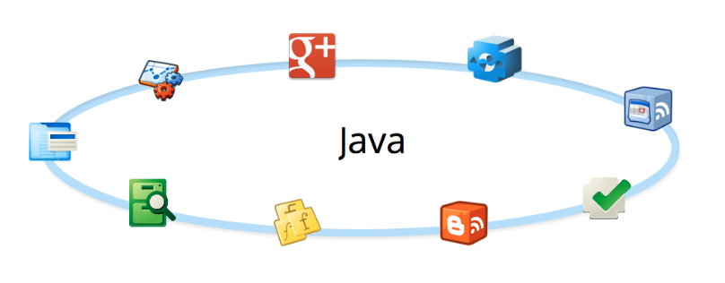
Iostream

Slide 2
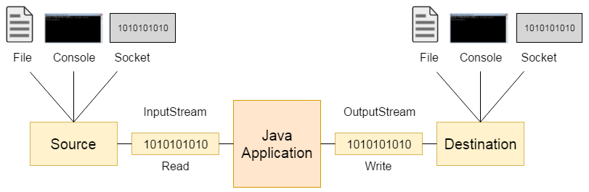
Streaming Data
Streaming Data

Slide 3
Streaming Data VS. Random Access
Streaming data – a stream is a sequence of data read or written, one item at a time
Blocking: java.io package
Non-blocking: java.nio package
Random access – reading and writing data can be done in a non sequential order
java.io.RandomAccessFile
Streaming Data

Slide 4
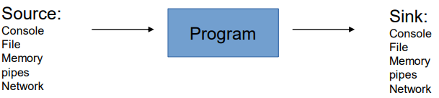
Source & Sink
Streaming Data
A stream can come to the program from a source or can be generated by the program to a sink. Sources and sinks are both node streams:

Slide 5
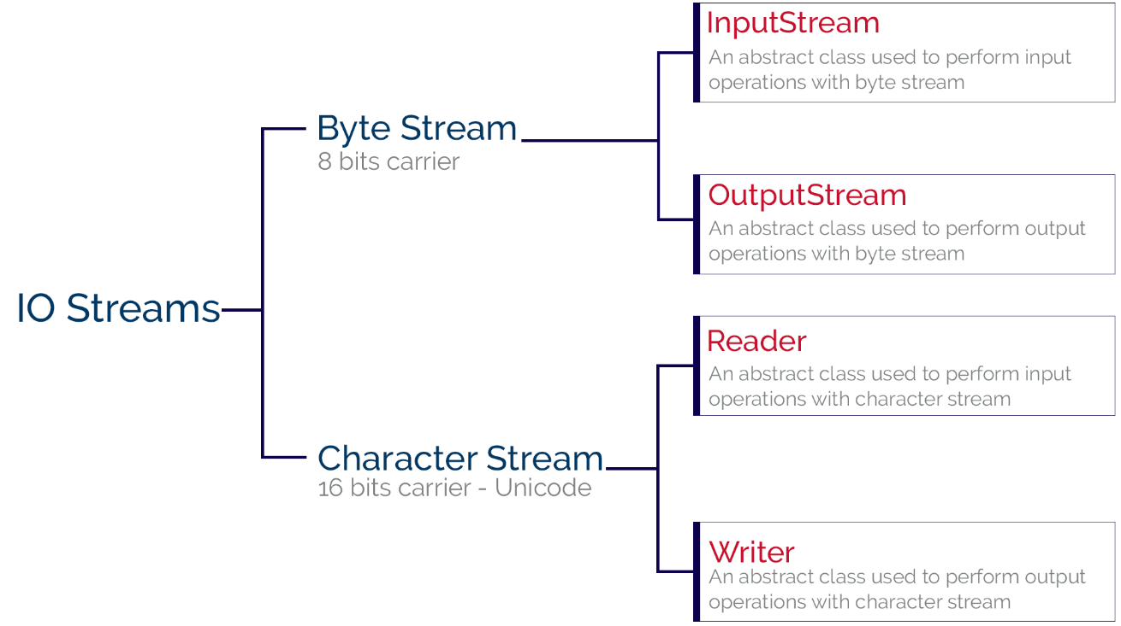
IO Stream
Streaming Data

Slide 6
Byte Stream VS. Character Stream
The basic abstract classes for the different types of streams are:
Streaming Data
Character streams:
Reader
Writer
Byte streams:
InputStream
OutputStream

Slide 7
InputStream VS. Reader
Feature | InputStream | Reader
Data Type | Byte-oriented (binary data) | Character-oriented (text data)
Superclass | InputStream | Reader
Read Method | read() (reads byte) | read() (reads character)
Buffering | BufferedInputStream | BufferedReader
File Handling | FileInputStream | FileReader
Common Use Cases | Binary files (e.g., images, audio) | Text files (e.g., plain text, JSON)
Conversion Bridging | N/A | InputStreamReader (converts byte streams to character streams)
Streaming Data

Slide 8
Character Stream
Use :
When dealing with text-based data, such as plain text files, configuration files, or any file that contains human-readable characters.
Advantages:
Character streams automatically handle character encoding and decoding, making them suitable for dealing with text in different character sets.
They provide higher-level abstractions like Reader and Writer, which work with characters rather than bytes.
Example:
FileReader reader = new FileReader("textFile.txt");
FileWriter writer = new FileWriter("output.txt");
Streaming Data

Slide 9
Byte Stream
Use :
When working with binary data, such as image files, audio files, or any non-text data.
Advantages:
Byte streams are low-level and handle data in its raw form, making them suitable for binary data or when you need to work with the actual bytes of a file.
They are more suitable for network operations where data is transmitted in binary form.
Example:
FileInputStream inputStream = new FileInputStream("binaryFile.bin");
FileOutputStream outputStream = new FileOutputStream("output.bin");
Streaming Data

Slide 10
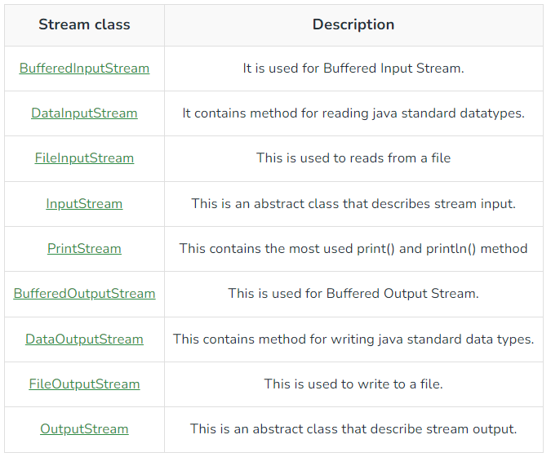
Byte Streaming Methods
Streaming Data

Slide 11
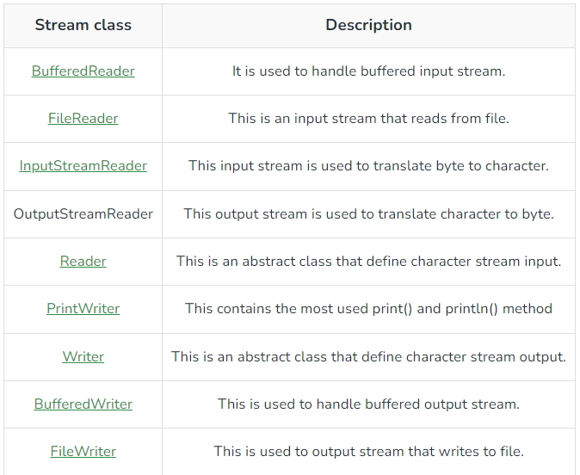
Character Stream methods
Streaming Data

Slide 12
IO endpoints
Main IO endpoints (sources and sinks):
File System:
• FileReader / FileWriter / FileInputStream / FileOutputStream
Networking:
• Socket / ServerSocket
Threads communication (pipes):
• PipedInputStream / PipedOutputStream
Streaming Data

Slide 13
Streams
Three default accessed streams
System.in – InputStream
System.out - PrintStream (OutputStream)
System.err - PrintStream
Streaming Data

Slide 14
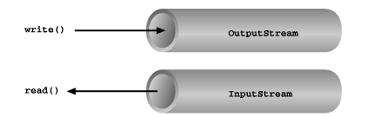
IO Stream Func
Basic input and output stream functionality
Streaming Data

Slide 15
InputStream methods
int available()
int read()
int read(byte[] b)
int read(byte[] b, int off, int len)
long skip(long n)
void close()
void mark(int readlimit)
boolean markSupported()
void reset()
Streaming Data

Slide 16
OutputStream methods
void write(byte[] b)
void write(byte[] b, int off, int len)
void write(int b)
void flush()
void close()
Streaming Data

Slide 17
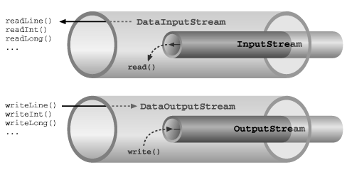
IOStream Func
Basic input and output stream functionality
Streaming Data

Slide 18
Filter Streams Decorators
Stream created over another stream
Subclasses of:
FilterInputStream
FilterOutputStream
FilterReader
FilterWriter
used frequently to decorate IO into:
Text
Primitives
Objects
Stream Decoration

Slide 19
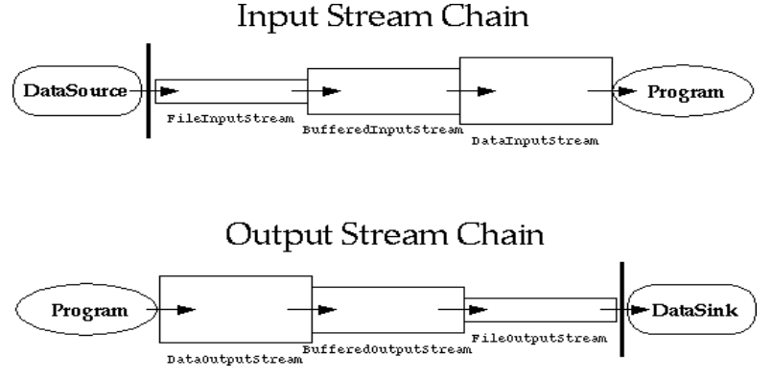
Chaining Decorators
Stream Decoration

Slide 20
Switch Stream Type
Switch between binary <-> text IO
InputStreamReader:
Converts bytes read from an InputStream into characters using a specified charset.
OutputStreamReader:
Converts characters to bytes according to the character coding before writing
Stream Decoration

Slide 21
Text Decorators
BufferedReader / BufferedWriter
Provides Line based reading and writing:
Reading:
BufferedReader.readLine() returns String (or null on end of file).
Writing:
BufferedWriter.write(String line) & BufferedWriter.newline()
Stream Decoration

Slide 22
Primitives Decorators
DataInputStream / DataOutputStream
Provides primitive based reading and writing:
Reading:
• readUTF() : String
• readInt() : int
• readBoolean() : boolean ….
Writing:
• writeUTF(String)
• writeInt(int)
• writeBoolean(boolean)
Stream Decoration

Slide 23
Object Decorators
ObjectInputStream / ObjectOutputStream
All objects must implement Serializable
Provides Objects based reading and writing:
Reading:
• readObject() : Object
Writing:
• writeObject(Object)
Stream Decoration

Slide 24
Serialization
Only the object's data are serialized
Data marked with the transient keyword are not serialized.
Serialization stores the state of an object to a file
Serializable objects can be stored and loaded from object streams:
ObjectInputStream
ObjectOutputStream
Serialization

Slide 25
Random Access
Constructors:
RandomAccessFile(File file, String mode)
RandomAccessFile(String name, String mode)
Mode is usually ”r” or ”rw” .
file pointer can be read and positioned:
int skipBytes(int)
void seek(long)
long getFilePointer()
Random AccessFile

Slide 26
Stream Tokenizer
A class reads the stream character by character.
Each of them can have zero or more of the following attributes:
white space, alphabetic, numeric, string quote or comment character.
types of characters:
Word characters: ranges like ‘a’ to ‘z’ and ‘A’ to ‘Z
Numeric characters: 0,1,…,9
Whitespace characters: ASCII values from 0 to 32
Comment character: /
String quote characters: ‘ and “
StreamTokenizer

Slide 27
Thank You !!

