Slide 1
Instructions for using custom visual stimuli in OSARI
The visual stimuli presented in OSARI are .jpeg image files. We have provided a PowerPoint version of these stimuli so that users can edit the instructions to their liking (e.g., you may wish to change the language the task is presented in)
To use your adjusted PowerPoint slides in OSARI, simply save the slides as .jpeg files and name them using the same name as the original files (‘welcome_image.jpeg’, ‘go_instr_image.jpeg’ and ‘stop_instr_image.jpeg’) and replace the original files in the Stimuli folder

Slide 2
Welcome to OSARI
An open-source anticipated response inhibition task
Press SPACE to continue
If you need any help with using the task, please contact the team at either opensourceTAP@gmail.com OR www.github.com/teamOSTAP/OSARI/issues

Slide 3
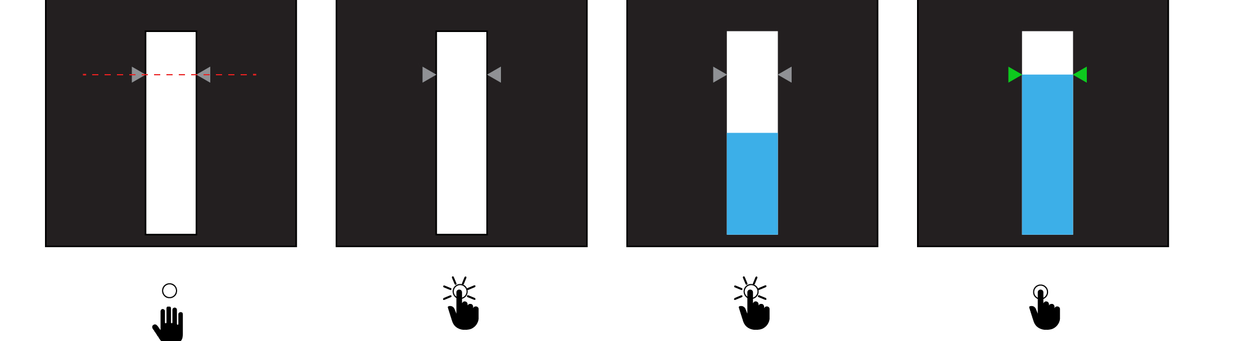
Before we begin, here are some instructions!
STEP 1:
In each trial, try to keep your eyes on the target
STEP 2:
To begin, hold down the button
STEP 3:
The bar will begin to fill from bottom to top. Your task is to release the button to stop the bar as close to the target line as possible.
Feedback is provided by the target arrows filling with a certain color depending on how close you are to the target. Try to aim for the green arrows.

Slide 4
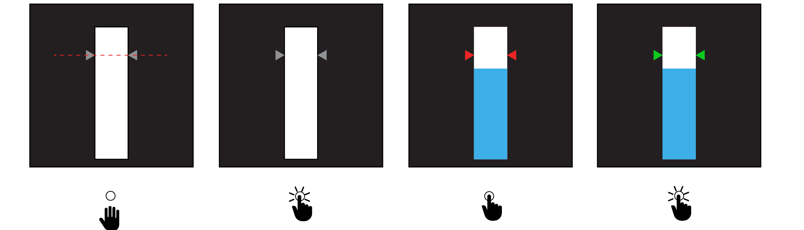
Trials where you lift your finger are called go trials.
Now lets talk about stop trials.
STEP 1:
Stop trials will begin like go trials. Keep your eyes on the target
STEP 2:
Just like in go trials, begin a trial by holding down the button
STEP 3:
Unlike go trials, in stop trials, the bar will stop rising before reaching the target. Your task is to continue holding down the button until the arrows turn green.
The arrows will turn red if you fail to keep the button down
The arrows will turn green if you were able to keep the button down

