Slide 1
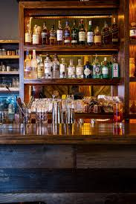
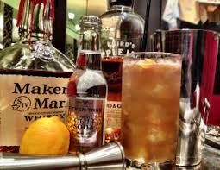
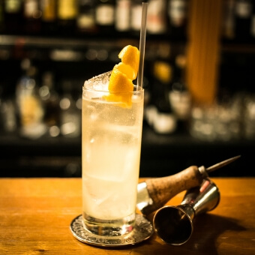
SpeakEZbar
Miguel Galarraga • Patrick Heron Aimee Bojorquez • Miguel Fernandez

Slide 2
About SpeakEZbar
Have a tinkering for rum but don't know what kind of drink to make? Check out SpeakEZbar!
It's a one stop shop for all things drinks! Simply select a liquor category and voila you’ll get an assortment of cocktail recipes!

Slide 3
Demonstration

