Slide 1

SMART-JAM
team Smart Jam web

Slide 2
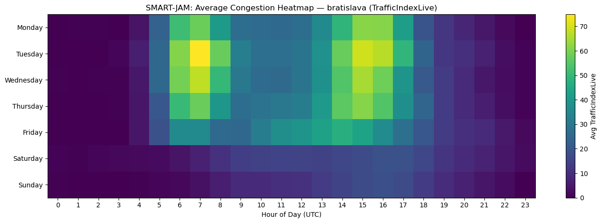
What’s the problem ?
Traffic congestion wastes time and increases emissions
Cities usually react too late

Slide 3
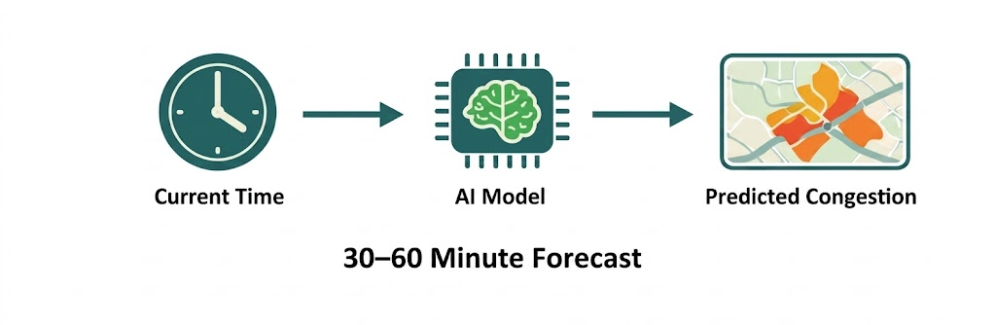
Our solution
Predict congestion 30-60 minutes ahead
Early warnings for specific areas

Slide 4
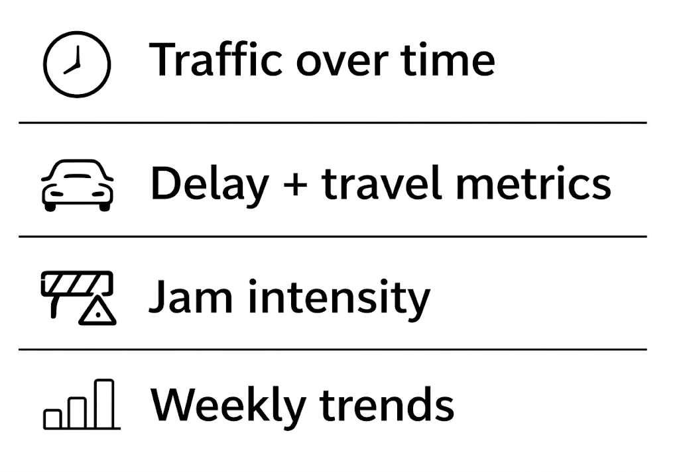
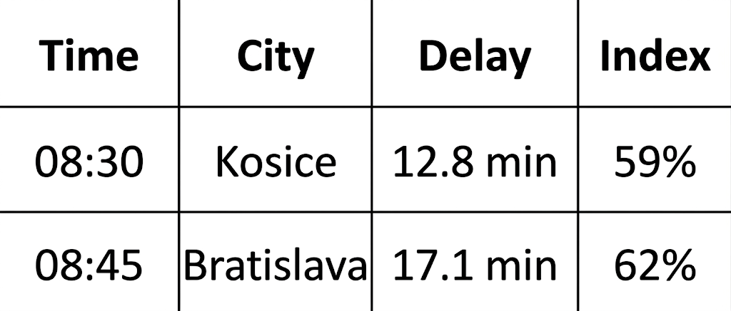
What data we work with
Predict congestion 30-60 minutes ahead
Predict congestion 30-60 minutes ahead
Early warnings for specific areas
Early warnings for specific areas

Slide 5
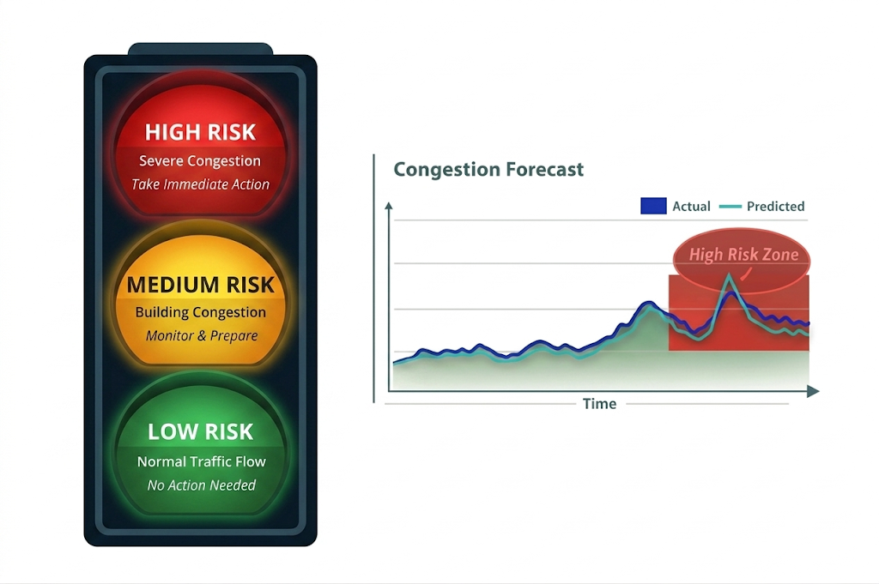
Model output

Slide 6
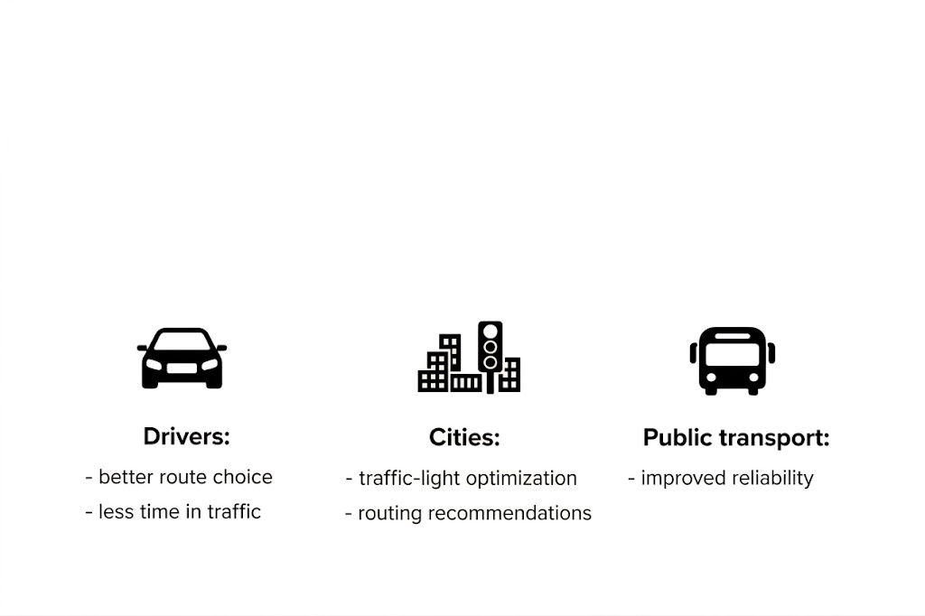
Who benefits ?

Slide 7
User Requirements

Slide 8

What are user requirements?
What users need the system to do — not how it is built.
User perspective:
what the system enables
Not about implementation (algorithms/architecture)
Focus on value & usability

Slide 9

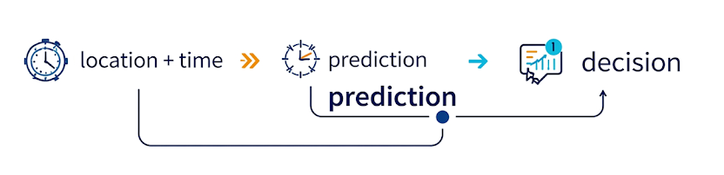
Core requirements?
Input
Predict
Risk
Decide

Slide 10


Users
Quick risk + alert → choose an alternative route
Drivers
City Authorities
Analytics + history + forecast → manage traffic and policy

Slide 11
Quality & outcome requirements?
Why Smart-Jam?
Raw traffic data
actionable insight
less congestion
smarter city movement.
Non-functional needs
Near real-time, fast response, high availability, scalable, mobile-friendly, and trustworthy.

Slide 12

SWOT ANALYSIS

Slide 13
SWOT Overview
Internal
External
S
W
O
T
Strengths
Weaknesses
Opportunities
Threats
Practical value for users
Clear problem focus
Data-driven approach
User-oriented design
Scalable concept
Dependence on data quality
Limited historical data (early stage)
Model complexity
Potential performance issues
User trust challenge
Growing smart-city initiatives
Integration with navigation platforms
Increasing demand for mobility tools
Expansion to public transport analytics
Academic and research potential
Strong competition
Data access restrictions
Rapid changes in traffic patterns
Privacy and regulation concerns
Technology expectations
Notes:
[ Sources] - SMART-JAM project slides (user-provided): SMART-JAM.pptx - Requirements overview (user-provided): Pitch Deck.pptx [/Sources]

Slide 14

Strengths
Practical value for users
Clear problem focus
Data-driven approach
User-oriented design
Scalable concept

Slide 15


Opportunities
Growing smart-city initiatives
Integration with navigation platforms
Increasing demand for mobility tools
Expansion to public transport analytics
Academic and research potential

Slide 16


Weaknesses
Dependence on data quality
Limited historical data (early stage)
Model complexity
Potential performance issues
User trust challenge

Slide 17


Threats
Strong competition
Data access restrictions
Rapid changes in traffic patterns
Privacy and regulation concerns
Technology expectations

Slide 18
Model Data Visualisation

Slide 19
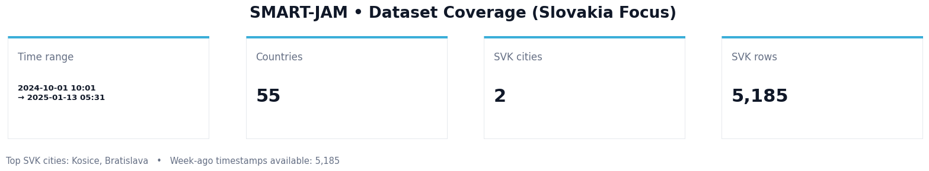
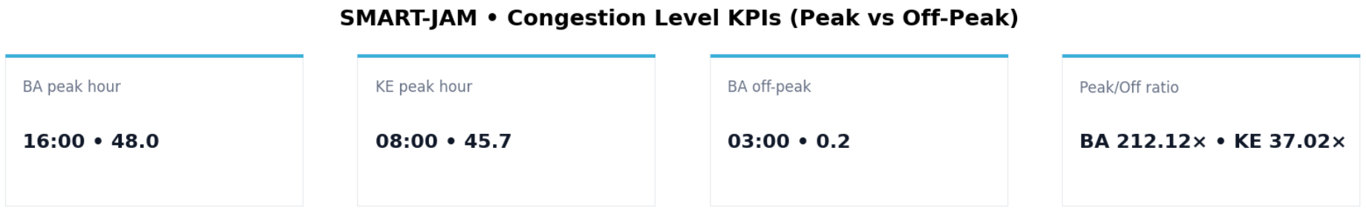
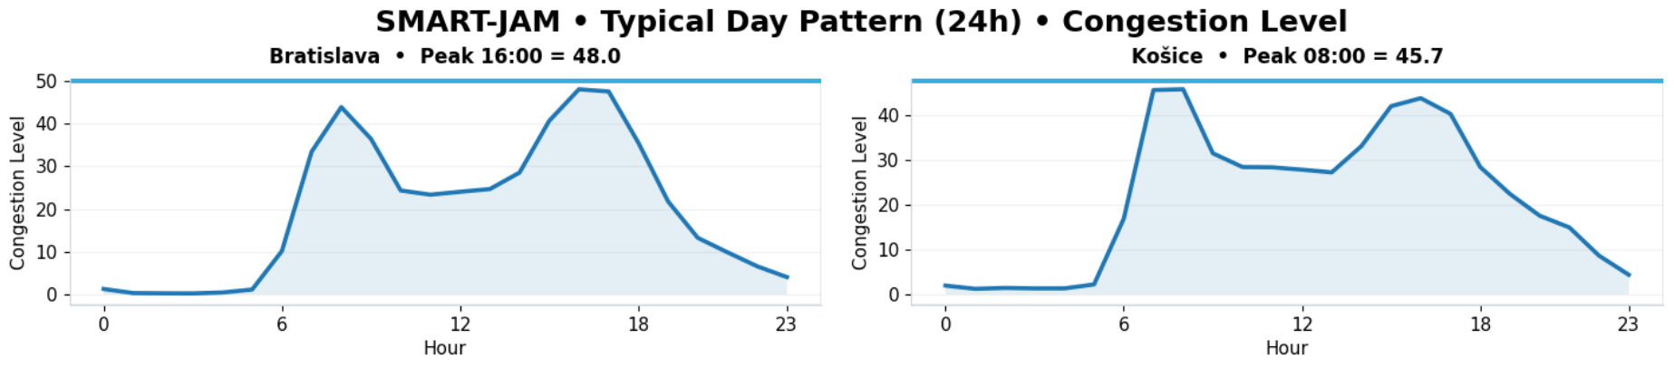
Using most up-to date data we plan to determine most efficient routes

Slide 20

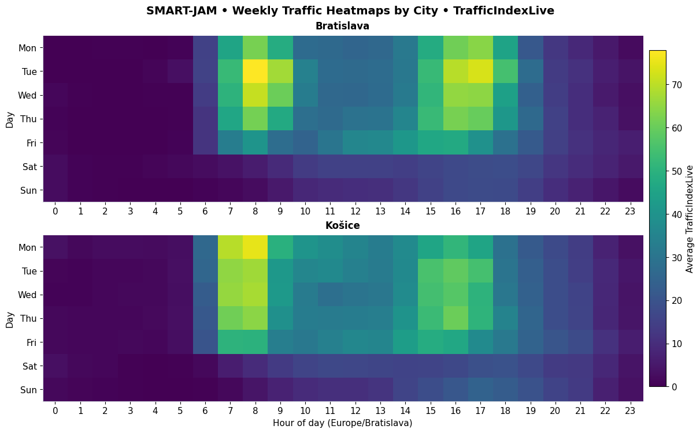
Congestion levels
(Congestion level of 20 = trips take about 20% longer as opposed to free-flow traffic trips)

Slide 21
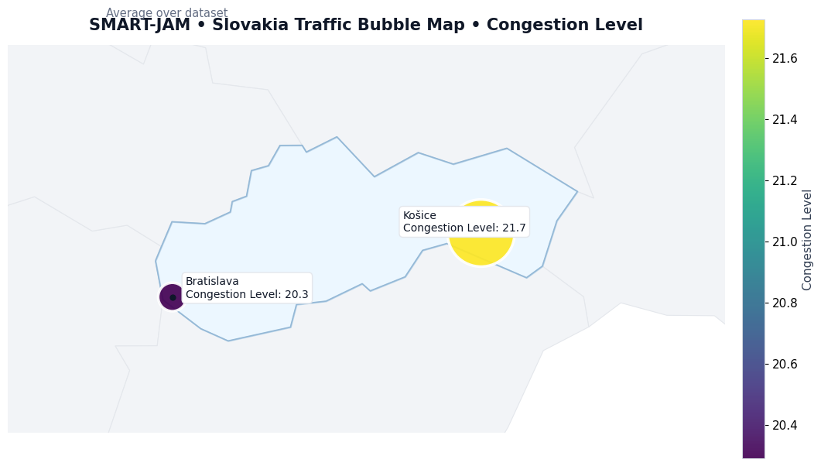
Congestion levels
Congestion in Košice and Bratislava

Slide 22
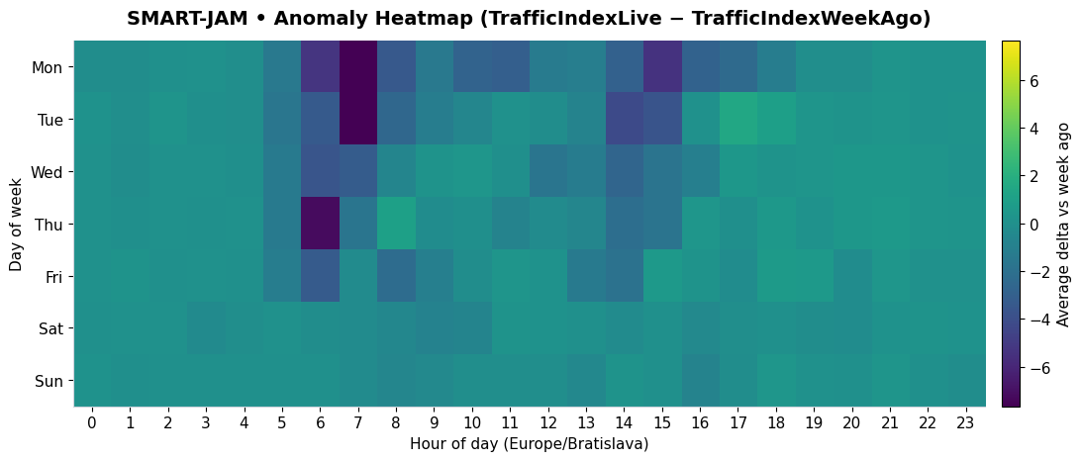
From data to predictions
Our goal – use real time data to make hasty predictions and satisfy users

Slide 23
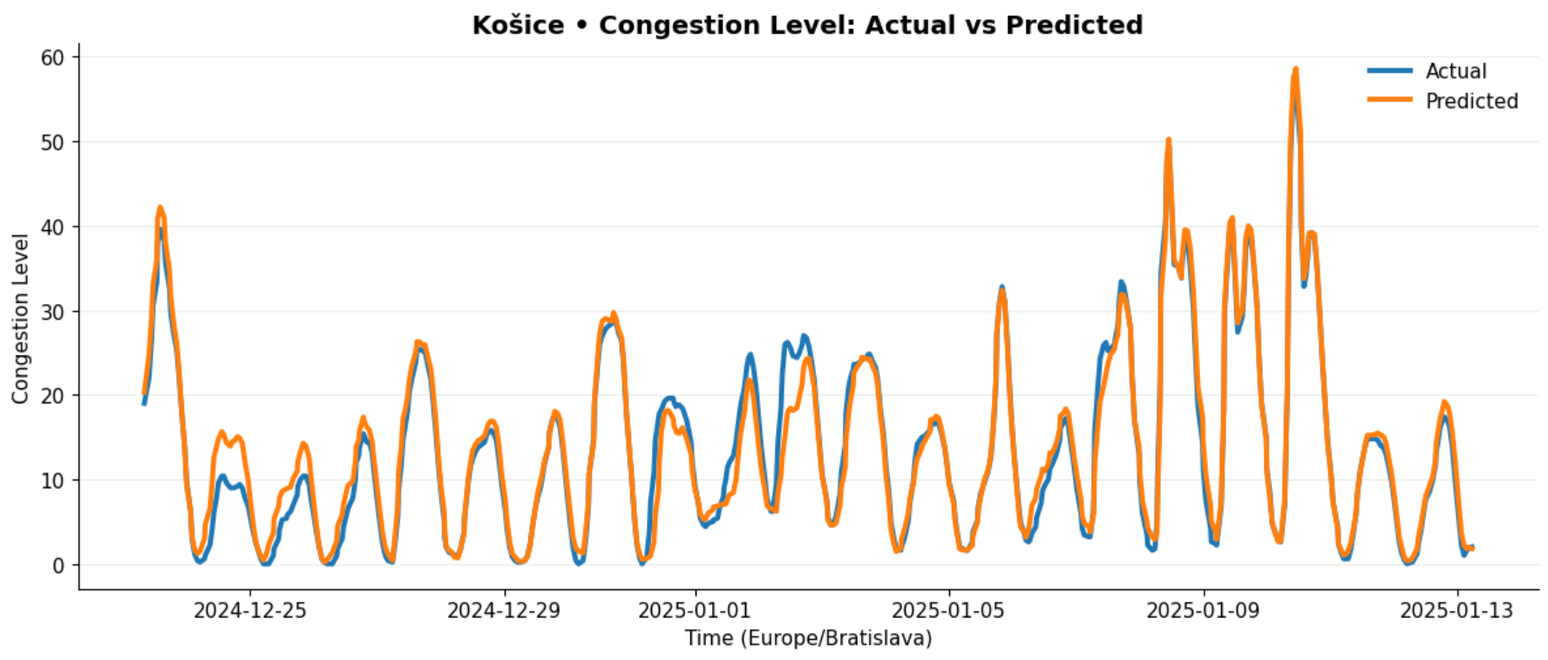
From data to predictions

Slide 24
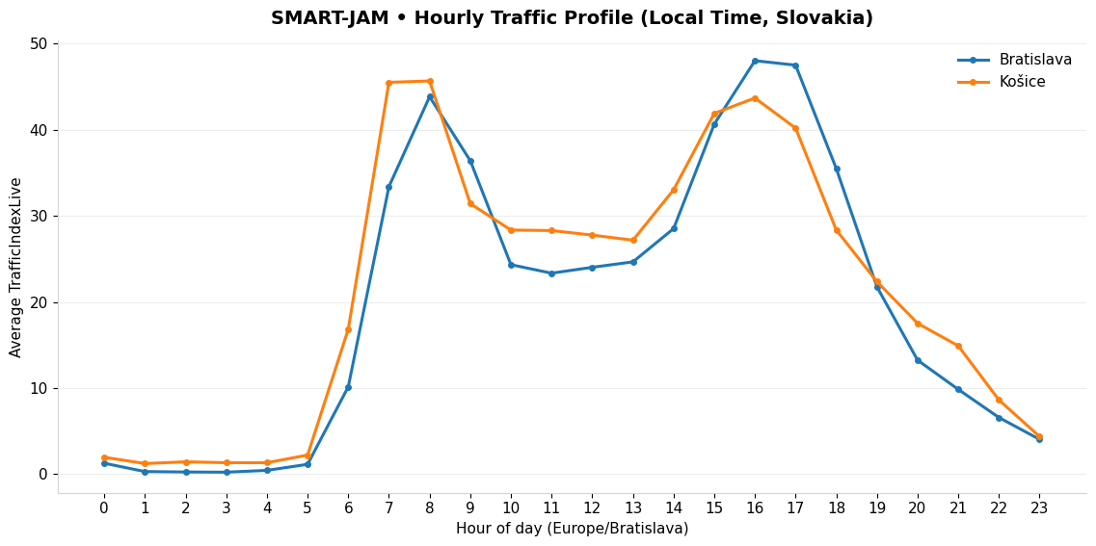
From data to predictions

Slide 25
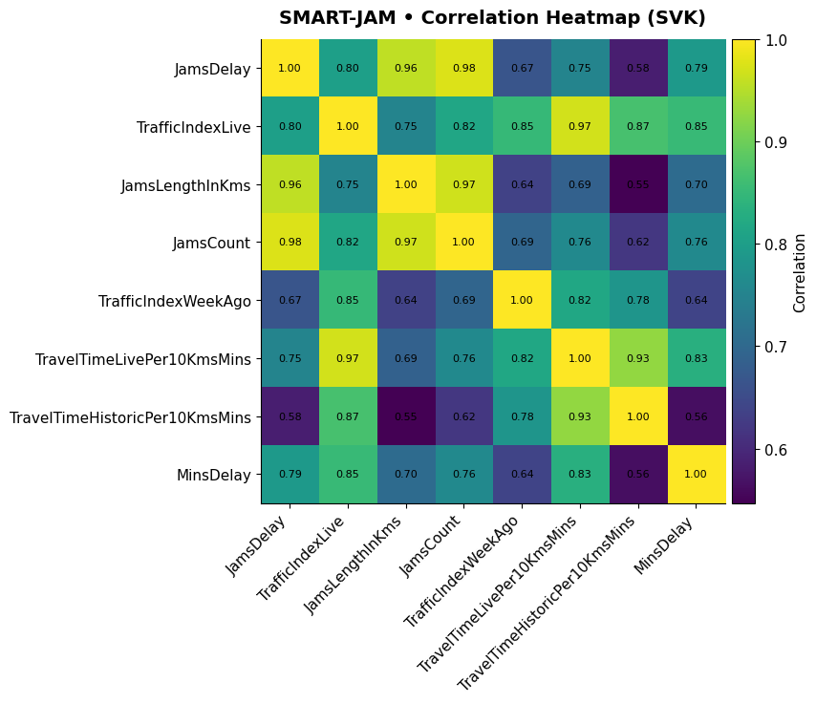
From data to predictions

Slide 26
Ethical aspects

Slide 27


Privacy Protection
Anonymous driver data
GDPR data processing
No audio recording

Slide 28

Data Security
Encrypted data storage
Authorized access only
Cybersecurity

Slide 29

Transparency
Explainable predictions
Bias prevention
Result reliability

Slide 30
Entity Relationship
Diagram

Slide 31
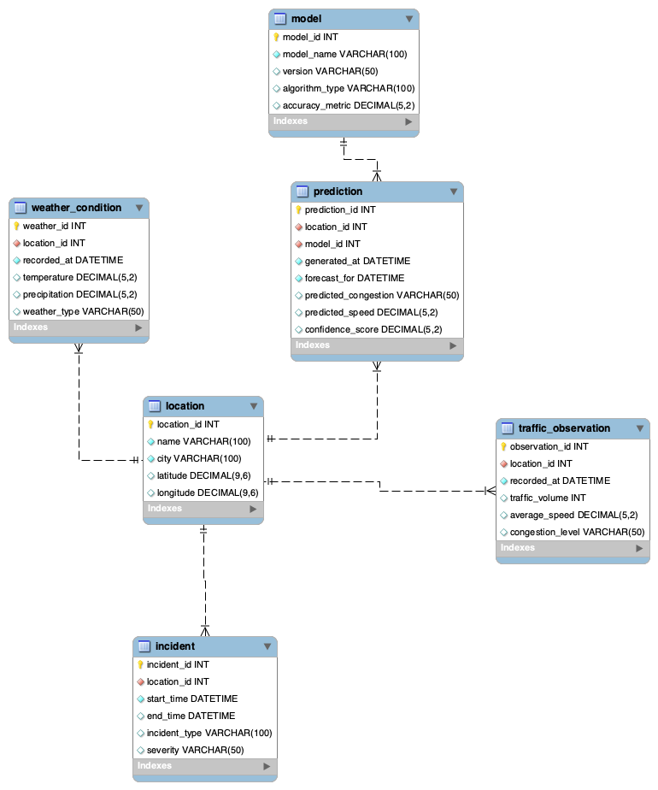

Complete ERD
The Smart-Jam database is designed to support the collection, storage, and analysis of traffic-related data for short-term traffic congestion prediction.
It stores information about monitored locations, real traffic observations, weather conditions, incidents affecting traffic flow, machine learning models, and generated predictions.

Slide 32

Location
stores information about monitored road locations, including the location name, city, and geographic coordinates.
A single location can have multiple traffic observations, weather records, incidents, and predictions.
Cardinality summary >
location → traffic_observation = 1:N
location → weather_condition = 1:N
location → incident = 1:N
location → prediction = 1:N

Slide 33

Weather condition
stores weather-related data for a location and time, including temperature, precipitation, and weather type.

Slide 34

Model
stores information about the forecasting models used in the system, including model name, version, algorithm type, and accuracy metric.
Cardinality summary >
model → prediction = 1:N

Slide 35

Prediction
contains generated traffic forecasts for specific locations and times, including predicted congestion, predicted speed, and confidence score.
each prediction is generated by one specific model.

Slide 36

Traffic
observation
records real traffic data for a specific location and time, such as traffic volume, average speed, and congestion level.

Slide 37

Incident
contains information about traffic-related events that may influence road conditions, such as accidents or roadworks, together with their severity and duration.

Slide 38
Database logic
The relationships between these entities reflect the main logic of the system.
This structure ensures clear organization of input data and forecasting results while keeping the database simple and suitable for the project scope.
The database allows the system to analyze current road conditions and produce forecasts for the next 30–60 minutes.

Slide 39
Social computing

Slide 40

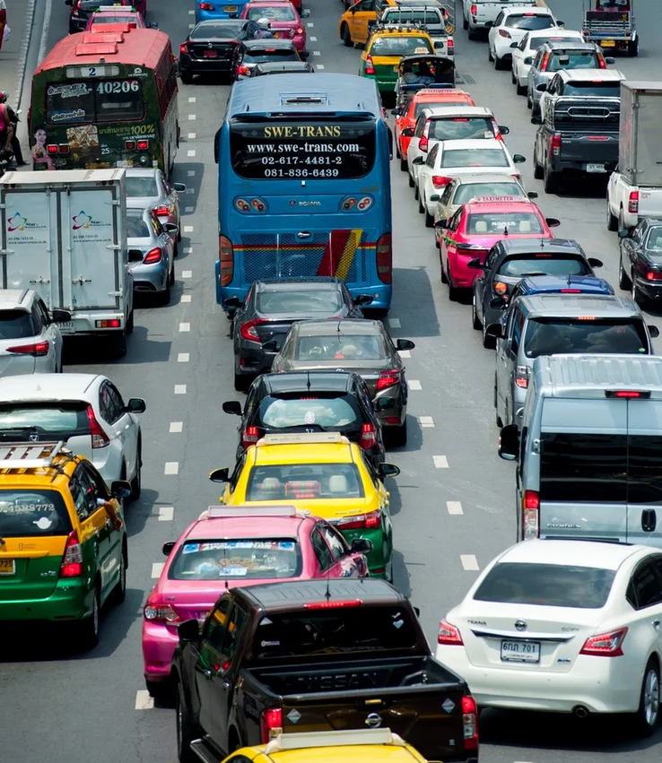

WHY SMART-JAM MATTERS ?
PREDICT EARLIER. REACT FASTER. PLAN SMARTER.
Traffic congestion is still one of the biggest urban mobility problems.
It causes delays, increases emissions, and makes public and private transport less efficient.
Smart-Jam addresses this issue by predicting congestion before it becomes critical.
PREDICTING CONGESTION BEFORE IT HAPPENS

Slide 41

MARKET DEMAND
There is clear demand for predictive traffic tools.
Cities and transport operators need solutions that improve planning, reduce delays, and support smarter mobility.
Smart-Jam meets this need through data-driven traffic forecasting.
DATA → PREDICTION → INSIGHT → ACTION

Slide 42
Competition & our advantage
The market already includes strong traffic analytics platforms.
Companies such as INRIX, Miovision, and HERE prove that this is a real and growing field.
Smart-Jam stands out through focused prediction and easier local deployment.
Big platforms
SMART-JAM
▪
▪
BROAD SYSTEMS
▪
FOCUSED SOLUTION
▪
COMPLEX TOOLS
▪
SIMPLE DASHBOARD
▪
ENTERPRISE SCALE
▪
LOCAL PILOT READY

Slide 43

HOW CAN CUSTOMERS FIND US ?
AI TRAFFIC PREDICTION
IN KOSICE
TRAFFIC MANAGEMENT
URBAN MOBILITY
ANALYTICS
CUSTOMERS USUALLY SEARCH BY PROBLEM, NOT BY BRAND. THEY LOOK FOR SOLUTIONS SUCH AS AI TRAFFIC PREDICTION, TRAFFIC CONGESTION FORECASTING, AND SMART CITY TRAFFIC MANAGEMENT.

Slide 44
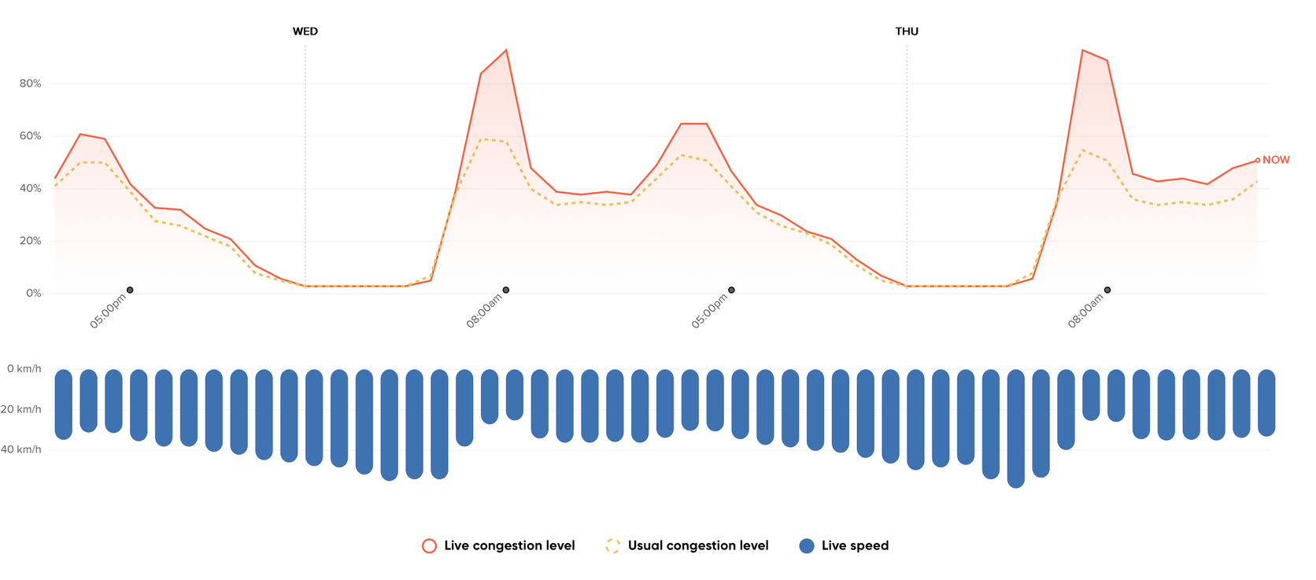
PROMOTION & POSITIONING
WE WILL PROMOTE
SMART-JAM THROUGH:
• pilot projects
• case studies
• smart-city events
•demo presentations

Slide 45
THANK YOU FOR LISTENING!
team Smart Jam web
team Smart Jam members :
Faina Petrenko Mykola Beshynskyi
Richard Buko Dominik Gmitter

Slide 46
Sources
Kaggle – dataset
HTTPS://WWW.PINTEREST.COM/PIN/1857741720916171/
HTTPS://WWW.TOMTOM.COM/SOLUTIONS/GOVERNMENT-AND-PUBLIC-SECTOR/
MA DOKUMENTS
FlatIcon icons
Freepik icons
team Smart Jam web

