Slide 1

SMART-JAM
team Smart Jam web

Slide 2
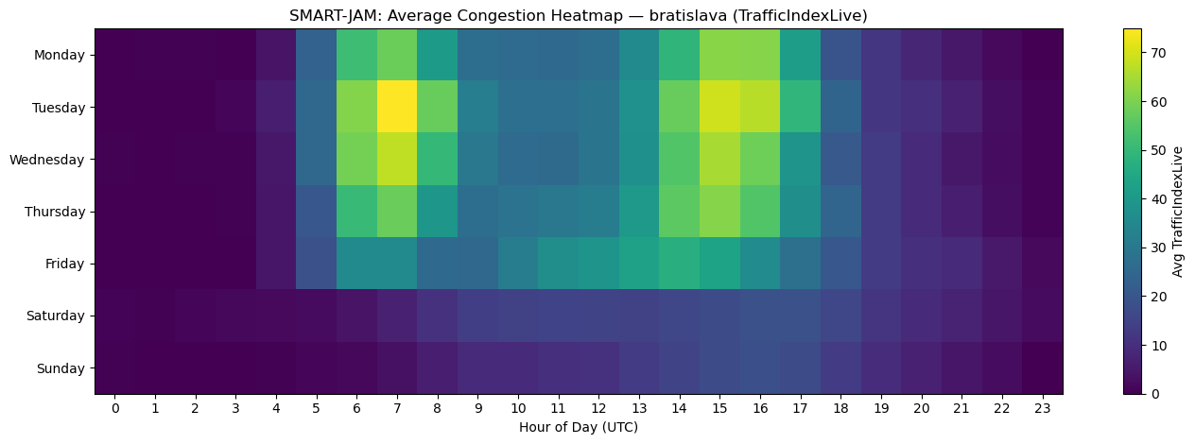
What’s the problem ?
Traffic congestion wastes time and increases emissions
Cities usually react too late

Slide 3
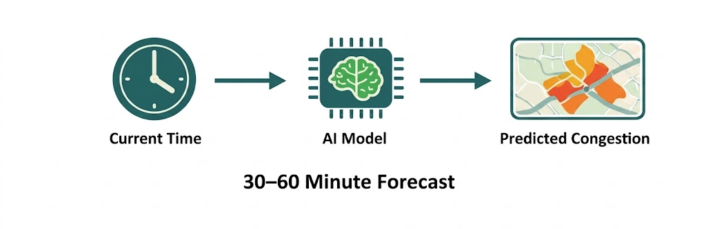
Our solution
Predict congestion 30-60 minutes ahead
Early warnings for specific areas

Slide 4
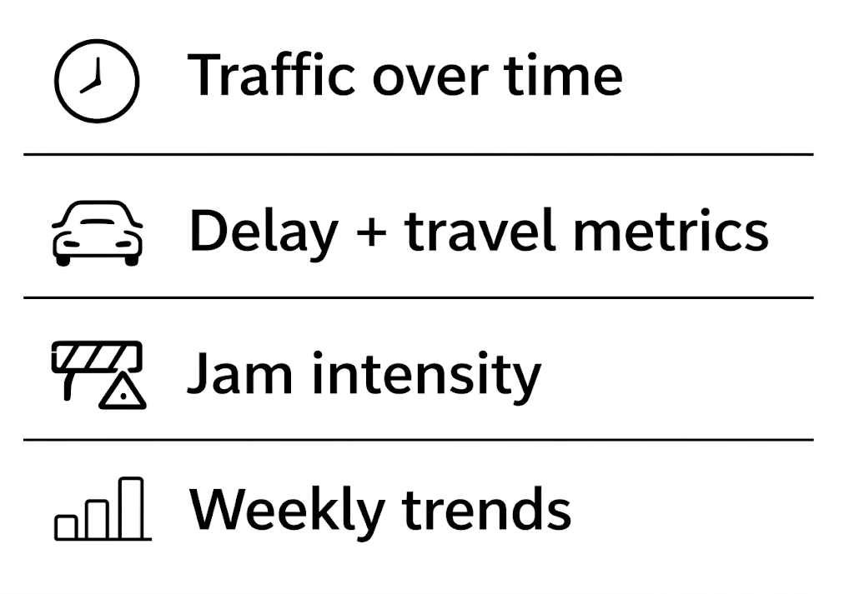
What data we work with
We collect real-time traffic data from different cities to monitor congestion, delays, and travel patterns throughout the day.
Time | City | Delay | Index
08:30 | Kosice | 12.8 min | 59%
08:45 | Bratislava | 17.1 min | 62%
09:00 | Zilina | 9.4 min | 44%

Slide 5
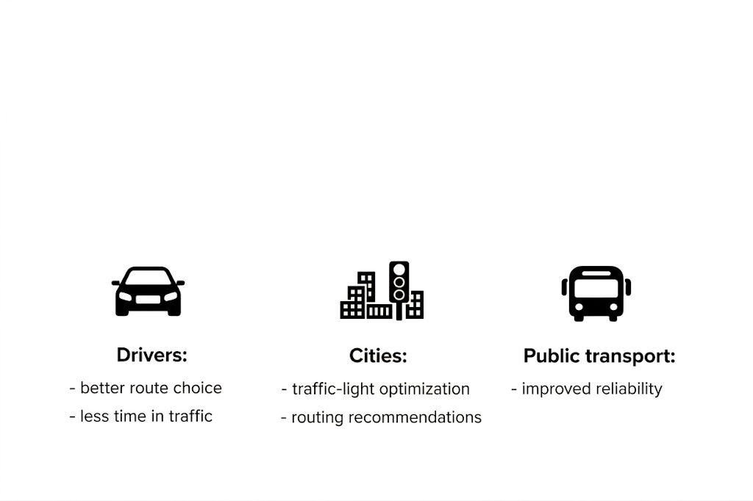
Who benefits ?

Slide 6

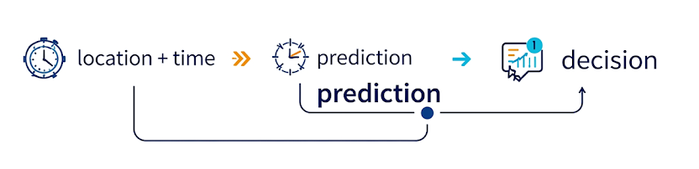
Core requirements?
Input
Predict
Risk
Decide

Slide 7
SWOT Overview
Internal
External
S
W
O
T
Strengths
Weaknesses
Opportunities
Threats
Practical value for users
Clear problem focus
Data-driven approach
User-oriented design
Scalable concept
Dependence on data quality
Limited historical data (early stage)
Model complexity
Potential performance issues
User trust challenge
Growing smart-city initiatives
Integration with navigation platforms
Increasing demand for mobility tools
Expansion to public transport analytics
Academic and research potential
Strong competition
Data access restrictions
Rapid changes in traffic patterns
Privacy and regulation concerns
Technology expectations
Notes:
[ Sources] - SMART-JAM project slides (user-provided): SMART-JAM.pptx - Requirements overview (user-provided): Pitch Deck.pptx [/Sources]

Slide 8

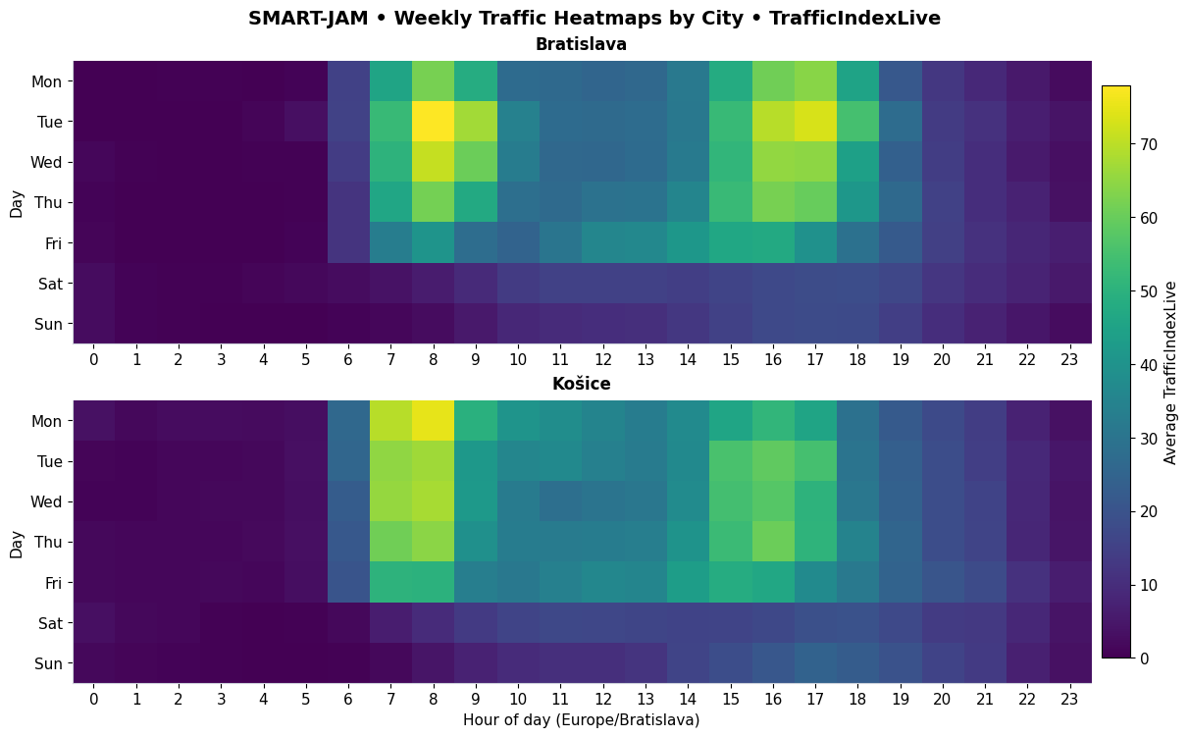
Congestion levels
(Congestion level of 20 = trips take about 20% longer as opposed to free-flow traffic trips)

Slide 9
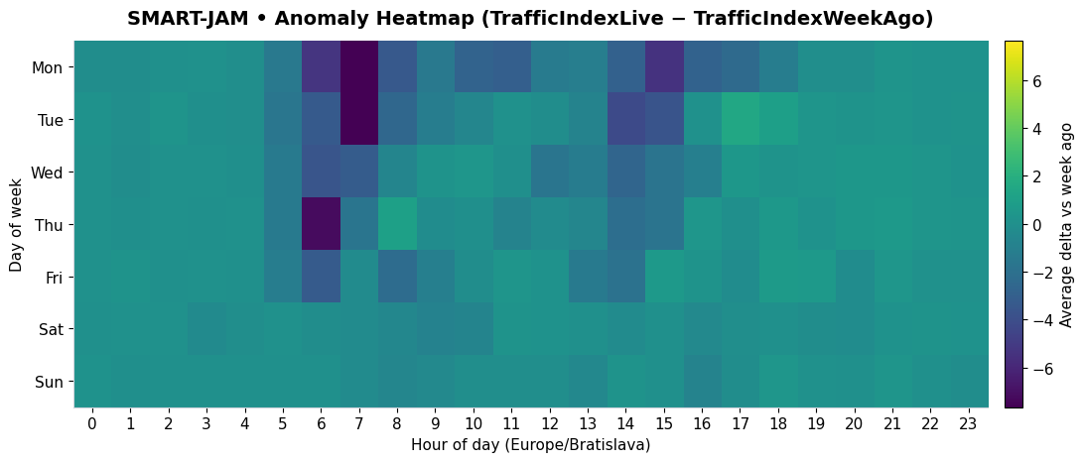
From data to predictions
Our goal – use real time data to make hasty predictions and satisfy users

Slide 10



Privacy Protection
Data Security
Transparency
Anonymous driver data
Encrypted data storage
Explainable predictions
GDPR data processing
Authorized access only
Result reliability
No audio recording
Cybersecurity
Bias prevention

Slide 11

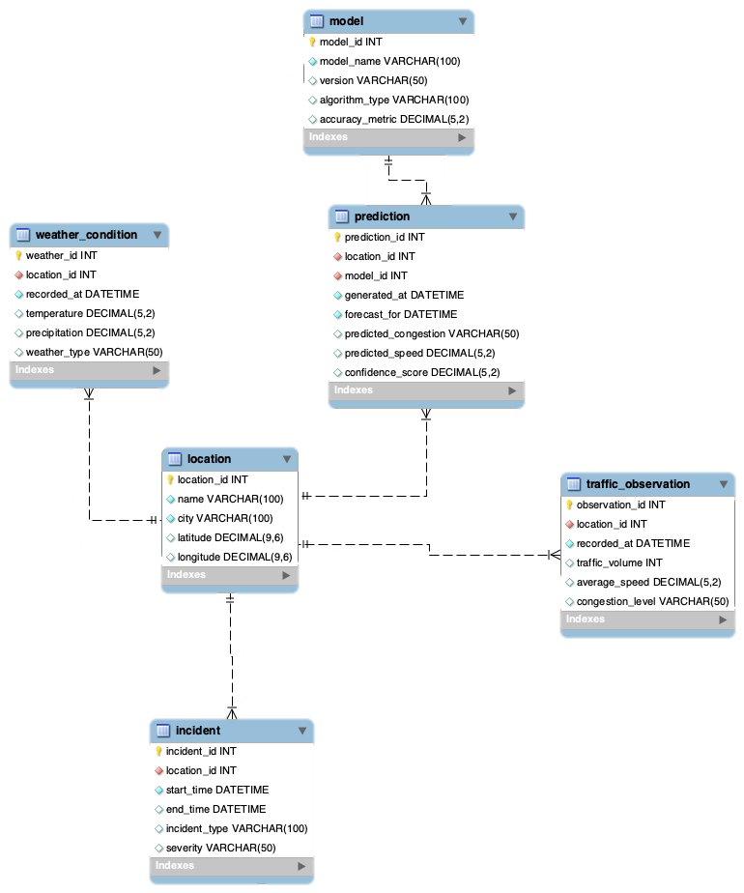
Complete ERD
The Smart-Jam database is designed to support the collection, storage, and analysis of traffic-related data for short-term traffic congestion prediction.
It stores information about monitored locations, real traffic observations, weather conditions, incidents affecting traffic flow, machine learning models, and generated predictions.
The relationships between these entities reflect the main logic of the system.

Slide 12

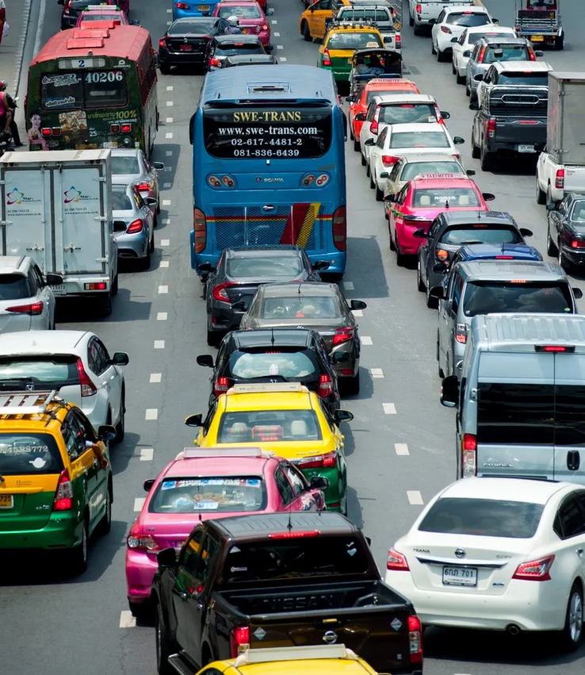

WHY SMART-JAM MATTERS ?
PREDICT EARLIER. REACT FASTER. PLAN SMARTER.
Traffic congestion is still one of the biggest urban mobility problems.
It causes delays, increases emissions, and makes public and private transport less efficient.
Smart-Jam addresses this issue by predicting congestion before it becomes critical.
PREDICTING CONGESTION BEFORE IT HAPPENS

Slide 13

MARKET DEMAND
There is clear demand for predictive traffic tools.
Cities and transport operators need solutions that improve planning, reduce delays, and support smarter mobility.
Smart-Jam meets this need through data-driven traffic forecasting.
DATA → PREDICTION → INSIGHT → ACTION

Slide 14
Competition & our advantage
The market already includes strong traffic analytics platforms.
Companies such as INRIX, Miovision, and HERE prove that this is a real and growing field.
Smart-Jam stands out through focused prediction and easier local deployment.
Big platforms
SMART-JAM
▪
▪
BROAD SYSTEMS
▪
FOCUSED SOLUTION
▪
COMPLEX TOOLS
▪
SIMPLE DASHBOARD
▪
ENTERPRISE SCALE
▪
LOCAL PILOT READY

Slide 15
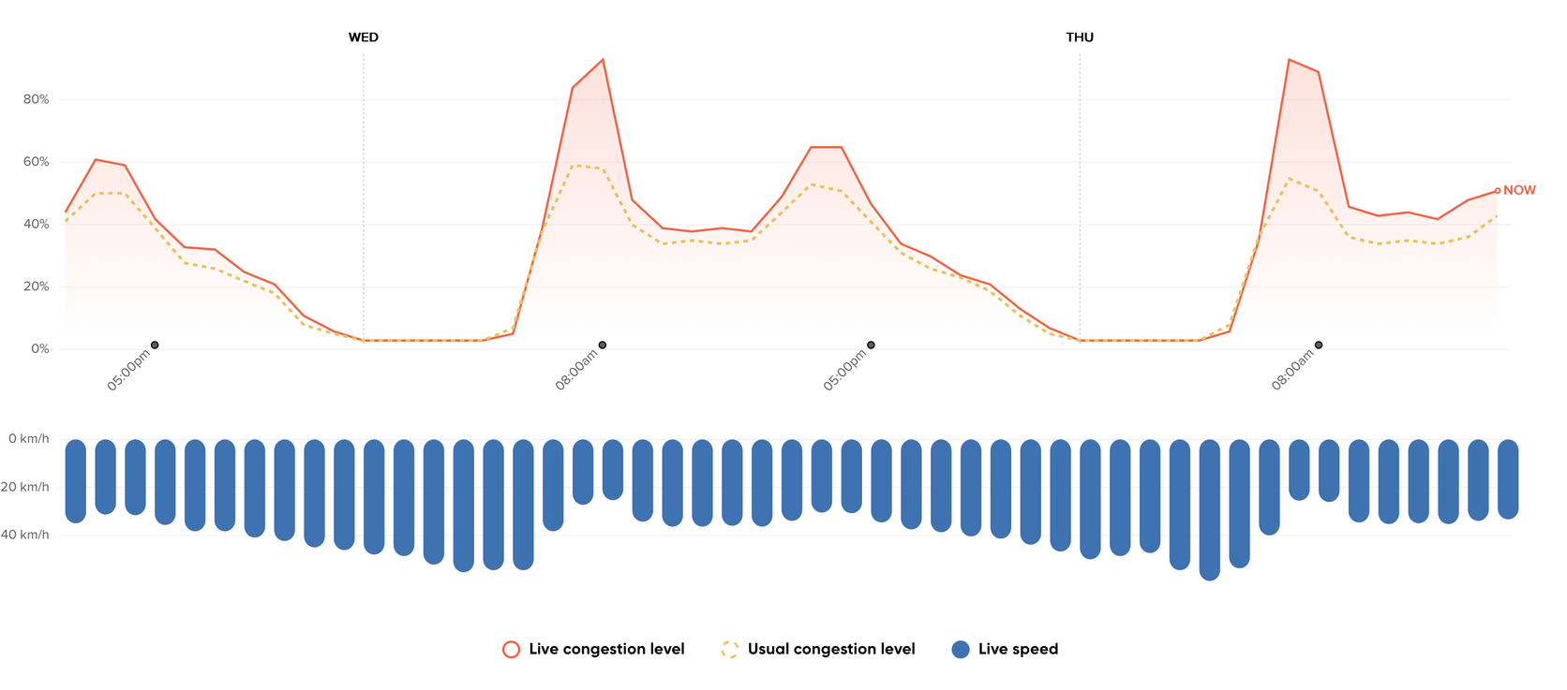
PROMOTION & POSITIONING
WE WILL PROMOTE
SMART-JAM THROUGH:
• pilot projects
• case studies
• smart-city events
•demo presentations

Slide 16
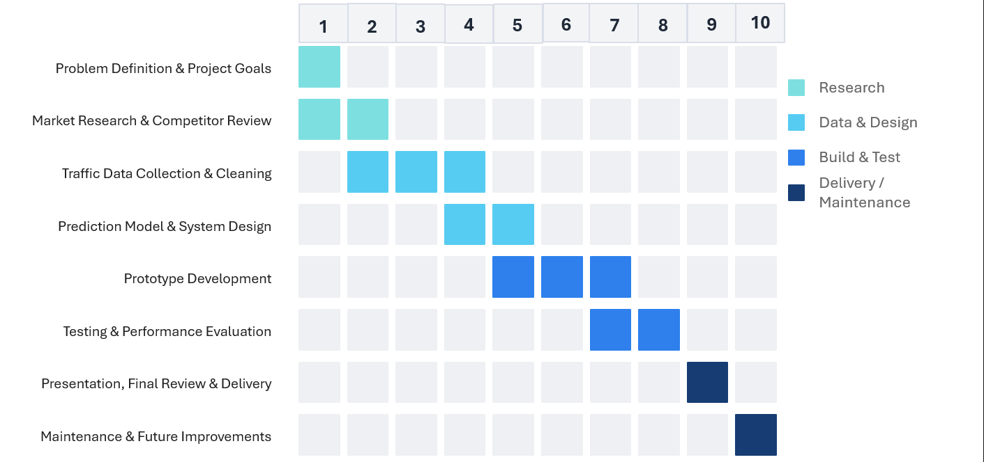
Gantt Chart

Slide 17
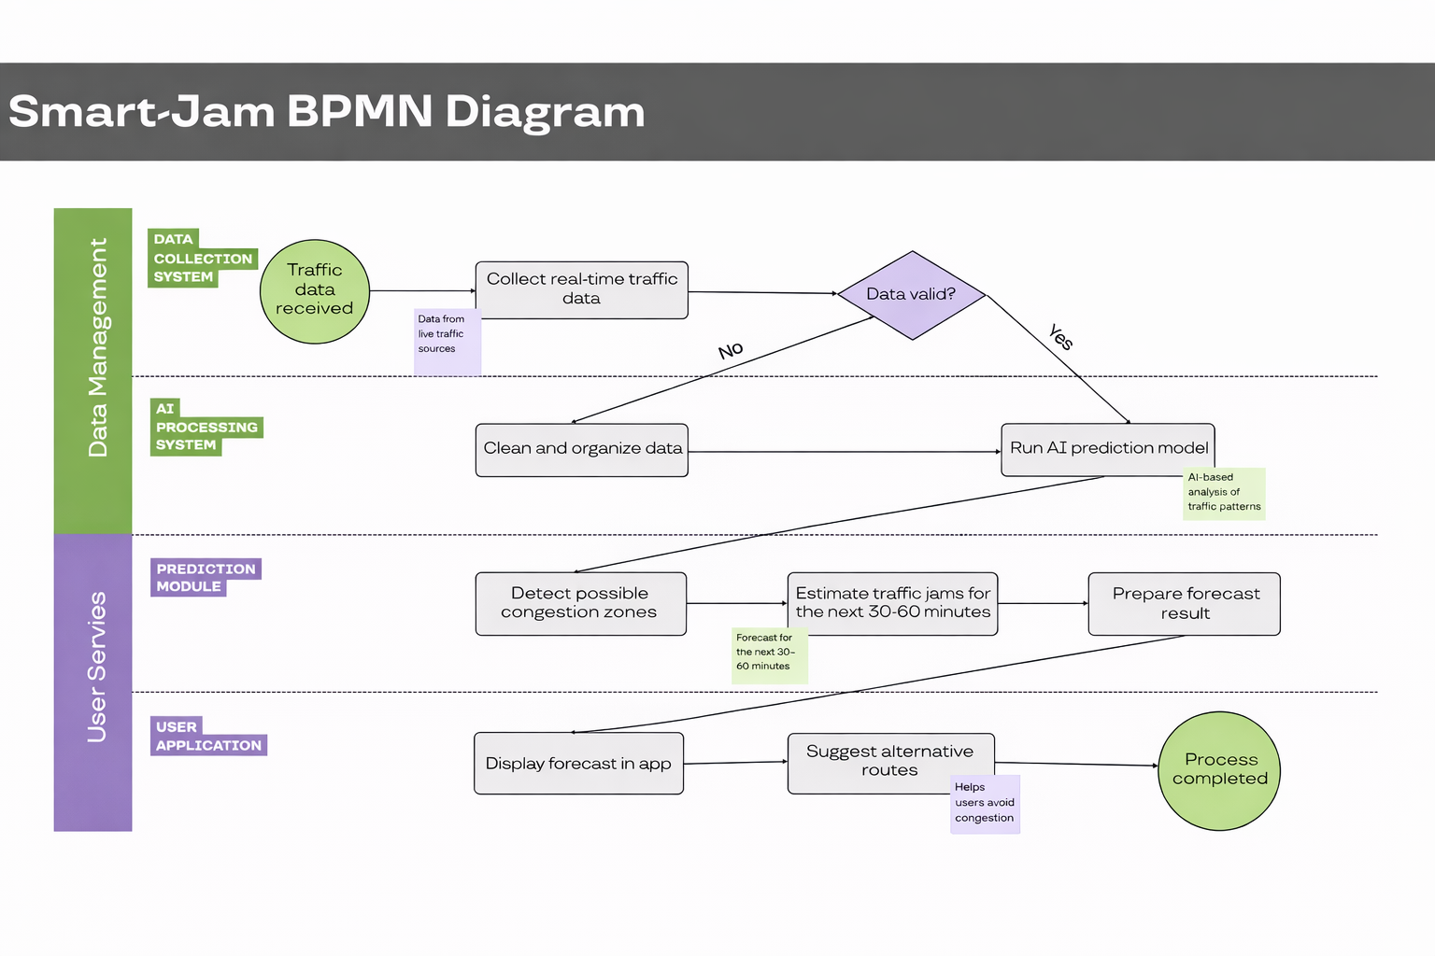
BPMN Diagram

Slide 18
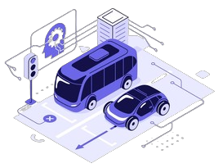
Supply Chain
Digital supply chain based on data, technology, and cooperation
Inputs: traffic data, cloud infrastructure, software tools, developers, and AI specialists
Processing: raw data is cleaned, analyzed, and transformed by AI into traffic predictions
Distribution: results are delivered through web dashboards, mobile apps, and API integrations
Users: drivers, cities, transport operators, and logistics companies
Benefits: faster decisions, less congestion, lower fuel consumption, reduced emissions, and better urban planning

Slide 19
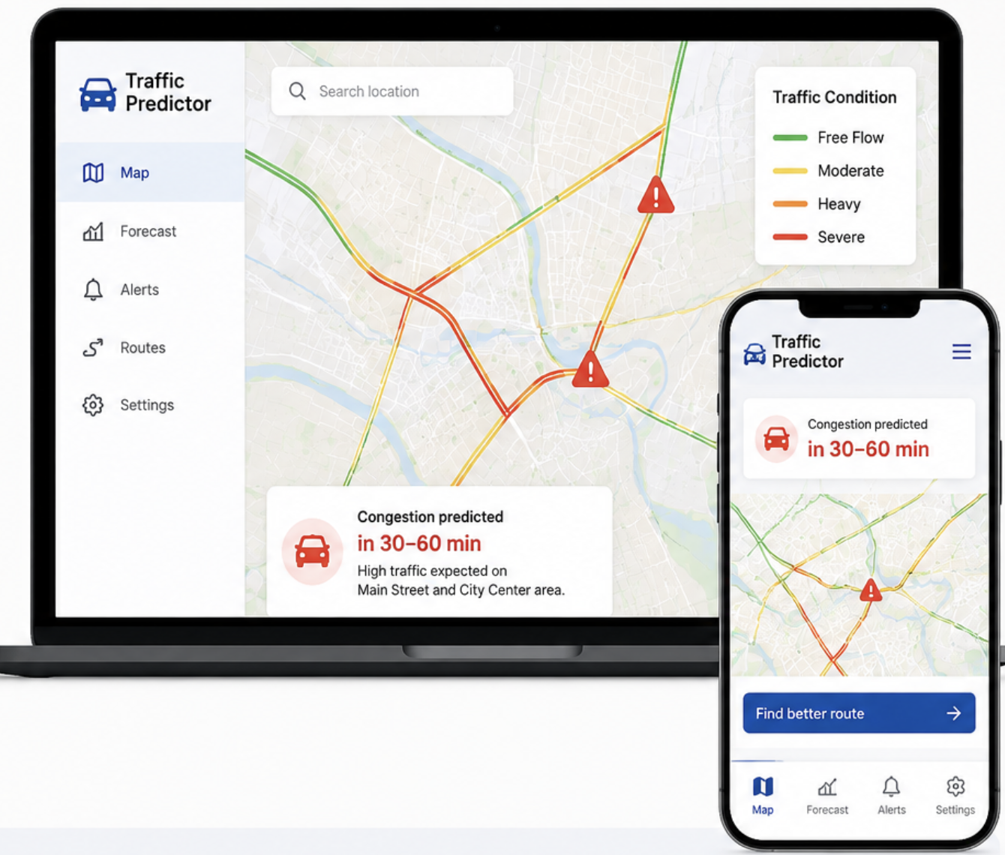
USER INTERFACE
Interactive Map
Traffic Forecast
Alerts & Notification
Route Suggestions
User-Friendly Design

Slide 20
THANK YOU FOR LISTENING!
team Smart Jam web
team Smart Jam members :
Faina Petrenko Mykola Beshynskyi
Richard Buko Dominik Gmitter

Slide 21
Sources
Kaggle – dataset
HTTPS://WWW.PINTEREST.COM/PIN/1857741720916171/
HTTPS://WWW.TOMTOM.COM/SOLUTIONS/GOVERNMENT-AND-PUBLIC-SECTOR/
MA DOKUMENTS
FlatIcon icons
Freepik icons
team Smart Jam web

