Slide 1
PROJECT SMART-JAM SUPPLY CHAIN

Slide 2

What is Smart-Jam Supply Chain?
Smart-Jam is a digital supply chain that connects data, technology, and users.
Unlike traditional systems, it does not produce physical products but creates value through information and cooperation.

Slide 3

INPUTS
Traffic data (APIs, sensors)
Cloud infrastructure
Software tools
Developers and AI specialists

Slide 4

Internal Processing
Inside the system, raw data is transformed into useful insights using artificial intelligence.
Data is cleaned and analyzed
AI predicts traffic conditions
Applications are developed and tested

Slide 5
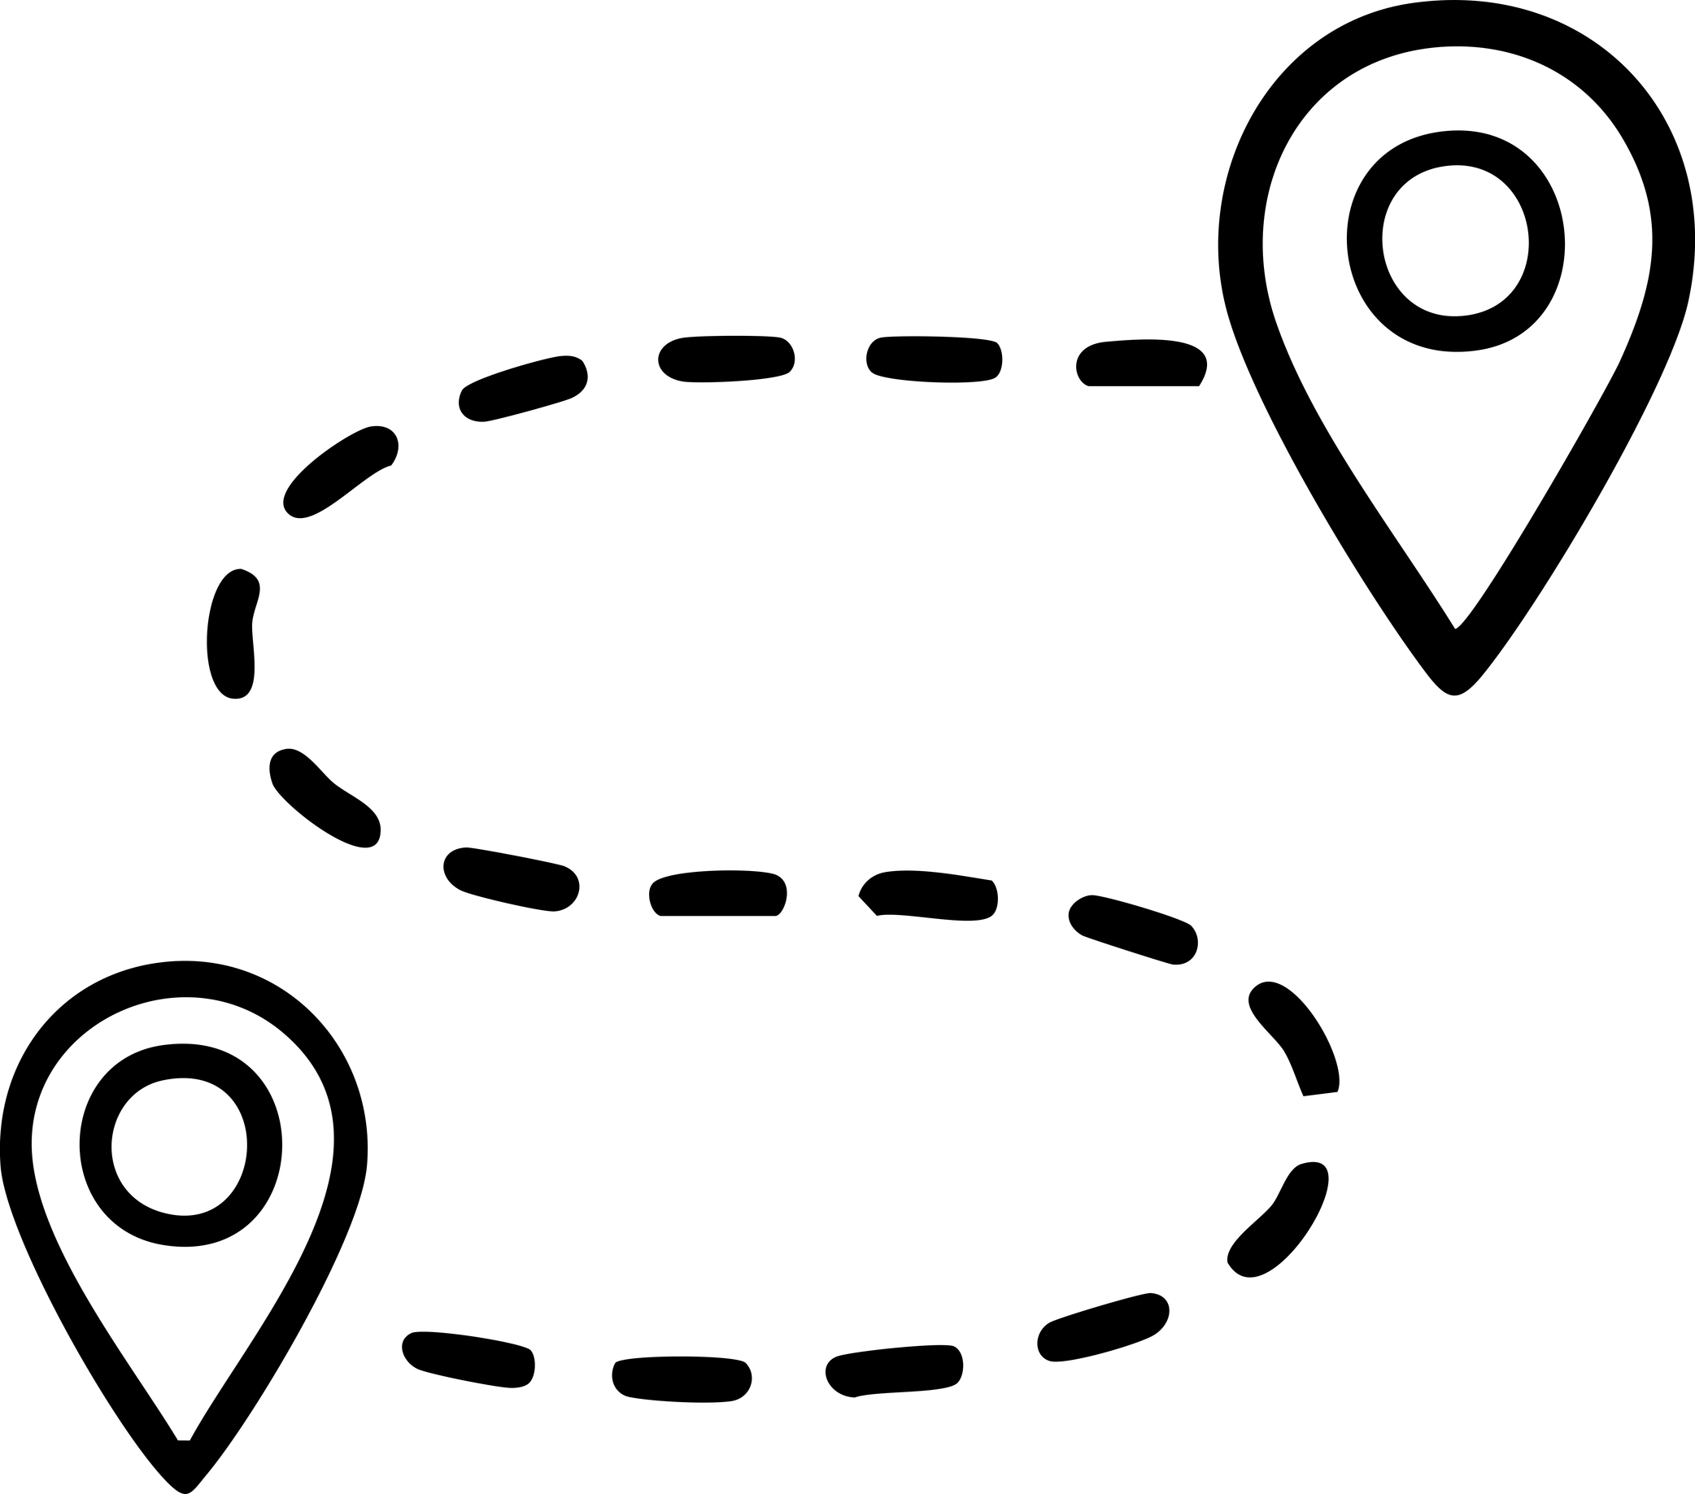

DISTRIBUTION & USERS
Distribution :
Users :
Web dashboards, mobile apps, and API integrations allow easy access.
Drivers, cities, transport operators, and logistics companies benefit from the system.

Slide 6

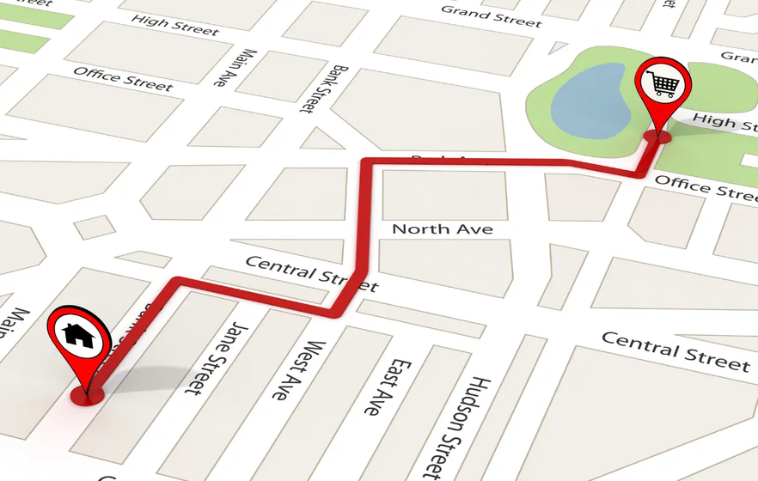
BENEFITS
Faster decisions.
Less traffic congestion.
Lower fuel consumption.
Reduced emissions.
Better urban planning.

Slide 7
Thank You

