Slide 1
A Comparison of Six 10-Class Classifiers Using the NotMNIST Data Set
By Team Bengio
June 21, 2017

Slide 2
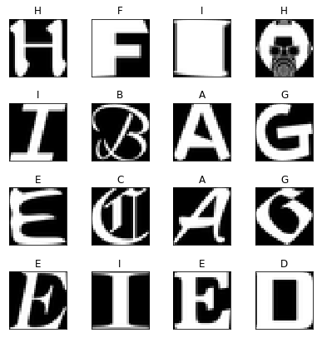
Objective: Accuracy vs CPU Time vs Number of PC
Accuracy
n PC
Classifier
Dimension
Reduction
by
PCA
CPU Time
Number of PC
NotMNIST Data Set of A to J in the same format as MNIST
From https://github.com/davidflanagan/notMNIST-to-MNIST
Training set size 60000 with 6000 per letter
Test set size 10000 with 1000 per letter

Slide 3




Objective: Accuracy vs CPU Time vs Number of PC
n PC
Bayesian Classifier
Dimension
Reduction
by
PCA
Model
Parameters
$$X_{train}$$
Augment by 1
Linear Classifier
$$X_{test}$$
Classifier
$$T_{train}$$
Augment by
non-linear combinations
Linear Classifier
$${\hat{T}}_{test}$$
One VS Rest Multiclass Classifier
One VS One Multiclass Classifier

Slide 4








Linear Classifier with Non-linear Combinations of Features
$$X_{nc}$$
Augment by
non-linear combinations
Linear Classifier
$$X$$
$$[x_{1},x_{2},…,x_{n}]$$
$$x_{a}$$
$$X_{nc}$$
Augment by
1
From Matrix
$${x_{a}^{T}x}_{a}$$
Get Upper
Triangle
$$x_{a}=[1,x_{1},x_{2},…,x_{n}]$$
$$x_{a}^{T}x_{a}=\left[\begin{matrix}\begin{matrix}1 & x_{1} \\ x_{1} & x_{1}x_{1}\end{matrix} & \begin{matrix}… & x_{n} \\ … & x_{1}x_{n }\end{matrix} \\ \begin{matrix}⋮ & ⋮ \\ x_{n} & x_{1}x_{n}\end{matrix} & \begin{matrix}⋱ & ⋮ \\ … & x_{n}x_{n}\end{matrix}\end{matrix}\right]$$

Slide 5
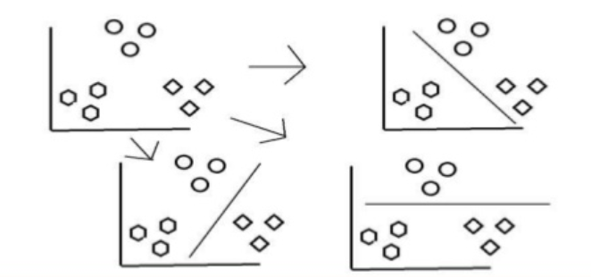
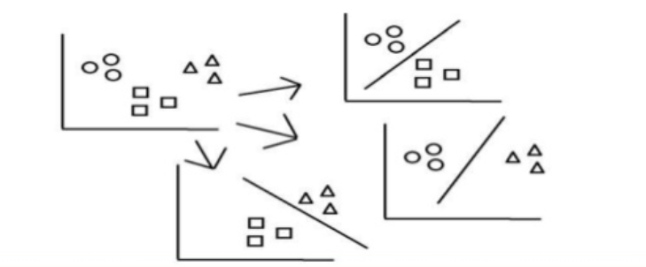
One-vs-Rest and One-vs-One Multiclass Classification
One-vs-Rest
One-Vs-One
Do classification of a data vector
on a pair of labels at a time.
The most frequent label of the data
is the final classification of the data.
Kesler’s Construction on the
class labels

Slide 6
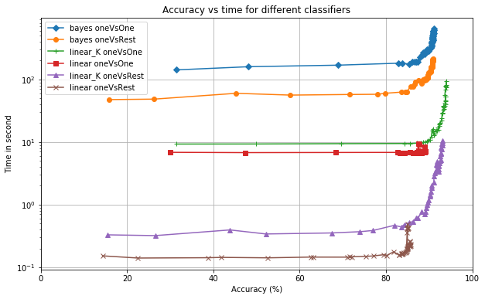
Results
Zoom

Slide 7
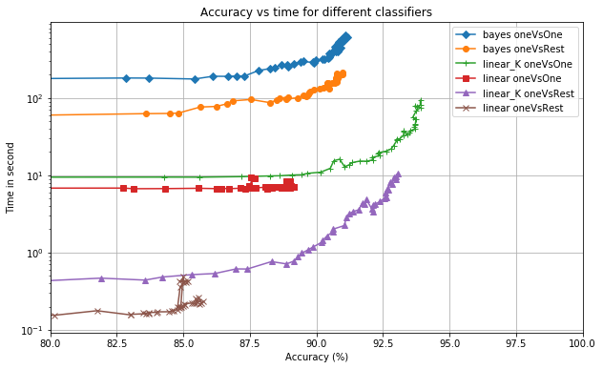
Results
Bayes are slowest
OneVsOne is slow
Linear classifiers with non-linear combination of feature have the best accuracy
Linear classifers are fast

Slide 8
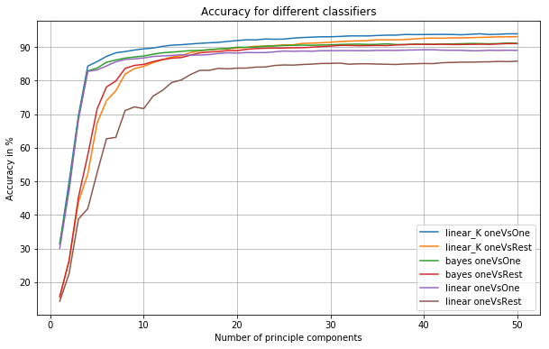
Results
OneVsOne
OneVsOne is
better when
the number
of PC < 15
OneVsRest

Slide 9
Conclusions
Bayes classifier is the slowest.
OneVsOne has higher accuracy than OneVsRest when the number of PC < 15.
When the number of PC > 20, the difference in accuracy between OneVsOne and OneVsRest is small. But OneVsOne is more computational intensive.
Linear classifier with non-linear combinations of features has the best trade-off in computation/accuracy/number of PC.

Slide 10
Thank You

Slide 11
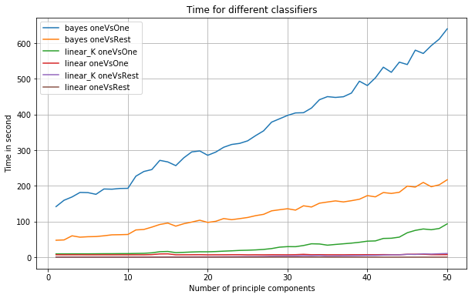
Results
Bayes is
very slow

Slide 12
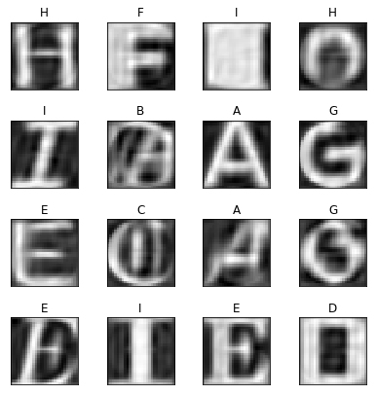
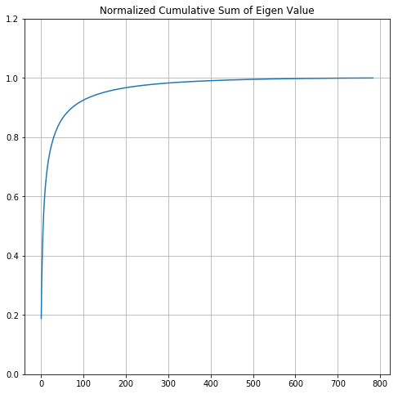
Results
Original Data
Reconstructed
with 50 PC
Evaluated CPU time and accuracy trade-off from 1 to 50 principle components

