Slide 1
A Comparison of Six 10-Class Classifiers Using the NotMNIST Data Set
By Team Bengio
June 21, 2017

Slide 2
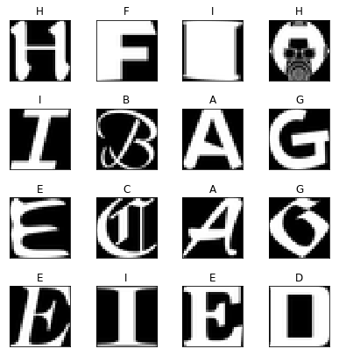
Objective: Accuracy vs CPU Time vs Number of PC
Accuracy
n PC
Classifier
Dimension
Reduction
by
PCA
CPU Time
Number of PC
NotMNIST Data Set of A to J in the same format as MNIST
From https://github.com/davidflanagan/notMNIST-to-MNIST
Training set size 60000 with 6000 per letter
Test set size 10000 with 1000 per letter

Slide 3




Objective: Accuracy vs CPU Time vs Number of PC
n PC
Bayesian Classifier
Dimension
Reduction
by
PCA
Model
Parameters
$$X_{train}$$
Augment by 1
Linear Classifier
$$X_{test}$$
Classifier
$$T_{train}$$
Augment by
non-linear combinations
Linear Classifier
$${\hat{T}}_{test}$$
One VS Rest Multiclass Classifier
One VS One Multiclass Classifier

Slide 4








Linear Classifier with Non-linear Combinations of Features
$$X_{nc}$$
Augment by
non-linear combinations
Linear Classifier
$$X$$
$$[x_{1},x_{2},…,x_{n}]$$
$$x_{a}$$
$$X_{nc}$$
Augment by
1
From Matrix
$${x_{a}^{T}x}_{a}$$
Get Upper
Triangle
$$x_{a}=[1,x_{1},x_{2},…,x_{n}]$$
$$x_{a}^{T}x_{a}=\left[\begin{matrix}\begin{matrix}1 & x_{1} \\ x_{1} & x_{1}^{2}\end{matrix} & \begin{matrix}… & x_{n} \\ … & x_{1}x_{n }\end{matrix} \\ \begin{matrix}⋮ & ⋮ \\ x_{n} & x_{1}x_{n}\end{matrix} & \begin{matrix}⋱ & ⋮ \\ … & x_{n}^{2}\end{matrix}\end{matrix}\right]$$

Slide 5
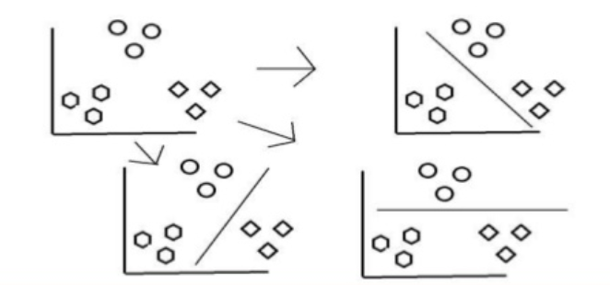
One-vs-Rest Multiclass Classification with K Classes
Same as home work:
K-classes linear classifiers with Kesler Construction
K-classes Bayesian classifiers

Slide 6
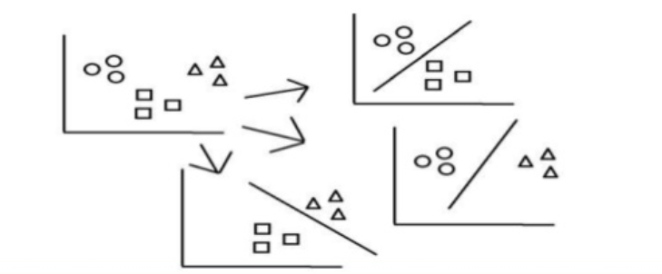
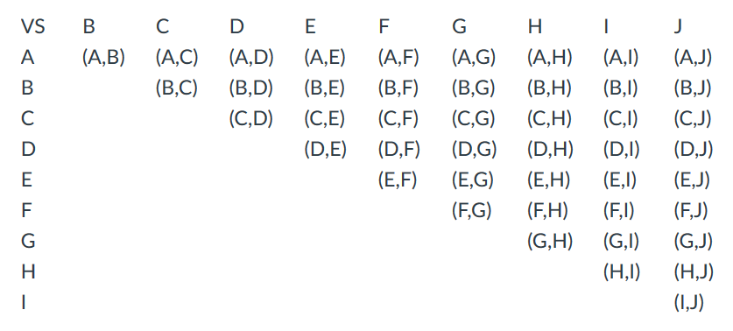

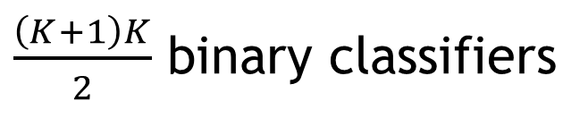
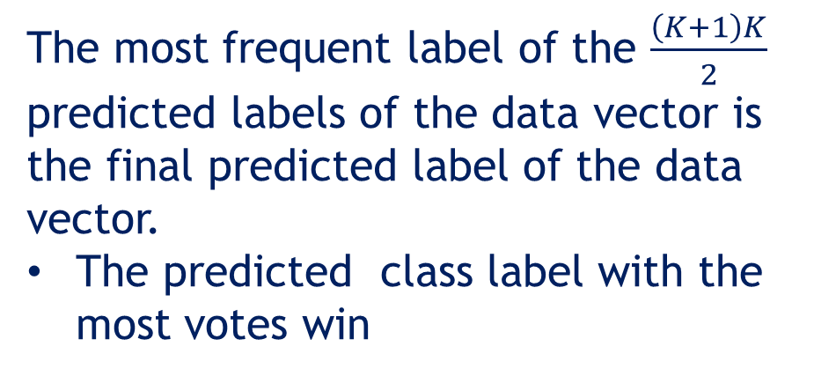
One-vs-One Multiclass Classification with K Classes
$\frac{\left(K+1\right)K}{2}$ binary classifiers
C or E ?
The most frequent label of the $\frac{\left(K+1\right)K}{2}$
predicted labels of the data vector is
the final predicted label of the data
vector.
The predicted class label with the most votes win
Do $K$ class classification of a data vector
on a pair of classes at a time

Slide 7
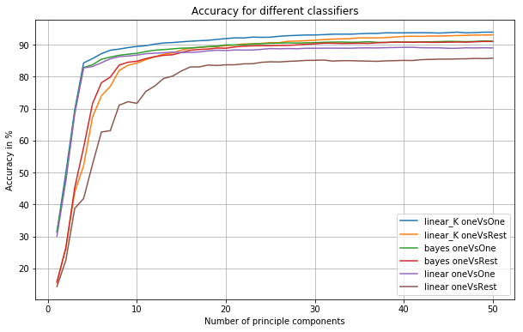
Results: Accuracy vs Number of PC
Accuracy = Percentage of Correct Classifications
OneVsOne
More on 16 PCs
OneVsOne is
better when
the number
of PC < 15
OneVsRest

Slide 8
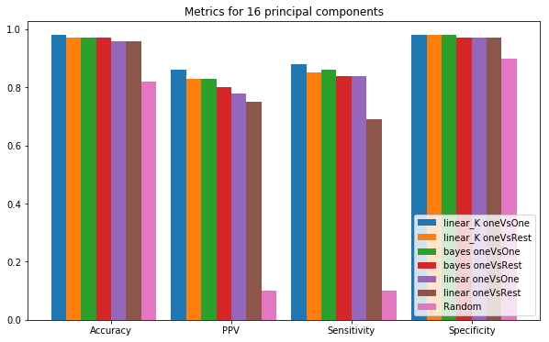
Results: Metrics for 16 Principle Components

Slide 9
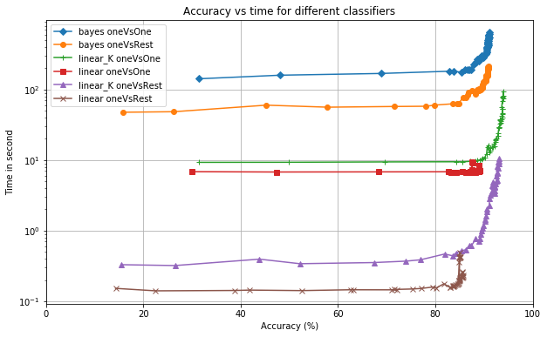
Results: Elapsed CPU Time vs Accuracy
Zoom

Slide 10
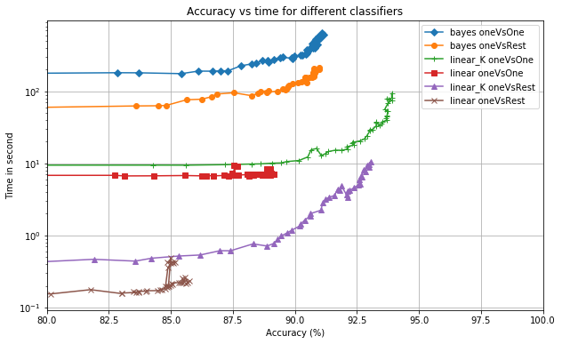
Results: Elapsed CPU Time vs Accuracy
Bayes are slowest
OneVsOne is slow
Linear classifiers with non-linear combination of feature have the best accuracy
Linear classifers are fast

Slide 11
Conclusions
Bayes classifier is the slowest.
OneVsOne has higher accuracy than OneVsRest when the number of PC < 15.
When the number of PC > 20, the difference in the accuracy between OneVsOne and OneVsRest is small. But OneVsOne is more computational intensive.
Linear classifier with non-linear combinations of features has the best trade-off in computation/accuracy/number of PC.

Slide 12
Thank You

Slide 13
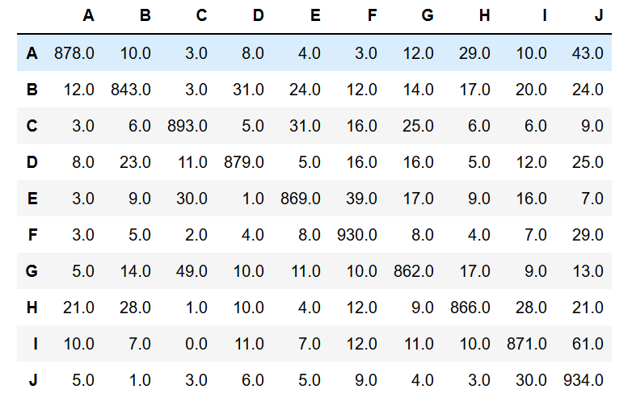
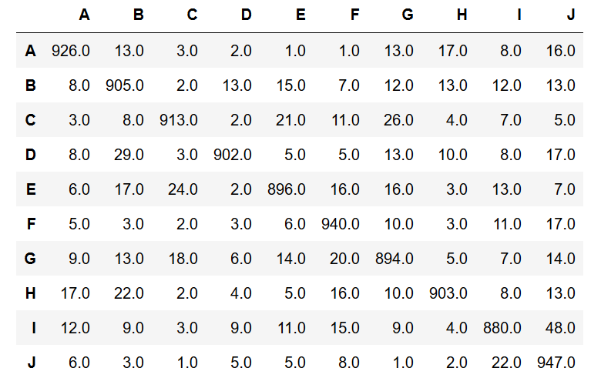
Results: Examples of Confusion Matrix (16 PCs)
One vs One Linear Classifier with
Non-Linear Combination of Features
One vs Rest Bayesian Classifier

Slide 14
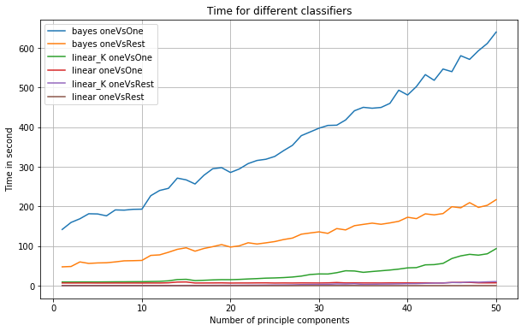
Results: Elapsed CPU Time vs Number of PCs
Bayes is
very slow

Slide 15
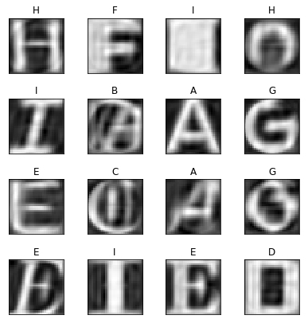
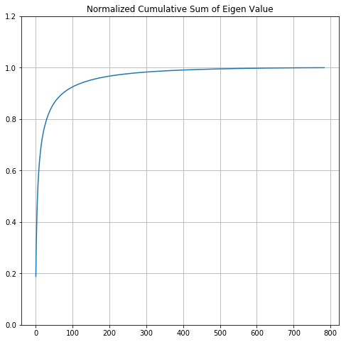
Results
Original Data
Reconstructed
with 50 PC
Evaluated Elapsed CPU time and accuracy trade-off from 1 to 50 principle components

