Slide 1
A Comparison of Six 10-Class Classifiers Using the NotMNIST Data Set
By Team Bengio
June 21, 2017

Slide 2
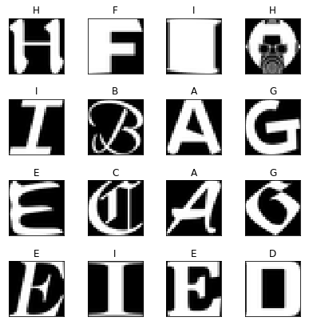
Objective: Accuracy vs CPU Time vs Number of PC
Accuracy
n PC
Classifier
Dimension
Reduction
by
PCA
CPU Time
Number of PC
NotMNIST Data Set of A to J in the same format as MNIST
From https://github.com/davidflanagan/notMNIST-to-MNIST
Training set size 60000 with 6000 per letter
Test set size 10000 with 1000 per letter

Slide 3




Method: Accuracy vs CPU Time vs Number of PC
n PC
Bayesian Classifier
Dimension
Reduction
by
PCA
Model
Parameters
$$X_{train}$$
Linear Classifier
Classifier
Classifier
$$X_{test}$$
Augment by
1
$$T_{train}$$
Augment by
non-linear combinations
Linear Classifier
$${\hat{T}}_{test}$$
One VS Rest Multiclass Classification
One VS One Multiclass Classification

Slide 4




Linear Classifier
$$x_{a}$$
Augment by
1
Linear Classifier
backend
$$x$$
$$[x_{1},x_{2},…,x_{n}]$$
Augment by
1
$$x_{a}=[1,x_{1},x_{2},…,x_{n}]$$

Slide 5






Linear Classifier with Non-linear Combinations of Features
$$x_{nc}$$
Augment by
non-linear combinations
Linear Classifier
Backend
$$x$$
$$[x_{1},x_{2},…,x_{n}]$$
$$x_{a}$$
$$X_{nc}$$
Augment by
1
From Matrix
$${x_{a}^{T}x}_{a}$$
Get Upper
Triangle
$$x_{a}=[1,x_{1},x_{2},…,x_{n}]$$
$$x_{a}^{T}x_{a}=\left[\begin{matrix}\begin{matrix}1 & x_{1} \\ x_{1} & x_{1}^{2}\end{matrix} & \begin{matrix}… & x_{n} \\ … & x_{1}x_{n }\end{matrix} \\ \begin{matrix}⋮ & ⋮ \\ x_{n} & x_{1}x_{n}\end{matrix} & \begin{matrix}⋱ & ⋮ \\ … & x_{n}^{2}\end{matrix}\end{matrix}\right]$$

Slide 6
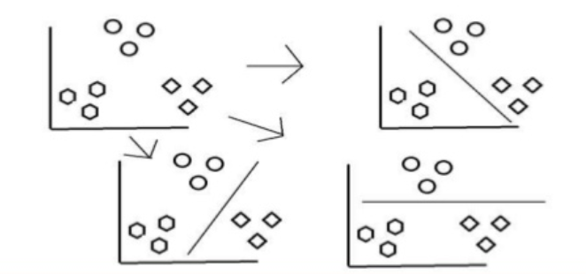
One-vs-Rest Multiclass Classification with K Classes
Same as home work:
K-classes linear classifiers with Kesler construction
K-classes Bayesian classifiers
Addition:
K-classes linear classifier with non-linear feature combination and Kesler construction

Slide 7
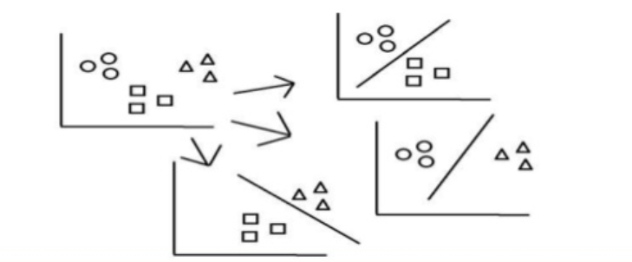
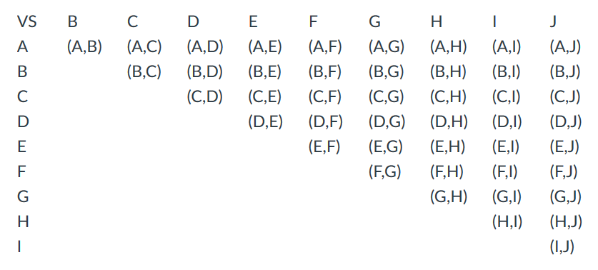
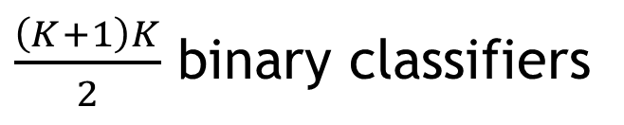
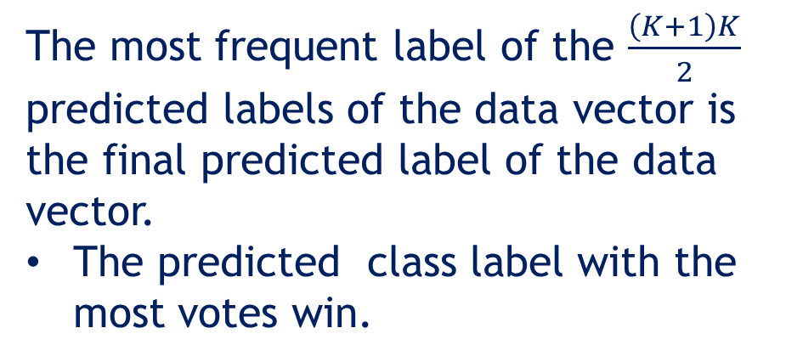

One-vs-One Multiclass Classification with K Classes
$\frac{\left(K+1\right)K}{2}$ binary classifiers
C or E ?
The most frequent label of the $\frac{\left(K+1\right)K}{2}$
predicted labels of the data vector is
the final predicted label of the data
vector.
The predicted class label with the most votes win.
Do $K$ class classification of a data vector
on a pair of classes at a time

Slide 8
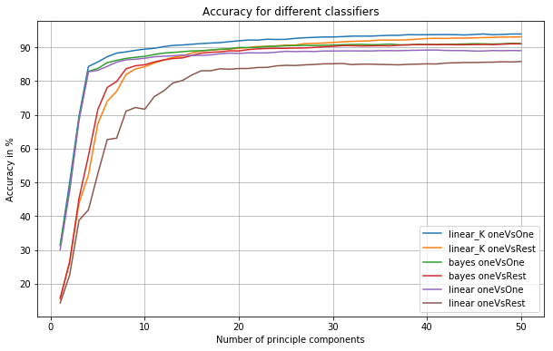
Results: Accuracy vs Number of PC
Accuracy = Percentage of Correct Classifications
OneVsOne
More on 16 PCs
OneVsOne is
better when
the number
of PC < 15
OneVsRest
Number of principal components

Slide 9
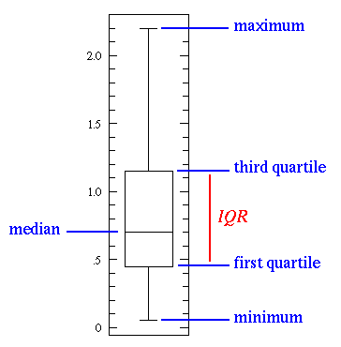
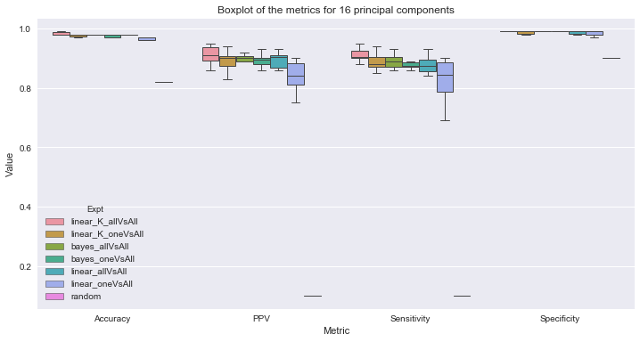
Results: Performance Comparison with Box Plot at 16 PC
Boxplot of metric for the 10 letters with 16 principal components

Slide 10
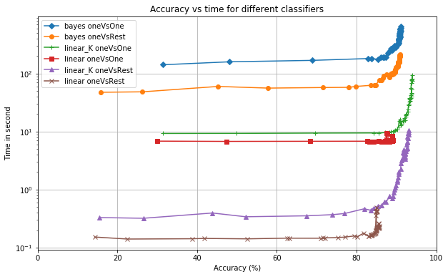
Results: Elapsed CPU Time vs Accuracy
Zoom

Slide 11
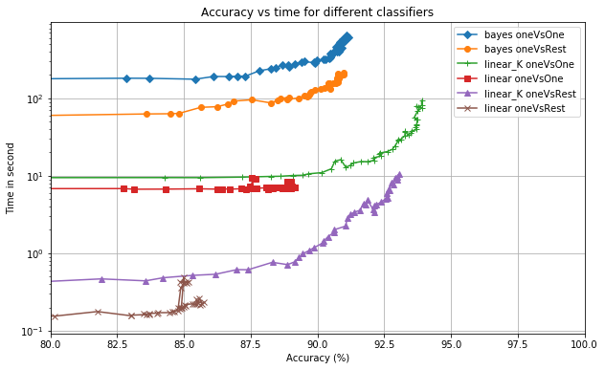
Results: Elapsed CPU Time vs Accuracy
Bayes are slowest
OneVsOne is slow
Linear classifiers with non-linear combination of feature have the best accuracy
Linear classifers are faster

Slide 12
Conclusions
Bayes classifier is the slowest.
OneVsOne has higher accuracy than OneVsRest when the number of PC < 15.
When the number of PC > 20, the difference in the accuracy between OneVsOne and OneVsRest is small. But OneVsOne is more computational intensive.
Linear classifier with non-linear combinations of features has the best trade-off in computation/accuracy/number of PC.

Slide 13
Thank You

Slide 14
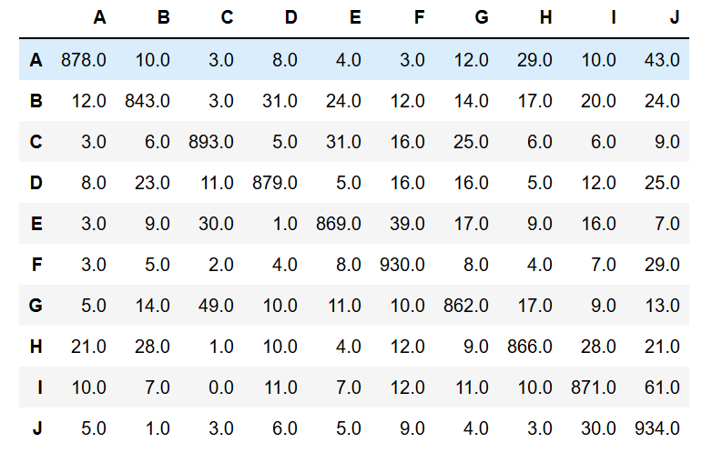
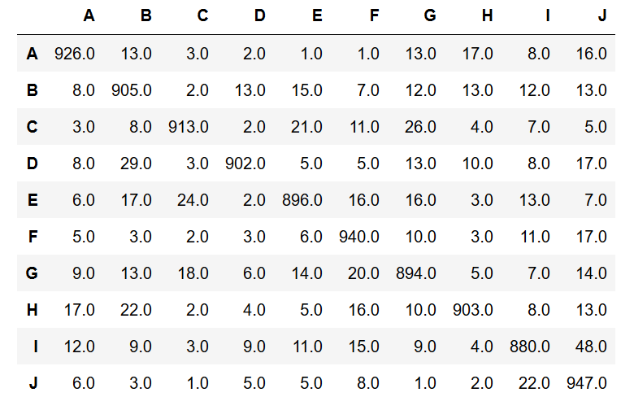
Results: Examples of Confusion Matrix (16 PCs)
One vs One Linear Classifier with
Non-Linear Combination of Features
One vs Rest Bayesian Classifier

Slide 15
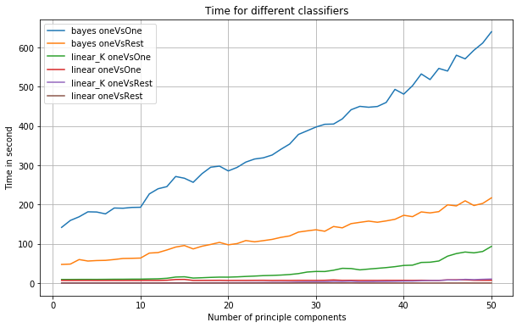
Results: Elapsed CPU Time vs Number of PCs
Bayes is
very slow

Slide 16
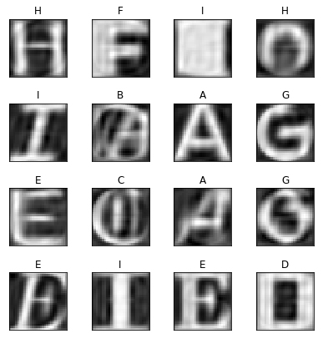
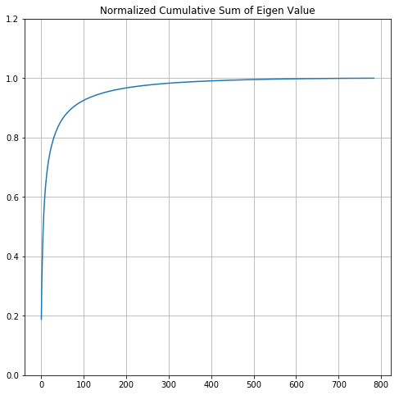
Results
Original Data
Reconstructed
with 50 PC
Evaluated Elapsed CPU time and accuracy trade-off from 1 to 50 principal components

