Slide 1
BUS S103 Oral Presentation
S12363662 Chong Wing Wong
Thanks for giving me this opportunity to present my assignment.

Slide 2

A Complaint Letter to 100 Cleaning Services Company
Planning the message
Identity the purpose
Analyze the audience
Research for information
Writing the message
Opening
Middle
Closing
Letter Structure
Layout
Format

Slide 3
Planning the message

Slide 4


Identity the purpose
🎯 Desired audience response
Immediately schedule dust cleaning.
Arrange the proper procedures to ensure there is no wet floors.
All rubbish bins should be cleaned daily.
✉️ Communication channel
This is a serious complaint, and should be delivered as formal letters to lay down a paper trail in case they need to be used as evidence in a lawsuit.
📅 Accomplishment date
Reply in one week.

Slide 5
Analyze the audience
Sender
Eddy Fung, the Administration Manager of Fit Fitness
Primary audience
Carol Cheng, the General Manager of the 100 Cleaning Services Company.
Secondary audience
Other employees of the 100 Cleaning Services Company
We should not use a negative tone as we want Carol to read the whole letter.
But at the same time we want her to know this is important, use a neutral attribute and a formal tone to write this letter.
Pinpoint the consequences of poor cleaning service.

Slide 6
Research for the information
Fit Fitness with 23 branches in Hong Kong, is one of 100 Cleaning Services Company largest client.
Carol Cheng is managing the overall operations of 100 Cleaning Services Company, she is the key decision maker of the company.

Slide 7
Writing the message

Slide 8

Opening
Our company name and locations.
When the problem began.
Express dissatisfaction with the cleaning service.
Use direct approach to get to the point as quickly as possible.

Slide 9
Middle
Provide the details
Full of dusts
When? / Where?
The floor is wet
When? / Where?
Rubbish Bins not cleaned.
When? / Where?
Outline what steps we have token to resolve the matter.
Describe the consequences of poor cleaning service.

Slide 10
Closing
State your expectations of how the company should resolve the matter.
Including specific actions.
Provide a deadline.
Provide addition contact method.

Slide 11
Letter Structure

Slide 12

Layout
Return address
Organization’s name & address
Date
Attention line
Full name & Job title of the receiver
Receiver’s organization name & address
Salutation
Subject line
Content
Opening
Middle
Closing
Complimentary close
Signature
Identification line

Slide 13
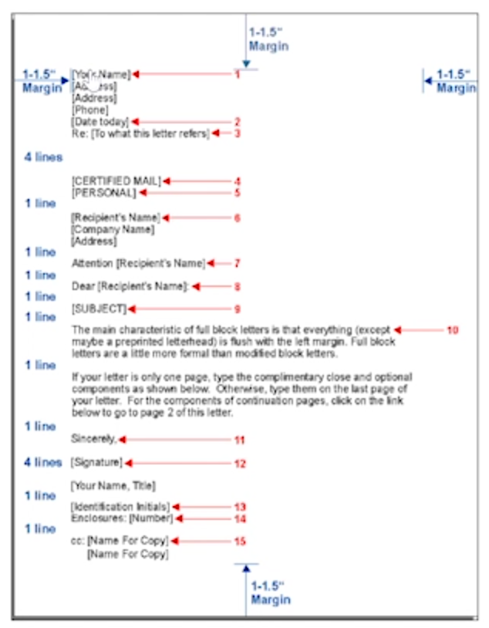
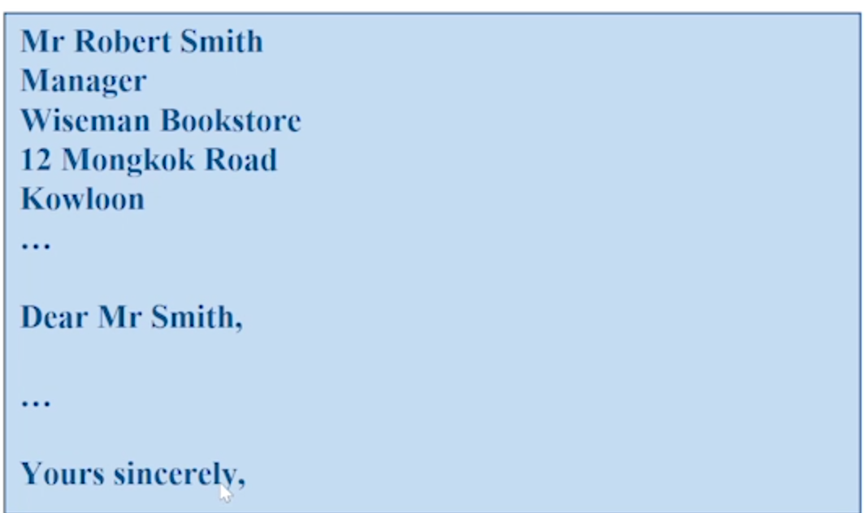
Format
Full block
Mixed punctuation

Slide 14
Thanks
Thanks again for giving me this opportunity to learn effective communication skills in English.

