Slide 1
BUS S103 Oral Presentation
S12363662 Chong Wing Wong
Thanks for giving me this opportunity to present my assignment.

Slide 2

A request for approval letter to chair of the board of directors
Planning the message
Identity the purpose
Analyze the audience
Research for information
Writing the message
Opening
Middle
Closing
Letter Structure
Layout
Format

Slide 3
Planning the message

Slide 4


Identity the purpose
🎯 Desired audience response
Approve budget amounting HK$500,000 for this project.
✉️ Communication channel
A formal Business Letter make the request official and can be documented as evidence later down the line.
📅 Accomplishment date
Next month

Slide 5
Analyze the audience
Sender
Rebecca Lee, the Marketing Director of Modern Furniture Company
Primary audience
Gordon Yu, the Chair of the Board of Directors of the Modern Furniture Company.
Initial audience
Secretary of Gordon Yu.
Secondary audience
Other directors of the Modern Furniture Company.
Watchdog
ADD Research Consultancy
Gordon is a senior management and we are seeking for his approval of the project.
Use a positive attribute and a formal tone for this letter.
Pinpoint the project revenue.

Slide 6
Research for the information
ADD Research Consultancy is a famous market research company
ADD Research Consultancy advise that a new advertising slogan and some online promotional campaigns on social media will increase the sales volume by 30%.
An advertisement survey found that 68% companies will increase their social media advertising.

Slide 7
Writing the message

Slide 8

Opening
Self introduction.
State exactly what sender is seeking approval for.
New advertising slogan
Social media campaign
And the outcome
At least 30% increase of sales volume

Slide 9
Middle
Provide the details
What is the new slogan
Christmas social media campaign
Mention that we are partner with ADD Research Consultancy, a famous market research company.
Emphasize how well the new project fits the new remote work situation.
Emphasize the innovative aspects of the new project.
Provide survey result to suggest that we must act fast or competitors may get ahead of the competition.

Slide 10
Closing
Action item, to approve the budget of HK$500,000
Provide a deadline.
Provide addition contact method.

Slide 11
Letter Structure

Slide 12

Layout
Return address
Organization’s name & address
Date
Attention line
Full name & Job title of the receiver
Receiver’s organization name & address
Salutation
Subject line
Content
Opening
Middle
Closing
Complimentary close
Signature
Identification line

Slide 13
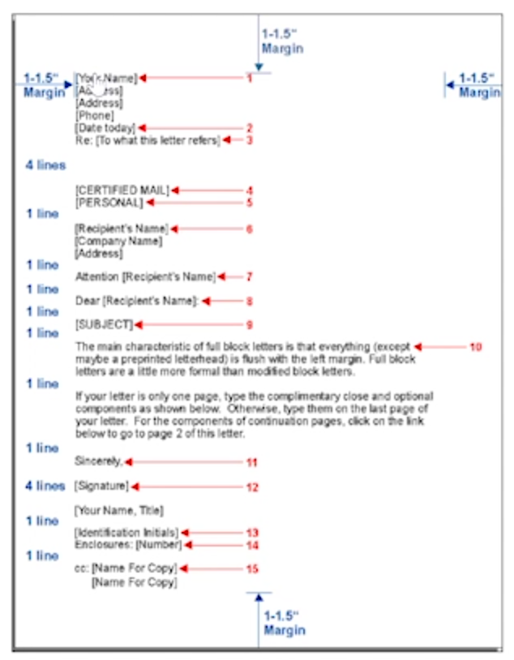
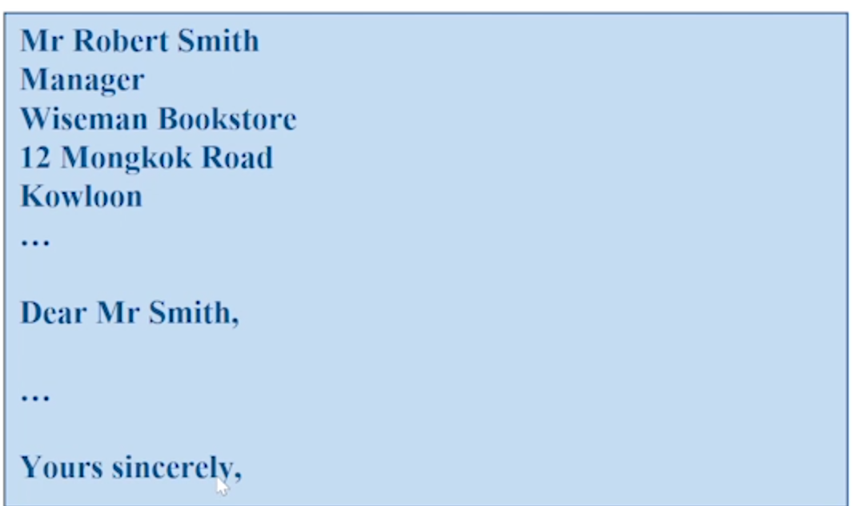
Format
Full block
Mixed punctuation

Slide 14
Thanks
Thanks again for giving me this opportunity to learn effective communication skills in English.

