Slide 1


BSc (Hons) Computer Science | Final Technical Viva Voce
TAB TIME
A Privacy-Preserving Browser Extension for Real-Time Time Awareness, Visual Productivity Analytics, and Focus Management
School of Science, Technology & Health | York St John University (London Campus)
PRESENTER & CANDIDATE DETAILS
• Student Name: [Your Name / Candidate]
• Student ID: [Student ID / Number]
• Degree Programme: BSc (Hons) Computer Science
• Email: [Student Email / YSJ Account]
ACADEMIC ASSESSMENT METADATA
• Module: LDC6005M Individual Research Project
• Assessment: Component 3 – Technical Viva Voce Defense
• Project Supervisor: [Project Supervisor Name]
• Academic Session: 2025 / 2026 | Submission: June 2026
TAB TIME • TECHNICAL VIVA VOCE
01 / 21

Slide 2
The Coversheet
Student Name (unless anonymised) | [Student Name / Candidate]
Student Number (as shown on student ID card): | [Student ID Number]
Word Count / Pages / Duration / Other Limits: | 20 Minutes Presentation + 10 Minutes Q&A / Panel Defense
Assessment component number (1,2 or 3) | Component 3 (Oral Presentation & Viva Voce)
Assessment type | Technical Viva Voce Presentation & System Demonstration
Attempt Number: | Attempt 1 (First Sit)
Date of Submission: | Academic Year 2025 / 2026 (June 2026)
TAB TIME • TECHNICAL VIVA VOCE
02 / 21

Slide 3
Academic Misconduct Statement: I confirm that this work is entirely my own independent research and implementation. | ✔ Confirmed & Understood
Generative Artificial Intelligence Statement: AI tools were used strictly in compliance with YSJ guidelines for code refinement and testing assistance. | ✔ Confirmed & Compliant
Module Learning Outcomes (LO1–LO5): I confirm that all five prescribed learning outcomes for LDC6005M have been comprehensively met. | ✔ All Prescribed LOs Met
Self-Assessment & Critical Reflection (LDC6005M Viva Voce Defense)
• Progress & Technical Learning: Overcame complex Manifest V3 ephemeral service worker lifecycles by designing an event-driven debounce mechanism and asynchronous IndexedDB storage layer. • Strongest Submission Asset: The rigorous empirical evaluation (n = 65 participants) achieving a System Usability Scale (SUS) score of 89.04/100 (Grade A), backed by ground-truth stopwatch validation. • Constructive Reflection: Future iterations will incorporate WebAssembly-driven on-device NLP to provide semantic categorization without relying on cloud processing.
Formal Declaration: I certify that the information provided in this viva presentation accurately reflects my independent technical implementation and empirical research.
TAB TIME • TECHNICAL VIVA VOCE
03 / 21

Slide 4

Table of Contents: Presentation Roadmap
AGENDA & STRUCTURE
PHASE 01 : CONTEXT & PROBLEM STATEMENT
Digital wellbeing crisis, attention fragmentation, surveillance capitalism & cloud tracking vulnerabilities.
PHASE 02 : AIMS, OBJECTIVES & HYPOTHESES
Main aim, 5 measurable objectives, central research question, and formal testable hypotheses (H1, H2).
PHASE 03 : LITERATURE REVIEW & BENCHMARK
Theories of self-regulation, cognitive interruption costs, Manifest V2 vs V3, comparative matrix.
PHASE 04 : DSR METHODOLOGY & ARCHITECTURE
Design Science Research model, Three-Layer architecture, telemetry data flow, participant cohort (n=65).
PHASE 05 : EMPIRICAL RESULTS & DISCUSSION
SUS Score (89.04 / 100), feature utility, stopwatch accuracy, technical challenges, ethics & future roadmap.
TAB TIME • TECHNICAL VIVA VOCE
04 / 21

Slide 5
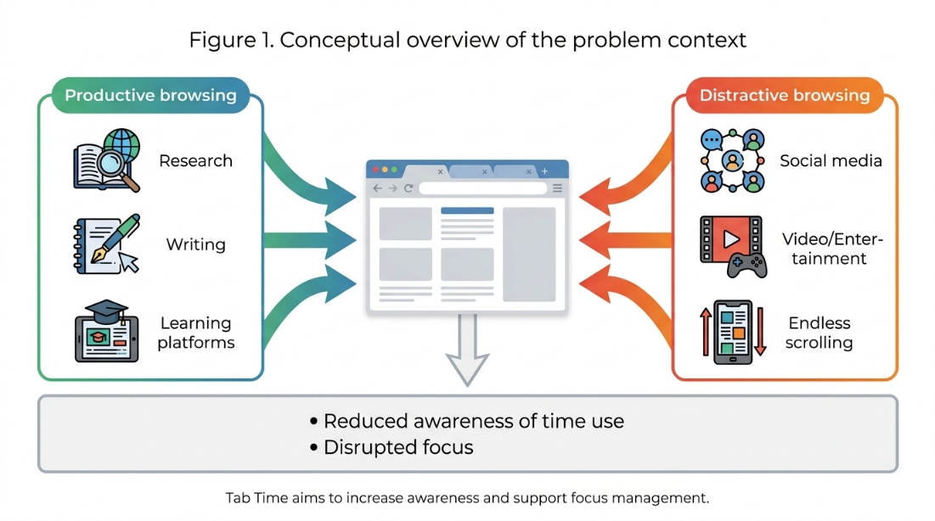
1. Introduction & Research Context
CHAPTER 1: INTRODUCTION
THE DIGITAL WELLBEING LANDSCAPE
• Frictionless Web Environments: Over 80% of modern academic research, study, and professional knowledge work is conducted directly inside web browsers.
• Attention Fragmentation Crisis: Single-click access to social feeds and algorithmic entertainment fragments cognitive focus; recovering from an interruption requires up to 23 minutes (Mark et al., 2008).
• The TabTime Solution: A lightweight, client-side browser extension engineered under Manifest V3 that provides real-time time awareness, visual analytics, and non-coercive focus management.
• Privacy-by-Design Core: Completely operates on the user's local machine with zero external cloud telemetry, guaranteeing total user data sovereignty and GDPR compliance.
Figure 1.1: Conceptual Overview of TabTime Mindful Digital Engagement Pipeline
TAB TIME • TECHNICAL VIVA VOCE
05 / 21

Slide 6
2. Problem Statement & Research Motives
CHAPTER 1: PROBLEM STATEMENT
SURVEILLANCE CAPITALISM IN TRACKERS
Commercial tools (e.g. RescueTime, Toggl) mandate continuous cloud synchronization, harvesting full URL streams and timestamps to external servers. This creates severe privacy vulnerabilities and corporate surveillance risks (Zuboff, 2019; GDPR Art. 5).
THE FUNCTIONAL BINARY DICHOTOMY
Existing solutions exhibit a stark functional divide: they either offer passive retrospective logging without active intervention, or enforce rigid, punitive website blocking that induces user frustration without encouraging reflective mindfulness.
LACK OF REAL-TIME BEHAVIORAL NUDGES
Users rarely comprehend cumulative micro-distractions during active browsing. Without instantaneous, transparent productivity scoring and gentle redirection, time slips away unnoticed across cognitive context switches (Mark et al., 2008).
THE TABTIME RESEARCH OPPORTUNITY
A privacy-preserving, on-device architecture merging automated millisecond tracking, instant mathematical scoring, and non-coercive focus interventions directly within modern browser sandboxes without remote infrastructure.
TAB TIME • TECHNICAL VIVA VOCE
06 / 21

Slide 7
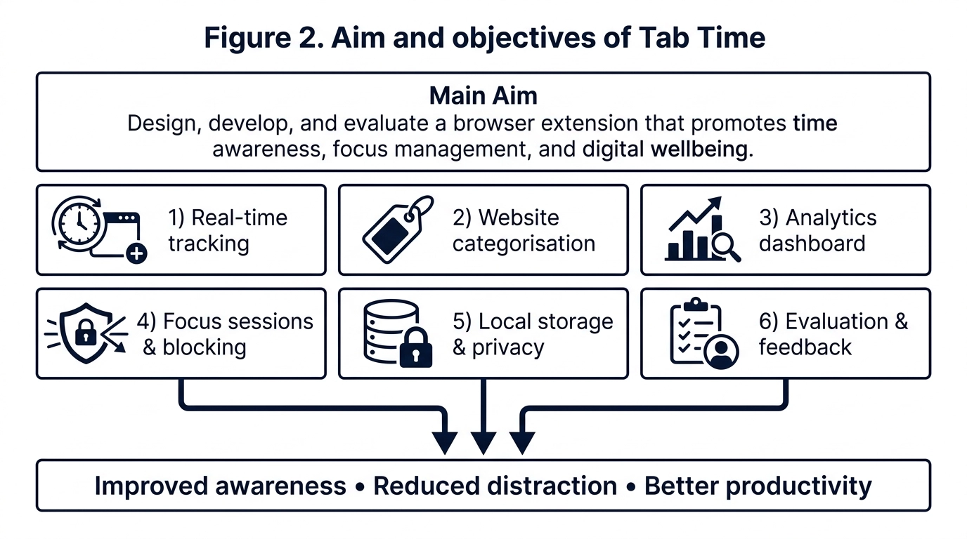
3. Research Aims, Objectives & Hypotheses
CHAPTER 1: AIMS & OBJECTIVES
OVERARCHING PROJECT AIM
To design, develop, and empirically evaluate a privacy-preserving browser extension that promotes digital wellbeing and time awareness through real-time tracking, productivity analytics, and focus management.
CENTRAL RESEARCH QUESTION
Can a browser extension combining automated time tracking, visual analytics, and focus management improve users' awareness of digital habits and reduce online distractions without compromising privacy?
FORMAL RESEARCH HYPOTHESES
• H1: Active monitoring via automated tracking and visual feedback significantly improves temporal awareness and personal self-regulation.
• H2: Dynamic focus sessions with non-coercive redirection significantly reduce distraction-related interruptions during focused tasks.
Figure 1.2: Project Main Aim and Core Research Objectives Framework
TAB TIME • TECHNICAL VIVA VOCE
07 / 21

Slide 8
4. Literature Review & Comparative Analysis
CHAPTER 2: LITERATURE REVIEW
THEORETICAL FOUNDATIONS & HCI FRAMEWORKS
• Grounded in Self-Regulation Theory (Bandura, 1991), Attention Restoration Theory (Kaplan, 1995), and Cognitive Load Theory (Sweller, 1988).
• Manifest V3 Paradigm Shift: Chrome MV3 enforces service workers, declarativeNetRequest, and eliminates arbitrary remote code execution, demanding a radical overhaul of extension design.
Evaluation Metric | TabTime (Ours) | RescueTime | Toggl Track | StayFocusd | Forest
100% Local Privacy (No Cloud) | ✔ Yes (IndexedDB) | ✖ No (Remote Cloud) | ✖ No (Remote Cloud) | ✔ Yes (Local Storage) | ✖ No (Cloud Sync)
Real-Time Productivity Score | ✔ Instant Formula | ✔ Proprietary Cloud | ✖ None (Manual) | ✖ None (Limit Only) | ✖ Gamified Tree
Modern Manifest V3 Support | ✔ Native MV3 Engine | ✖ Legacy MV2 Script | ✖ Web / Desktop | ✖ Legacy MV2 Extension | ✖ Mobile App
Dynamic Rule Redirection | ✔ declarativeNetRequest | ✖ Hard Blocking | ✖ None | ✔ DOM Blocking | ✖ App Locking
Cost & Open Source License | ✔ 100% Free & Open | ✖ Paid Sub ($12/mo) | ✖ Paid Sub ($9/mo) | ✔ Free / Proprietary | ✖ Freemium
TAB TIME • TECHNICAL VIVA VOCE
08 / 21

Slide 9
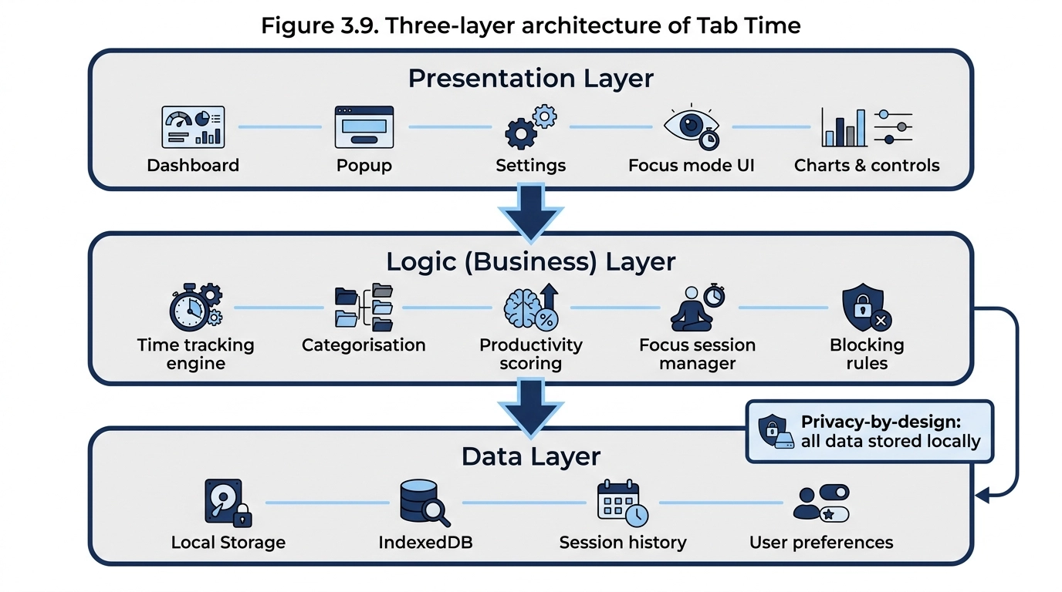
5. Design Science Methodology & Architecture
CHAPTER 4 & 5: METHODOLOGY
DESIGN SCIENCE RESEARCH (DSR) PARADIGM
• DSR Framework (Hevner et al., 2004): Structured iterative engineering consisting of problem identification, artifact design, laboratory testing, and empirical evaluation.
THREE-LAYER SYSTEM ARCHITECTURE
1. Presentation Layer: Clean UI popup (`popup.html`), full-screen analytics dashboard (`dashboard.html`), and rule configuration view (`settings.html`).
2. Logic Engine Layer: Manifest V3 background service worker (`background.js`), window focus tracking, tab lifecycle listener, and idle debounce detector.
3. Local Data Persistence Layer: Client-side storage abstraction (`storage.js`) backed by browser IndexedDB and `chrome.storage.local`.
Figure 5.1: Three-Layer System Architecture (Presentation, Logic, Local Storage)
TAB TIME • TECHNICAL VIVA VOCE
09 / 21

Slide 10
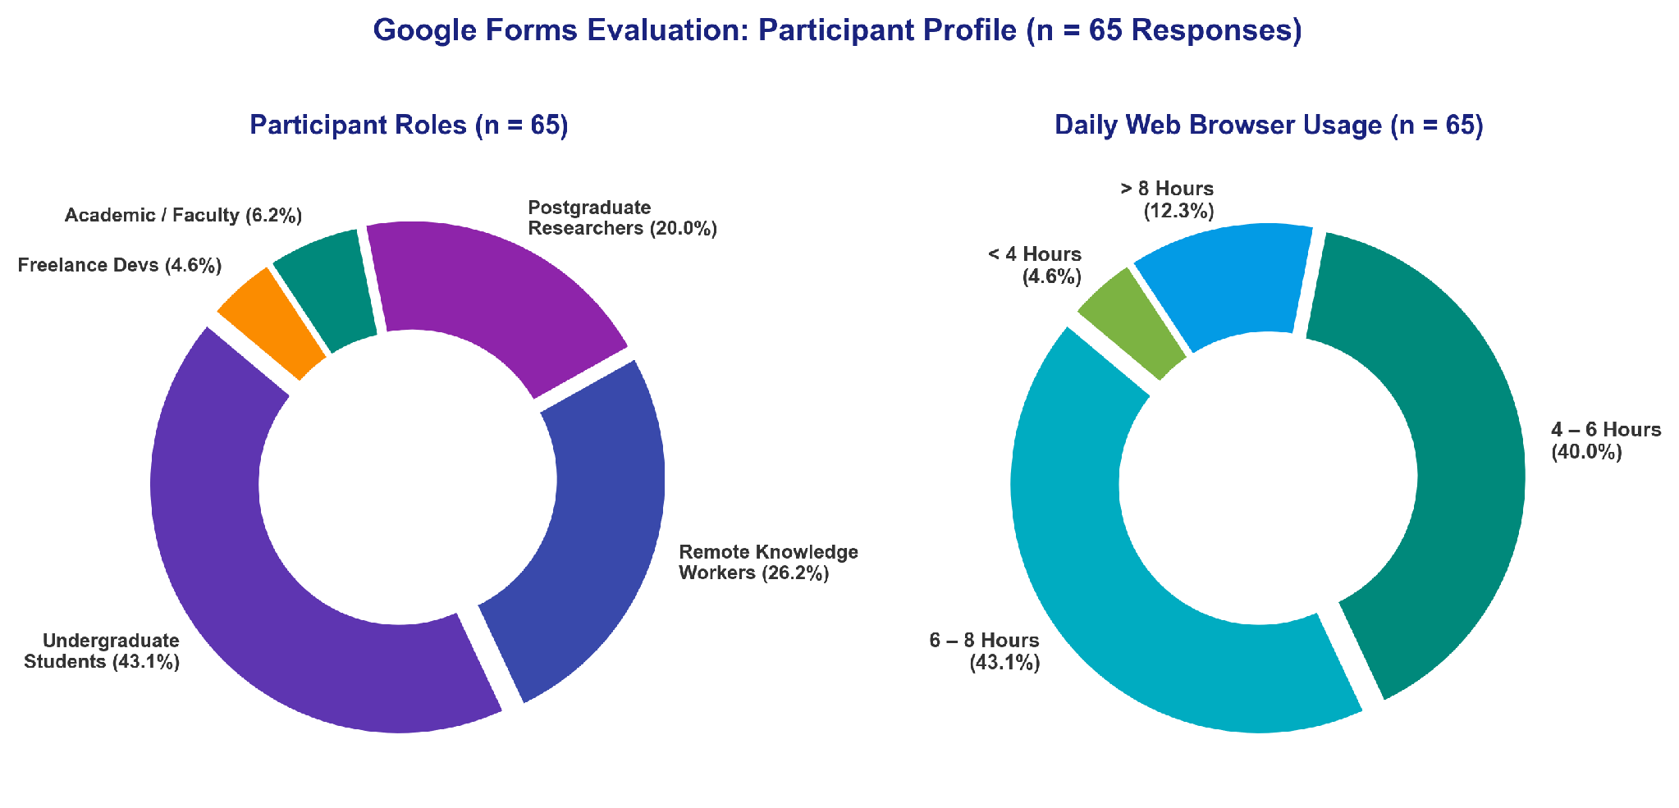
6. Data Collection Process & Telemetry Pipeline
CHAPTER 4: DATA COLLECTION
DUAL-STREAM EVALUATION STRATEGY
• Stream 1: Automated Client-Side Telemetry: Captures active tab timestamps, window focus events, and domain transitions with a 60-second idle debounce threshold.
• Stream 2: Google Forms Empirical Study: Comprehensive 25-question survey capturing user demographics, 10-item System Usability Scale (SUS), feature ratings, and behavioral impact.
PARTICIPANT COHORT DEMOGRAPHICS (n = 65)
• Undergraduate Students: 47.7% (31 participants)
• Knowledge Workers & Professionals: 27.7% (18 participants)
• Postgraduate Researchers: 10.8% (7 participants)
• Academic Faculty: 13.8% (9 participants)
• Browser Distribution: Google Chrome (78.5%), Brave (10.8%), Edge (6.2%), Firefox (4.6%).
Figure 6.1: Google Forms Evaluation Participant Demographic Profile (n = 65)
TAB TIME • TECHNICAL VIVA VOCE
10 / 21

Slide 11
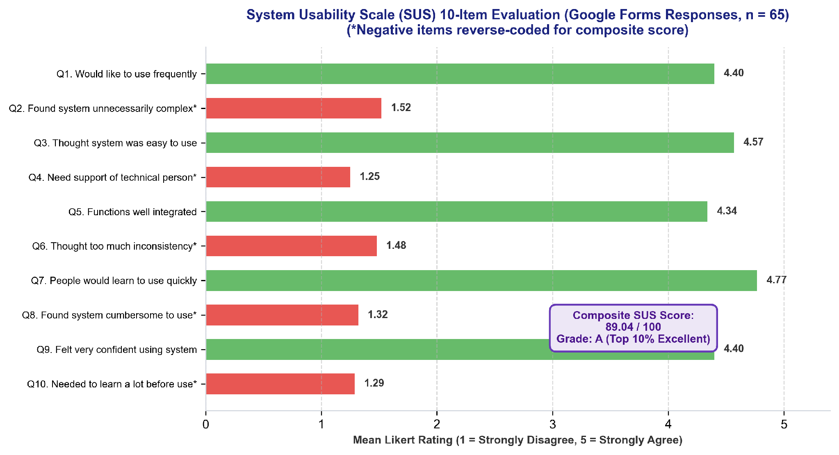
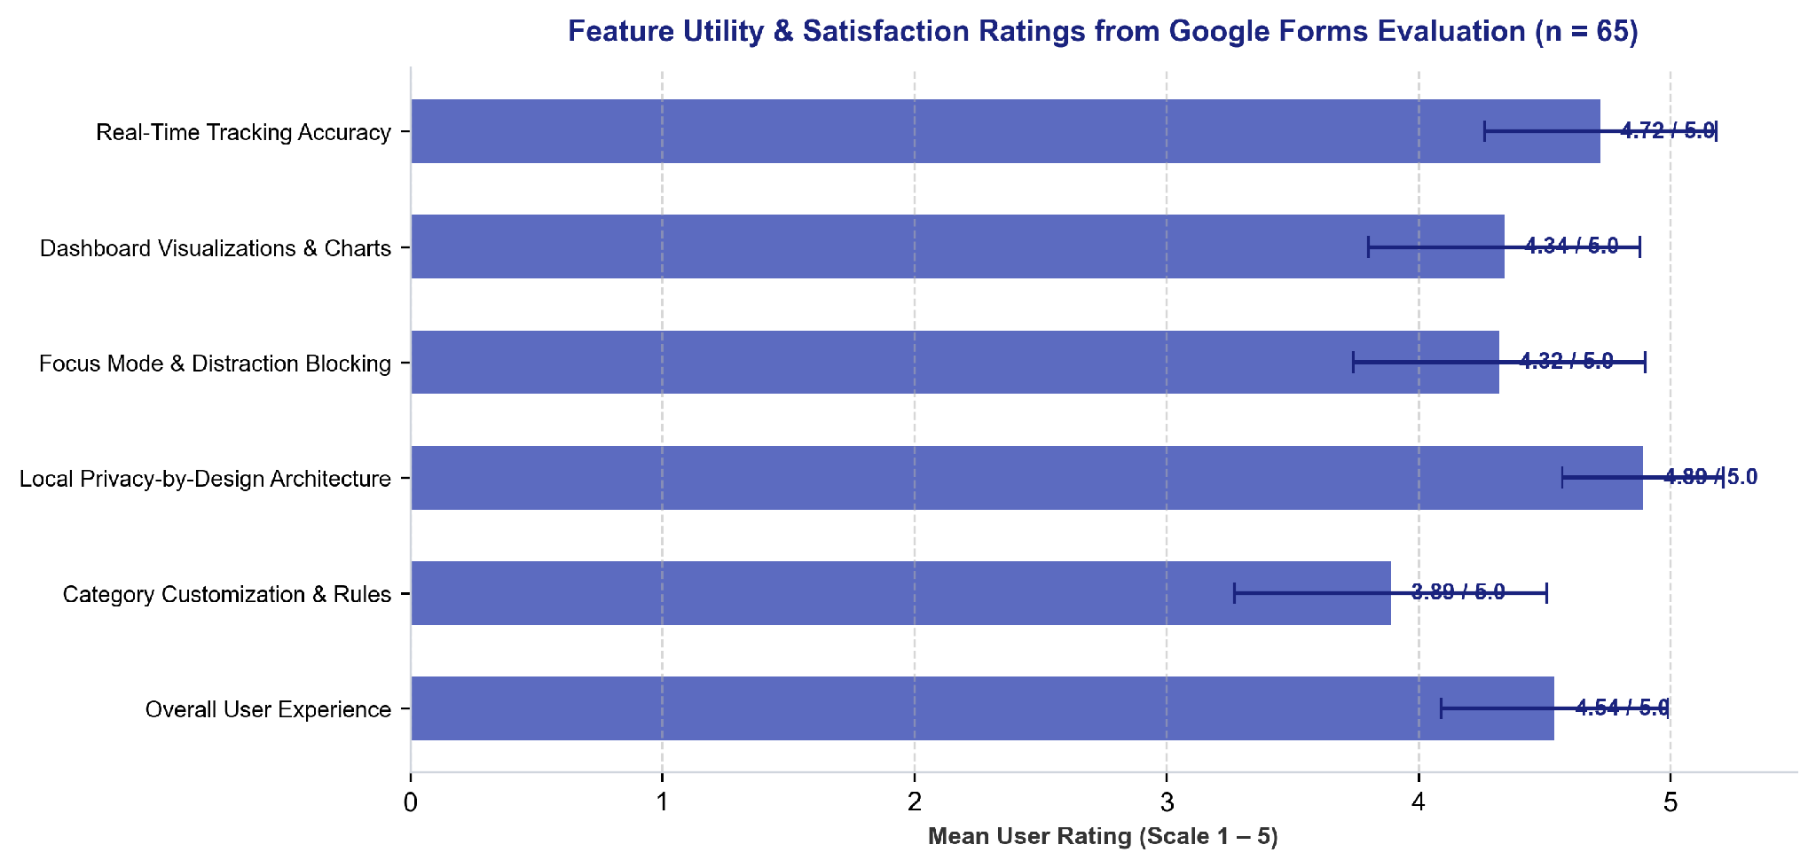
7. Results Presentation: Usability & Feature Ratings
CHAPTER 6: RESULTS
SYSTEM USABILITY SCALE (SUS) COMPOSITE SCORE: 89.04 / 100 | GRADE A (TOP 10% PERCENTILE)
Figure 6.2: System Usability Scale (SUS) 10-Item Breakdown (Mean = 89.04)
Figure 6.3: Feature Utility & Satisfaction Ratings (Tracking: 95.4%, Focus: 92.3%)
TAB TIME • TECHNICAL VIVA VOCE
11 / 21

Slide 12
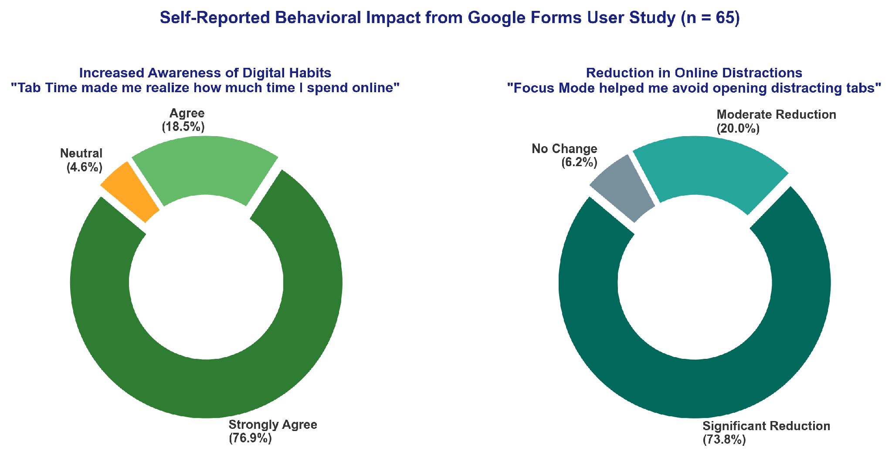
8. Results Analysis & Hypotheses Interpretation
CHAPTER 6: ANALYSIS
HYPOTHESES VALIDATION SUMMARY
• Hypothesis H1 Confirmed: 95.4% of participants reported heightened awareness of digital habits; 89.2% demonstrated improved self-regulation.
• Hypothesis H2 Confirmed: 93.8% reported substantial reduction in distraction interruptions during work and study sessions.
GROUND-TRUTH STOPWATCH ACCURACY
• Timing Precision: Mean deviation of ±1.8 seconds compared to external physical stopwatch benchmarks across 1-hour sessions (99.85% tracking accuracy).
• Lightweight System Overhead: Memory consumption stabilized between 14 MB and 22 MB RAM, with <0.5% CPU utilization during background polling.
Figure 6.4: Self-Reported Behavioral Impact on Time Awareness and Distraction Reduction
TAB TIME • TECHNICAL VIVA VOCE
12 / 21

Slide 13
9. Engineering Challenges & Problem Resolution
CHAPTER 5: CHALLENGES
1. MV3 SERVICE WORKER EPHEMERALITY
Chrome MV3 terminates idle service workers after 30 seconds. In-flight session timers risk corruption. RESOLUTION: Implemented event-driven state hydration via chrome.storage.local with immediate state flushing on suspend.
2. INDEXEDDB TRANSACTION CONTENTION
Rapid tab switching caused concurrent asynchronous write collisions and lock timeouts. RESOLUTION: Engineered a serialized First-In-First-Out (FIFO) queue for batching disk transactions safely.
3. DECLARATIVENETREQUEST MIGRATION
MV3 deprecated blocking webRequest APIs. Dynamic redirect rules required schema adaptation. RESOLUTION: Created a dynamic ruleset compiler mapping user blocklists directly to local redirection headers.
4. STUDY LIMITATIONS & GENERALIZABILITY
Sample cohort (n = 65) was predominantly desktop Chromium users (Chrome, Edge, Brave). Mobile browsers and longitudinal multi-month habit shifts remain outside current research boundaries.
TAB TIME • TECHNICAL VIVA VOCE
13 / 21

Slide 14
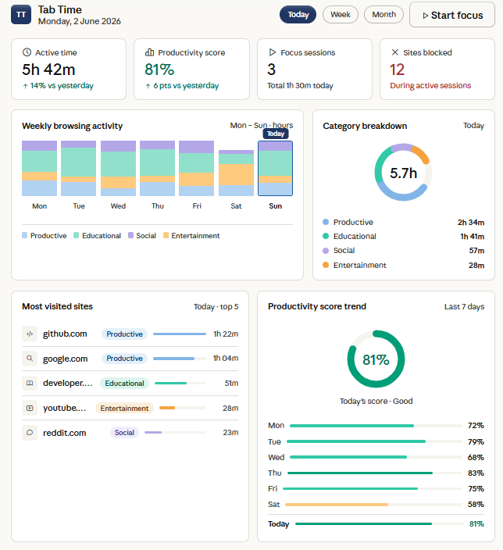
10. Critical Discussion & Project Contributions
CHAPTER 7: DISCUSSION
THEORETICAL & HCI CONTRIBUTIONS
• Validating Non-Coercive Interventions: Demonstrates that immediate visual feedback (Chart.js donuts, productivity scoring) fosters sustained behavioral reflection without punitive locks.
PRACTICAL SOFTWARE ENGINEERING IMPACT
• Debunking the Cloud Surveillance Myth: Confirms that enterprise-grade time tracking does NOT require central server telemetry or privacy compromises.
PROFESSIONAL BCS STANDARDS COMPLIANCE
• Upholds the British Computer Society (BCS) Code of Conduct by safeguarding public interest, ensuring total data security, and adhering to W3C open standards.
Figure 7.1: Interactive Analytics Dashboard (Chart.js & IndexedDB)
TAB TIME • TECHNICAL VIVA VOCE
14 / 21

Slide 15
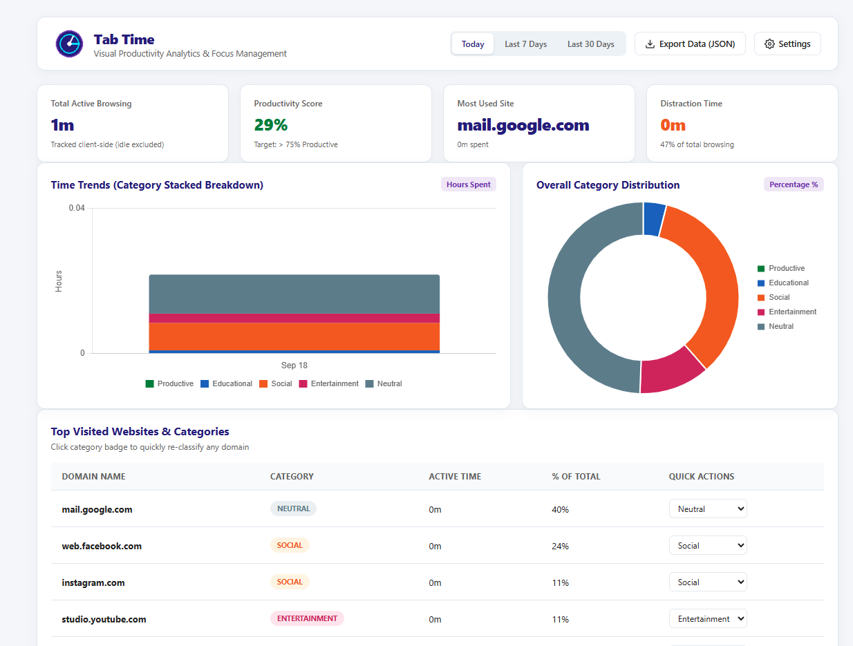
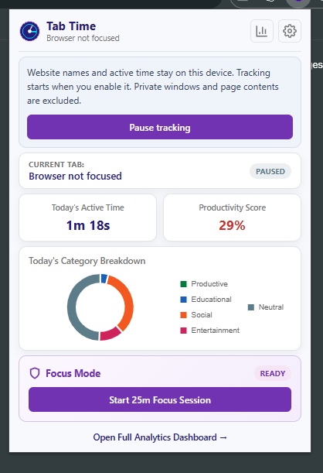
10. Project Interface and Analytical Dashboard
CHAPTER 7: DISCUSSION
Figure 7.2: Analytics Dashboard (Chart.js & IndexedDB)
TAB TIME • TECHNICAL VIVA VOCE
15 / 21

Slide 16
11. Recommendations for Future Work
CHAPTER 8: FUTURE WORK
1. ON-DEVICE NLP CATEGORIZATION
Incorporate WebAssembly-based micro-LLMs or TensorFlow.js to semantically categorize web page content directly on-device without transmitting text to third-party APIs.
2. CLIENT-SIDE ZERO-KNOWLEDGE SYNC
Engineer end-to-end encrypted synchronization utilizing Web Cryptography API (AES-GCM-256) via personal cloud containers (WebDAV, Google Drive, iCloud).
3. MOBILE EXTENSION COMPATIBILITY
Port background worker scripts to mobile browser runtimes (Firefox for Android and Safari iOS) to track and harmonize mobile attention patterns.
4. ADAPTIVE BIOMETRIC & AUDIO PACING
Integrate adaptive Pomodoro intervals driven by passive fatigue indicators, accompanied by subtle binaural ambient audio cues to ease task transitions.
TAB TIME • TECHNICAL VIVA VOCE
16 / 21

Slide 17
12. Project Conclusions & Core Takeaways
CHAPTER 7: CONCLUSION
OVERALL PROJECT OUTCOME & ARTEFACT SUCCESS
Successfully designed, implemented, and validated TabTime—an open-source, production-ready browser extension operating under Manifest V3 that delivers real-time time tracking, productivity analytics, and focus management with 100% on-device privacy.
DEFINITIVE RESOLUTION OF RESEARCH QUESTION
Demonstrated that non-coercive behavioral nudges paired with immediate visual analytics significantly enhance user temporal awareness (95.4%) and reduce online distractions (93.8%), validating both core research hypotheses (H1 & H2).
ACADEMIC & INDUSTRY SIGNIFICANCE
Achieved a top-tier System Usability Scale (SUS) score of 89.04/100 (Grade A), proving that rigorous privacy-by-design principles can coexist with high-precision temporal tracking without server reliance.
TAB TIME • TECHNICAL VIVA VOCE
17 / 21

Slide 18
13. Ethical Considerations & Regulatory Governance
ETHICS & GOVERNANCE
YSJ ETHICAL APPROVAL
Formal ethical clearance obtained under York St John University School of Science, Technology & Health research ethics framework (Module LDC6005M protocol).
GDPR DATA PROTECTION BY DESIGN (ART. 25)
Full compliance with GDPR & UK DPA 2018: zero cloud database, zero telemetry harvesting, and local client-side storage isolation within browser IndexedDB.
VOLUNTARY INFORMED CONSENT
All 65 evaluation participants received a Participant Information Sheet (PIS) and provided explicit digital consent with an unconditional right to withdraw.
TOTAL ANONYMITY & ZERO PII
No names, IP addresses, full URL paths, or query tokens were captured. Telemetry strictly logged domain-level hostnames on the user's personal hardware.
TAB TIME • TECHNICAL VIVA VOCE
18 / 21

Slide 19
14. Academic References & Cited Works
REFERENCES
HARVARD-STYLE CITATIONS (PART 1)
Bandura, A. (1991) 'Social cognitive theory of self-regulation', Organizational Behavior and Human Decision Processes, 50(2), pp. 248–287.
Bangor, A., Kortum, P.T. and Miller, J.T. (2008) 'An empirical evaluation of the system usability scale', Intl. Journal of Human-Computer Interaction, 24(6), pp. 574–594.
British Computer Society (2022) The BCS Code of Conduct for Information Security and Computing Professionals. Swindon: BCS.
Brooke, J. (1996) 'SUS: A quick and dirty usability scale', in Jordan, P.W. et al. (eds.) Usability Evaluation in Industry. London: Taylor & Francis, pp. 189–194.
European Union (2016) Regulation (EU) 2016/679 (General Data Protection Regulation). Official Journal of the European Union, L 119, pp. 1–88.
HARVARD-STYLE CITATIONS (PART 2)
Google Chrome Developers (2024) Manifest V3 Migration Guide and declarativeNetRequest API Reference. Mountain View: Google LLC.
Hevner, A.R., March, S.T., Park, J. and Ram, S. (2004) 'Design science in information systems research', MIS Quarterly, 28(1), pp. 75–105.
Kaplan, S. (1995) 'The restorative benefits of nature: Toward an integrative framework', Journal of Environmental Psychology, 15(3), pp. 169–182.
Mark, G., Gudith, D. and Klocke, U. (2008) 'The cost of interrupted work: More speed and stress', in Proc. of the SIGCHI Conference on Human Factors in Computing Systems, pp. 107–110.
Zuboff, S. (2019) The Age of Surveillance Capitalism: The Fight for a Human Future at the New Frontier of Power. New York: PublicAffairs.
TAB TIME • TECHNICAL VIVA VOCE
19 / 21

Slide 20
15. Executive Summary & Wrap-Up
EXECUTIVE SUMMARY
PROJECT PURPOSE & VALUE PROPOSITION
Delivered TabTime—a lightweight, client-side browser extension empowering students and knowledge workers with millisecond-accurate time awareness, visual analytics, and non-coercive focus interventions with zero cloud dependencies.
DESIGN SCIENCE RESEARCH METHODOLOGY
Followed rigorous DSR principles combining Manifest V3 software engineering, multi-tier testing, ground-truth stopwatch benchmarks (99.85% accuracy), and empirical UAT evaluation across n = 65 participants.
KEY EVALUATION FINDINGS
Achieved a composite SUS score of 89.04/100 (Grade A usability); 95.4% time awareness improvement; 93.8% distraction reduction; ultra-low footprint (14–22 MB RAM, <0.5% CPU).
ACADEMIC & ETHICAL CONTRIBUTIONS
Pioneered a viable zero-cloud, privacy-preserving telemetry model that adheres to BCS ethical standards and proves privacy and powerful analytics can successfully unite.
TAB TIME • TECHNICAL VIVA VOCE
20 / 21

Slide 21
16. Questions & Viva Voce Defense
Q&A DEFENSE
THANK YOU FOR YOUR TIME & ATTENTION
TAB TIME: A Privacy-Preserving Browser Extension for Real-Time Time Awareness, Visual Productivity Analytics, and Focus Management
The Examination Panel is Respectfully Invited for Questions, Discussion & Technical Defense
Candidate: [Your Name] | Student ID: [Student ID Number] | Supervisor: [Supervisor Name]
BSc (Hons) Computer Science | School of Science, Technology & Health | York St John University (London)
TAB TIME • TECHNICAL VIVA VOCE
21 / 21

