Slide 1





Duck
EscaPe
Team D
Presented By:
Gururaj Somanna Dhruva Lokesh
Sravan Chowdary Gogineni

Slide 2
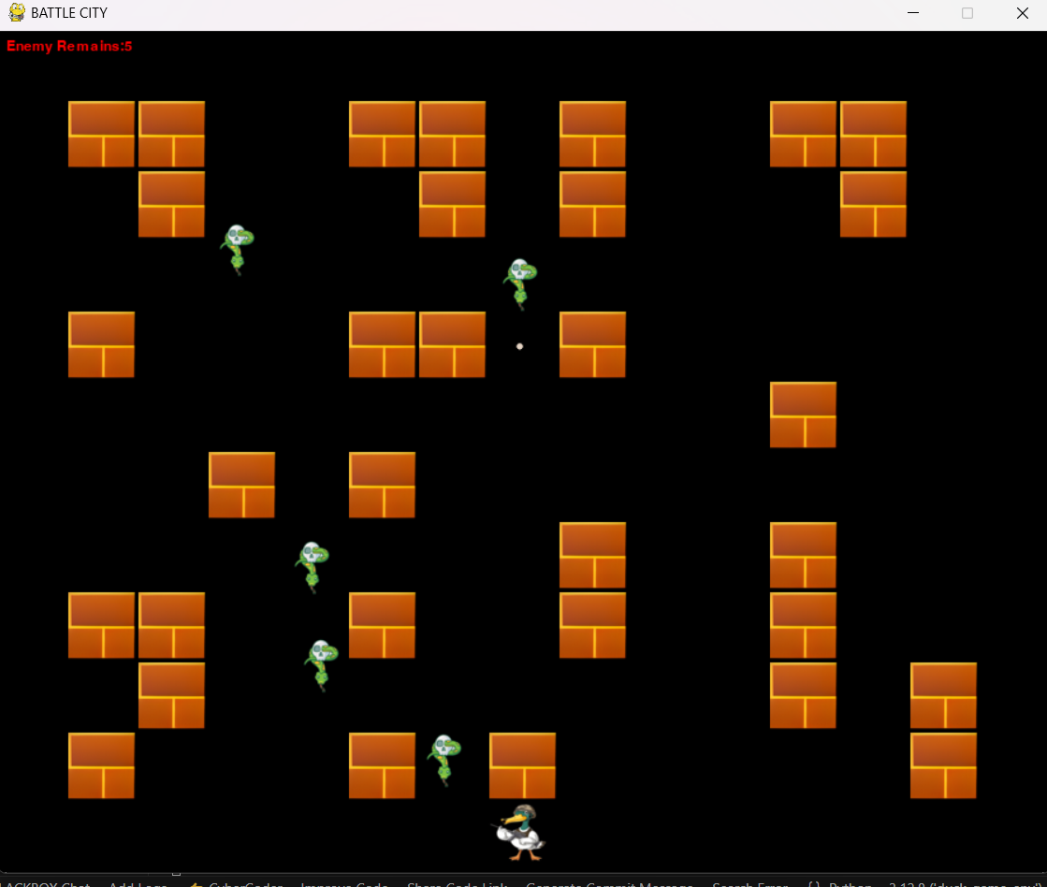
ProÉect
DescriPtion
Duck Escape is a multi-directional shooter video game for the Family Computer produced and published in 1985 by Namco. It is a successor to Namco's 1980 Tank Battalion and would be succeeded by the 1991 Tank Force.
The Game itself is based on NES(Nintendo Entertainment System)

Slide 3



Statement of ProÉect ObÉectives
01 02 03
Provide intriguing
an gaming
Establish in
Design challenging levels and enemy behaviors
To keep players interested, provide a sequence of increasingly difficult levels with various adversary tactics. To make things harder and give players a sense of advancement, add new enemies and tasks.
Place
and
resPonsive seamless
exPerience
controls
Create a multidirectional, easy-to- use shooting game in which players take control of a duck to shoot adversaries, dodge obstacles, and live as long as possible. While keeping a demanding pace to keep players interested, the game should include easy-to-use controls to make it accessible to players of all ages.
Create controls that are responsive and easy to use so that players can move the duck through a field of opponents and brick barriers with ease. This will improve user happiness and the overall gaming experience.

Slide 4
Original
APProaches
Random directions
ScriPts
Limited by the NES machine.
Limited by the chip.
Hand-coded events
Limit Flexibility based on waypoints
Our APProaches
A* search
Heuristic - Manhattan distance
Construct a possible route for the agent(enemy snakes) We need to do a limited A* search –
The world(map) set up and the search algorithm make the calculation costly
Limit the number of runs can improve the framerate

Slide 5
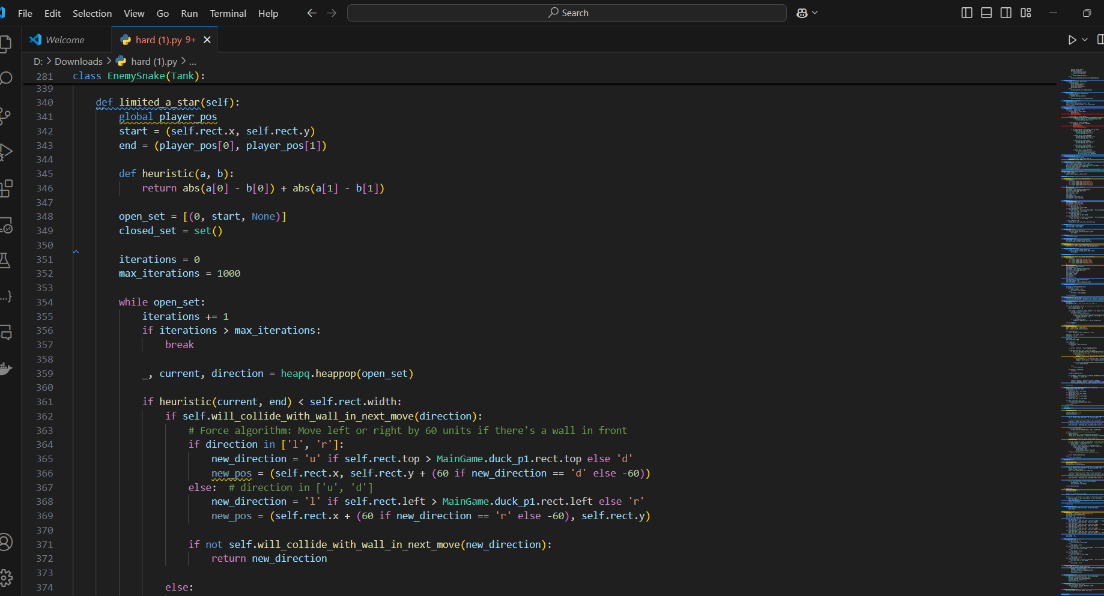
implementationof A*algorithm

Slide 6
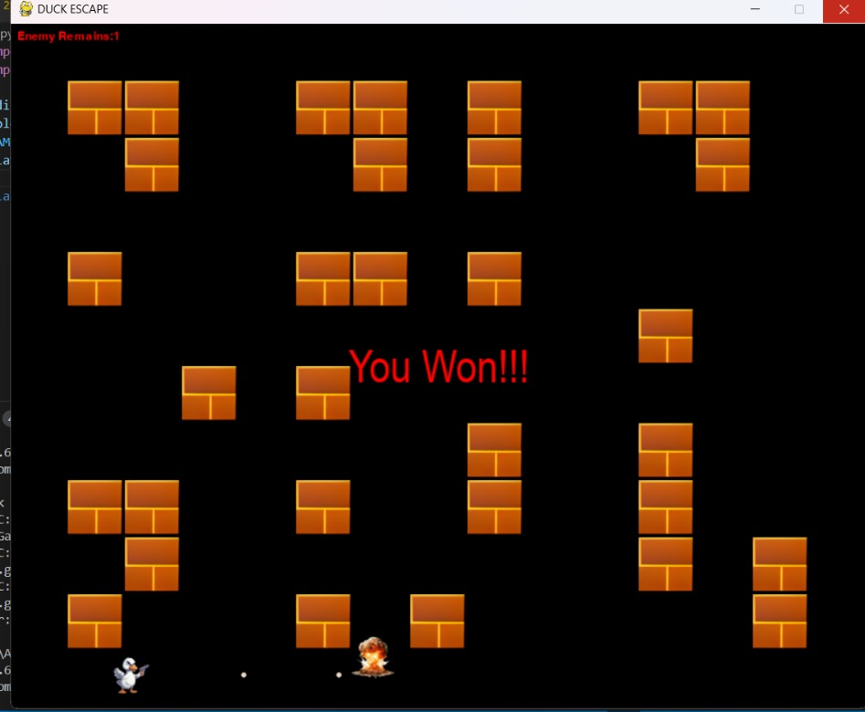
Results

Slide 7
Future Enhancements
Implement Reinforcement learning
A comprehensive document that acts as a blueprint for the development process
Designing an approach when the enemy snakes do not know the
position of the player duck.
Apply MDP and scoring to improve agent(enemy snakes) performance
Add back more elements to the game(eagle, snake, destructible obstacles, etc.)
Makes every enemy snake do a double limited A* search for a more diverse attack route.

Slide 8
Methodology
Evaluation
TESTING FOR USABILITY | Make sure the controls and game interface are simple to use and accessible.
GAMEPLAY TESTING | Evaluate the controls, gaming mechanics, and general user experience.
TESTING OF PERFORMANCE | Focus on frame rate, load times, and resource efficiency to guarantee fluid gaming on all devices and screen sizes.
ERROR AND BUG EXAMINING | Find and fix any issues that are interfering with gameplay or the graphics.
METRICS FOR USER ENGAGEMENT AND SATISFACTION | Assess game replay ability, player satisfaction, and engagement levels.

Slide 9
THANKS

