Slide 1

IMDB 1000 Movies
by Yogesh Chandra

Slide 2
1. Introduction
Data science is a multidisciplinary blend of data inference, algorithm development, and technology in order to solve analytically complex problems.
In response to this massive influx of data, the field of Data Science has come to the forefront in the past decade. Cobbled together by people from a diverse array of fields statistics, physics, computer science, design, and many more . The field of Data Science represents our collective desire to understand and harness the abundance of data around us to build a better world.

Slide 3
Data Loading and Description
- Data set of 1,000 most popular movies on IMDB in the last 10 years. The data fields included are:
Rank, Title, Genre, Description, Director, Actors, Year, Runtime, Rating, Votes, Revenue, Metascrore
- The dataset comprises of 1000 observations of 12 columns. Below is a table showing names of all the columns and their description.

Slide 4
Rank - Movie rank order
Title - The title of the film
Genre - A comma-separated list of genres used to classify the film
Description - Brief one-sentence movie summary
Director - The name of the film's director
Actors - A comma-separated list of the main stars of the film
Year - The year that the film released as an integer.
Runtime (Minutes) - The duration of the film in minutes.
Rating - User rating for the movie 0-10
Votes - Number of votes
Revenue (Millions) - Movie revenue in millions
Metascore - An aggregated average of critic scores. Values are between 0 and 100. Higher scores represent positive reviews.

Slide 5
Problem Statement
Let’s assume that we are working for a start-up that just got funded by World famous producers to analyse the Data given, and come up with insights, which will help them to understand the market, audience and best Director for them to choose for the next project and many more information which will help them produce better cinema.

Slide 6
Processing
Dealing with missing values Replacing missing values of Revenue (Millions) and Metascore with median values.
Creating a new column named __CategoryOnRating__, Categorising the 'Rating' column. if the Rating is less than or equal to 'min' that will be called as 'Not watchable', if rating is more than 'min' and less than or equal to '25%' that will be called as 'Not Good', if rating is more than '25%' and less than or equal to '50%' that will be called as 'Below Average', if rating is more than '50%' and less than or equal to '75%' that will be called as 'Below Average', if rating is more than '75%' and less than or equal to 'max' that will be called as 'Value for Money'.

Slide 7
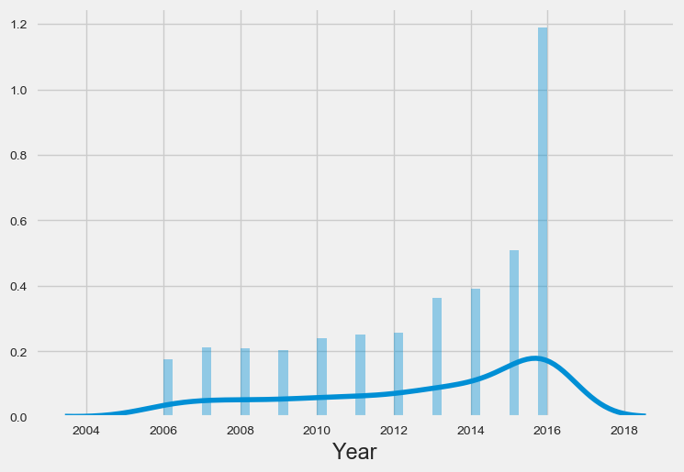
Grouping all the movies with respect to Year of release
Using Distribution Plots

Slide 8
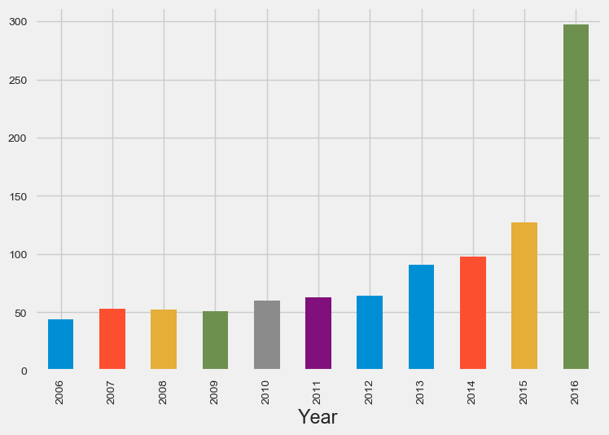
Which year highest Revenue was generated ?
Trying to show the distribution with Bar plot below

Slide 9
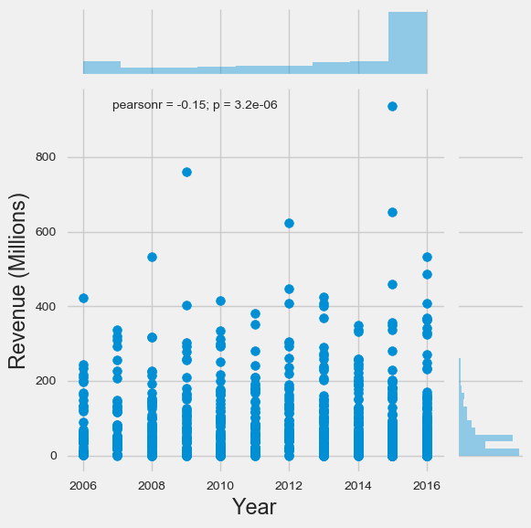

Slide 10
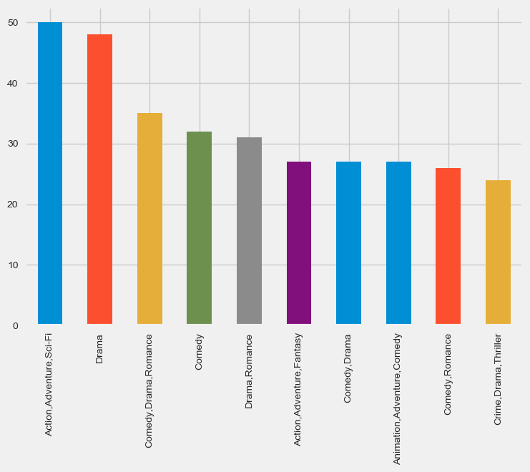
Which Genre's are listed the most
Let’s see which Genres are listed most in 10 years
We shall consider Top 10 Genre's as listed below
This will tell us, what type of movies audience like the most

Slide 11
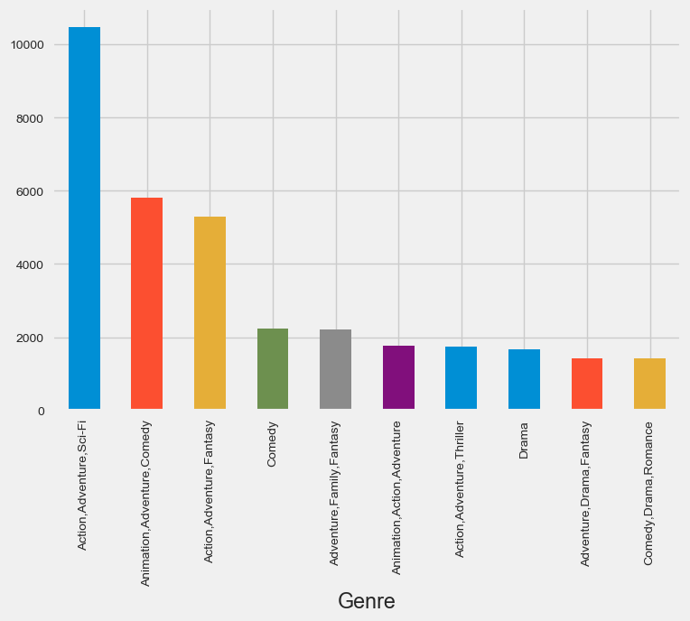
Which Genre movie has generated the highest Revenue
Using the bar plot

Slide 12
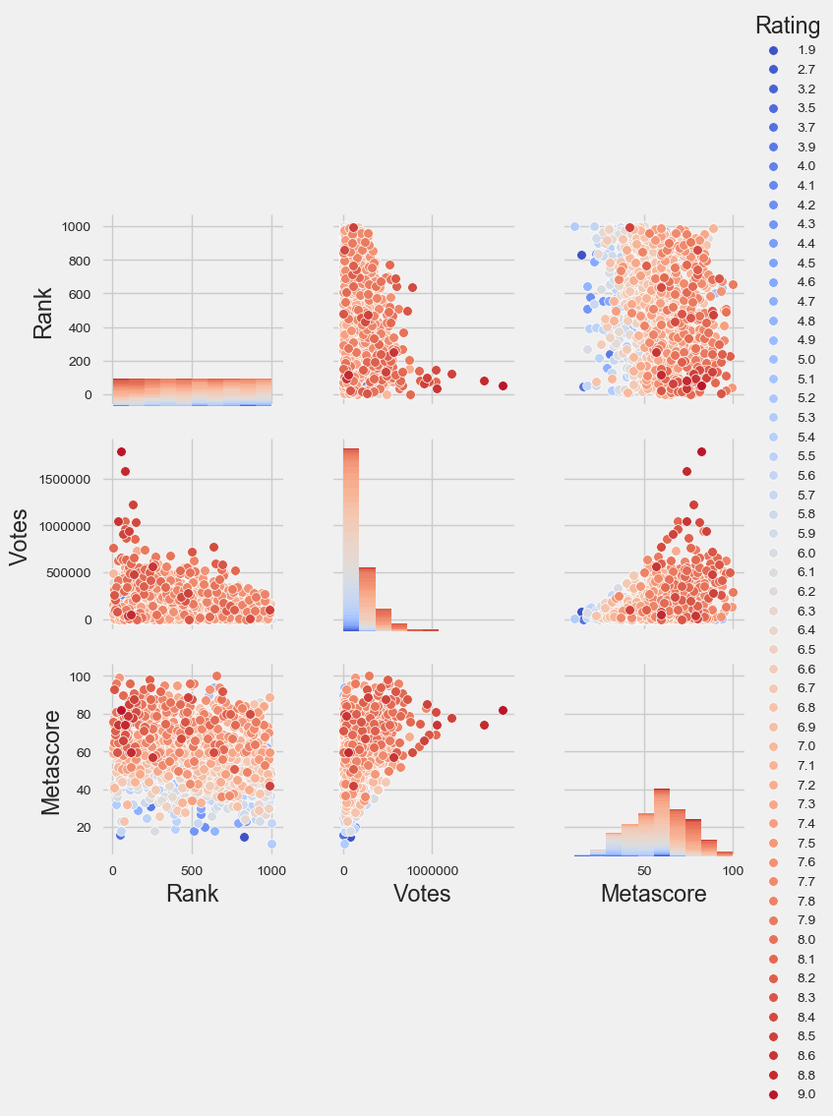
How are 'Rank' , 'Votes', 'Metascore' affecting the 'Ratings' of the movie ?
Lets draw a pair plot first and see the pairing

Slide 13
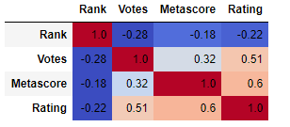
How strongly is ‘Rank’, ‘Votes’, 'Metascore' variables correlated with Rating ?
We shall see by ploting scattered plot, how is the correlation between 'Rank', 'Votes', 'Metascore' and 'Rating‘ Variables.

Slide 14
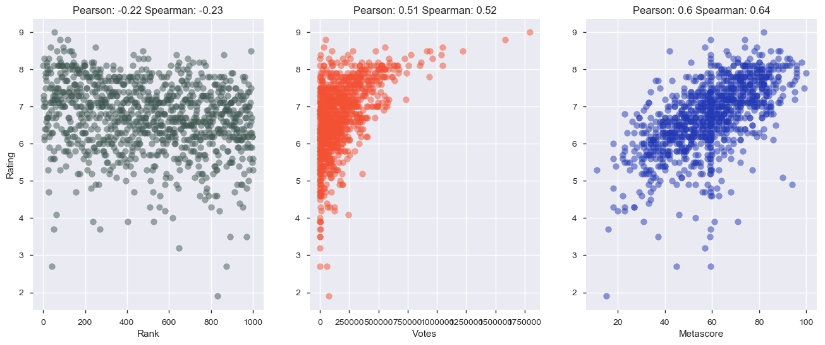

Slide 15
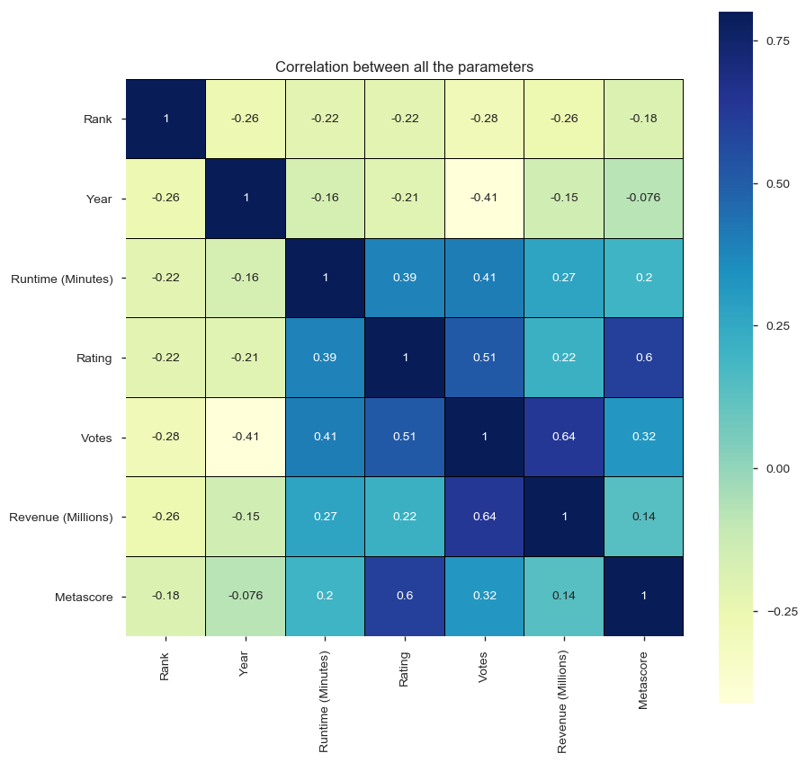
Establish coorelation between all the features using heatmap.

Slide 16
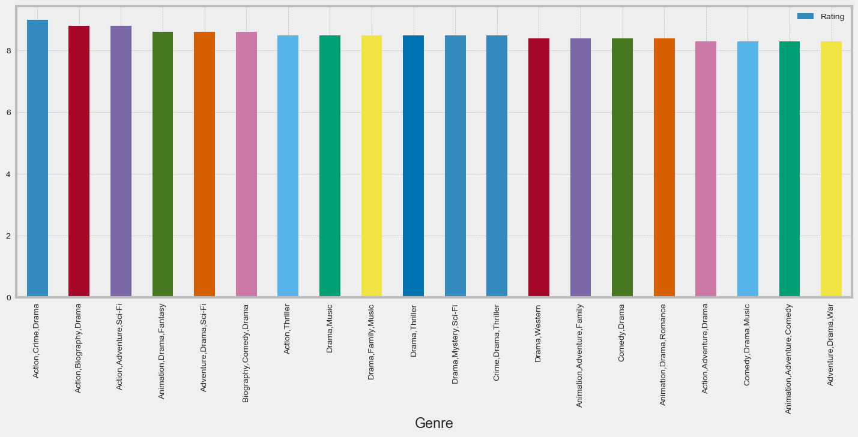
Which Genre has got maximum Rating ?

Slide 17
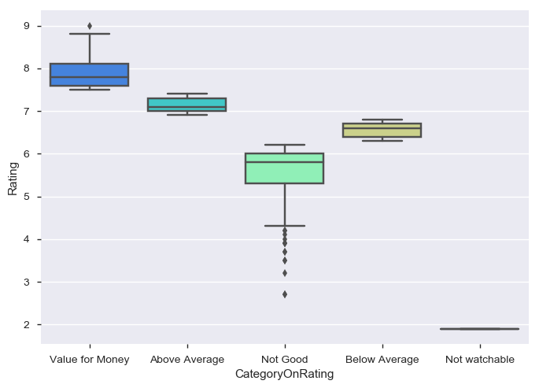
Analysing based on the column "CategoryOnRating"

Slide 18
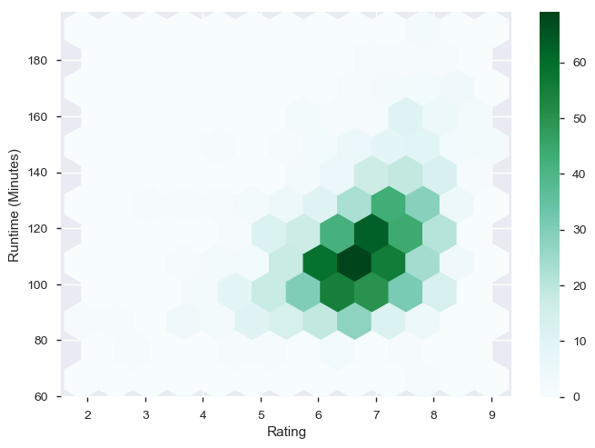
Analysing Rating with Runtime (Minutes)

Slide 19
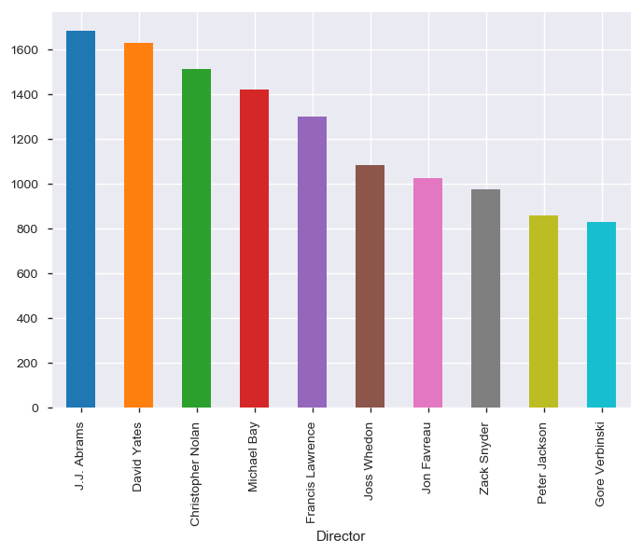
finding out which directors movie has the highest box office collection?

Slide 20
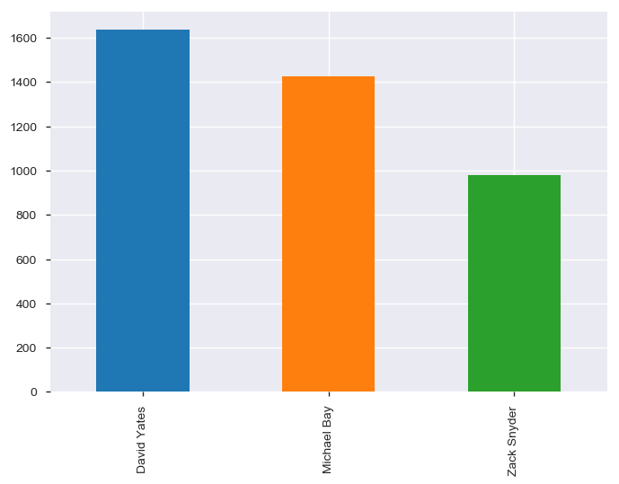
Lets joine both 6.11 and 6.12 to see who is the best Director ?

Slide 21
Conclusion
IMDB is one of the top online database of information related to world films, television programs, home videos and video games, and internet streams, including cast, production crew and personnel biographies, plot summaries, trivia, and fan reviews and ratings.
1000 Movie data , as the name suggested contains 1000 rows and 12 columns.
The Data has very less missing values, which were taken care in section 5.3 Preprocessing
From section 6.1 we can see that movies released in the year 2013, 2014, 2015, and 2016 have been listed more.
From section 6.2 we can know that Movies released in the year 2013, 2014, 2015, and 2016 have been Generated more Revenue.
We can also see that 'Votes’, 'Metascore' are more important for a movie to get the Ratings. since reviews are more important these days, everybody check for the rating before going out and watching that movie.

Slide 22
Conclusion
In section 6.7 we can see that Runtime (Minutes) of the Movie is an considerable entity which indirectly affects the Votes, Metascore and Rating which In turn affecting the Revenue (Millions). This shows that Movies with good content matters than movies with long run time.
we can see that "Action,Crime,Drama" , "Action,Biography,Drama" , "Biography,Comedy,Drama", "Adventure,Drama,Sci-Fi" and "Animation,Drama,Fantasy" Genre are the top Revenue Generators. This concludes that people are more likely to watch Movies like Action, Sci-Fi, Fantasy, Animation ... kind of movies. today we have VFX__ and Animation technologies which are helpinng to create more good , attractive contents in the movie, which are attracting more audience and generating more revenue.
CategoryOnRating this column which was created by categorising the Rating data, helped us see how Rating, Revenue, Runtime of the movie can be categorised as 'Not watchable' , 'Not Good', 'Below Average', 'Above Average', 'Value for Money'__, which can give more insigth on the Movie quality.

Slide 23
Conclusion
Finally we saw that which Director has appeared more than once in the list which gave us an idea which Directors movie is listed more than once in the 1000 Movies list in 10 years. the section 6.11 , 6.12 and 6.13 gives the clear picture that , which director will be the best choice for the producers to make. by the revenue generated we can conclude that these Directors are more capable of making Good content Movies.

