Slide 1
Thamarai - Education
How to cultivate interest, curiosity, questioning, daily practice and fun in learning?

Slide 2
What can we learn from babies and toddlers?
How much time does it takes for babies to walk?
Is there a daily practice?
Is there perseverance?
Are there failure that demotivated them?
How do we train kids with habits like brushing?
Do children learning everything by themselves?
Do we need to ask everyday (to walk/talk)? or push or motivate?
How do you reprimand kids if they don’t daily practice?
Is there anything elders can learn from it?
I want to get healthy, but no time for exercise
I want to get good in the skill (computers/maths/spoken English), but no time?

Slide 3
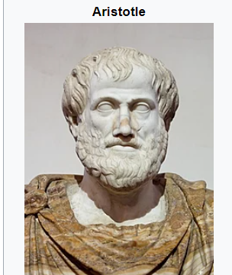
Excellence…Genius…
We are what we repeatedly do.
Excellence, then, is not an act, but a habit
Aristotle - https://en.wikipedia.org/wiki/Aristotle

Slide 4
Is our skills fixed or genetically configured?
If I pick up a new skill, with focus, learn and practice daily, can I become good at it?
Time period may vary between person to person?
One person may become good in a skill in 6 months?
Another person may become good in a skill in 3 months?
Isn’t everyone is unique and special in someway?
I fear not the man who has practiced 10,000 kicks once, but I fear the man who has practiced one kick 10,000 times…Bruce Lee
Even at age 10/20/3/40/50/60/70/80, we can pickup new skill, learn and practice?

Slide 5
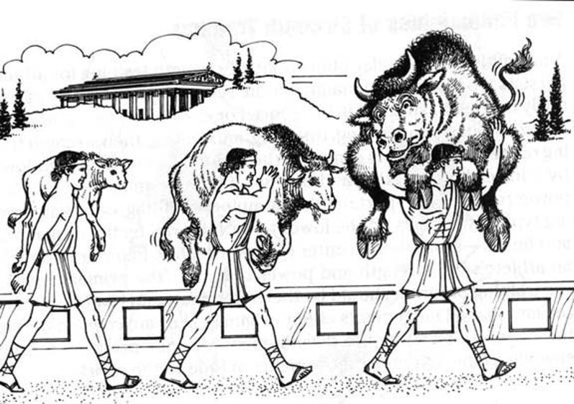
Story of “Milo of Croton”
Story from 'Milo of Croton', He was a famous wrestler. Calf was born near Milo’s home. Milo decided to lift the small animal up and carry it on his shoulders.
The next day, he returned and did the same. Milo continued this strategy for the next four years, hoisting the calf onto his shoulders each day as it grew. If we try lifting 4 year old bull on your kids shoulder on day-1, is it possible?
Similarly we don't train our kids, but blame them for failure later in their exams. We can't expect our kids to be Genius or Smart when they turn 18, you should help them to setup environment to practice everyday!

Slide 6
What is the role of family?
P V Sindhu | Her parents have been national level volleyball players. Her father, Ramana, who was a member of the Indian volleyball team that won the bronze medal in 1986 Seoul Asian Games, received the Arjuna Award in 2000
Sachin Tendulkar | Ajit Ramesh Tendulkar, elder brother of Sachin, was the early inspiration of Sachin Tendulkar. Ajit played a significant role in Sachin’s career giving him inspiration and courage in his childhood. The most important thing is that Ajit took Sachin to Ramakant Achrekar, the childhood coach of Sachin Tendulkar, when Sachin was 11 and had no experience of playing with cricket ball (hard ball). So, in fact, it was a bold initiative taken by Ajit Tendulkar.
Viswanathan Anand | Anand started learning chess from age six from his mother Sushila
Martina Hingis | Melanie Molitorová and Karol Hingis, both of whom were tennis players. Molitorová was a professional tennis player who was once ranked tenth among women in Czechoslovakia, and was determined to develop Hingis into a top player as early as pregnancy.
Steve Wozniak | His father, Jerry Wozniak, was an engineer for Lockheed Corporation. Waz learnt and played with electronics since the age of 4
A.R. Rahman & Prabhu Dev | Both their parents from their relevant field, they passed on their mastery to their kids. They can’t give magical touch ☺

Slide 7
Daily Practice
Why daily practice?
Why consistency could beat an extra ordinary effort (only one time)?
Rabbit and Tortoise story
What do we learn from life of extra ordinary people?
Isn’t it they are ordinary people, who has put daily effort to become extra-ordinary
To remain extra-ordinary, they keep putting daily practice and effort?
Expert - Is it one generation/two generation/three generations?
Sindhu – Her parents were national level volleyball players
Sachin Tendulkar – His brother was a cricketer, who found the right coach for Tendulkar and gave up his cricket for Tendulkar
Martin Hingis – Got tennis training from her mother at the age of 3

Slide 8
How to become a better person
Do my work to the best of my abilities and keep learning and improving myself?
Care for everyone at home?
Care for everyone in our neighbourhood?
Care for the environment?
Water
Air
Plants & Trees
Animals
Environment
Care for our society, village, city, country and the world
APJ Kalam - https://youtu.be/xE4azJ-wro4?t=60

Slide 9
What should become daily habit?
Reading at least one page
Tamil
English
Writing at least one page
Tamil
English
Basic Mathematics – few problems
Addition
Subtraction
Multiplication
Division

Slide 10
How to get better in school subjects?
What are the ways we could create cultivate daily practice?
Quiz app - Steps
Download Book - http://tnschools.gov.in/textbooks
What subject am I interested/I am skilled?
How to create one or more quiz for a lesson/small part of a lesson?
How to divide a 5/10 mark question into a quiz with 5 to 10 questions that could cover the important 5/10 points that answers the question?
Daily, small and incremental effort
Daily consistency creates an expert

Slide 11
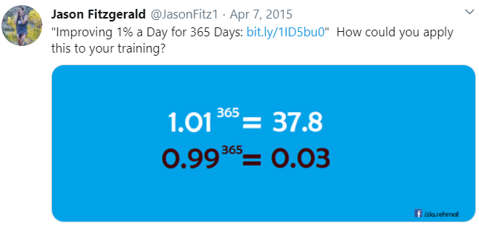
Daily 1% improvement, is it so big?

