Slide 1
Thamarai - Education
How to cultivate interest, curiosity, questioning, daily practice and fun in learning?

Slide 2
Learn about learning from our own learnings
Intentionally kept blank… let group brain-storm

Slide 3
Learn about learning from our own learnings
How much time does it takes for babies to walk?
Is it genetic?
Is there a daily practice?
Have you seen any who gave up learning to walk? Are there perseverance?
Are there failure that demotivated?
Is everyone learn same way?
Is everyone learn within same duration?
How did we learn to walk/talk?
How did we learn to cycle/swim/typing?

Slide 4
What can we learn from babies and toddlers?
How do we train kids with habits like brushing?
Do children learning everything by themselves?
Do we need to ask everyday (to walk/talk)? or push or motivate?
How do you reprimand kids if they don’t daily practice?
What elders can learn from it?
I want to get healthy, but no time for exercise
I want to get good in the skill (computers/math/english), but no time?

Slide 5
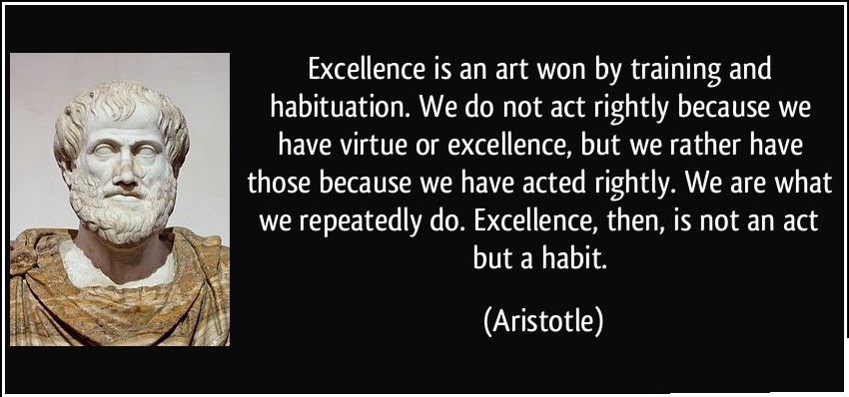
Excellence begins with habit

Slide 6
Is our skills fixed or genetically configured?
If I pick up a new skill, with focus, learn and practice daily, can I become good at it?
Time period may vary between person to person?
One person may become good in a skill in 6 months?
Another person may become good in a skill in 3 months?
Isn’t everyone is unique and special in someway?
I fear not the man who has practiced 10,000 kicks once, but I fear the man who has practiced one kick 10,000 times…Bruce Lee
Even at age 10/20/3/40/50/60/70/80, we can pickup new skill, learn and practice?

Slide 7
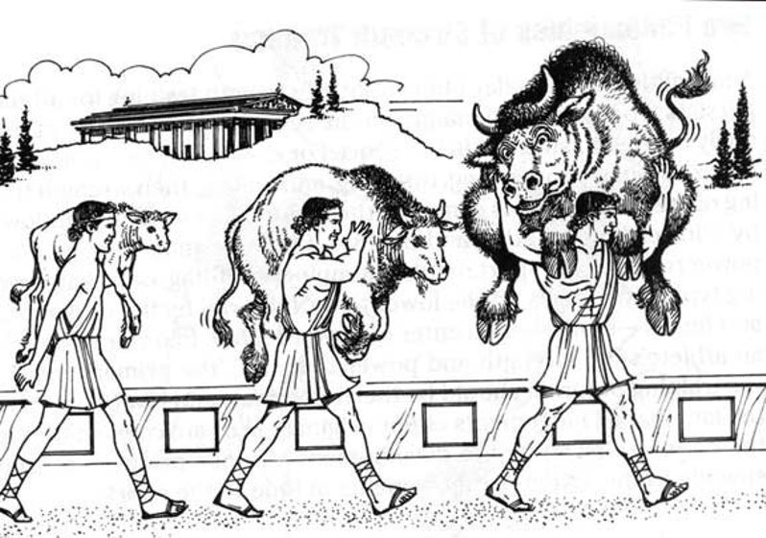
Story of “Milo of Croton”
Story from 'Milo of Croton', He was a famous wrestler. Calf was born near Milo’s home. Milo decided to lift the small animal up and carry it on his shoulders.
The next day, he returned and did the same. Milo continued this strategy for the next four years, hoisting the calf onto his shoulders each day as it grew. If we try lifting 4 year old bull on your kids shoulder on day-1, is it possible?
Similarly we don't train our kids, but blame them for failure later in their exams. We can't expect our kids to be Genius or Smart when they turn 18, you should help them to setup environment to practice everyday!

Slide 8
Role of family
P V Sindhu | Her parents have been national level volleyball players. Her father, Ramana, who was a member of the Indian volleyball team that won the bronze medal in 1986 Seoul Asian Games, received the Arjuna Award in 2000
Sachin Tendulkar | Ajit Ramesh Tendulkar, elder brother of Sachin, was the early inspiration of Sachin Tendulkar. Ajit played a significant role in Sachin’s career giving him inspiration and courage in his childhood. The most important thing is that Ajit took Sachin to Ramakant Achrekar, the childhood coach of Sachin Tendulkar, when Sachin was 11 and had no experience of playing with cricket ball (hard ball). So, in fact, it was a bold initiative taken by Ajit Tendulkar.
Viswanathan Anand | Anand started learning chess from age six from his mother Sushila
Martina Hingis | Melanie Molitorová and Karol Hingis, both of whom were tennis players. Molitorová was a professional tennis player who was once ranked tenth among women in Czechoslovakia, and was determined to develop Hingis into a top player as early as pregnancy.
Steve Wozniak | His father, Jerry Wozniak, was an engineer for Lockheed Corporation. Waz learnt and played with electronics since the age of 4
A.R. Rahman & Prabhu Dev | Both their parents from their relevant field, they passed on their mastery to their kids. They can’t give magical touch ☺

Slide 9
Daily Practice – Role of family
Why daily practice?
Why consistency could beat an extra ordinary effort (only one time)?
Rabbit and Tortoise story
What do we learn from life of extra ordinary people?
Isn’t it they are ordinary people, who has put daily effort to become extra-ordinary
To remain extra-ordinary, they keep putting daily practice and effort?
Expert - Is it self made/is it pedigree?
Sindhu – Her parents were national level volleyball players
Sachin – His brother was a cricketer, who found the right coach for Tendulkar and gave up his cricket for Tendulkar
Martina Hingis – Got tennis training from her mother at the age of 3

Slide 10
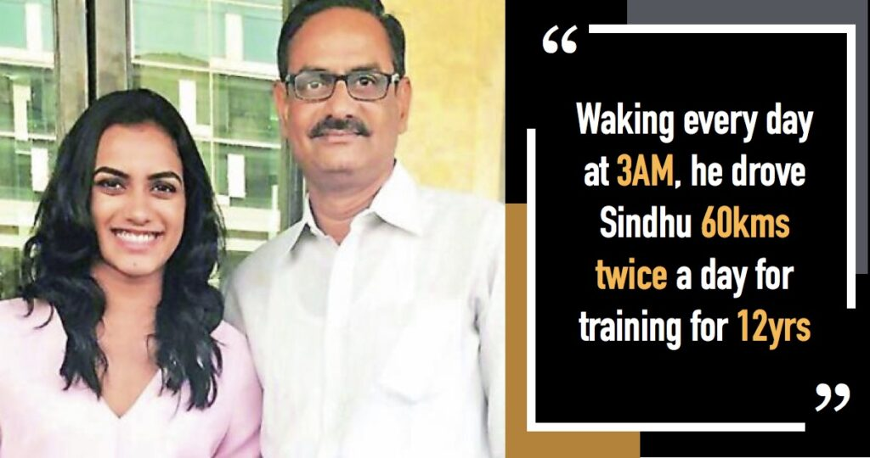
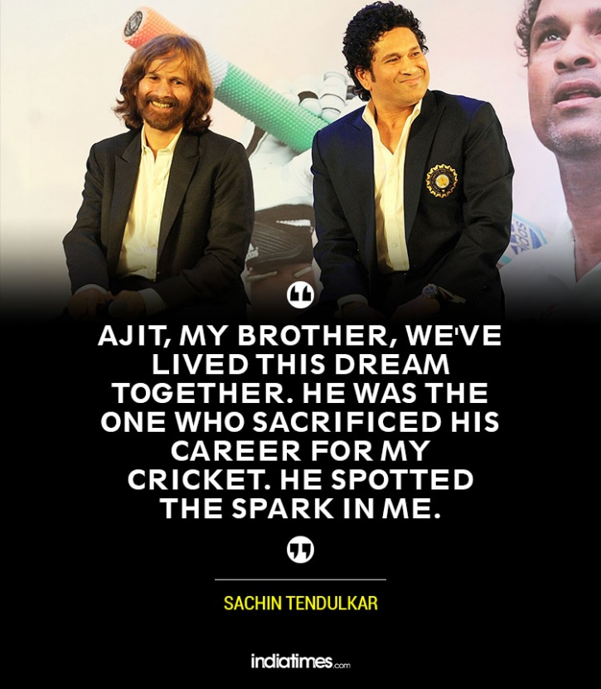
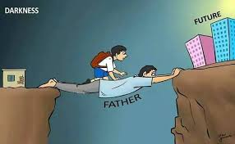
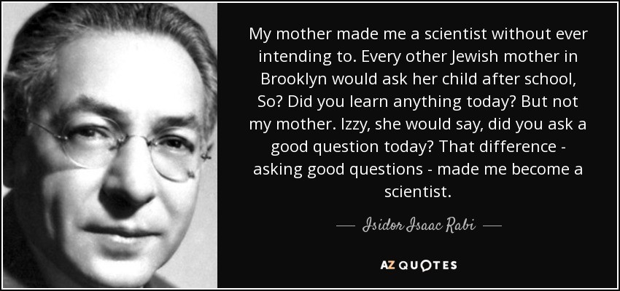
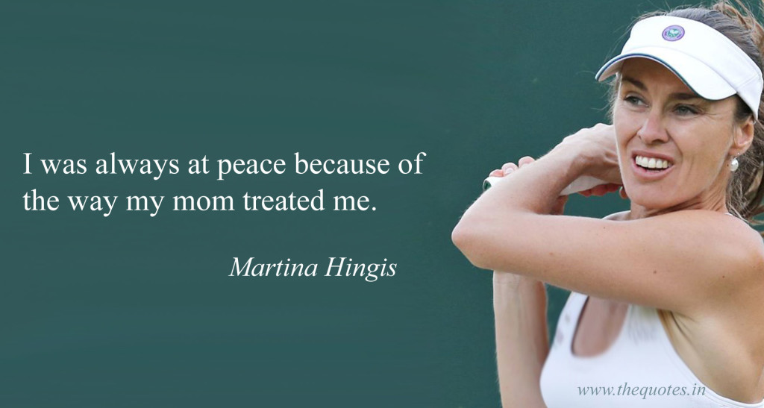
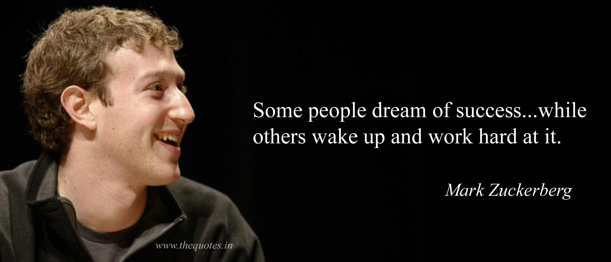
Daily Practice – Role of family

Slide 11
What should become daily habit?
Reading at least one page
Tamil
English
Writing at least one page
Tamil
English
Basic Mathematics – few problems
Addition
Subtraction
Multiplication
Division

Slide 12
https://dailypractice.info/
Goal
Spread daily-practice itself a great learning tool/technique for kids
Create kids with extremely fast numerical/logical/memory skills
Organized by few volunteers
Practice math numerical skills
Counting for Juniors (< 5 years)
Addition/Subtraction/Division/Multiplication/Fast-Multiplication
Please share daily (via whatsapp group)
Great way to say “Good morning!”
Works like attendance
Triggers other kids to practice
Try to use the same device
We store the progress and statistics on that device (personal data mining/tracking/add-target)
We need volunteers
Be a responsible parent and daily-practice something
Request new feature that would help your child
If you kid requires, someone else would also require
Sponsor gifts/gadgets for kids in villages/Spread the knowledge
Create group and organize among your family-circle/school/caste/religion/race

Slide 13
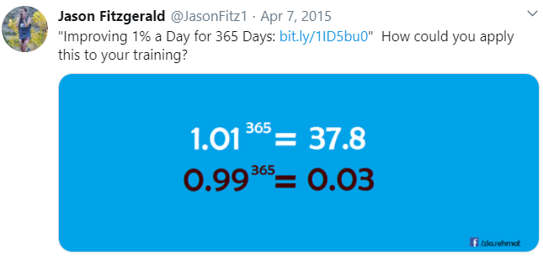
Daily 1% improvement, is it really matter?
To understand the real meaning
You should know Mathematics
To learn mathematics
You should dailypractice

