Slide 1
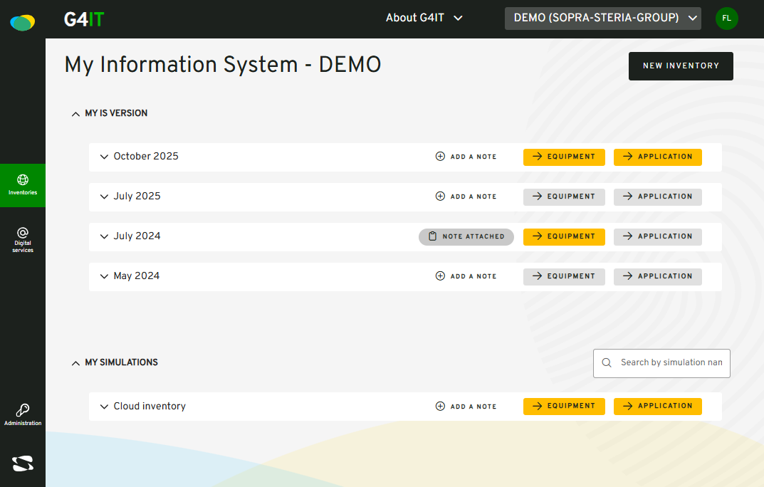

Slide 3
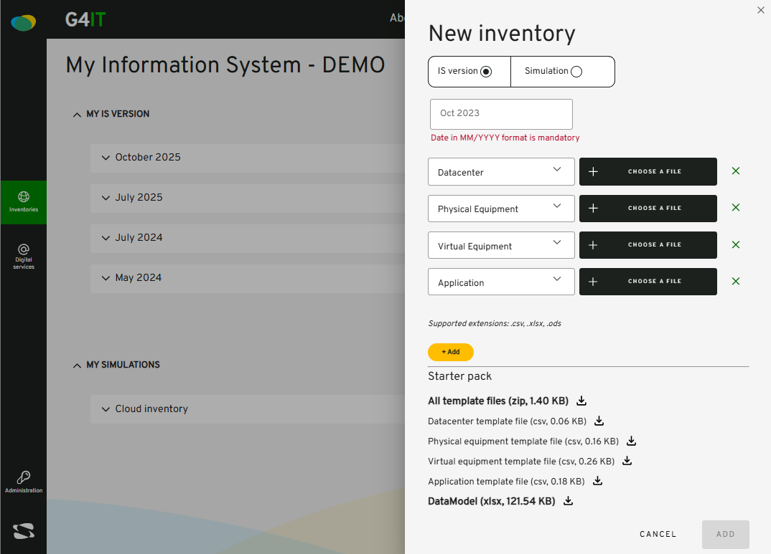
①
②
③
④
⑤

Slide 4
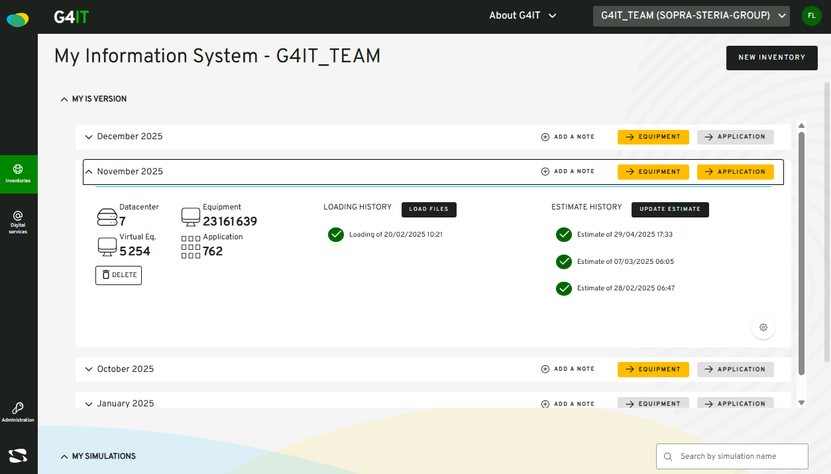
②
①

Slide 5
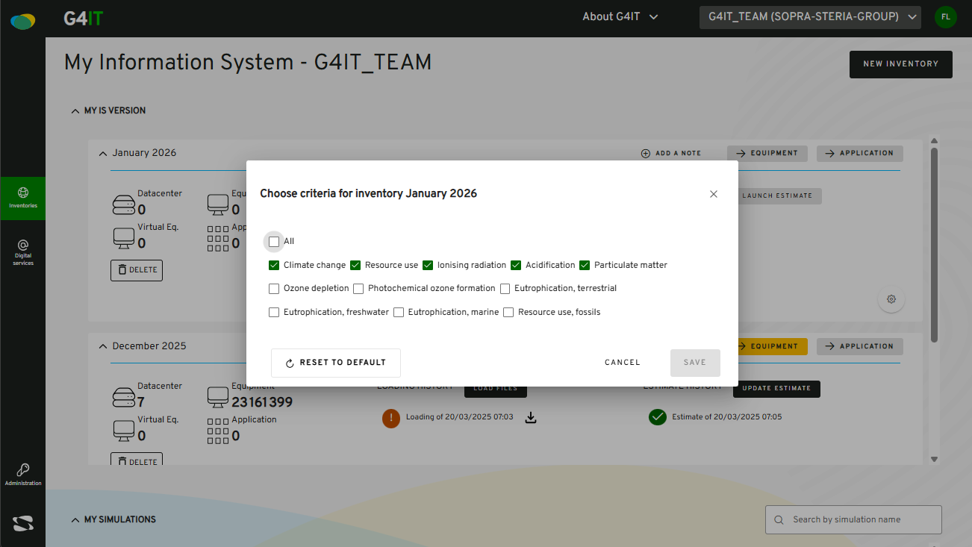

Slide 6
①
②

Slide 7

①
②
③
④

Slide 8
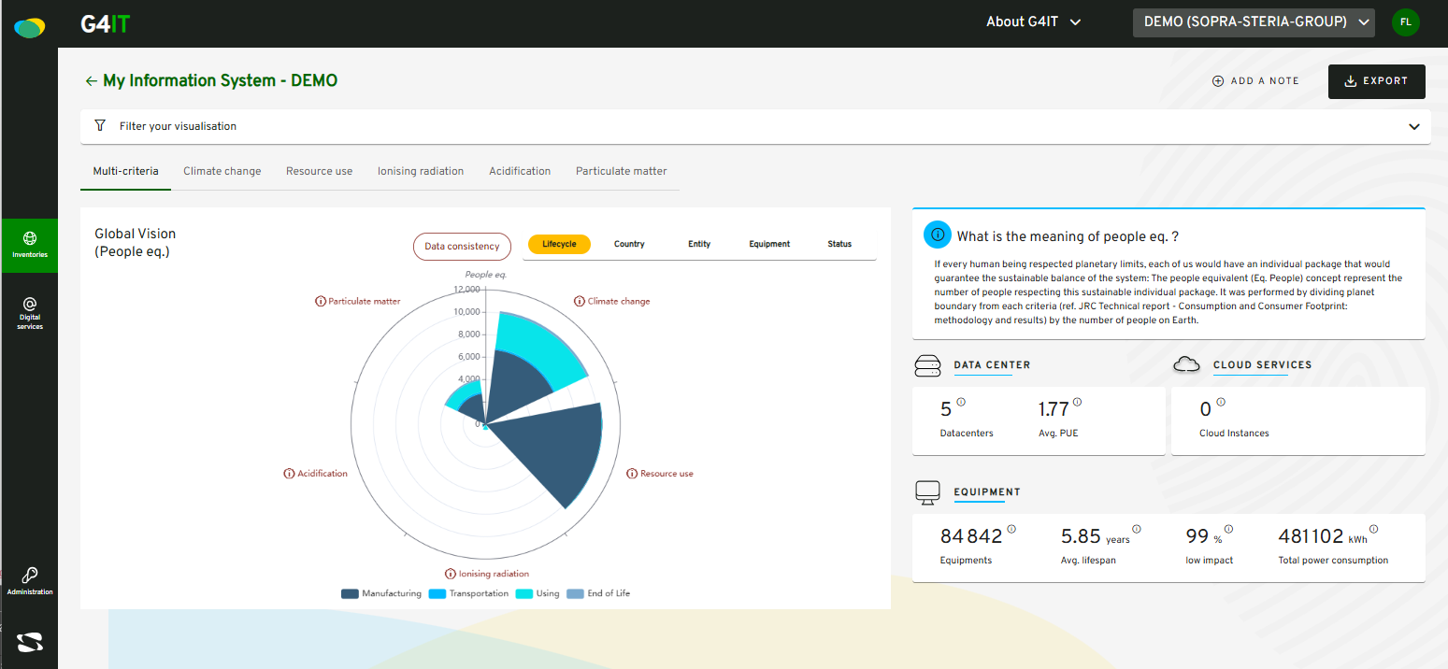
④
⑤
②
①
③

Slide 9
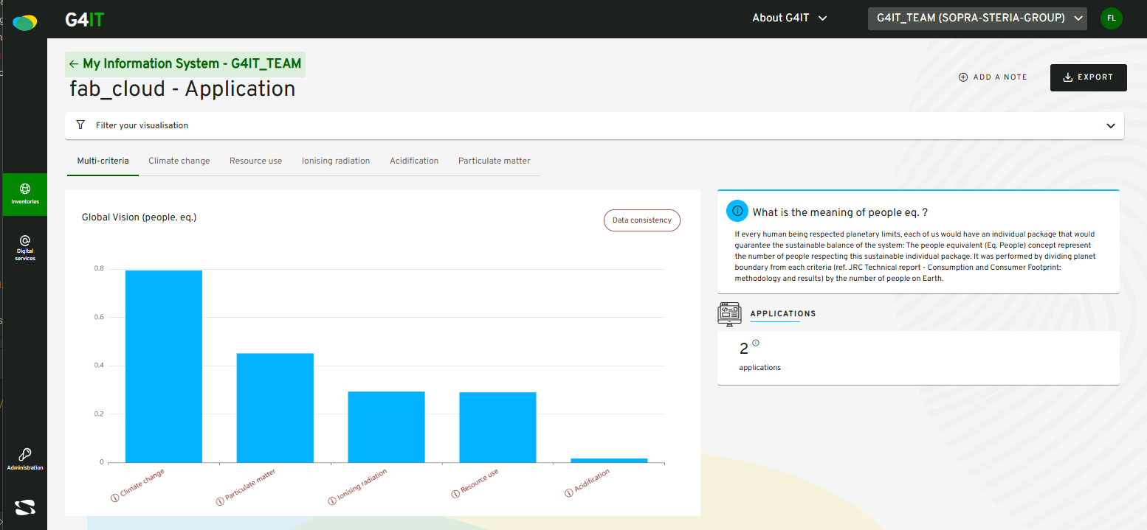

⑤
②
④
③
①

Slide 10
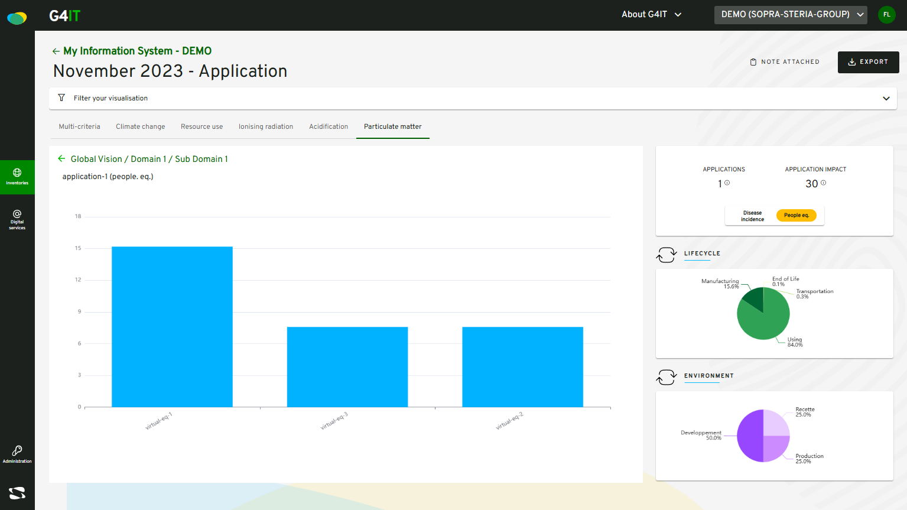
①
②

