Slide 1
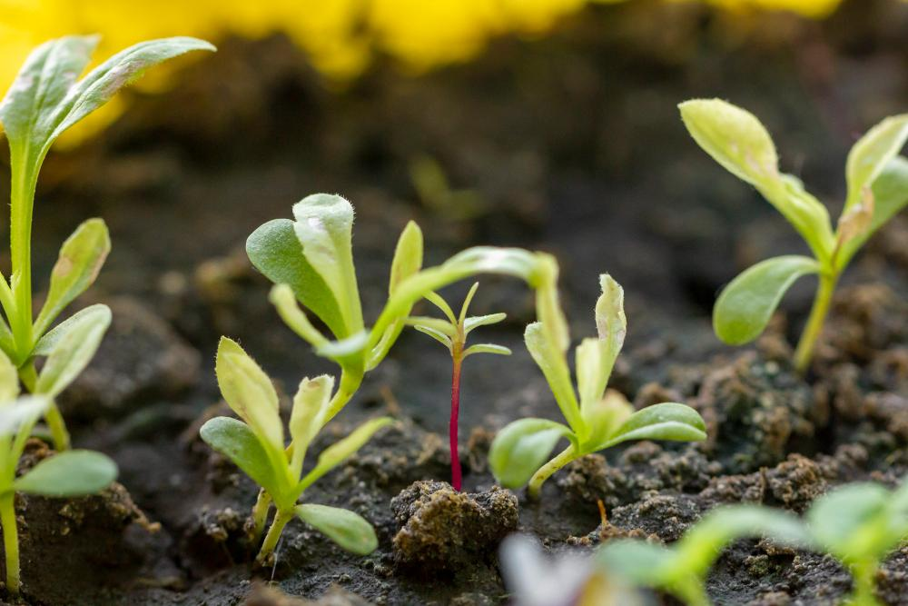
Crop Recommendation System for Improving Crop Yield
Team G
Khyathi Narra
Madhav Reddy Betha
Sumanth Gannamani

Slide 2
Contents
GitHub
Introduction
Dataset Overview
Approach
Literature survey
Feature Engineering
Consolidating Data for Exploratory Analysis
EDA
Model Construction
Model Evaluation
Challenges & Next Steps
References

Slide 3
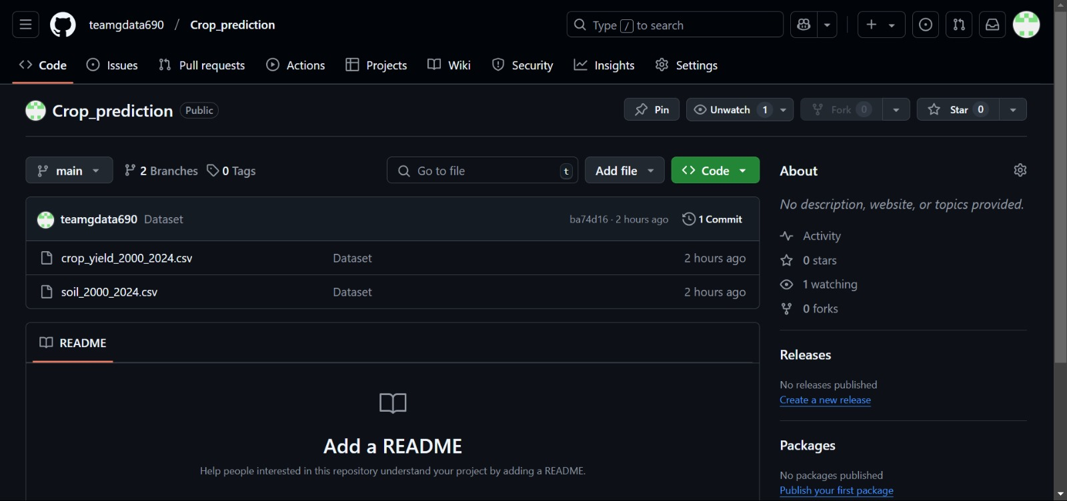
GitHub Snapshot
GitHub link: https://github.com/teamgdata690/Crop_prediction

Slide 4
Project Introduction
What is it about?
A system to recommend optimal crops for specific regions in the US to maximize yield, considering soil properties and historical yield data.
Why this project?
Addresses the critical need for efficient and sustainable agriculture in the face of changing climate and resource constraints. It helps farmers make data-driven decisions.
Research Question/Hypothesis:
Machine learning models, incorporating soil and historical yield data, can accurately predict crop yields and provide valuable recommendations for crop selection.

Slide 5
Dataset Overview
Dataset Description:
Two datasets:
crop_yield_2000_2024.csv: Historical crop yield data for US states from 2000-2024.
https://www.nass.usda.gov/Data_and_Statistics/
soil_2000_2024.csv: Soil property data for US states during the same period.
https://websoilsurvey.sc.egov.usda.gov/app/

Slide 6
Dataset Overview
Data Size:
Crop Yield: 2,325,669 rows, 21 columns
Soil: 33441 rows, 47 columns
Raw Attributes: Year, State, Commodity, Value (yield), soil properties like composition percentages, pH, organic matter, CEC etc.

Slide 7
Approach
Type of Analysis: Classification, Prediction and Recommendation
Predict crop yield based on soil properties and historical data.
Recommend optimal crop(s) for a given region based on predicted yields.
Classification/Regression: Primarily we use regression for yield prediction. Then we classify suitability for a crop based on Soil and Region.
Models: Random Forest Classifier, XGBoost Classifier, XGBoost Regressor.

Slide 8
Literature Survey
State of the Art:
Existing studies use ML for crop yield prediction and soil classification, but often lack integration of multiple datasets (soil, weather, and historical crop data)
What's Missing?
Limited focus on combining soil health classification with crop yield prediction using comprehensive datasets.
Your Proposed Methods:
Our project integrates soil and historical crop data to provide a decision-support system for farmers.

Slide 9
Feature Engineering Crop Dataset
Loaded raw crop dataset and removed completely empty columns.
Dropped irrelevant columns like 'Program', 'Week Ending', 'watershed_code', etc.
Filtered out unwanted commodities and rows with irrelevant data items using regex.
Extracted Item, Metric, and Measurement_Unit from the 'Data Item' column.
Extracted the measurement unit (e.g., BU, TON, LB) into a new column Unit_Extracted.
Cleaned the 'Value' column by removing commas, letters, and brackets, and converted to numeric.
Standardized 'PRICE RECEIVED' values to TON using unit-specific conversion factors.

Slide 10
Feature Engineering Crop Dataset
Created a unified Pivot_Value column combining standardized price and other metrics.
Pivoted the dataset to convert metric types into separate columns (e.g., YIELD, SALES).
Selected important columns including year, state, commodity, and metric values.
Applied label encoding to categorical features: Year, Period, Geo Level, State, Commodity.
Trained HistGradientBoostingRegressor models to impute missing target values.
Imputed missing values in YIELD, SALES, STOCKS, PRICE RECEIVED, PROGRESS, and CONDITION.
Dropped temporary encoded columns after imputation and retained original categoricals.

Slide 11
Feature Engineering Soil Dataset:
Imputed missing values in numeric columns using random values between the 10th and 95th percentiles.
Clipped numeric columns to the 1st and 99th percentile to handle outliers.
Applied log transformation to skewed columns: Cation Exchange Capacity, Organic Matter, and ksat.
Imputed missing Drainage Class values with random selections from valid drainage categories.
Converted Period strings (week wise) to approximate month names (e.g., "April").
Saved the cleaned and transformed soil dataset for merging with crop data.

Slide 12
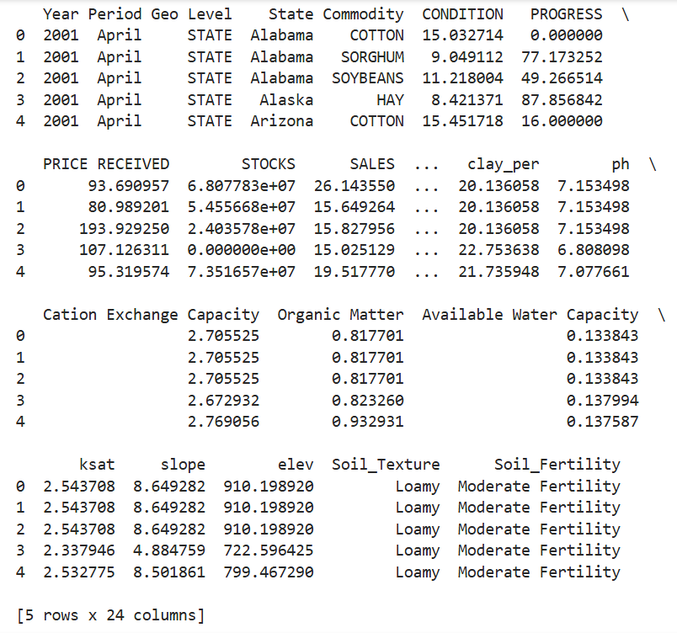
Consolidating Data for Exploratory Analysis
Standardized and cleaned Period column in both crop and soil datasets.
Aggregated soil data at (Year, State, Period) level for merging.
Created fallback soil summary tables at (Year, State) and (State) levels.
Merged soil features into crop data using primary and fallback keys.
Filled remaining numeric missing values using random values from the 25th–75th percentile range.
Clipped all numeric columns to ensure non-negative values.

Slide 13
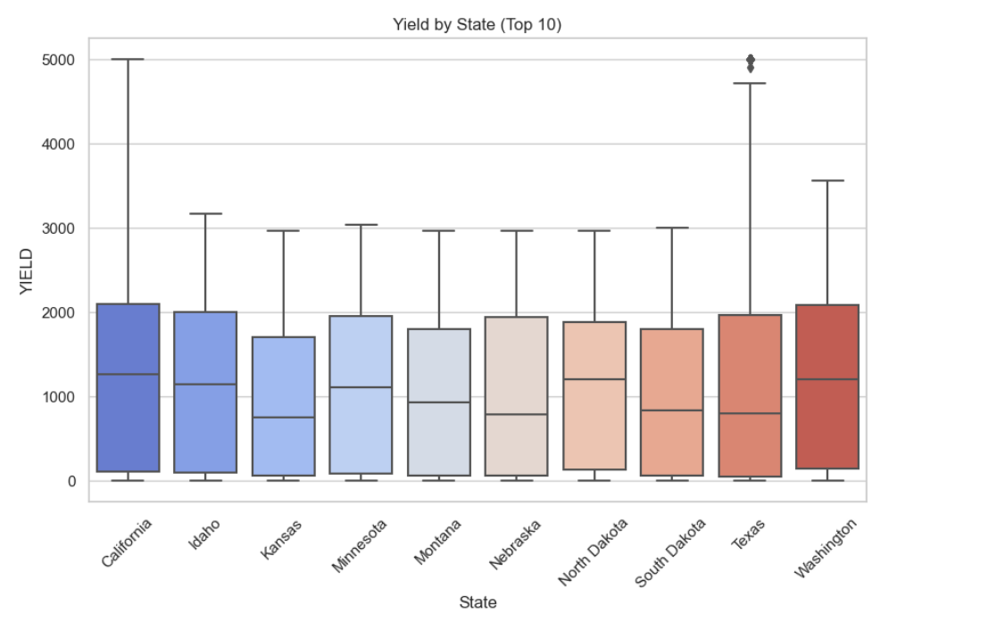
Exploratory Data Analysis (EDA)
The image shows a box plot graphing crop yields among the top 10 states, with markers indicating variations in yields. With such information, a Crop Recommendation System can use trends to recommend the best crops for individual states to yield maximum.

Slide 14
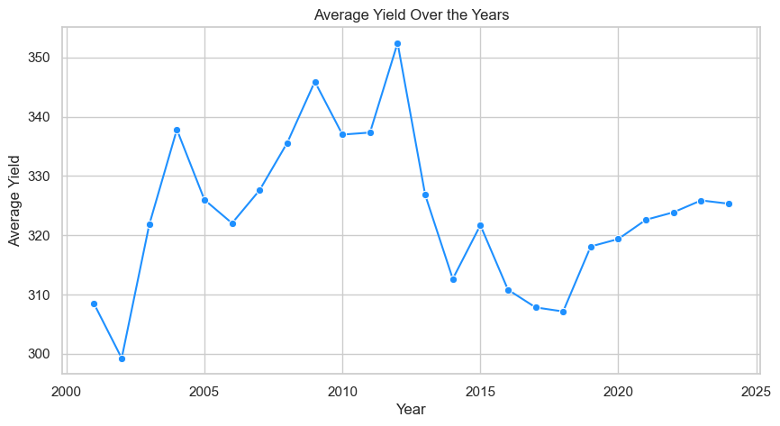
Exploratory Data Analysis (EDA)
Yield rose from ~1040 in 2000 to ~1190 in 2020.
Major increase observed post-2010.
Peak in 2020 with stable values since.
Indicates improved farming and conditions.
Useful for predicting future yield trends.

Slide 15
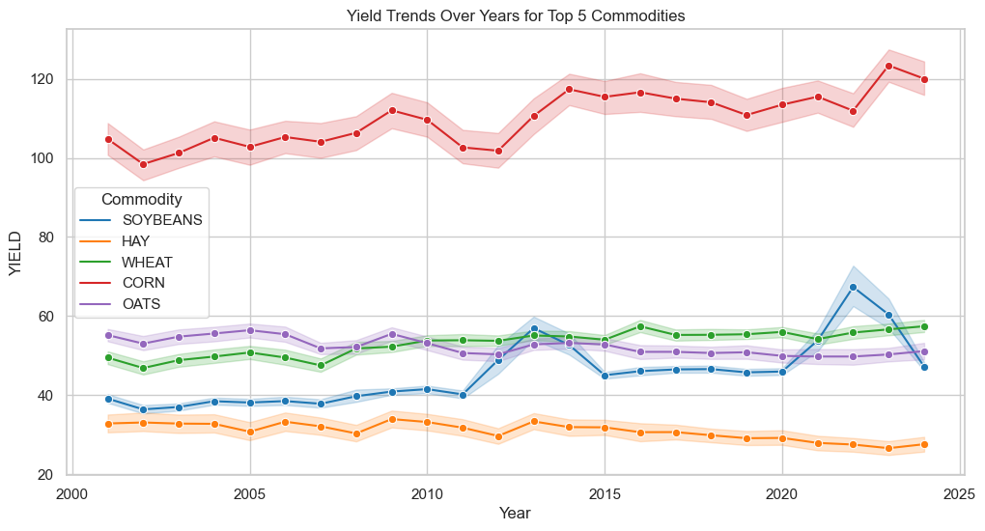
Exploratory Data Analysis (EDA)
Corn shows the highest and steadily increasing yield.
Oats and Soybeans show moderate fluctuations.
Wheat is stable with slight improvements.
Hay yield is lowest with a slow decline.
Useful for crop planning and recommendation based on long-term trends.

Slide 16
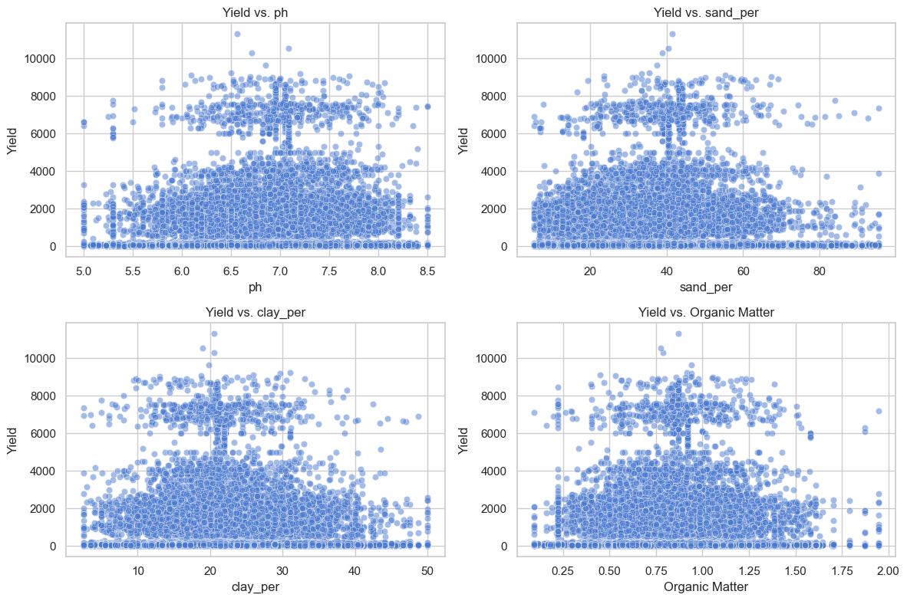
Exploratory Data Analysis (EDA)
Yield clusters around certain ranges for all features, suggesting optimal soil conditions.
pH: Most yields are concentrated between pH 6.0–7.5, indicating neutral pH supports better growth.
Sand & Clay %: Moderate sand and clay levels (~30–50%) seem to align with higher yields.
Organic Matter: Yields increase slightly up to ~1.5%, then plateau, showing diminishing returns.

Slide 17
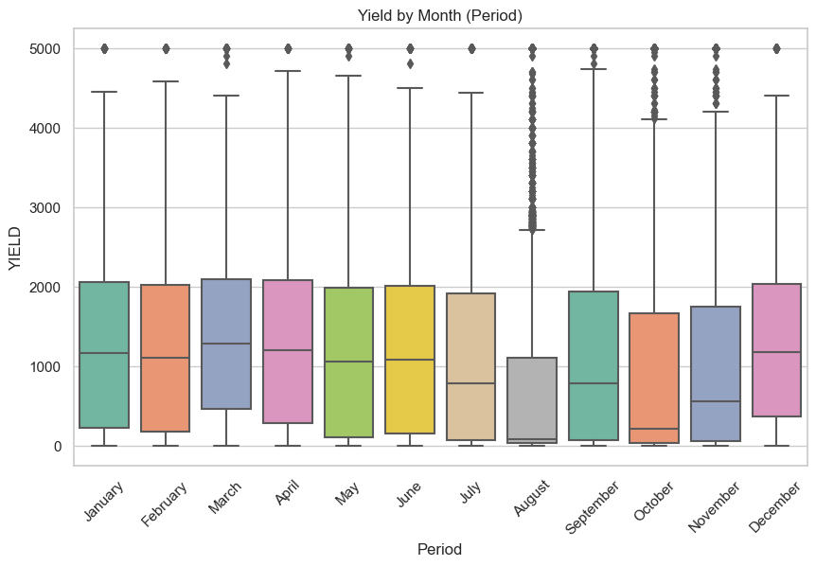
Exploratory Data Analysis (EDA)
March & April show higher median yields.
August has the lowest median yield.High yield variability observed in all months.
Outliers are frequent, especially in later months.
Useful for seasonal yield prediction and planning.

Slide 18
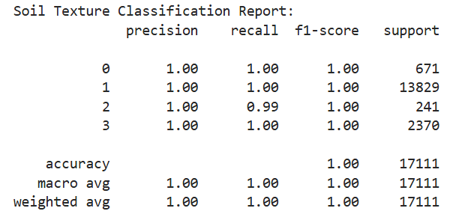
Model Construction
Soil Texture Classification:
Selected soil-related features and encoded variables as model inputs.
Defined Soil_Texture_Enc as the target for classification.
Split data into 80% train and 20% test using stratified sampling.
Trained a Random Forest Classifier with 100 estimators.
Achieved 100% accuracy, precision, recall, and f1-score across all classes.

Slide 19
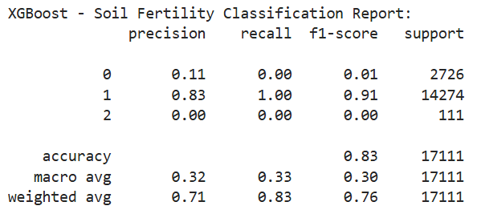
Model Construction
Soil Fertility Classification:
Defined Soil_Fertility_Enc as the target for classification.
Split data into 80% train and 20% test using stratified sampling.
Trained an XGBoost Classifier with mlogloss as the evaluation metric.
Initial model achieved 83% accuracy but failed on minority classes due to imbalance.
Applied SMOTE to handle class imbalance and improve minority class prediction.
Post-SMOTE model produced more balanced and reliable results.

Slide 20
Model Construction
Yield Regression:

Slide 21
Model Evaluation
Evaluation Results:
Random Forest Model:
Training Accuracy = X%, Test Accuracy = Y%.
Neural Network Model:
Training Loss vs Validation Loss graph.
Test Accuracy = Z%.
Key Observations:
Overfitting mitigated using dropout layers in the neural network.
Random Forest performed better on smaller datasets; Neural Network excelled with engineered features.
Include performance comparison tables or graphs.

Slide 22
Challenges & Next Steps
Challenges:
Data Collection: researching and collecting data and
Data Quality Issues: Missing values and inconsistencies in the dataset.
Column Validation: Validating whether columns were suitable for analysis (e.g., relevance, completeness, and consistency) was a time-intensive process.
Next Steps:
Model Training and Evaluation: Train various models and assess their performance based on key metrics.
Deployment and Testing: Deploy the model and test it in real-world scenarios for accuracy and reliability.

Slide 23
References
https://websoilsurvey.sc.egov.usda.gov/app/
https://www.nass.usda.gov/Data_and_Statistics/
Sharma, A., Jain, A., Gupta, P., & Chowdary, V. (2021). Machine Learning Applications for Precision Agriculture: A Comprehensive Review. IEEE Access, 9(2169-3536), 4843–4873 https://ieeexplore.ieee.org/document/9311735
Syed Ishtiak Rahman, Shifa Chowdhury Iwase, Arefin Ittesafun Abian, Ghosh, T., & Dewan Md. Farid. (2023). A Comprehensive Review on Precision Agriculture and Machine Learning Approach in Bangladesh. https://doi.org/10.1109/i2ct57861.2023.10126189

Slide 24
Thanks!
Do you have any questions?

