Slide 1
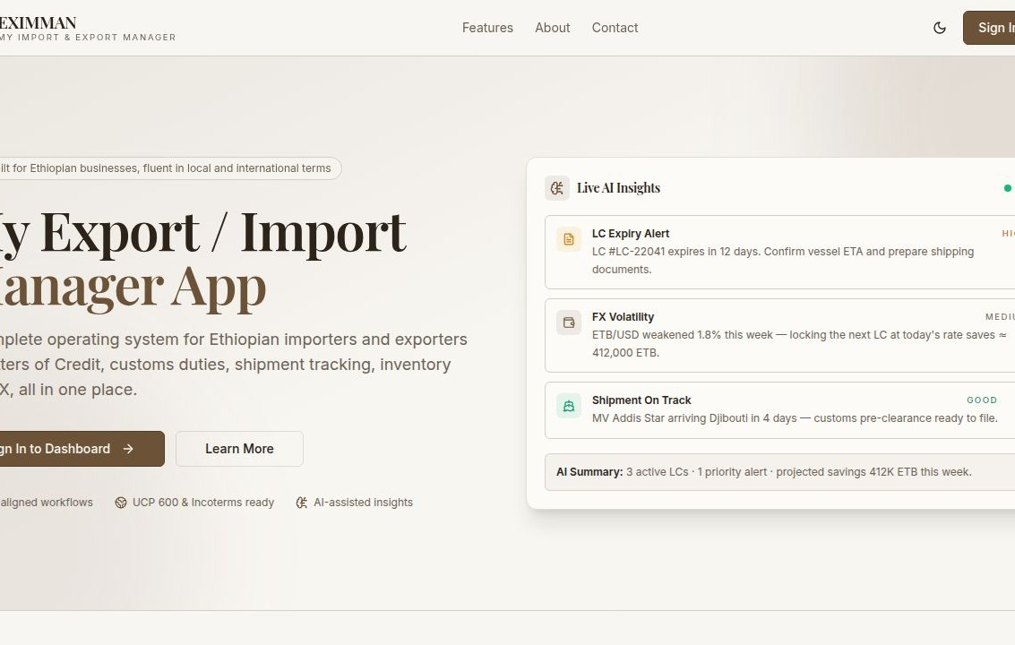
E
EXIMMAN
FOR ETHIOPIAN IMPORTERS & EXPORTERS
My Import
& Export
Manager.
One operating system for trade.
LC · Customs · Logistics · Inventory · Finance · FX
Product preview · v1.0
01 / 15

Slide 2
THE CHALLENGE
Trade is fragmented.
Tools are not.
Ethiopian importers and exporters juggle banks, customs, freight forwarders,
spreadsheets and WhatsApp threads — across five currencies and three time zones.
·
·
·
·
Letters of Credit
Customs & Duties
Shipment Tracking
FX & Cash Flow
Drafted in Word, tracked in email, signed off in person.
Tax assessments calculated by hand for every declaration.
No single view from supplier to warehouse — only screenshots.
Bank rates change hourly; petty cash lives on paper.
EXIMMAN · My Import & Export Manager
WHY WE BUILT IT
02 / 15

Slide 3
THE PRODUCT
One workspace,
front-to-back.
EXIMMAN unifies every step of an import or export flow into a single,
calm, role-aware workspace — built for Ethiopian regulation and global trade.
11
26
UCP 600
ETB · USD
EUR · AED · CNY
Connected modules
Ethiopian banks tracked live
Compliant LC workflows
Native multi-currency
EXIMMAN · My Import & Export Manager
WHAT IT IS
03 / 15

Slide 4
WHAT'S INSIDE
Eleven modules.
One calm surface.
LC
CU
SH
IN
Letters of Credit
Customs Engine
Shipments
Inventory
UCP 600 ready. Draft, track, settle — with bank-by-bank logic.
CIF, duty, VAT, surtax and withholding — auto-calculated.
End-to-end tracking from supplier yard to your warehouse.
Post-clearance stock, warehouse utilization, reorder alerts.
CA
FN
FX
AI
Cash Against Docs
Finance
Exchange Rates
AI Insights
Export-side payment instruments and NBE forex preview.
Expenses, petty cash, payables and receivables in ETB.
Live ETB rates from 26 banks, refreshed every five minutes.
Risk scoring, FX hedging hints and shipment consolidation.
EXIMMAN · My Import & Export Manager
CAPABILITIES
04 / 15

Slide 5
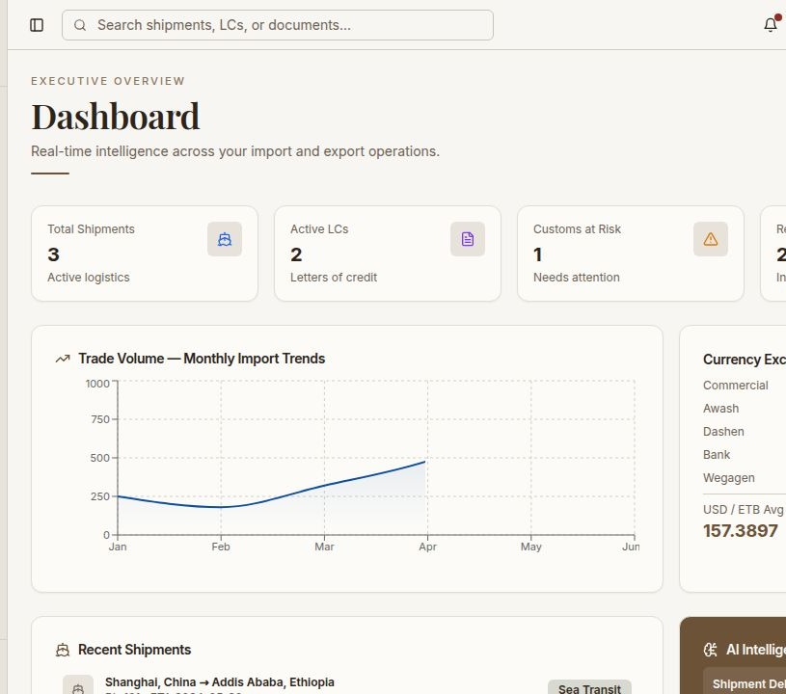
MODULE 01 · COMMAND CENTER
Executive Dashboard
A real-time overview of every active LC, shipment, customs case and inventory line — built for daily review.
Live KPI cards across the entire operation
Monthly trade volume trend & FX averages
Recent shipments and AI risk feed
One-click report generation
EXIMMAN · My Import & Export Manager
FOR IMPORTERS & EXPORTERS
05 / 15

Slide 6
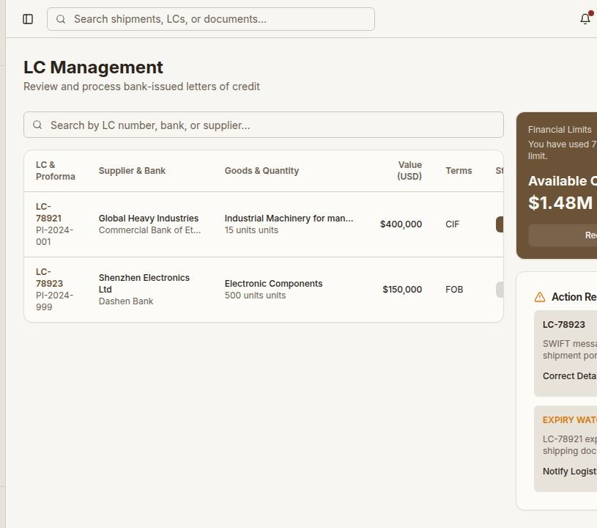
MODULE 02 · IMPORT
Letters of Credit
Manage every bank-issued LC from draft to settlement — without leaving the platform.
Proforma, supplier, bank and Incoterms in one record
Auto-calculated FOB + freight + insurance
Partial shipment and transshipment logic
Expiry watch and document checklist
EXIMMAN · My Import & Export Manager
FOR IMPORTERS
06 / 15

Slide 7
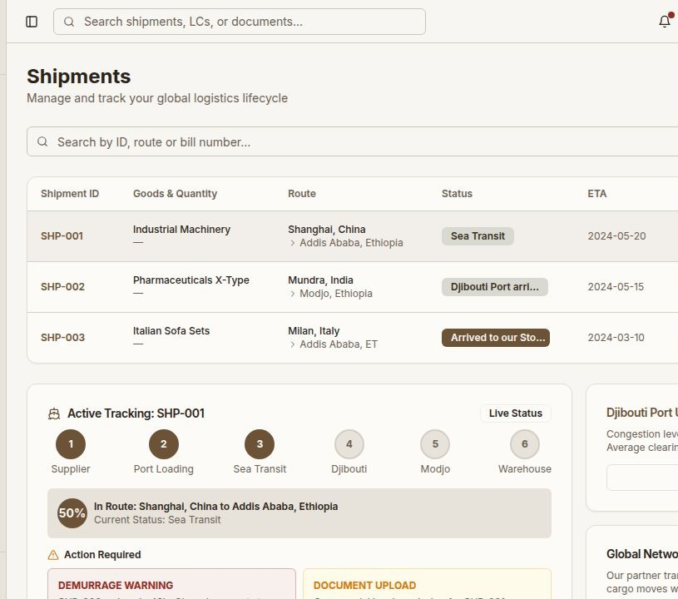
MODULE 03 · IMPORT
Shipment Tracking
From supplier loading bay to your Addis warehouse — six-stage live tracking with port-level intelligence.
Six-stage route progress per shipment
Bill of lading and declaration numbers
Djibouti port congestion updates
Demurrage and document alerts
EXIMMAN · My Import & Export Manager
FOR IMPORTERS
07 / 15

Slide 8
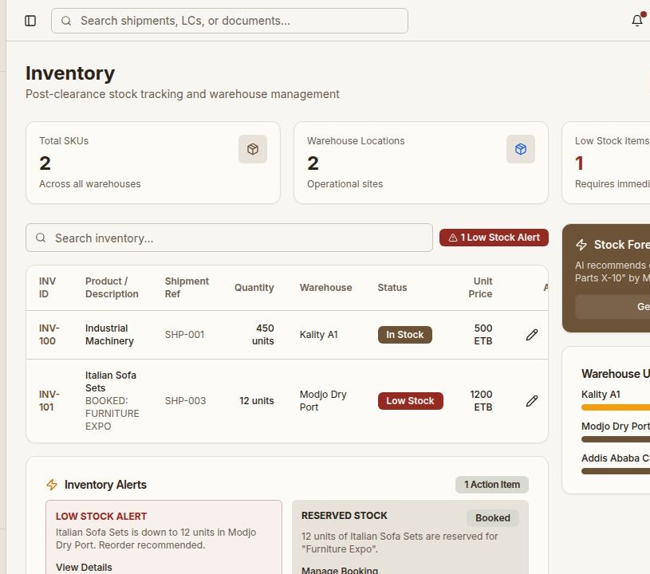
MODULE 04 · IMPORT
Inventory & Warehouse
Post-clearance stock, warehouse utilization and forecasting — kept honest by your shipment data.
SKU-level stock across multiple warehouses
Low-stock and reservation alerts
Per-warehouse capacity utilization
AI-suggested reorder plans
EXIMMAN · My Import & Export Manager
FOR IMPORTERS
08 / 15

Slide 9
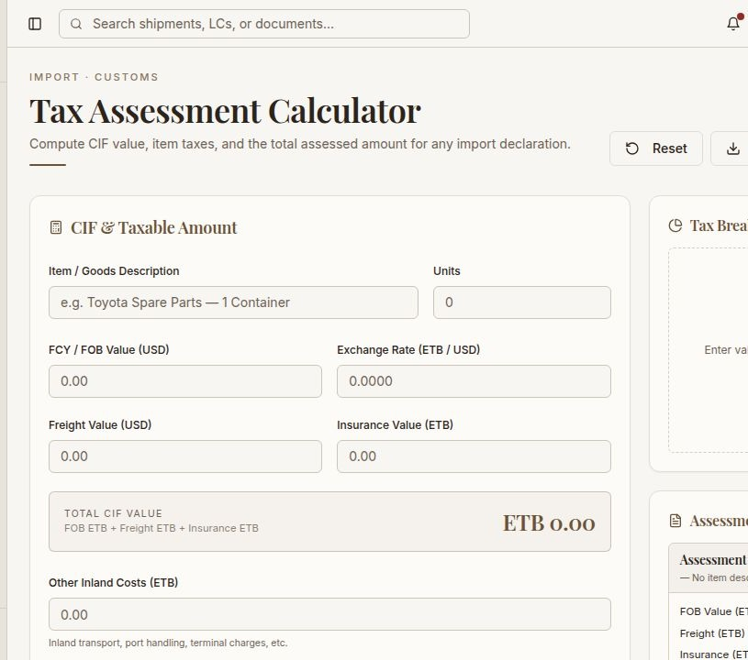
MODULE 05 · IMPORT
Customs & Tax Engine
Compute CIF, item taxes and the total assessed amount for any import declaration — print-ready notices included.
CIF auto-build from FOB, freight, insurance
Duty, VAT, surtax, withholding lines
Inland costs and exchange-rate aware
Save as PDF or print directly
EXIMMAN · My Import & Export Manager
FOR IMPORTERS
09 / 15

Slide 10
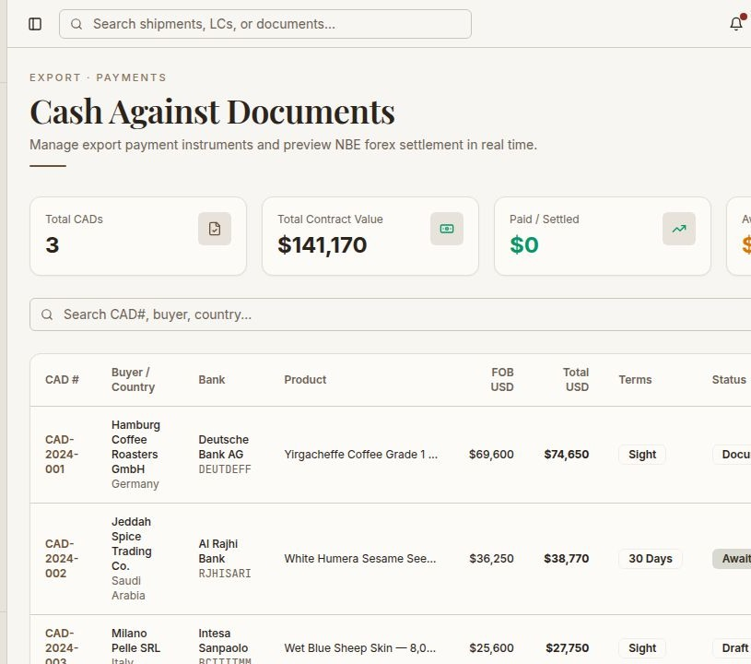
MODULE 06 · EXPORT
Cash Against Documents
Manage outbound payment instruments and preview NBE forex settlement in real time.
CAD register with buyer, bank, terms
Status flow: draft → sent → settled
FOB and total contract value tracking
Per-CAD product and document lineage
EXIMMAN · My Import & Export Manager
FOR EXPORTERS
10 / 15

Slide 11
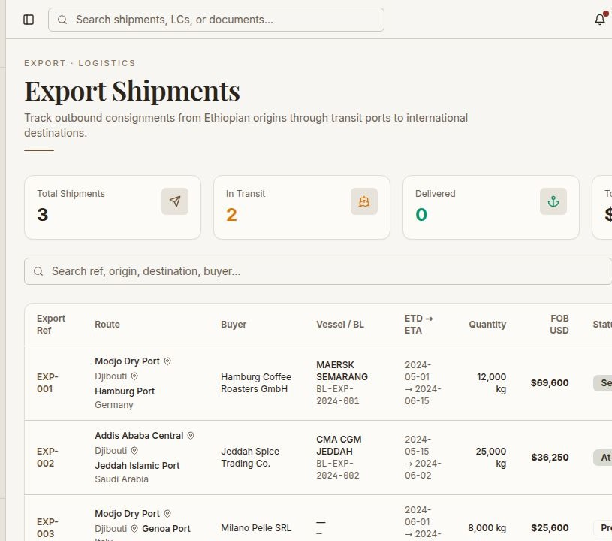
MODULE 07 · EXPORT
Export Shipments
Track outbound consignments from Ethiopian origins through transit ports to international destinations.
Vessel, BL number, ETD and ETA
Buyer, route and transit port view
FOB value and weight per shipment
Status from preparing to delivered
EXIMMAN · My Import & Export Manager
FOR EXPORTERS
11 / 15

Slide 12
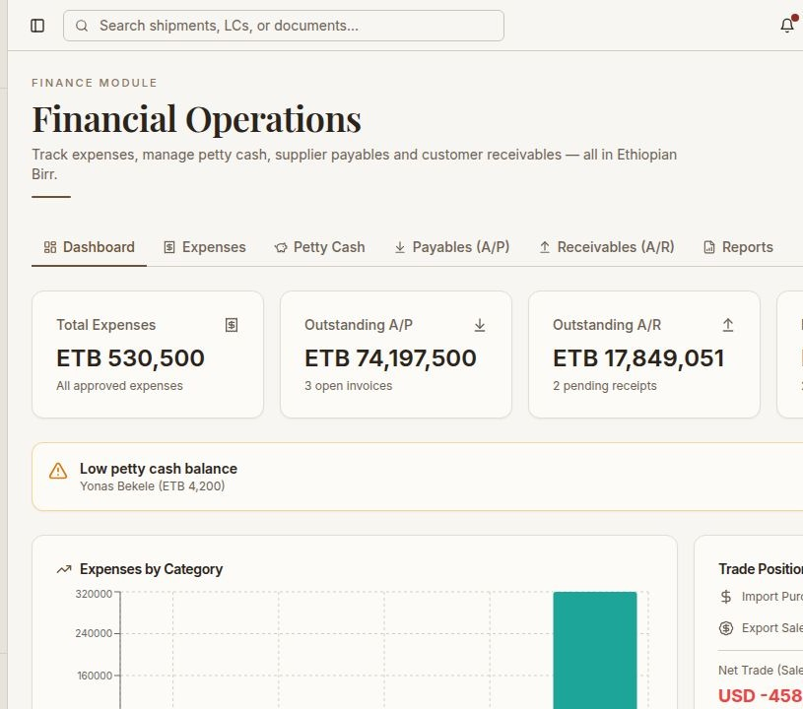
MODULE 08 · FINANCE
Financial Operations
Expenses, petty cash, supplier payables and customer receivables — all in Ethiopian Birr, all in one tab.
Six tabs · dashboard to reports
Low petty cash alerts and progress bars
A/P and A/R with multi-currency
Expense-by-category and trade-position charts
EXIMMAN · My Import & Export Manager
FOR IMPORTERS & EXPORTERS
12 / 15

Slide 13
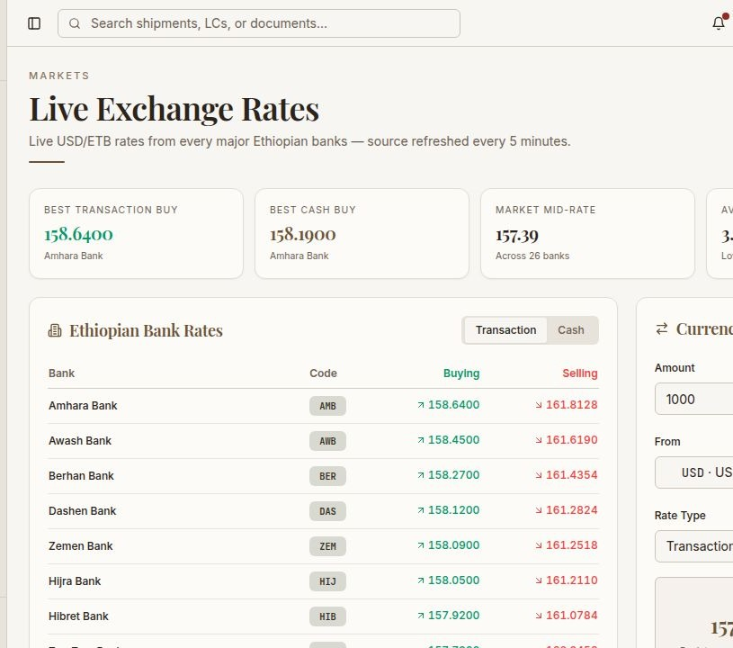
MODULE 09 · MARKETS
Live Exchange Rates
Live USD/ETB rates from every major Ethiopian bank — refreshed every five minutes with a built-in converter.
Buy and sell rates from 26 banks
Best transaction and cash buy spotlights
Market mid-rate and average spread
Currency converter for instant quotes
EXIMMAN · My Import & Export Manager
FOR IMPORTERS & EXPORTERS
13 / 15

Slide 14
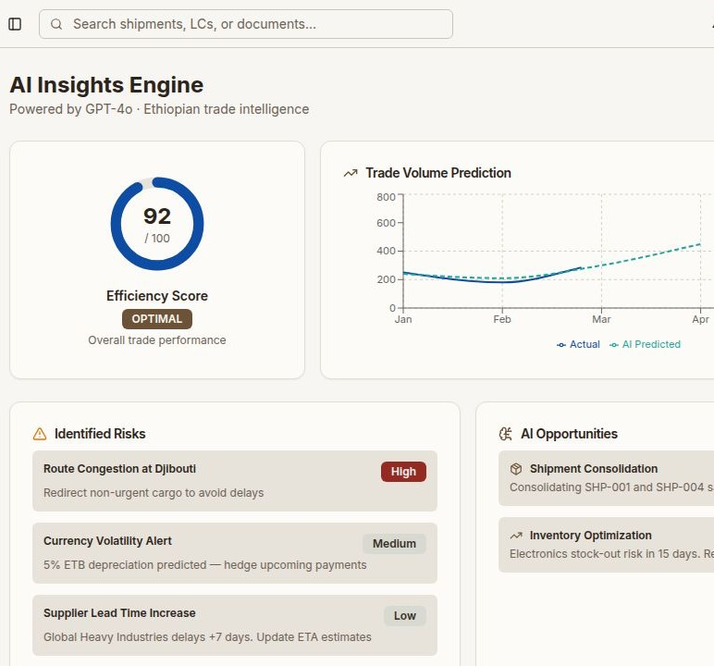
MODULE 10 · INTELLIGENCE
AI Insights Engine.
Risk scoring, FX hedging hints and shipment consolidation suggestions —
powered by GPT-4o, tuned for Ethiopian trade context.
WHO IT'S FOR
Importers
Exporters
Open and settle LCs
Sourcing & purchases
Customs & duty filing
CAD instruments
Inland logistics
Outbound shipments
Inventory control
FX & receivables
EXIMMAN · My Import & Export Manager
SMART BY DEFAULT
14 / 15

Slide 15
READY WHEN YOU ARE
Run your import
and export business
from one place.
Open your first LC, file a customs declaration, track a shipment to Modjo,
or reconcile a CAD — all in your first afternoon with EXIMMAN.
Sign in to dashboard →
Request a demo
EXIMMAN · My Import & Export Manager · Addis Ababa, Ethiopia
15 / 15

