Slide 1
InsurePro
Team Details
Project: InsurePro AI
Domain: HealthTech / InsurTech
KRISHNAKANTH M
SHIBIRAM R S
KANAGARAJ G
PRASANTH M S
GOWTHAM S
AI
AI in Life Insurance Underwriting Intelligence

Slide 2

Use Case Details
AI in Life Insurance Underwriting Intelligence
Objective
Scope
System Must Do
Automate and accelerate life insurance underwriting using AI
Incomplete or self-declared customer health data
Collect customer data from digital application forms
Validate customer data and assess health-based risk accurately
Limited availability of verified medical datasets
Validate data authenticity using rules and consistency checks
Reduce costs, fraud, and customer drop-offs while improving decision quality
Requirement for model explainability and auditability
Apply AI to assess health risk and detect anomalies
Generate a risk score and underwriting decision (approve / load / defer / reject)

Slide 3
Problem Statement
The challenge in health insurance underwriting today
⏱
Slow Process
📋
Human Error
Manual underwriting takes days or weeks — delaying coverage for patients who need it urgently.
Manual data entry from medical reports introduces errors that lead to incorrect risk assessment.
💰
High Cost
📄
Paper-Heavy
Employing large underwriting teams is expensive, making insurance inaccessible for smaller providers.
Medical reports are still mostly paper or image-based, making automated processing difficult.

Slide 4
Impact on Sector & Industry
Why this matters for healthcare and insurance
$5.5T
40%
Global health insurance market by 2030
Underwriting cost reduced with automation
3 Days → 3 Min
60%
Processing time improvement
Reduction in manual data entry errors
InsurePro AI directly addresses these gaps by automating the full underwriting pipeline — from OCR to risk scoring.

Slide 5
Abstract
Project overview and objectives
InsurePro AI is a full-stack health insurance underwriting system designed to automate the end-to-end process of analyzing medical reports and generating insurance quotes. The system accepts a policyholder profile and a scanned medical report image. Using Tesseract OCR running directly in the browser, it extracts text from the report and uses regex-based pattern matching to identify medical values such as glucose, blood pressure, HbA1c, and cholesterol. A rule-based risk scoring engine — aligned with ADA and AHA/ACC guidelines — assigns risk scores based on age, BMI, lifestyle, family history and clinical values. The system then maps the score to one of 5 premium tiers, from Platinum (₹4,000/yr) to Declined.
🎯 Automate OCR
⚡ Instant Quotes
🔒 No API Keys

Slide 6
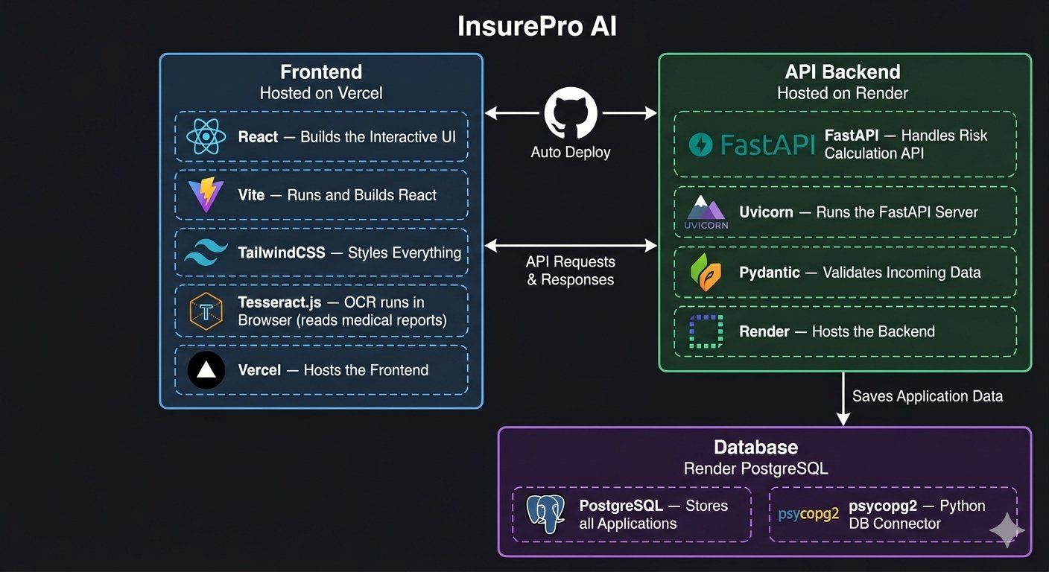

Slide 7
Requirements Collected
Functional and Non-Functional requirements of InsurePro AI
Functional Requirements
Non-Functional Requirements
Automated Data Ingestion from Digital Forms
High Accuracy and Reliability
Rule-Based and AI-Based Data Validation
Regulatory Compliance and Auditability
Predictive Risk Scoring and Classification
Data Privacy and Security
Fraud Detection and Anomaly Identification
Scalability for Large Customer Volumes
Medical Report OCR (Tesseract.js in Browser)
Low Latency for Real-Time Underwriting
Insurance Premium Tier Generation
No Cloud API Dependency (Offline OCR)
Policy Application Storage (PostgreSQL)
Cross-Browser Compatibility

Slide 8
Advantages
Key benefits of InsurePro AI
🌐
Browser-side OCR
⚡
Instant Results
🔒
No API Keys Needed
Tesseract.js runs OCR directly in the user's browser — no image is uploaded to a server, ensuring data privacy.
Risk assessment and premium calculation happens in seconds, replacing a process that used to take days.
Fully offline OCR with no dependency on paid cloud APIs like Google Vision or AWS Textract.
📊
Medical Guidelines
💻
Full Stack Modern
🧪
Sample Profiles
Risk scoring follows ADA (diabetes) and AHA/ACC (cardiovascular) guidelines for accurate, defensible decisions.
React + FastAPI + Vercel + Render = production-ready, scalable architecture with CI/CD via GitHub.
Built-in sample data for Acceptable, Needs Review, and Declined profiles for easy demonstration and testing.

Slide 9
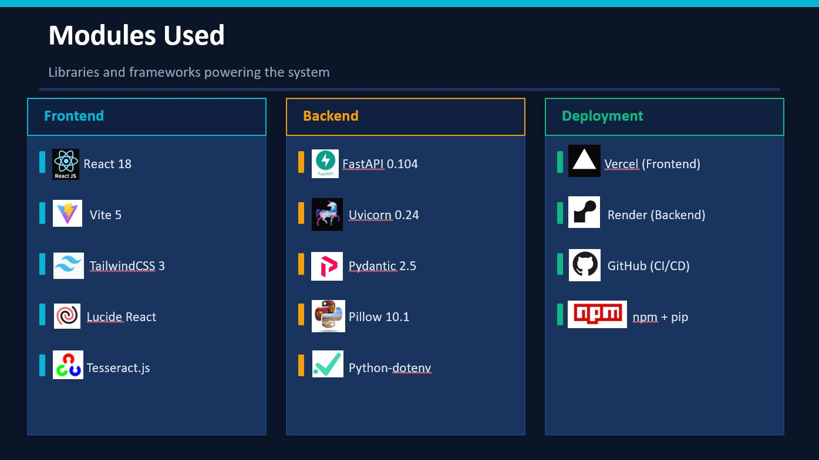














Slide 10
Hardware & Software Requirements
What you need to run InsurePro AI
🖥 Hardware Requirements
⚙️ Software Requirements
CPU: Any modern dual-core processor
OS: Windows 10+ / macOS / Linux (Ubuntu)
RAM: Minimum 4GB (8GB recommended)
Python: Version 3.9 or above
Storage: 500MB free disk space
Node.js: Version 18 or above
Browser: Chrome / Edge / Firefox (latest)
Tesseract OCR: v5.x (local) / Tesseract.js (web)
Network: Internet for deployment access
Git: For version control and deployment

Slide 11
Technical Requirements — Frontend
React application architecture and components
App.jsx
PolicyHolderProfile
ClinicalRiskAssessment
ResultCard
Root component
Manages step state
& API calls
Step 1 form
Input validation
Sample profiles
Step 2 upload
Tesseract.js OCR
Date & value extraction
Step 3 results
Premium tier display
Risk factor breakdown
→
→
→
Key FE Features:
Drag & drop file upload
Live OCR progress bar (0-100%)
Input guards (digits/letters only)
3 sample profiles
Responsive dark UI (TailwindCSS)

Slide 12
Technical Requirements — Backend & AI Tools
FastAPI risk engine and OCR pipeline
API Endpoints (FastAPI)
Risk Engine
GET /api/health
Server health check
Age bracket scoring
BMI calculation
GET /api/debug
Tesseract version info
Smoking / Alcohol / Exercise
POST /api/validate
Validate report date
Family history keywords
Fasting Glucose & HbA1c
POST /api/extract
Extract medical values
Blood Pressure (AHA/ACC)
POST /api/underwrite
Risk score + premium tier
Cholesterol & Triglycerides
🔍 OCR Tool: Tesseract.js (browser) · Regex extraction for dates & medical values · No cloud API required

Slide 13
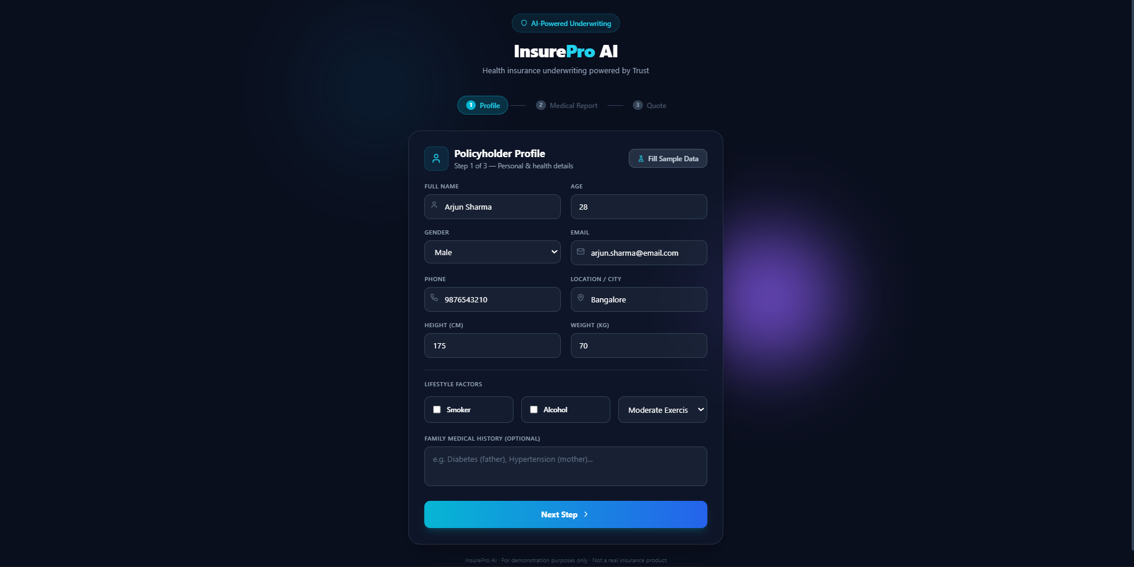
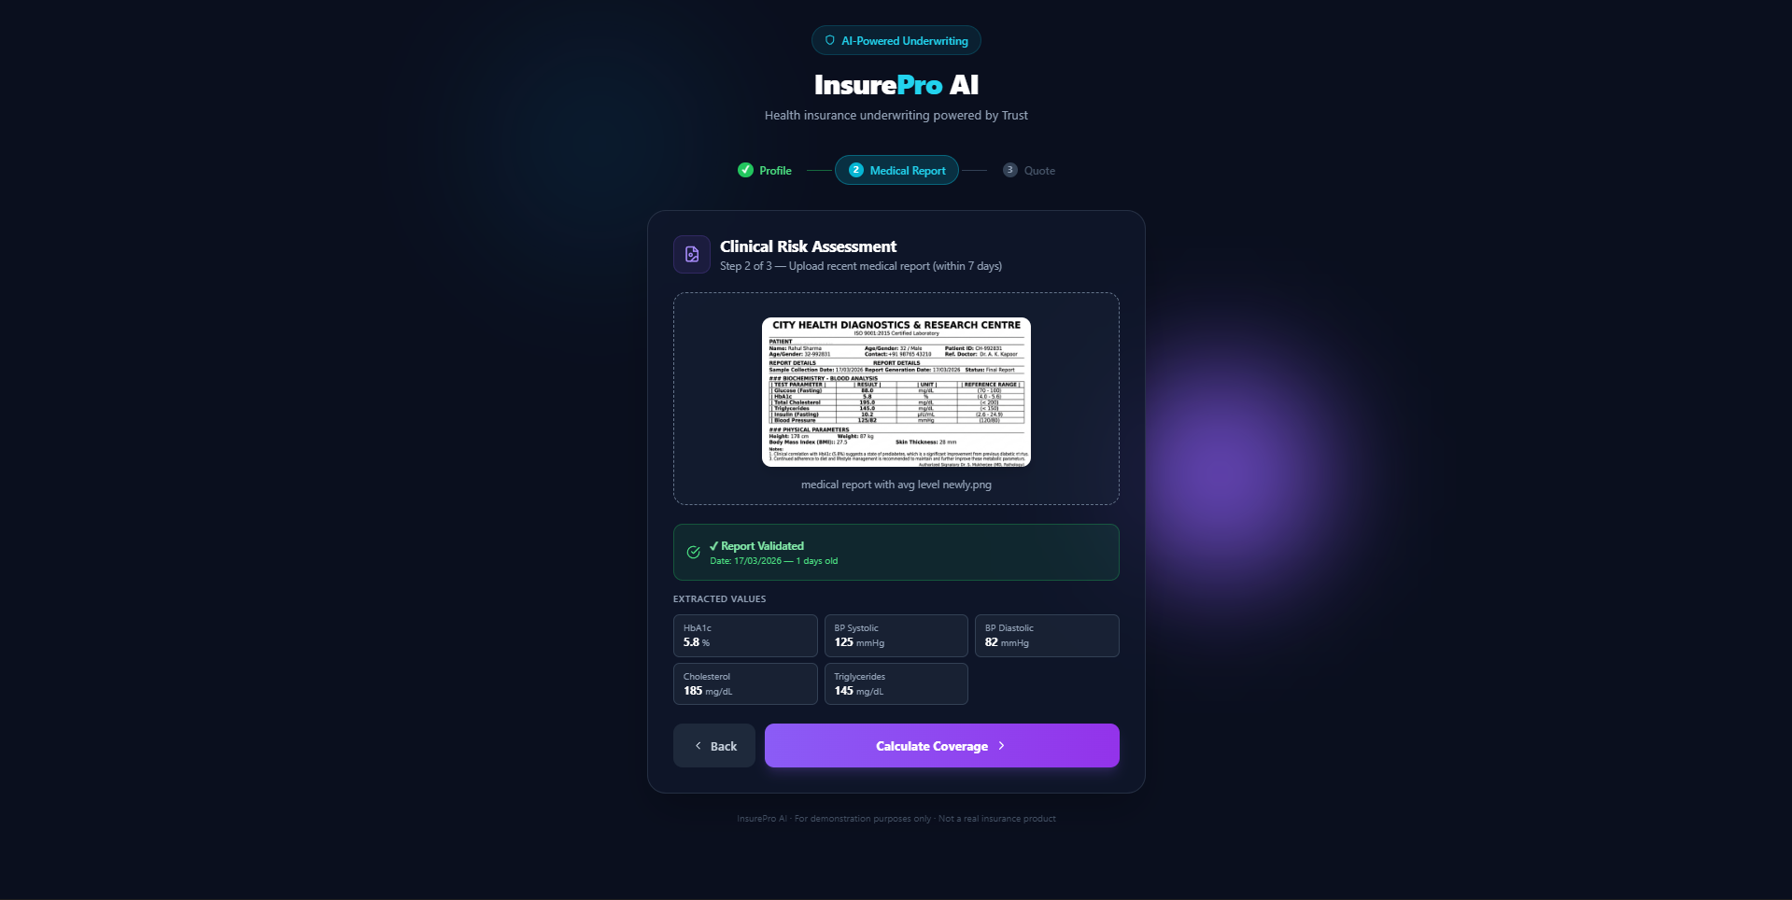
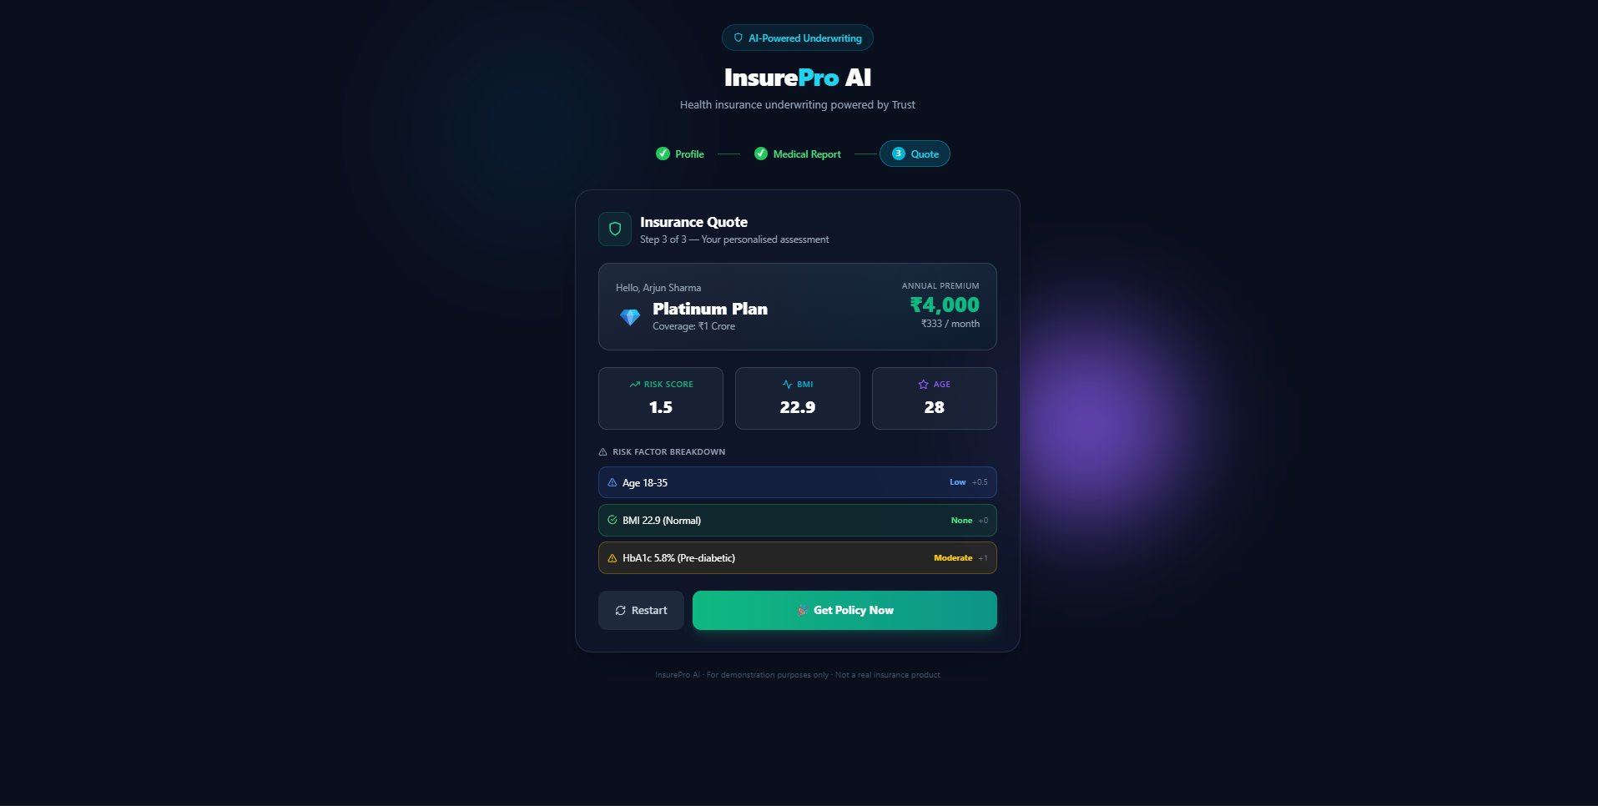
Output Screenshots
Live application running at insure-final.vercel.app
Step 1 — Profile Form
Step 2 — Medical Report Upload
Step 3 — Insurance Quote
[ Screenshot ]
[ Screenshot ]
[ Screenshot ]
Policyholder enters personal details, height/weight, lifestyle factors. Sample data buttons available for quick testing.
Drag & drop medical report image. Tesseract.js OCR runs in browser, extracts date and medical values with live progress bar.
Risk score, BMI, premium tier (Platinum/Gold/Silver/Standard/Declined) with detailed risk factor breakdown.
🌐 Live at: insure-final.vercel.app

Slide 14
Insurance Premium Tiers
Risk-based pricing aligned with industry standards
💎
Platinum
Risk Score: ≤ 1.5
Coverage: ₹1 Crore
₹4,000/yr
🏆
Gold
Risk Score: ≤ 3.0
Coverage: ₹75 Lakhs
₹6,000/yr
🥈
Silver
Risk Score: ≤ 5.0
Coverage: ₹50 Lakhs
₹9,000/yr
📋
Standard
Risk Score: ≤ 7.0
Coverage: ₹25 Lakhs
₹13,000/yr
❌
Declined
Risk Score: > 7.0
Coverage: N/A
—
* Premiums multiplied by age factor: 1.15× (36–45) · 1.35× (46–55) · 1.60× (55+)

Slide 15
Conclusion
What we built and what we achieved
InsurePro AI successfully demonstrates a complete, production-ready health insurance underwriting pipeline. The system integrates Tesseract.js OCR for client-side document processing, a rule-based risk scoring engine based on medical guidelines, and a modern React + FastAPI full-stack architecture — deployed live on Vercel and Render.
✅ Full 3-step underwriting flow working end-to-end
✅ OCR runs in browser — no server dependency, no API costs
✅ Risk engine follows ADA and AHA/ACC medical standards
✅ Deployed live — accessible from any device worldwide

Slide 16
Future Work
Enhancements planned for the next version
🗄️
Database Integration
🔐
User Authentication
Add PostgreSQL to store policyholder profiles, medical history and quote history for returning users.
JWT-based login system so agents and policyholders can access their history securely.
🤖
AI-Enhanced OCR
📱
Mobile App
Integrate an LLM layer (like Gemini or GPT-4 Vision) on top of Tesseract for handling low-quality or handwritten reports.
React Native version for field agents to capture and process reports directly from their phones.
📈
Analytics Dashboard
🔗
Insurer API Integration
Admin panel showing aggregate risk trends, approval rates and premium distribution across demographics.
Connect with real insurance provider APIs to generate actual policy documents and payment links.

Slide 17
Thank You!
InsurePro AI — Health Insurance Underwriting System
🌐 Live Demo: insure-final.vercel.app 💻 GitHub: github.com/teamgraphiks024-jpg/insure-final
Questions & Feedback Welcome

