Slide 1


GRAPHIKS
TEAM MEMBERS:
KRISHNAKANTH M
SHIBIRAM R S
KANAGARAJ G
PRASANTH M S
GOWTHAM S

Slide 2
Use Case Details
Use Case Title
AI in Life Insurance Underwriting Intelligence
Objective
Automate and accelerate life insurance underwriting using AI
Validate customer data and assess health-based risk accurately
Reduce costs, fraud, and customer drop-offs while improving decision quality
Scope
Incomplete or self-declared customer health data
Limited availability of verified medical datasets
Requirement for model explainability and auditability
System Must Do
Collect customer data from digital application forms
Validate data authenticity using rules, consistency checks, and external sources
Apply AI to assess health risk and detect anomalies or misrepresentation
Generate a risk score and underwriting decision (approve / load / defer / reject)

Slide 3
Use Case Sector Mapping & It’s Impact
Industry Sector
Life Insurance
Financial Services
Sample Industry Players
Life Insurance Corporation of India (LIC)
HDFC Life Insurance
Impact
Faster policy issuance
Reduced operational costs
Improved customer experience
Lower fraud-related losses

Slide 4
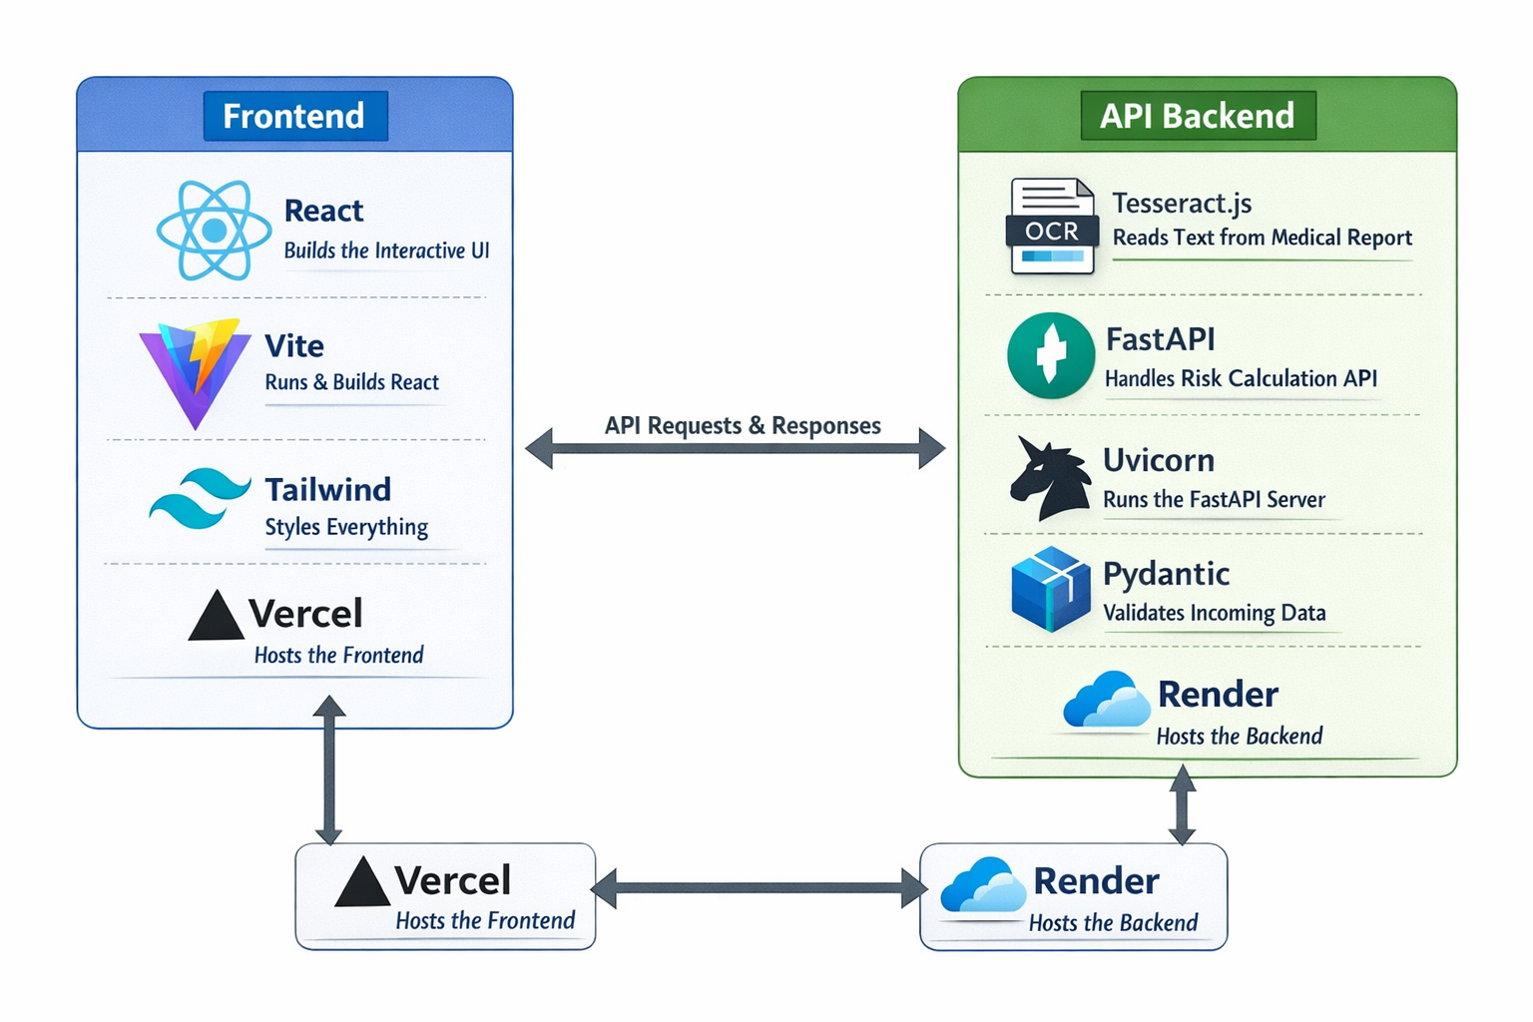
SOLUTION ARCHITECTURE

Slide 5
Requirements Collected
Functional Requirements :
Automated Data Ingestion From Digital Forms
Rule-Based And Ai-Based Data Validation
Predictive Risk Scoring And Classification
Fraud Detection And Anomaly Identification
Non-Functional Requirements :
High Accuracy And Reliability
Regulatory Compliance And Auditability
Data Privacy And Security
Scalability For Large Customer Volumes
Low Latency For Real-Time Underwriting

Slide 6
THANK
YOU !

