Slide 1







ZIMBABWE AGRICULTURAL SHOW 2026
PFUMA
pfuma · the Shona word for wealth
Enterprise agri-health intelligence for Zimbabwe
For a rural family, that wealth is standing in the kraal.
We built the system that protects it.
5 ROLES · 1 RECORD
POLICE-CLEARED SALES
AI ASSISTANT + IOT COLLAR
TEAM GRIWD
Arnold T. Mapindu · Adrianny Jaliele
Notes:
Hook, say it first: Pfuma is the Shona word for wealth — and for a rural family, that wealth is usually standing in the kraal. We built an app that protects it: stops your cattle being stolen, catches disease before it spreads, and gets police and vets involved digitally instead of on foot. Then stop talking and let them ask a question.

Slide 2




01
THE PROBLEM
Livestock is often a rural family's largest store of wealth. It is also the least protected asset they own.
500,000+
3,400+
0
LOST TO JANUARY DISEASE
ARRESTS IN ONE CRACKDOWN
VERIFIABLE DIGITAL RECORDS
Theileriosis has killed more than half a million cattle in Zimbabwe since 2016. Most of that is preventable if it is caught early.
Stock theft is organised, not occasional. A single ZRP operation produced over three thousand four hundred arrests.
Theft, ownership disputes and outbreaks are tracked on paper, by memory, or not at all. A phone call disappears.
The gap isn't goodwill — it's proof. Police cannot clear a sale they have no visibility into, and a buyer cannot check a story he has only been told.
Notes:
Pick ONE opener depending on who is in front of you. To a farmer: how do you prove a cow is really yours if someone disputes it? To anyone: January Disease has killed 500,000+ cattle since 2016. To a skeptic: theft, disputes and outbreaks are tracked on paper, by memory, or not at all.

Slide 3






02
WHAT PFUMA IS
One platform. Five kinds of account.
One shared livestock record.
A farmer registers an animal
It's the paper trail everyone already should have — except it's real, it's digital, and nobody can fake it after the fact.
Breed, tag ID, brand mark, dip-tank and health history — recorded once, kept for life.
A vet certifies its health
Consultations, treatments and certificates become part of that animal's permanent file.
THE 30-SECOND ANSWER
An officer must clear it before sale
Ownership and brand papers verified, movement-permit number issued. Built in, not optional.
Not a replacement for the vet or the police. PFUMA gives that relationship a paper trail. A phone call disappears; a record does not.
A buyer sees all of it before paying
Not a stranger's word — a record, with the vet note and the clearance attached.

Slide 4

03
FIVE ROLES, ONE RECORD
FARMER
VETERINARIAN
SUPPLIER
RETAILER / BUYER
POLICE
Registers animals once — breed, tag, brand, health. Then gets weight tracking, vaccination due-dates and geofence alerts, and a verified profile buyers trust.
A caseload dashboard by province and district — real surveillance data, not guesswork. Farmers consult directly; certificates become permanent record.
Feed, medicine and vaccines sold straight to the farmers in each district who need them — instead of a phone call and a guess.
Every listing has passed police clearance, and usually a vet certificate, before it is even visible. You buy a record, not a promise.
Reviews signup applications, verifies ownership and brand papers, and issues the movement-permit number that unlocks a sale.
Nobody self-certifies. Police accounts are provisioned by an existing verified officer — never self-service. Vet applications are peer-reviewed by an already-verified vet. Every role uploads an ID plus a role-specific credential.
Ask what they do, then use the matching pitch — the same platform sounds different to a farmer, a vet and a buyer.
Notes:
Branch the conversation by who they are — ask what they do, then use the matching pitch. If they push on fake officers: police accounts aren't self-signup, an existing verified officer creates and vouches for the next one, the same way real ZRP units onboard.

Slide 5



04
THE JOURNEY OF ONE ANIMAL
Walk it as a story, not a diagram — it is the same file, growing over time.
1
2
3
4
5
REGISTER
MONITOR
TREAT
CLEAR
SELL
The farmer records breed, tag ID, brand mark and dip-tank details. No brand on record is flagged as a risk before any sale.
The collar reports temperature, heart rate, movement and location. A fever spike or a boundary breach raises an alert immediately.
The farmer messages a vet in-app. The vet reviews, treats, and can order medicine from a supplier — three roles, one system.
The listing opens as pending_clearance. An officer verifies ownership and brand papers and issues a movement-permit number.
Only now can buyers see it. The vet's health record and the police clearance travel with the sale.
The headline feature: the sale cannot go live until an officer clears it. That gate lives in the software, not in a policy document — which is exactly why it doesn't get skipped.
Every step is the same animal's file — a farmer who registers once never re-enters it.

Slide 6







05
INSIDE THE PLATFORM
Jinda AI Assistant
Weighted Diagnostics
Lifecycle & Compliance
IoT Command Center
Plain-language answers on disease, law and herd analytics. Role-aware.
Primary vs secondary symptom matching, with multi-step action plans.
Weaning and gestation countdowns; overdue, due today, upcoming.
Vitality Index fusing temperature, heart rate and activity. GPS geofencing.
Vet Advisory Portal
Police Oversight
Compliance Library
Auth & Access Control
Ticketing by province and district, plus DVS regional hotlines.
Signup review queue and sale-clearance queue with permit numbers.
Cited Zimbabwean livestock law; cattle, pigs, sheep and goats.
bcrypt passwords, JWT sessions, strict per-owner data scoping.
React (Vite) + Tailwind web app · Expo mobile app · Flask + PyMySQL API · MySQL · Recharts.

Slide 7

06
JINDA — THE AI FARM ASSISTANT
Answers in plain language
Built for a farmer with a phone, not a technician with a manual. Natural-language questions, no forms to learn.
JINDA
Farm assistant · online
Trained on what actually kills herds here
Mombe yangu iri kudedera uye haisi kudya. Ndoita sei?
January Disease (Theileriosis), Anthrax, Foot and Mouth, Lumpy Skin, African Swine Fever, and cattle gestation and weaning standards.
Knows the law, and says so
Those signs fit January Disease. Check for swollen glands behind the ear and a temperature above 39.5 °C. It is notifiable — you must report it to a DVS or police officer.
Draws on the cited compliance research to answer "what do I legally need to keep or sell this animal?"
Runs the herd maths for you
Herd size, health trends and analytics on request — and it will navigate the app when asked.
What do I need before I can sell her?
Role-aware by design
A brand mark on record, a vet health note, and police clearance. Two of the three are already on her file.
It refuses to discuss another user's animals. A vet sees oversight; a farmer sees only their own.
Jinda answers in the user's own words — including Shona — and pushes toward the legally required reporting step rather than "wait and see".

Slide 8




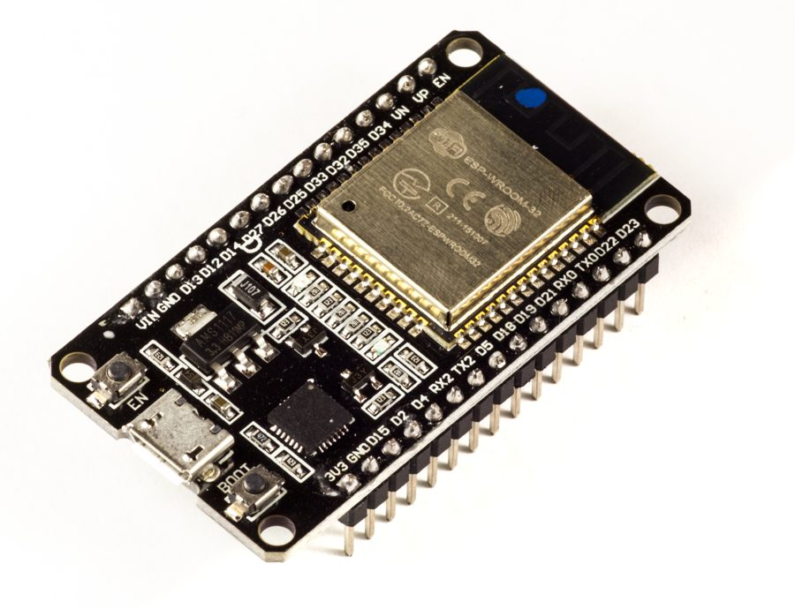
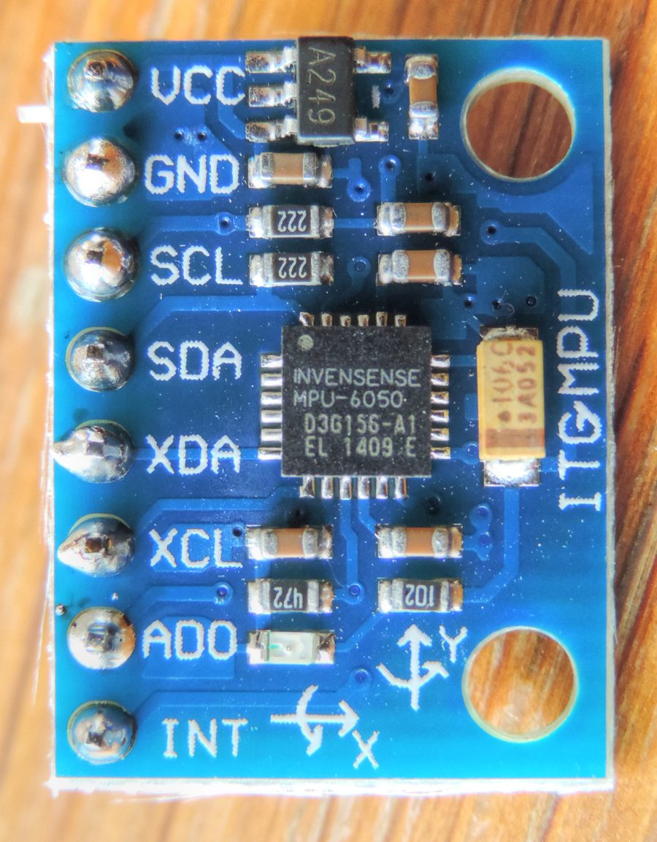
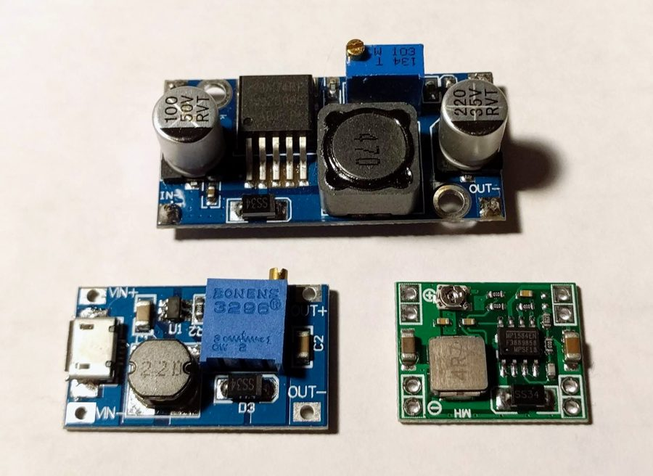
07
THE COLLAR THAT WATCHES THE HERD
We did not just build software. The collar is a real, buildable design — wiring diagrams, bill of materials and firmware included.
CN-01 COLLAR NODE
LoRa 433 MHz
BS-01 BASE STATION
FLASK API + APP
ESP32-WROOM-32, solar + LiPo, worn on the animal
Long range, no WiFi and no cell signal needed at the kraal
Fixed at the farm — LoRa gateway bridging to WiFi
Records land in the animal's file; alerts hit the phone
DS18B20 probe
MAX30102
MPU-6050 IMU
NEO-6M GPS
Body temperature — fever flagged automatically
Heart rate, fused into the Vitality Index
Movement and activity, filtered for sensor noise
Location and geofence breach alerts
PARTS WE ALREADY HAVE ON THE BENCH
Buildable today. Full pin-level wiring, BOM with supplier links, and firmware for both boards are in the repo.
ESP32-WROOM-32 devkit
MPU-6050 (GY-521)
LM2596 buck converter
Notes:
One sentence version: we designed real collar hardware — ESP32, GPS, heart-rate and temperature sensors, talking to a base station over long-range radio — so it works on a farm with no WiFi and no cell signal near the cattle. If they push, show the actual_equipment photos on the laptop.

Slide 9
08
BUILT ON ZIMBABWEAN LAW
Every headline feature maps to a specific Act — researched, cited, and in the repo for anyone who wants to check it.
WHAT PFUMA ENFORCES | THE LAW IT OPERATIONALIZES
Listings start pending_clearance; an officer verifies ownership and brand papers and issues a movement-permit number | Stock Theft Prevention Act [9:18]
Vet signup requires a CVSZ registration number, peer-reviewed by an already-verified vet | Veterinary Surgeons Act [27:15]
Animal records capture brand mark, tag ID and dip-tank; "no brand on record" is flagged before a sale | Brands Act + Livestock Identification Regs
Jinda pushes toward DVS or police reporting when a notifiable-disease pattern appears | Animal Health Act [19:01]
Cross-district sales prompt for a DVS veterinary movement permit alongside police clearance | The "two-gate" movement process
Retailer signup requires acknowledging disclosure, fixed pricing and the statutory right of return | Consumer Protection Act [14:44]
Said honestly: this is researched and citable, not a lawyer-certified audit. Sources are ZimLII, FAOLEX, CVSZ, Veritas and the Consumer Council — and where a detail could not be confirmed, the research says so plainly instead of guessing.

Slide 10

09
WHAT THIS CHANGES
FOR THE FARMER
Ownership he can prove, disease caught early, and a fair, documented sales channel instead of an isolated lowball offer. Verified profiles and clean sale history also make livestock wealth easier to borrow against.
FOR THE VETERINARIAN
Fewer wasted trips and real outbreak visibility. Province and district tagging builds exactly the regional surveillance data DVS needs for contact tracing.
FOR SUPPLIERS AND RETAILERS
A direct channel to the farmers who need their stock, and buyers who are no longer one bad purchase away from a receiving-stolen-goods charge.
FOR POLICE AND DVS
Clearance stops being a paper courtesy and becomes a structural gate. Officers review from a queue instead of chasing paperwork on foot.
FOR THE COUNTRY
Fewer disease deaths, less theft, better price discovery and easier access to vets compound into real rural household income — a measurable outcome, not a technology showcase.
The signup flow accepts title deeds, 99-year leases, offer letters, A1/A2 permits and communal land allocation letters — so communal farmers are not excluded by design.

Slide 11





10
WHAT'S ACTUALLY BUILT
Most projects at this stage are a UI mockup. Here is what already runs.
Working backend
Real database
Real security
Flask + PyMySQL with 30+ endpoints — not a stubbed demo API.
A MySQL schema covering animals, health records, listings, clearances and users.
bcrypt hashing, JWT sessions, per-owner scoping, uploads served outside the web root.
Web + mobile
Hardware design
Cited legal research
React (Vite) + Tailwind on the desktop, an Expo app on the phone, one API behind both.
Two boards, full pin-level wiring, BOM with supplier links, firmware for both.
Six Acts mapped to features, with sources — and the gaps named rather than hidden.
We built the boring, unglamorous part first — real auth, real database, real legal research. That is the difference between a showcase and a system.

Slide 12

11
QUESTIONS YOU'LL GET AT THE STAND
What if a farmer doesn't have a smartphone?
Isn't this just another app abandoned in a year?
A real gap in version one — it needs a phone or the web app. Every digital agriculture tool has to solve it. It is on the roadmap, not something we pretend isn't a limitation.
We built the unglamorous part first: real authentication, a real database, real legal research. Most projects at this stage are a mockup — ours has a working backend and hardware you could order parts for today.
How is this different from calling the vet or the police?
Who stops a fake officer approving fake sales?
You still call them. PFUMA doesn't replace the relationship, it gives it a paper trail. A phone call disappears. A record in PFUMA doesn't.
Police accounts aren't self-signup. An existing verified officer creates and vouches for the next one — the same way real ZRP units onboard members. You cannot register as police off the street.
Don't dodge these — they are good questions, and answering them straight is what makes the rest of the pitch believable.

Slide 13



12
PFUMA
Pfuma means wealth.
We built what protects it.
SEE IT LIVE
A demo account takes thirty seconds — look around as any role you like, even Police.
Five roles, one shared record. A sale that cannot go live until police clear it. An AI assistant that answers in a farmer's own words, and a collar that raises the alarm before anyone notices the animal is gone.
teamgriwd@gmail.com
Team GRIWD · Arnold T. Mapindu · Adrianny Jaliele
If you only remember five things
Pfuma = wealth, and this protects it
Five roles, one shared record
A sale can't go live until police clear it
500,000+ cattle lost since 2016 · 3,400+ arrests in one crackdown
It's real — working backend, real hardware, cited legal research
Zimbabwe Agricultural Show 2026
Notes:
Close by getting them to DO something: offer a demo account on the spot. If they're a farmer, vet or supplier genuinely interested, take their contact — a follow-up after the show is worth more than a booth conversation they forget by the next stall.

