Slide 1
Ghost Stories
Notes:
1

Slide 2
Do you believe in the supernatural?
Do you believe in Ghosts?
Are there any haunted towns/houses in the area?
Have you experienced something supernatural?
Notes:
2

Slide 3
Believe
Do you believe in the paranormal?
Have you seen something strange?
Have you heard something strange?
Have you heard a strange story?
Notes:
3

Slide 4

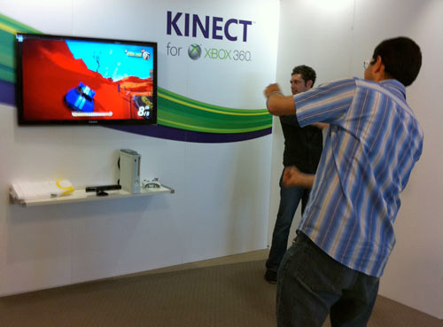
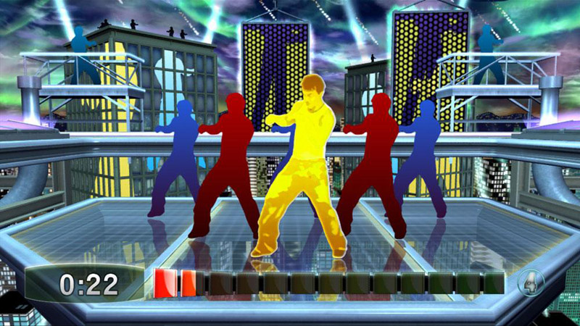
Ghost stories
Notes:
4

Slide 5
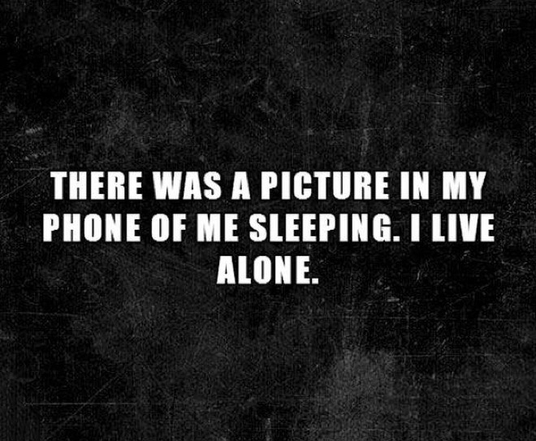
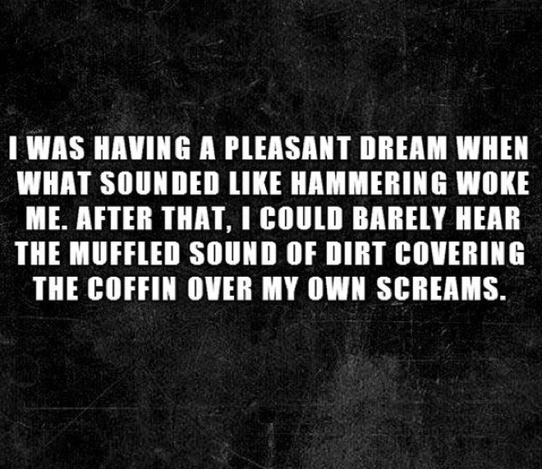

Slide 6
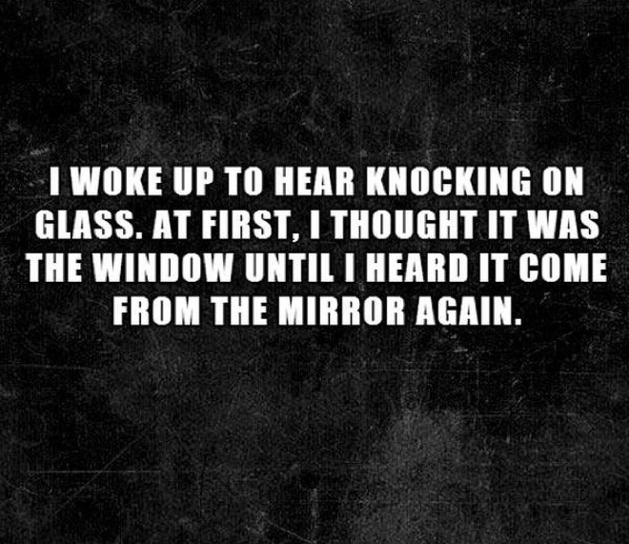
Notes:
6

Slide 7
Notes:
7

Slide 8
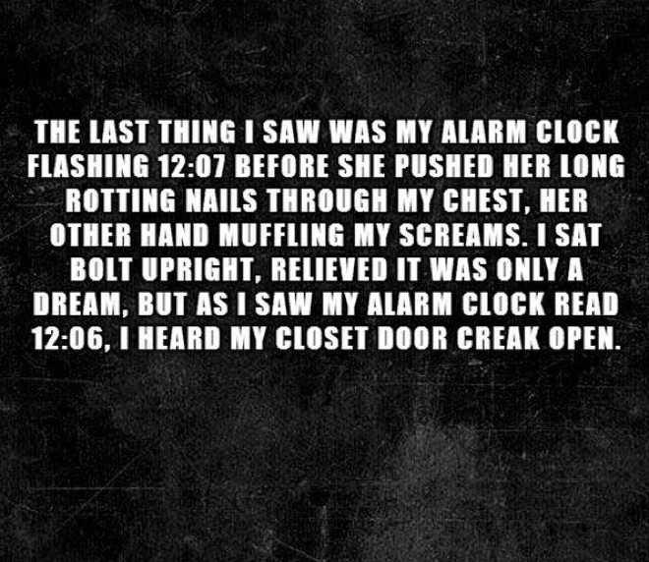
Notes:
8

Slide 9
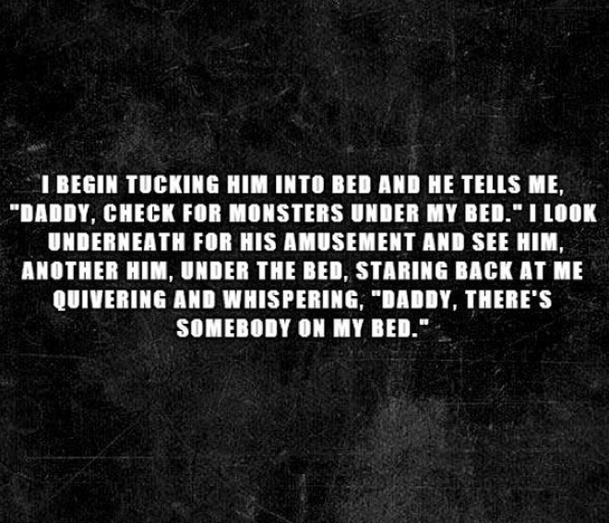
Notes:
9

Slide 10
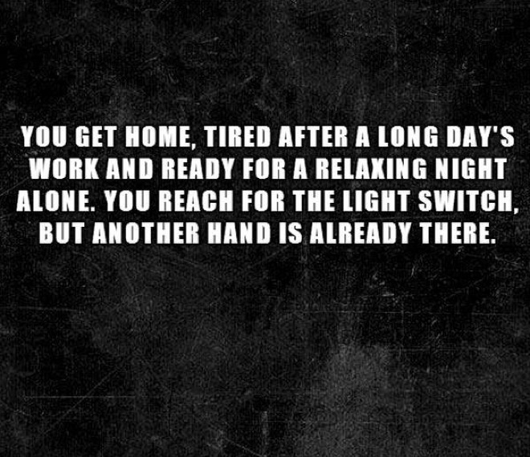
Notes:
10

Slide 11
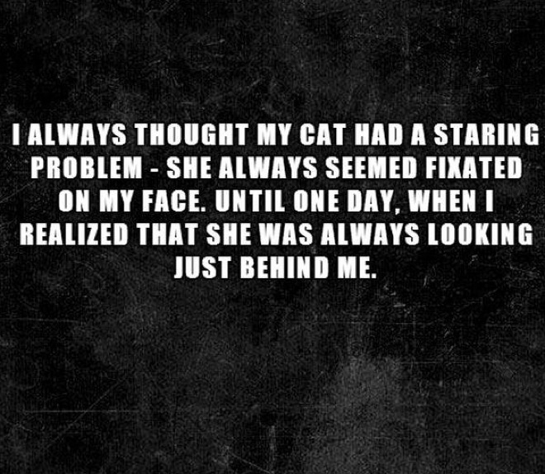
Notes:
11

Slide 12
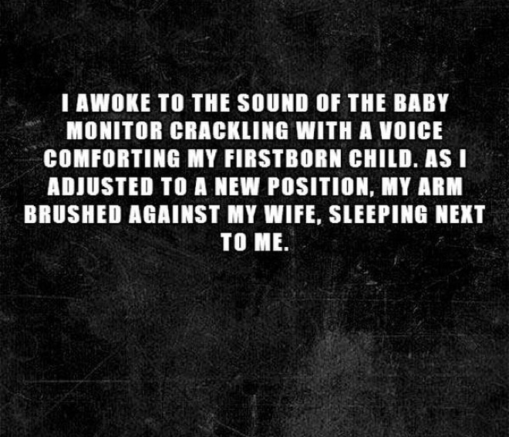
Notes:
12

Slide 13
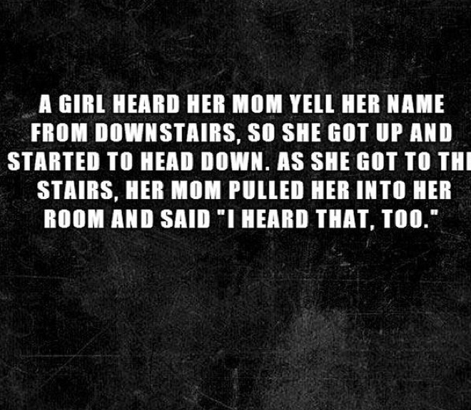
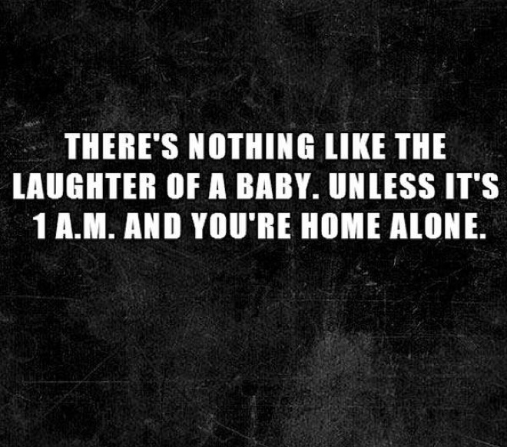
Notes:
13

Slide 14
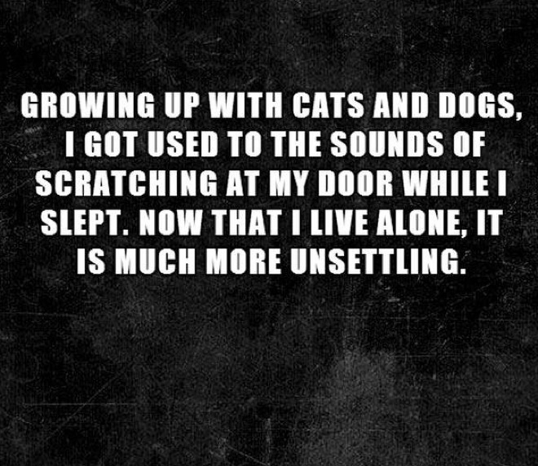
Notes:
14

Slide 15
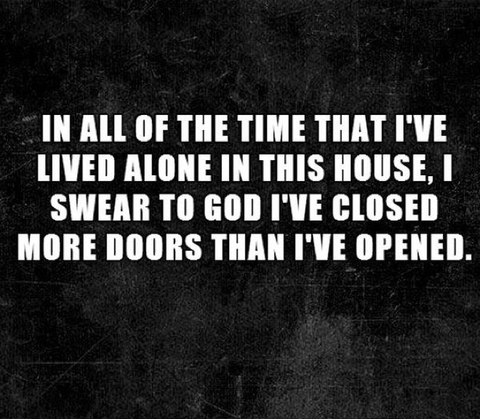
Notes:
15

Slide 16
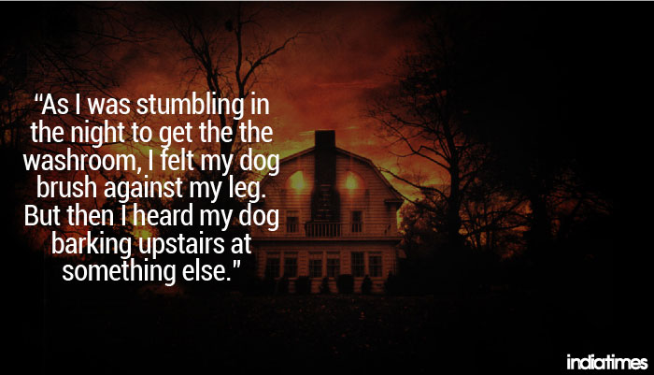
Notes:
16

Slide 17
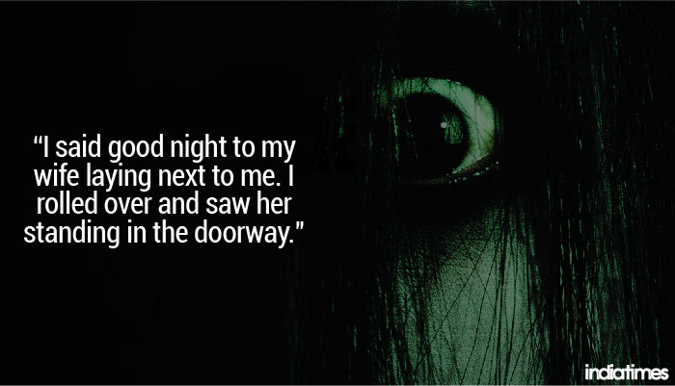
Notes:
17

Slide 18
A two sentence horror story
I want you to write a two sentence horror story
It must make sense
It must be interesting
It must be scary
Notes:
18

