Slide 1
Personal Finance Intelligence: Track, Recover and Forecast Money
Team Name : Innovision
Theme : Open Innovation
PS Category : Software
Team ID : DEX26346

Slide 2
IDEA TITLE | ONE VIEW OF YOUR FINANCIAL LIFE
Track, Recover and Forecast — Smarter Financial Decisions in One Platform
Problem : everyday money decisions are scattered across several apps, statements, reminder and memory.
Solution: A unified personal finance platform that helps users organise their finances, identify potentially recoverable payments, detect
recurring subscriptions, and understand how their current financial decisions may affect future savings.
1.Money Map:
Organise expenses,income,categories and investments in one dashboard.
2.Claimback:
Flag possible duplicate charges, refunds, and money that may be reclaimable.
3.Money Mirror:
Simulates how today’s decisions could affect a future budget or savings goal.
4. Subscription Leak Detection:
Highlights recurring payments and subscriptions that may be unused.
Transactions
Find patterns
Suggest actions
Preview impact
User decides
Example user journey:
Key Idea: Provide decision support, users approve any financial actions themselves.

Slide 3
TECHNICAL APPROACH | From Data To Useful Decisions
TECHNICAL APPROACH:
Prototype Architecture:
PROTOTYPE STACK:
Frontend: React or simple HTML/CSS/JavaScript
Backend: Python (FastAPI) or Node.js
Storage: SQLite for a local demo; encrypt sensitive data
Charts: Chart.js or Recharts
Testing: synthetic sample data and user-task tests
INPUTS: Manual entries • CSV imports • user-approved reminders
PROCESSING: Categorisation rules • recurring-payment detection • scenario calculator
INSIGHTS: Dashboard • claim checklist • future-budget scenarios
CONTROL: Consent • data minimisation • export/delete controls
Build Sequence: dashboard → recurring-payment flags → scenario simulator → claim checklist

Slide 4
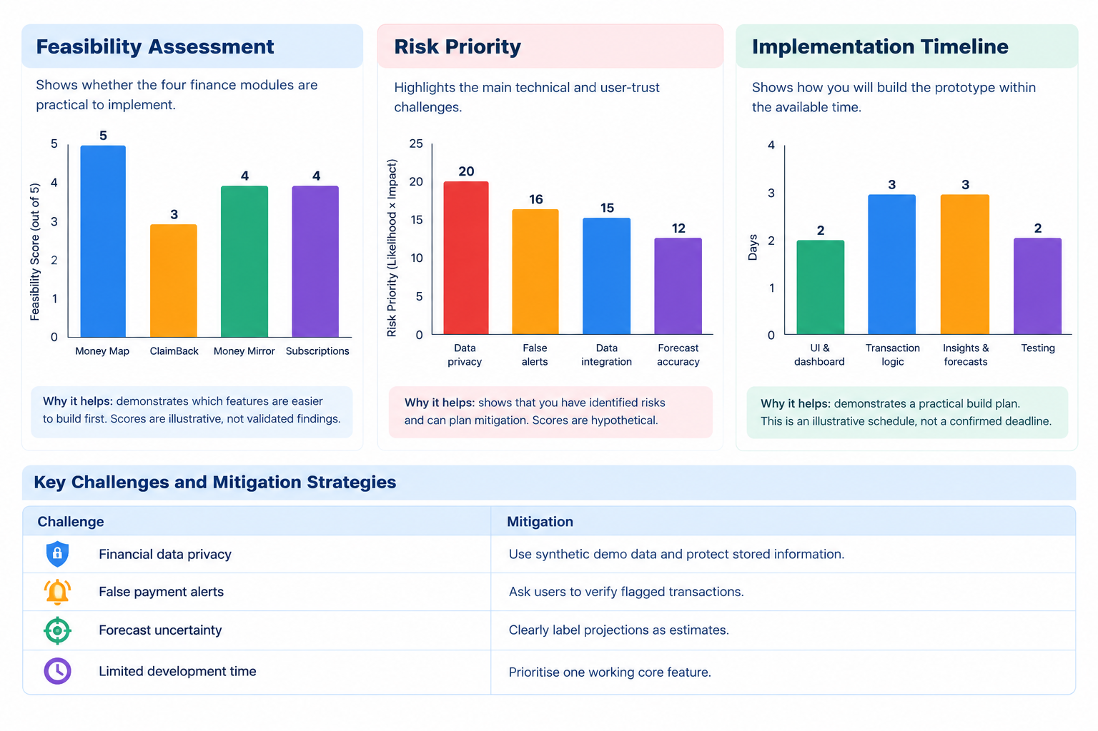
FEASIBILITY AND VIABILITY | Smart Small, Validate Early
Feasible MVP
Use synthetic user data and user-entered transactions. No bank integration is needed for the first demo.
Key Challenges
Misclassified transactions, false alerts, incomplete subscription data and user trust.
Mitigation
Show why an alert appeared , let users correct it, and label estimates as estimates.
Validation plan:
1
Use 20-30 synthetic
transaction sets.
2
Ask 10-15 users to complete
key tasks.
3
Measure categorisation accuracy
and useful alerts.
4
Track task completion time
And user reported clarity.

Slide 5
BUSINESS CANVAS | Who Benefits And How It Could Sustain
Mission & Vision
Help people understand their money clearly and make more informed everyday choises
Target users
Students, first-job earners, families and people managing multiple recurring payments.
Value proposition
One place to see spending patterns, possible recoveries, and the trade-offs of future choices.
Business and Sustainability Hypothesis:
Freemium: core tracking and basic insights free
Optional paid tier: advanced simulations and custom reports
Potential partnerships only after privacy and compliance review
Alternatives: spreadsheets, banking apps, budgeting apps
Differentiator hypothesis: connect recovery checks with future scenarios
Costs: hosting, maintenance, security, testing, and support

Slide 6
IMPACT AND BENEFITS | Make Financial Choices Easier To See
Clarity
Users can review income, spending, and investments in a single organised view.
Recurring-payment prompts can help users notice charges they may want to review.
Planning
Scenario comparisons can make savings goals and spending trade-offs easier to understand.
Awareness
How we will measure impact ?
Task success: can users find a transaction or identify a recurring payment?
Understanding: can users explain how a spending change affects a savings goal?
Usefulness: how many alerts are confirmed as relevant by test users?

Slide 7
RESEARCH AND REFERENCES
RBI — Financial Education
https://rbi.org.in
SEBI — Investor Education
https://sebi.gov.in
NPCI — Digital Payments
https://npci.org.in
OWASP — Application Security
https://owasp.org
React — Documentation
https://react.dev
FastAPI — Documentation
https://tiangolo.com
-THANK YOU …

