Slide 1
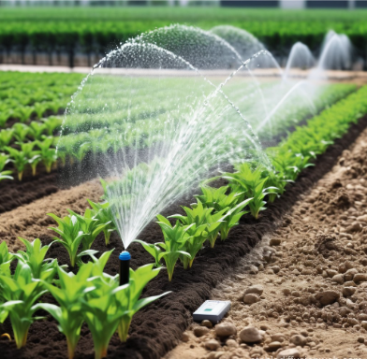
SMART AGRICULTURE USING IOT
PROJECT NAME - AquaMind
TEAM NAME - IOTRIX

Slide 2
Problem
PROBLEM STATEMENT
Can IoT-based smart irrigation reduce water wastage in farming?
Water Wastage in Traditional Irrigation
Manual Monitoring is Inefficient
Climate & Weather Dependency
Soil Degradation Due to Improper Irrigation

Slide 3
Solution
Real-time Soil Moisture Monitoring
Fully Automated Irrigation + Alerts
It also concerned with minimizing power use
It integrates sensing, controlling, and networking technologies to monitor the crops
THEME - "Precision irrigation for a sustainable future: saving every drop, and every watt."

Slide 4
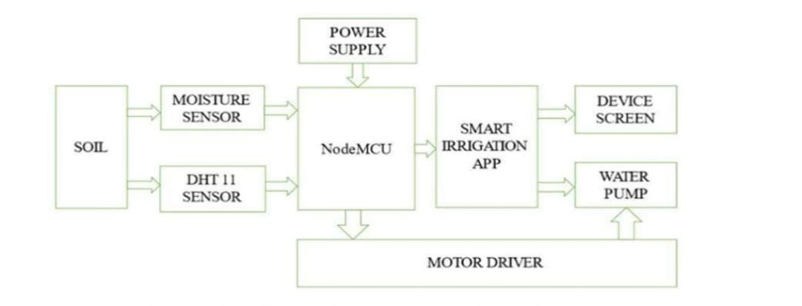
SYSTEM ARCHITECTURE

Slide 5
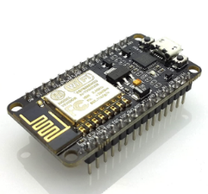
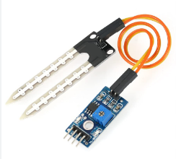
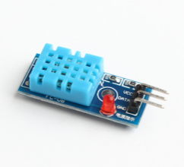
SYSTEM COMPONENTS -HARDWARE
ESP8266
Soil Moisture Sensor
DHT11 Sensor
Internet of Things (IoT) applications, enabling devices to connect to Wi-Fi networks and the internet
Measure or estimate the amount of water in the soil
A basic, ultra low-cost digital temperature and humidity sensor

Slide 6
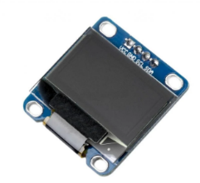
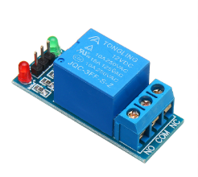
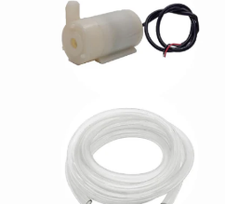
SYSTEM COMPONENTS -HARDWARE
OLED DISPLAY
RELAY MODULE
MOTOR
A device that can display text, graphics and images on a thin and flexible screen
Interface devices that enable the transfer of signals and information between different devices or systems
Acts as a pump, controlled by a microcontroller and sensors to automate watering based on real-time conditions

Slide 7
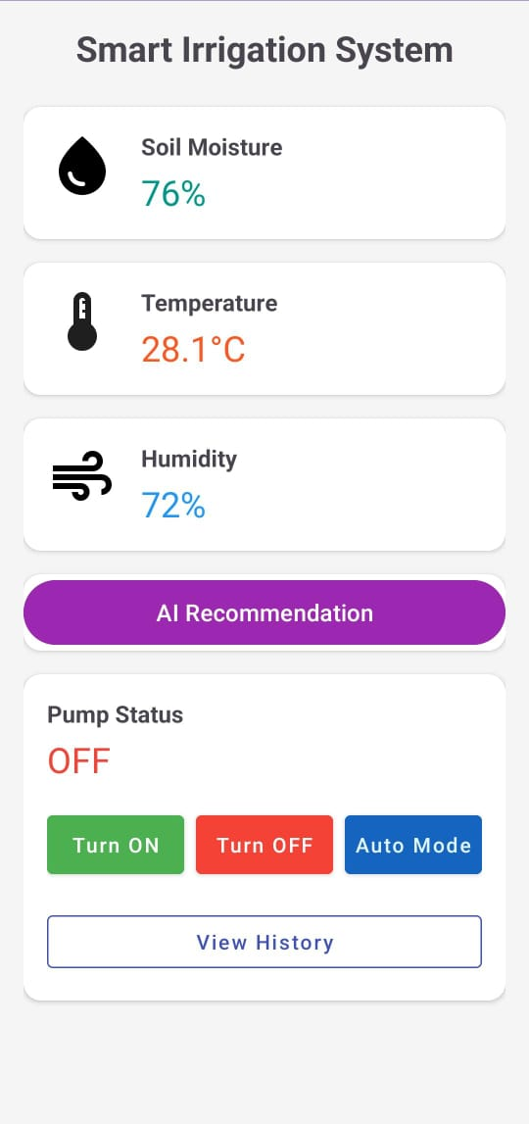
SYSTEM COMPONENTS - SOFTWARE
Arduino IDE : For programming the ESP8266 microcontroller logic
Communication Protocol
Rest API(HTTP)
ESP 8266 web Server
APP STACK
Android Studio(Java)
Retrofit(Networking)
Material Design
Key Features
Real-Time Control
Local AI Logic
Full History Logging

Slide 8
HOW IT WORKS
Standalone Server: The ESP8266 boots as a web server with a ready-to-use API.
Continuous Sensing: Constantly reads soil moisture, temperature, and humidity data.
Automatic Action: Triggers the water pump automatically based on soil moisture levels.
App Requests: The Android app sends commands and requests data via HTTP.
Live Data Sync: The hardware responds with JSON data for real-time app updates.
Activity Logging: Every pump action is logged with a timestamp in the device's history.

Slide 9
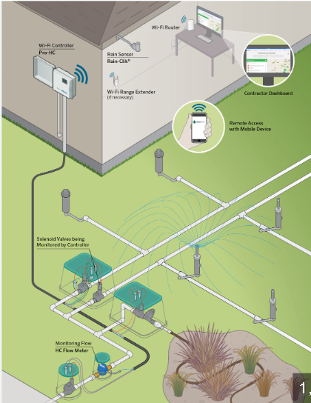
OUTCOMES
Water Savings: 30-70% reduction compared to flood irrigation
Yield Increase: 15-30% higher crop productivity (IoT Analytics 2023 data)
Cost Reduction: 50% lower labor + 60% energy savings (solar-powered)
Soil Health: Prevents salinity buildup + nutrient leaching
Scalability: Works for 0.1-acre gardens to 1000-acre farms
Sustainability: Reduces agricultural runoff (EPA compliance bonus)
ROI: Pays back in <12 months (Jain Irrigation case study)

Slide 10
Business Model
Segment | Homeowners &Gardeners | Commercial Farmers(Future)
Product | AquaMind DIY KIT | AquaMind Pro Subscribtion
Revenue | One-time purchase 9,000 to 13,000 | Annual SaaS Fee 20,000
Key Features | Easy setup Real-time app Basic history | Multi-Zone support Advanced AI analytics Fleet management API integration
Channel | Amazon, Website | Direct Sales, Agri-distributions

Slide 11
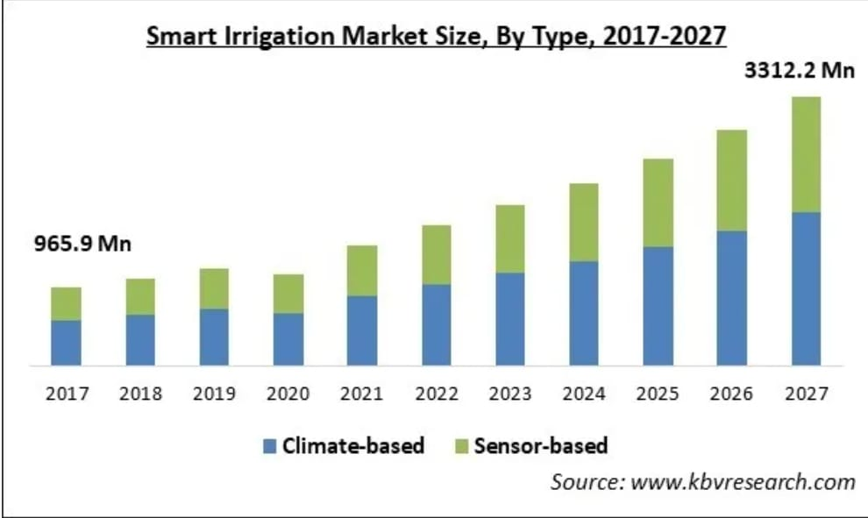
Business Model
Total Addressable Market (TAM): "The global smart irrigation market is projected to reach $3312.2 billion by 2027 “.

Slide 12
FUTURE ROADMAP
Phase 1: Refinement & Launch (0-12 months)·
Hardware
Software
Market
Phase 2: Expansion & Intelligence (1-3 years)
Multi-Zone Support
True AI Integration
Solar & Battery
Phase 3: Ecosystem & Scale (3-5 years)
Platform API
B2B Focus
Global Impact

Slide 13
THANK YOU!
🌱 Let’s Grow a Smarter Future Together We appreciate your time and interest in revolutionizing agriculture!
Email: teamiotrix@gmail.com
GitHub: https://github.com/teamiotrix04-ai/aquamind
MEMBERS | DELIVERABLE
Harshavarthan | Hardware
Jawahar | Backend(App)
Jayesh | Frontend(App)

