Slide 1
The Internet of Things: Some ISOC perspective
Frédéric Donck, Director, European Regional Bureau, Internet Society (ISOC)
Lisbon, 12 May 2016

Slide 2
The Internet Society
International, independent, non-profit organization that works for the open development and evolution of the Internet for all people.
Founded in 1992 by Internet Pioneers:
145 organization members
80,000 individual members (Join now!)
110 chapters worldwide
5 Regional Bureaus: Europe, Africa, Latin America & Caribbean, North America, Asia
Home to the IETF (Internet Engineering Task Force)
Sole focus is the Internet
Standards,
Development & Capacity Building,
Public Policy

Slide 3
Current Priorities
The opportunities and challenges facing the global Internet are as diverse as its 3 billion users.
1
2
3
4
Maintaining and strengthening multi-stakeholder processes both globally and locally.
Promoting robustness and resiliency of Internet security and privacy through technology standards and deployment.
Advancing the deployment of core Internet infrastructure and evolution of technology to ensure the sustainability and reliability of the Internet.
“Human Rights,”
wrt key technical aspects of the Internet and fundamental users abilities.

Slide 4
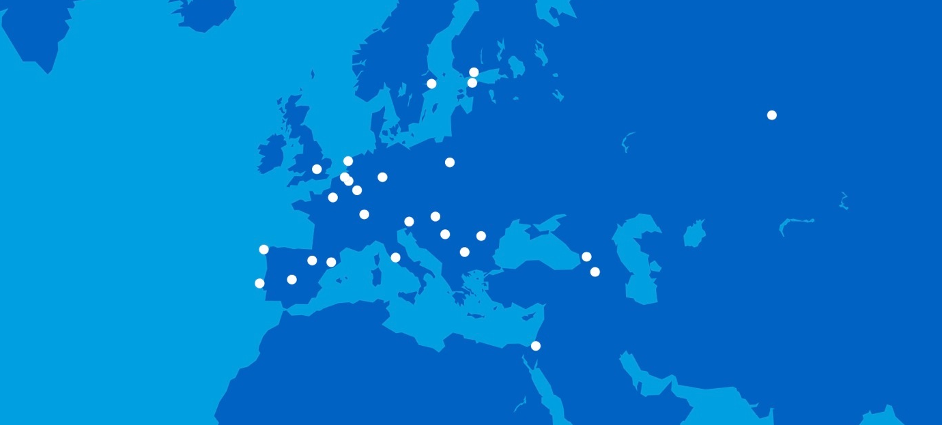
Europe
32 Chapters 9.465 Chapter members
Armenia
Belgium
Belgium Wallonia
Bulgaria
Estonia
Finland
France
Georgia
Germany
Hungary
Israel
Italy
Luxembourg
Malta
Montenegro
Netherlands
Norway
Poland
Portugal
Romania
Russia
Serbia Belgrade
Slovenia
Spain Aragon
Spain Catalonia
Spain
Spain Galicia
Sweden
Switzerland
Turkey
UK England
Ireland

Slide 5

IoT Overview: Concepts & Drivers
Notes:
Start with some IoT basics
What is it, where did it come from, and what’s driving it today?
Challenges in the opportunity

Slide 6
Our conversation to-day: IoT
What is it: definition(s)?
What kind of issues?
A single Conclusion for today!

Slide 7
1. What is it?
24 billion Internet connected objects by 2019 (Cisco) .. 75 billion networked devices by 2020 (Morgan Stanley) ..100 Billion by 2025 (Huawei)
Many incredible examples:
Refrigerator/RFID/bath
Glucose monitor in contact lens
Use of sensors in city services: potential for local regional, national and global optimisation of ressources (« smart » home to « smart » continent)
The Internet. Amazing how it has adpated to all of this…especially thanks to Internet characteristics.

Slide 8
Internet key characteristics: the Internet Model
The Internet is successful in large part due to its unique model of development and deployment:
Shared global ownership- no central control
Open technical standards
Collaborative Engagement models- researchers, business, civil society, academia, government
Freely accessible processes for technology and policy deployment
Transparent and collaborative governance
Notes:
Virtually everything we do online today is because of work done or of a standard or “best practice document” developed in the IETF constellatio

Slide 9
Internet key characteristics (2)
Best-effort transport between and within networks
The Internet does not care what is in the packets
A network of network (inter-network) designed to pass standardized packets of data
Openness
Innovation without permission
IPv4/IPv6 addresses

Slide 10
Definition(s)
IoT new..but concept already in the late 70’s and using IP to connect device in 1990 (IP-enabled-toaster)
No single universally accepted definition- Some specify the concept of IP or Internet while others not (eg.ITU/2012: « enabling advanced services by interconnecting things based on existing and evolving interoperable ICTs »)
Oxford dict.: « The Interconnection via the Internet of computing devices embedded in everyday objects, enabling them to send and receive data »
Different perspectives (not necessarily opposite)

Slide 11
Definition(s)
IoT refers broadly to the extension of network connectivity and computing capability to objects, devices, sensors and items not ordinarily considered to be computers
Exchanged data might not traverse the Internet or an IP based network
Likely, data generated or processed from those smart objects will ultimately pass through gateways with connectivity to IP-based networks and/or accessible via the Internet.
Users more concerned with services delivered (and implication) than issues of when or where data passes through an IP-based network…

Slide 12
If it’s not new, why now?: A Confluence of Market Trends
Ubiquitous Connectivity
COMPUTING ECONOMICS
MINIATURIZATION
UBIQUITOUS CONNECTIVITY
WIDESPREAD ADOPTION OF IP
Computing Economics
ADVANCES IN DATA ANALYTICS
RISE OF CLOUD COMPUTING
Advances in Data Analytics
Widespread Adoption of IP
Miniaturization
Notes:
1) New possibilities of IoT – and the reality of a hyperconnected world -- are a real testament to the open nature of the Internet –
2) May transform what it means to be “on the Internet”
Drivers are already evolving
Data Analytics → Artificial Intelligence.
Cloud computing → “Fog Computing” (collaborative multitude of end-user clients or near-user edge devices to carry out a substantial amount of storage)
There are a lot of enablers
New possibilities are a real testament to the open nature of the Internet –
Whether its 24 billion by 2019 or 50 billion 100 billion by 2025.

Slide 13
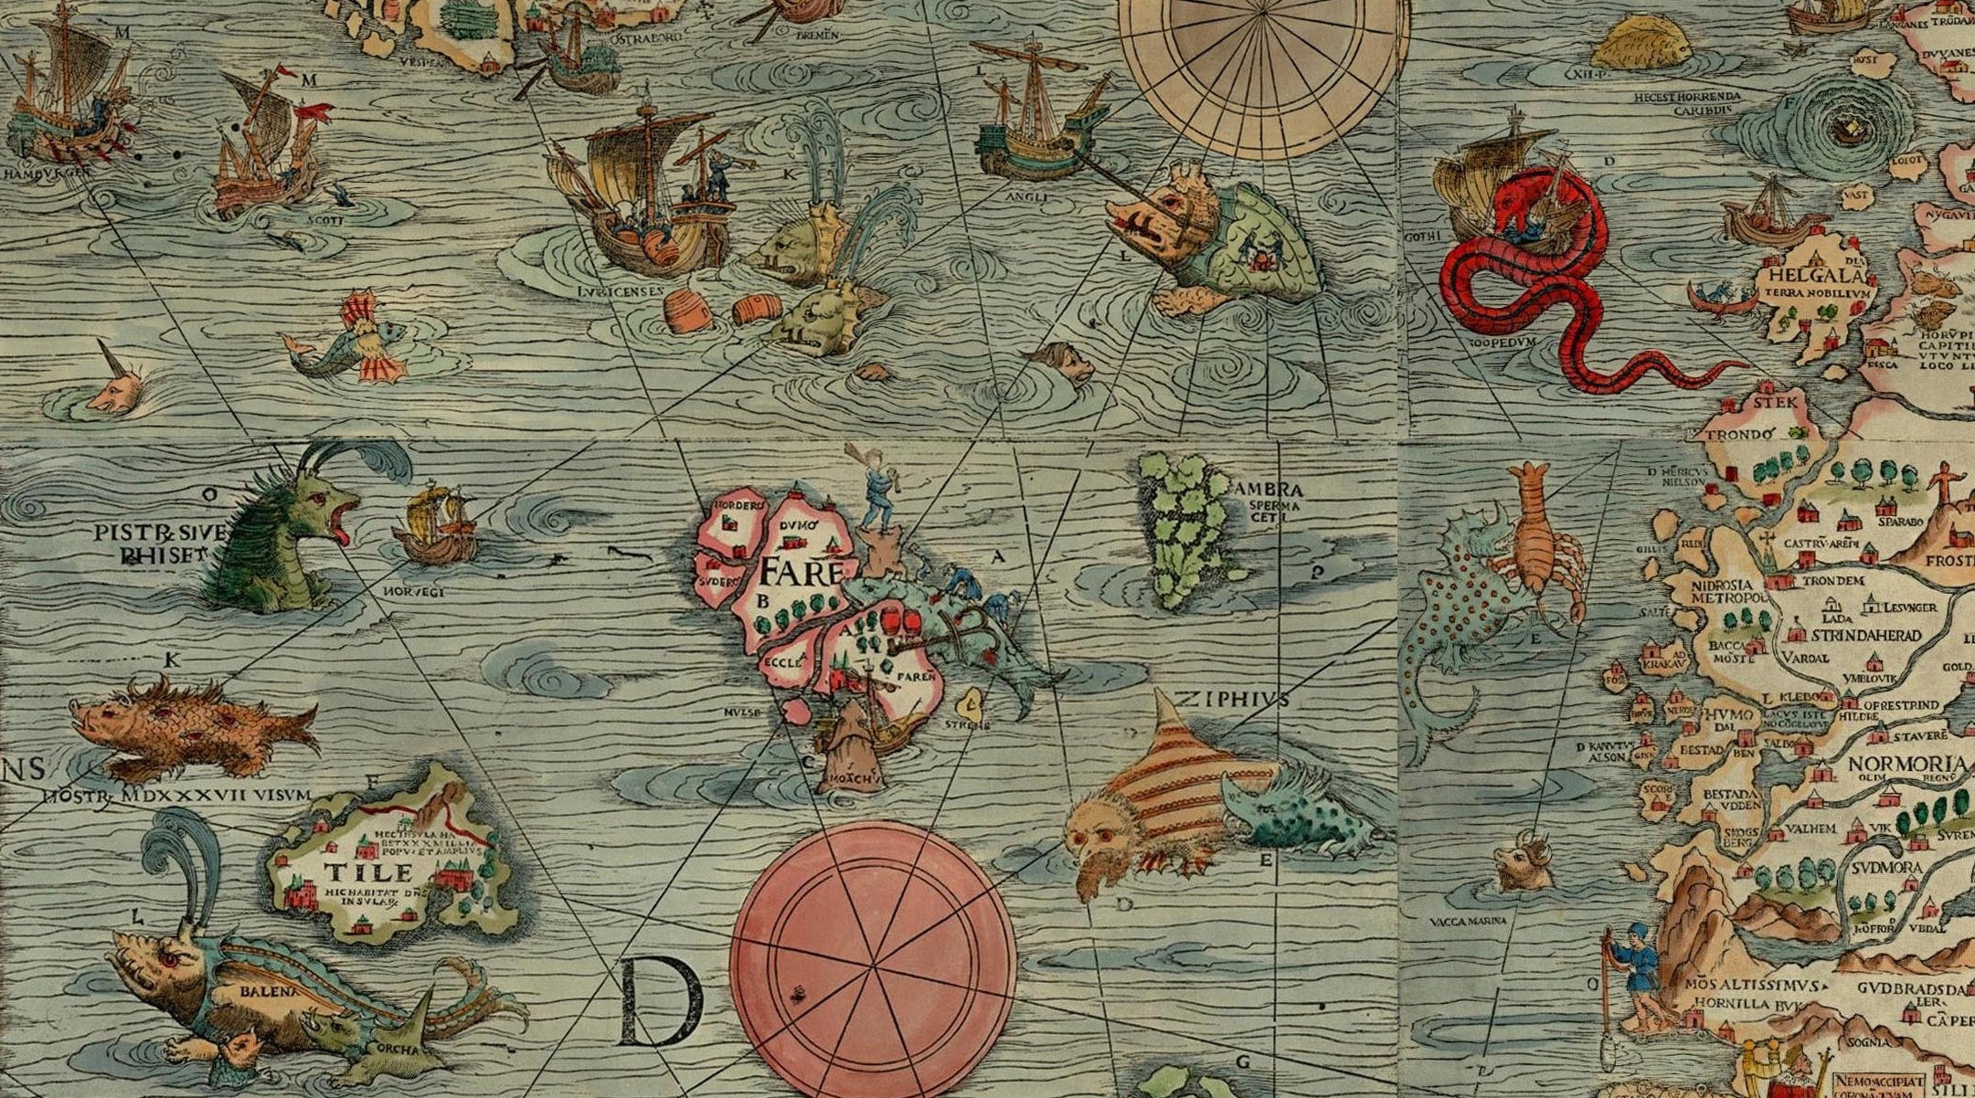
IoT Challenges
Notes:
Challenges in the opportunity
Land rush –-

Slide 14
2. Issues?
Security
Privacy
Interoperability (Standards)
Regulatory & Legal
Development
Vs. “Abilities” (to connect, speak, innovate, share, choose and trust)

Slide 15
Security issues
Ability to trust vs.risks, esp. in a fully connected world.
No absolute security
Factors influencing risks assessment..and trade-offs
Ecosystem & negative externality
Some Unique security challenges of IoT devices:
Sensors designed to be deployed at massive scale
Homogeneity
Long term support & management
Up-grade?
No clarity of intenal working
No visibility/awareness

Slide 16
Security issues (2)
Some key IoT Security Questions:
Costs vs.security trade offs?
Encryption?
Upgradeability
Regulation?
Obsolescence?
Bottom line:
a device on the Internet is a device part of the Internet
Collaborative security

Slide 17
Privacy Considerations
Privacy expectations re: scope and use
Combined individual data streams (tootbrush+refrigerator+fitness tracking..)
Awareness of user (eg: Smart TV set)
Some unique Privacy aspects of IoT
« notice and consent »
Privacy expectation from public to private spaces
Big Data

Slide 18
Privacy Considerations (2)
Some key IoT Privacy questions
Fairness in Data collection and use
Transparency (alternative to « notice and consent »?)
Privacy by design (and opt out by default?)
Identification

Slide 19
Interoperability/Standards
Basic requirement: talking the same language
Open vs. Walled gardens
Key challenges re: IoT Interoperability
Proprietary ecosystems and consumer choice
Technical and cost constraints
Schedule risk
Devices behaving badly

Slide 20
Conclusion
So many opportunities,
So many challenges, so
IoT requires collaboration across a wide range of stakeholders

Slide 21
Reference
Internet Society report on IoT:
http://www.internetsociety.org/sites/default/files/ISOC-IoT-Overview-20151014_0.pdf
Contact:
Frédéric Donck
European Regional Bureau
Internet Society
donck@isoc.org

