Slide 1
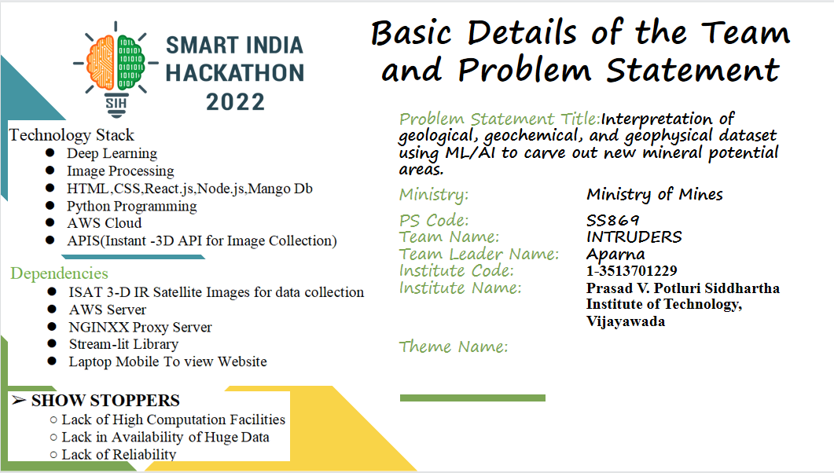

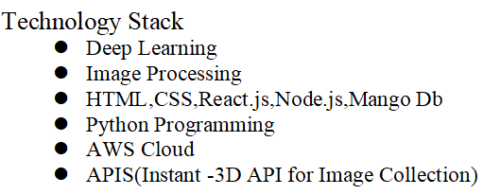
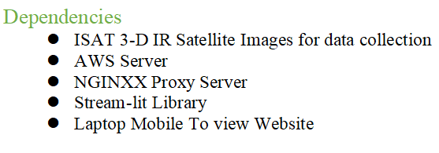
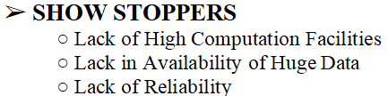
Basic Details of the Team and Problem Statement

Slide 2
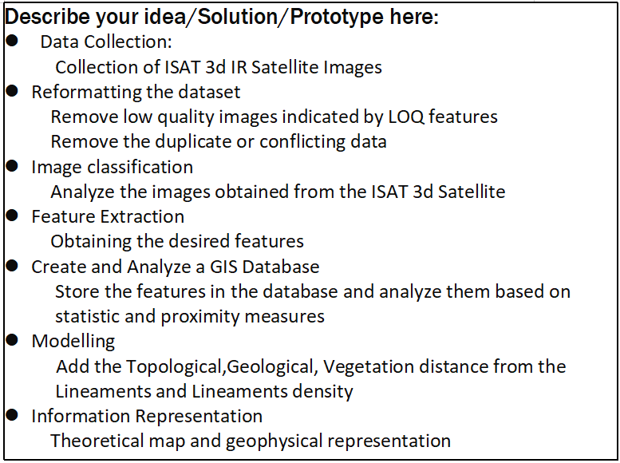
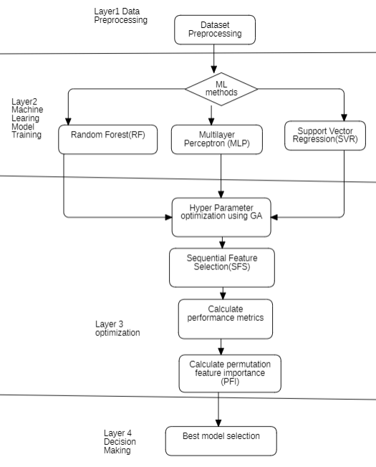
Idea/Approach Details
Activity Diagram

Slide 3
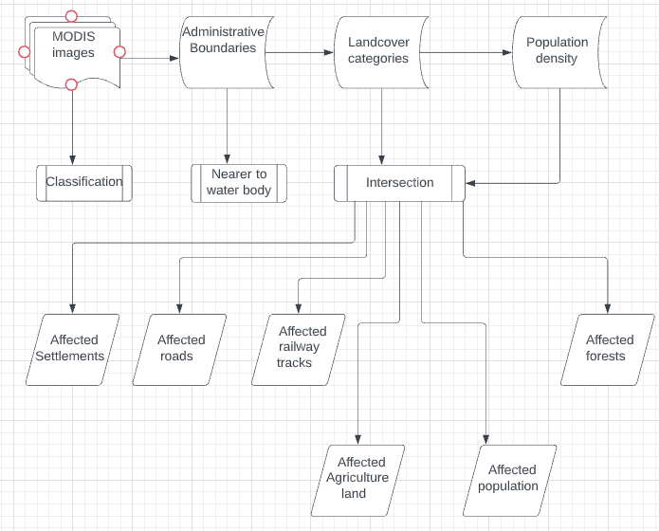
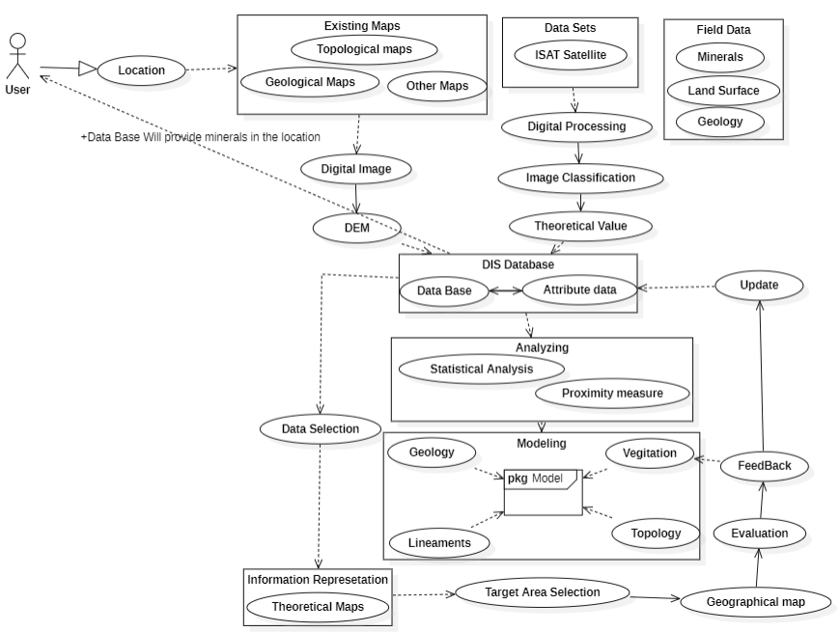
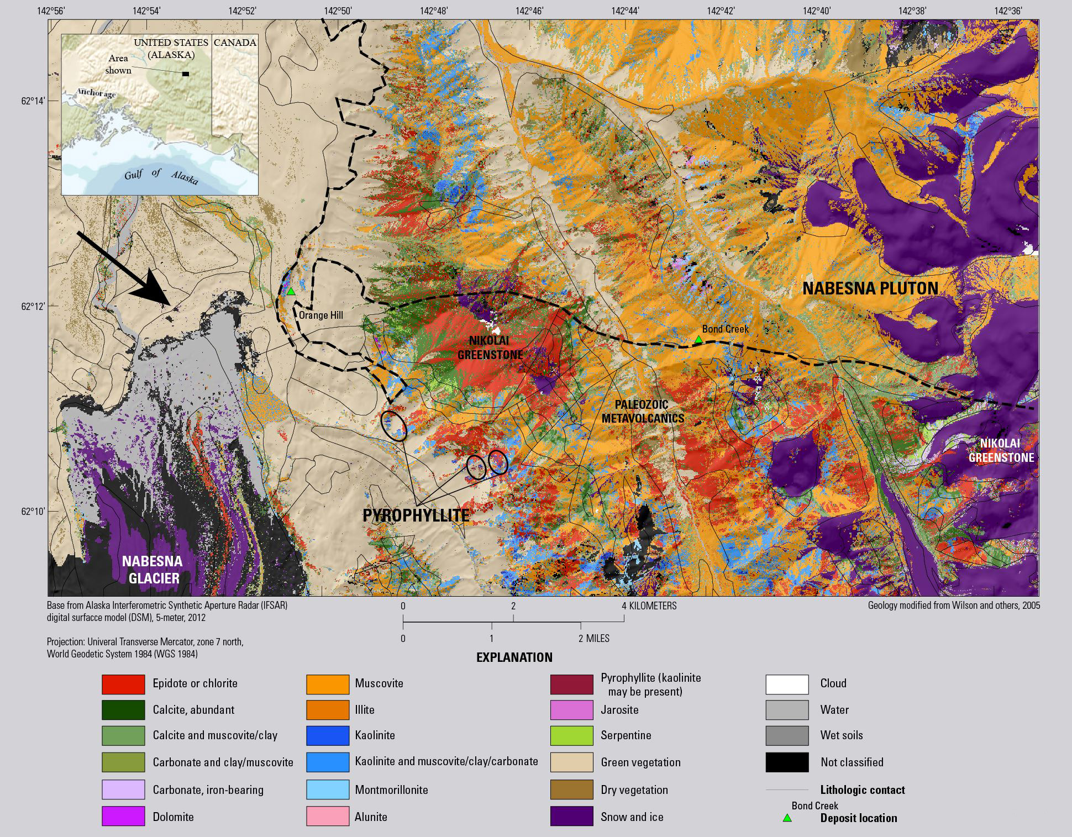
Idea/Approach Details
Flow Chart
Describe your Use Cases here
Output

Slide 4
Team Member Details
Team Leader Name: Aparna
Branch (Btech): Stream (CSE ): Year (III):
Team Member 1 Name: Seetha Ram
Branch (Btech): Stream (CSE): Year (III):
Team Member 2 Name: Prasanna Chandrika
Branch (Btech): Stream (CSE): Year (III):
Team Member 3 Name: Keerthika
Branch (Btech): Stream (CSE): Year (III):
Team Member 4 Name: Snehitha
Branch (Btech): Stream (CSE): Year (III):
Team Member 5 Name: Naga Harshitha
Branch (Btech): Stream (CSE): Year (III):
Team Mentor 1 Name: Type Your Name Here
Category (Academic/Industry): Expertise (AI/ML/Blockchain etc): Domain Experience (in years):
Team Mentor 2 Name: Type Your Name Here
Category (Academic/Industry): Expertise (AI/ML/Blockchain etc): Domain Experience (in years):

