Slide 1

TCP/IP Socket Programming
With Python

Slide 2

TCP/IP?
TCP:
Transmission
Control
Protocol
IP:
Internet
Protocol

Slide 3
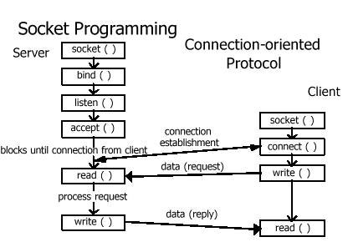
Socket
Programming

Slide 4
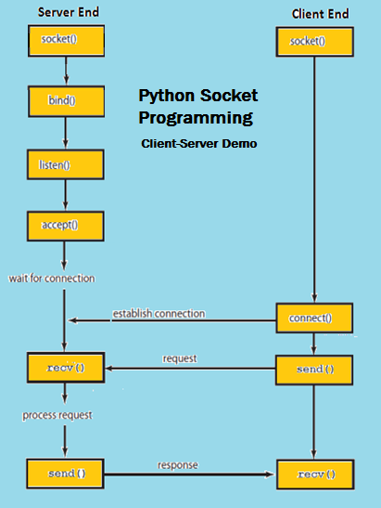
With Python

Slide 5
It’s Show Time

Slide 6
Thank you

