Slide 1

National Health Mission, Department of Health & Family Welfare, Gujarat
Let Hundred Flowers Bloom
An Action-oriented Consultative Seminar on
Health Planning in Gujarat

Slide 2
Flow of the Presentation
Introduction
Concept of the Seminar
Processes involved
Themes identified
Deliverables
Outcomes of the Seminar

Slide 3
Introduction
Decentralized bottom to up planning- core component but critical challenge for NHM PIP Planning.
Lack of capacity to plan well at bottom levels, often results in PIP being made by district and State levels.
NHM PIP may not represent the actual issues and challenges faced by the frontline workers and the community.
There was a felt-need of consultative planning. The pattern of the discussions held in Davos World Economic Forum has ignited the idea of Action Seminar Cum Workshop.
Principal Secretary (PH) & MD NHM decided to improvise on it and use it for participatory and decentralized planning under NHM
Mission Director, NHM has taken keen interest to create “thought process” amongst all stakeholders.
2 such consultative workshops conducted :
During Preparation of NHM PIP FY 2018-19 (10th Jan 2018.)
After receiving RoP Approval of NHM FY 2018-19 (29th Sept 2018)

Slide 4
Concept
To prepare a Structured & Decentralised PIP through consultative approach with involvement of the front line workers to higher most authorities in the health to involve in the consultative process
To identify bottlenecks of program interventions at each levels and support with do-able strategies to reach desired goals
Planning for specific results (outcomes) that program hopes to achieve and brings all stakeholders on one platform to accelerate efforts of program strengthening
Selection of participants
Orientations
Facilitation
Budgeting
Discussion
Finalization of Action Plan

Slide 5
Action Seminar Process
Preparatory activities:
Conceptual framework:
Seminar model has been designed in view to prepare Health Action Plan by consultative approach (mentioned in previous slide)
2) Major Themes finalised:
11 Themes finalised on the basis of the NITI AAYOG indicators and the state priorities, which would be able to provide a comprehensive health plan.
Discussion on each theme was designed to bring out key strategies with structured plan includes WHY-WHEN-WHO-WHERE-WHAT-HOW

Slide 6
Themes Identified
1
2
Reduction in Maternal Deaths, Identification & Management of Anemic Mothers & High Risk Mother
Reduction in Infant Deaths, Low Birth Weight babies
Immunization
4
Maternal, Child & Adolescent Nutrition.
5
6
7
8
9
10
11
Epidemic Deaths & Communicable Diseases
Spacing methods, terminal methods of family planning, Sex ratio at birth & Improving Sex ratio.
Non Communicable Diseases including Mental Health for all
Information Education Communication (IEC)/ SBCC & Documentation
Human Resources (Service Delivery & Program Management HR)
Information technology & Data Management
Review, Research & Innovations.
3

Slide 7
Action Seminar Process
3) Selection and allocation of group members:
About 250 to 280 participants & 25-27 participants each group.
Participant selected to ensure geographical representation all over state.
Participation of each cadre from ASHA, ANM, MPHW to State level Director has been ensured in the each group
Participation of representative from NGOs, Civil Societies and development partners working in respective subject has been ensured.
Officials from Govt. of India, NHSRC & Other State Dept ensured.
Detailed matrix of the participants along with the decided themes prepared .
Group composition :
Team leader : Director/State level officer
Rapporteur: Senior level Medical Officer
Key Resource Person: 2-3 consultants and Project officer.

Slide 8
Action Seminar
Orientation on Process
Plenary Session
Theme based Group Exercise
Construction of Roadmap
Presentation by Team members

Slide 9
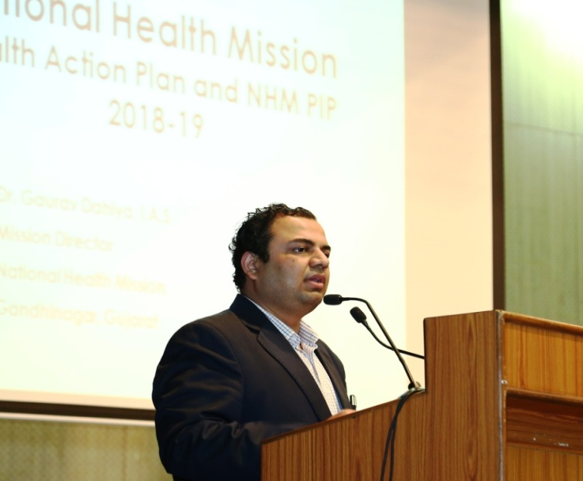
Action Seminar Process
Orientation on Process:
The participants reported on day before Seminar.
Methodology of seminar to be followed were explained.
Points discussed and explained:
Bottom to top approach,
Process to be carried out,
Plenary session,
Theme based group exercise,
Construction of the roadmap/action plan.
Presentation by Group.
Queries and doubts cleared.
All participants provided with reference documents which supports theme subject & data sheets on existing performance for each theme to promote evidence based planning.
Plenary Session:
State priorities and focus areas of each themes discussed
Views and feedback on the process from participants has been discussed.

Slide 10
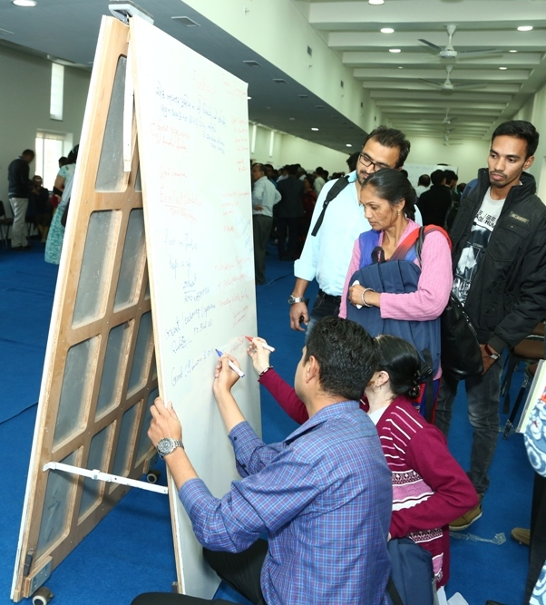
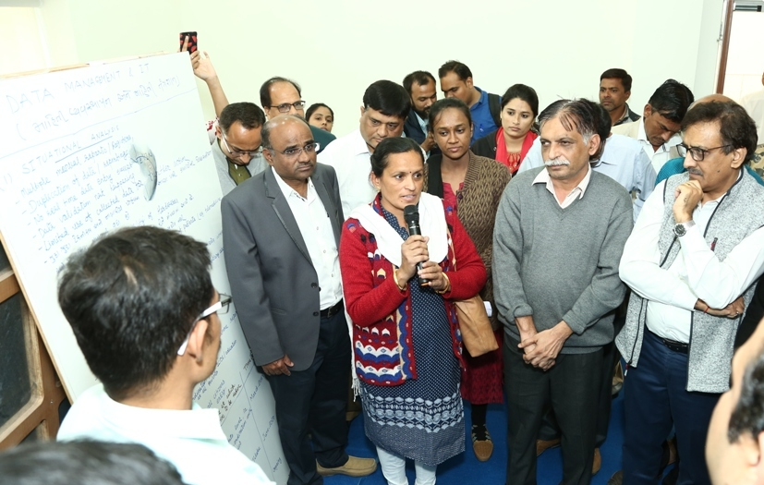
Action Seminar Process
Theme based Group Exercise & Construction of Roadmap: (Morning Session)
11 - Two sided white boards with marker pens were placed in hall & each Board designated to respective themes.
Designated group of 25-37 participants gathered to respective board, discussed, explored and decided the plan to improve the particular thematic issues.
Finalised points were being noted down on white boards simultaneously.
Resp. PS (PH), MD (NHM), GOI Officials and Additional Directors kept overlooking the exercise of the groups and suggested few things and moderated discussion if needed.
Hon’ble Minister of State (Health) also took the round to each group and understood the challenges and proposed supportive strategies.

Slide 11
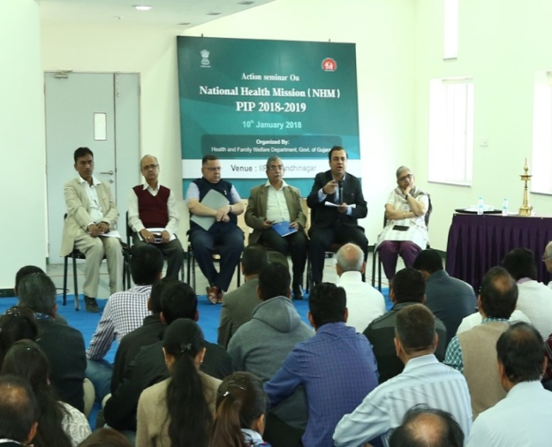
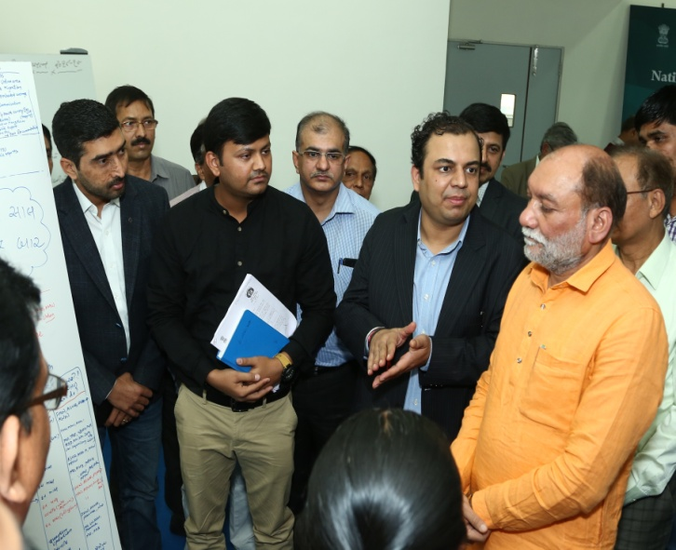
Action Seminar Process
Presentation by Teams: (Afternoon session)
All groups presented the action plans and all members were given chance to speak especially ASHA, ANM, MPHW, MO-PHCs.
Suggestions and feedback on the presented action plan were discussed with rest of the participants from others groups also.
Views from Govt. of India officials, NHSRC officials were also solicited.
Rapporteur were instructed to take a photographs of the white boards with final action plans and computerize and submitted to Resp. MD (NHM) in consultation with team leaders.

Slide 12
Deliverables
Each Thematic Group expected to submit :
Program Implementation Plan with:
Identified Gaps/ shortfalls
Identified Goals, Objectives, Targets
Result oriented Strategies,
Identified do-able activities
Monitoring mechanism with SMART indicators to review
Budgetary provision with detailed costing under NHM PIP
Scaling up of proven newer ideas
Instill the exact role and responsibilities of each functionaries towards achievement of the goals.

Slide 13
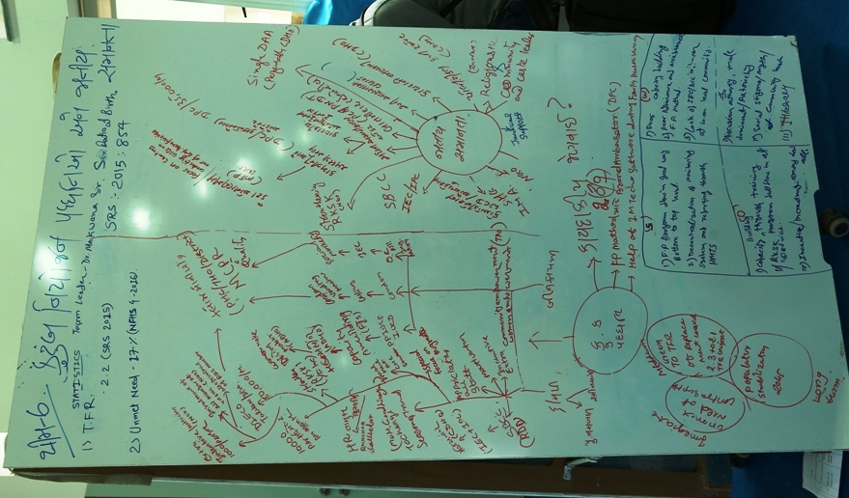
Outcome
A comprehensive theme wise roadmap along with activities to be carried out with timeline and taken upto VHSNCs.
Progress review through time based monitoring mechanism.
The participation of actual implementers made the plan realistic and practical.
The budgetary provision for activities to be carried out Vis-a-Vis State and NHM PIP Proposals of 2018-19.
Sharing on thought process on newer ideas implemented by various districts and health functionaries and to be scaled up.
Morale boosting of the participants.

Slide 14
Outcome (few examples)
Sr. No | Program | Component | Activity | Proposed Amount (Rs. in lakhs ) | Approved Amount (Rs. In Lakhs )
1 | RMNCH+A | Infrastructure | Saturating each districts with SNCUs & additional SNCU for bigger districts | 130.21 | 130.21
2 | RMNCH+A | Infrastructure | KMC ward - SNCUs | 73.50 | 73.50
3 | RMNCH+A | Referral Transport | Neonatal Ambulances (18) | 504.00 | 504.00
4 | HSS | Innovations | Comprehensive 104 Health Information & Grievance Helpline | 1336.00 | 1184.70
5 | Hemoglobinopathies | SD- Facility based | Screening of hemoglobinopathis | 558.21 | 558.21
6 | NOHP | SD- Community based | Mobile Dental Van | 63.00 | 63.00
7 | HSS | SD- Human Resources | Expansion of Specialist services through Initiation of CPS/ DNB | 700.00 | 700.00

Slide 15
Sr. No | Program | Level | Activity | Proposed Amount (Rs. in lakhs ) | Approved Amount (Rs. In Lakhs )
7 | NMHP | Community Intervention | District Counseling Center and crisis centre | 111.00 | 111.00
8 | Community Processes | Community Intervention | ASHA incentives for attending weekly SATCOM | 2535.19 | 2535.19
9 | RNTCP | Innovations | TB Free blocks | 112.40 | 112.40
10 | RMNCH+A | Innovations | Mothers Own Milk (Human Milk Bank) | 25.00 | 16.32
11 | RMNCH+A | SD- Facility Based | Mobile Mamta Divas (Valsad & BK) | 63.80 | 63.80
12 | RMNCH+A | “Labour Room” to “Navjeevan Kaksha” on Quality perspectives & Comprehensive JSSK |  | Zero Budget Activities
13 | RMNCH+A | Focus on Breast crawling after cord clamping |  | Zero Budget Activities
14 | RMNCH+A | Nutritional interventions/ Demo. Feeding, use of drumsticks |  | Zero Budget Activities

Slide 16
THANK YOU

