Slide 1
Essay topic : Talk to your partner. What are the reasons for and against living in a big city?
In most parts of the world, cities are becoming larger because people are moving there from the countryside. Some people believe that living in cities is a good thing, while others do not.
Discuss both points of view and give your own opinion.

Slide 2

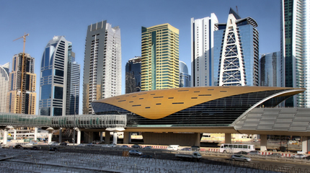





Talk to your partner. What reasons can you see for living in a big city?

Slide 3
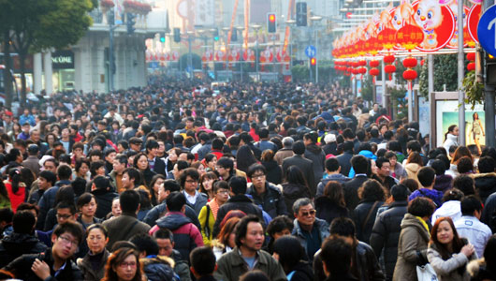
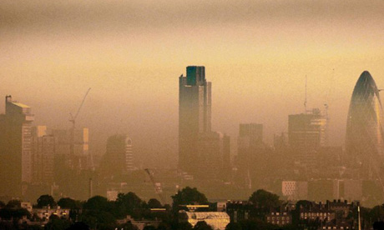
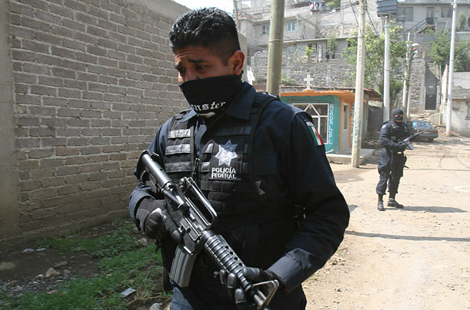
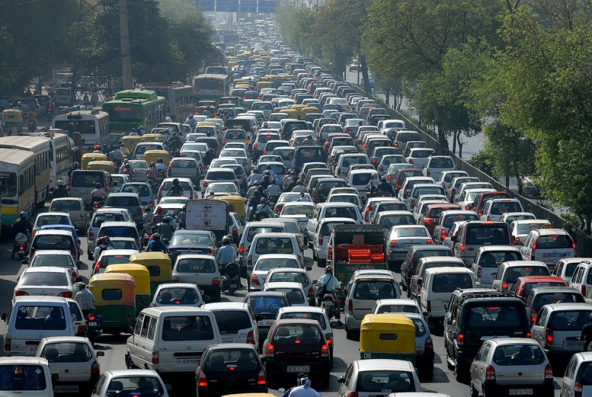

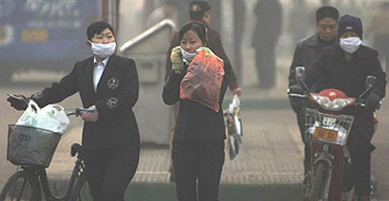

Talk to your partner. What reasons can you see for not living in a big city?

Slide 4
Brainstorm ideas and make a plan for the essay.
In most parts of the world, cities are becoming larger because people are moving there from the countryside. Some people believe that living in cities is a good thing, while others do not.
Discuss both points of view and give your own opinion.
Reason For 1
Reason Against 1
Example/ Explain
Example/ Explain
Result
Result
Reason For 2
Reason Against 2
Example/ Explain
Example/ Explain
Result
Result

Slide 5
Introduction structure
In most parts of the world, cities are becoming larger because people are moving there from the countryside.
Describe the advantages and disadvantages of living in cities.
1. G__________________ B_____________________
2. E__________________ T_____________________
3. T_______________
General Background
Essay Topic
Thesis (main idea) = I partly agree that … In the following essay, I will …

Slide 6
Essay comprehension questions
1) Is this a one-sided or two-sided essay?
2) How does the writer giver his/her opinion in the introduction?
3) What does the writer say he/she is going to do in this essay?
4) How many body paragraphs are there?
5) What does the first sentence of each body paragraph tell you?
6) How many reasons (main ideas) are there in each body paragraph?
7) How does the writer support the reasons?

Slide 7
Essay Structure Analysis: Introduction
1) Nowadays, the world’s population is increasing rapidly and people want a higher standard of living. 2) Because of this, many people have moved from small towns and villages to live in major urban areas.3) I partly agree that people should move from the countryside to live in big cities. In the following essay, I will discuss both sides of the argument.
1) General background
2) Essay topic
3) Thesis statement

Slide 8
Essay Structure Analysis: Body Paragraph 1
4) On one hand, there are several important reasons why people should move to live in cities. 5) The most important one is that the opportunities for work and promotion are much better than in the countryside. 6) For example, all major companies are based in big cities, 7) so people who want to get a high-level job in a big company need to live in a city. 8) Another reason is that cities have more facilities for people to use, 9) such as good hospitals and schools. 10) As a result, many families live in major cities because they need good healthcare and education for their children.
4) Topic sentence
5) 1st Reason
6) Example
7) Result
8) 2nd Reason
9) Example
10) Result

Slide 9
Essay Structure Analysis: Body Paragraph 2
11) On the other hand, there are many reasons why moving to the city is not a good idea. 12)The main one is that the environment is often not clean. 13) As so many people live so close together, there is usually more pollution in big cities than in small towns. 14) For instance, many big cities have problems with noise and air pollution from traffic. 15) Hence, cities can be unhealthy places to live. 16) In addition, crime is a serious problem in most major cities. 17) This is because criminals have many more places to hide in large cities than in small towns. 18) Consequently, cities can be dangerous places for the people who live there.
11) Topic sentence
12) 1st Reason
13) Explaining + result
14) Example
15) Result
16) 2nd Reason
17) Explaining
18) Result

Slide 10
Essay Structure Analysis: Conclusion
19) In conclusion, I agree to a certain extent that people should move from small towns to live in large cities. 20) This is because cities give people the chance to find a good career and have the facilities that most families need, but they are often polluted and dangerous. 21) Therefore, I believe that people who want to live in cities should be careful to keep their families healthy and safe
19) Thesis statement again
20) Summary of reasons (contrasted)
21) Advice

Slide 11
Essay Structure: Body Paragraph Plan
Agree Paragraph |  | Disagree Paragraph
1st Reason |  | 1st Reason
Support |  | Support
2nd Reason |  | 2nd Reason
Support |  | Support

Slide 12

Essay Structure: Linking Words and Phrases
Addition | Contrast | Reason | Example | Result
and

