Slide 1



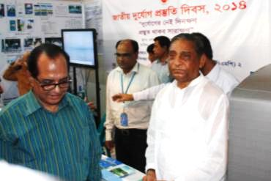
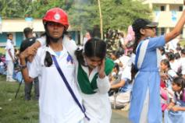


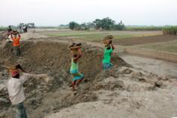
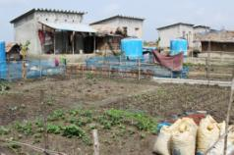
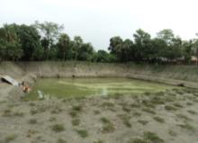

COMPREHENSIVE DISASTER MANAGEMENT PROGRAMME (CDMP II)
Tuesday, August 26, 2014

Slide 2
CDMP II PROJECT SUMMARY
Country | Bangladesh
Title of the Project | Comprehensive Disaster Management Programme 2010-2014 (CDMP-II) – Possibility to extension up to December 2015
Project ID | 00073416
Implementing Agency | Ministry of Disaster Management and Relief, Government of Bangladesh
Co-Implementing Partners | 13 Departments of 12 Ministries Universities and Training Institutes Disaster Management Committees Sub-Implementing Agencies
National Project Director | Mohammad Abdul Qayyum, Additional Secretary, GoB
Project Period | January 2010 - December 2014
Date of Approval | 24 May 2010
Project Budget | US$ 76.16 million
Funded By | GoB, DFID, EU, Norway, Sida, AusAID, UNDP
Contact Person | Peter Medway, Project Manager

Slide 3
CDMP II
A TWO-PHASED PROGRAMME TO SUPPORT GOVERNMENT VISION
GOAL
Reduce Bangladesh’s vulnerability to adverse natural events through technical assistance in risk reduction and comprehensive disaster management activities.
OBJECTIVES
To strengthen the capacity of the disaster management system to reduce unacceptable risk and improve response and recovery management at all levels.

Slide 4
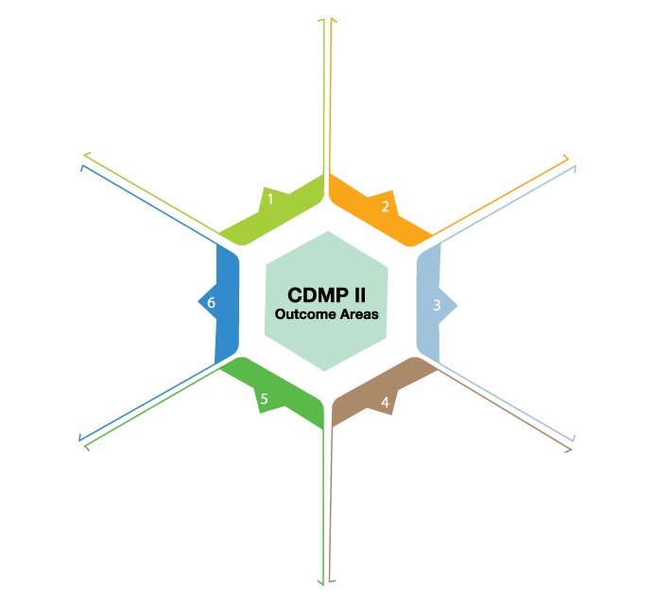
OUTCOME AREAS
DELIVERY
MECHANISMS
Professionalising
DM System
Rural Risk
Reduction
MODMR
DDM
PARTNER
DEPTS / MINS
DMCs
LOC. ADMINS
Community level
Climate Change Adaptation
Urban Risk
Reduction
MSU
UNDP
UNIVERSITIES
TRG INSTS.
Mainstreaming
DRR and CCA
Preparedness
and Response
NGOS
CIVIL SOCIETY
PRIVATE SECTORS

Slide 5
Every year, hundreds of Bangladeshi fishermen die at sea or disappear while fishing in the Bay of Bengal due to natural disasters.
Above 4,000 deaths from more than 500 passenger launch accidents in last 38 years in Bangladesh.
During natural disasters during 1980-2010, about 191,836 people died in Bangladesh and economic damage per year due to natural disasters was 0.55 billion US dollar.
Many of these deaths and economic loss could be averted if early warning system is strengthened and followed by all concerned.

Slide 6
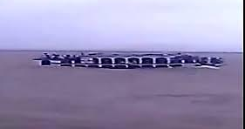
Recent tragic capsize of Pinak-6 launch:
Overloading was big reason. Also, on the tragic day Pinak-6 violated a ban on launches from sailing when there was a cautionary signal number-3 for rivers hoisted by Bangladesh Meteorological Department.

Slide 7
Need for rapid information flow makes the Perspective:
Dial 10941 for Emergency Alerts and Warnings
A milestone in building a disaster and climate resilient Bangladesh
Accurate and real-time information is urgent for decision making in disaster management. Mobile technology can play a vital role in information sharing for disaster management in Bangladesh because of its high tele-density. Every village of Bangladesh is under network coverage!
.

Slide 8
CDMP mandate:
Institutionalize and strengthen national capacity on Disaster Risk Reduction , through partnership with 13 sectoral ministries and department including-
Bangladesh Meteorological Department under the Ministry of Defense-the sole authorized government agency to deliver weather forecast and warning

Slide 9
‘National ICT Policy-2009’, ‘National Policy on Disaster Management’ and ‘Standing Orders on Disaster’ support leveraging ICTs to better collaborate with wider groups
of stakeholders through-
Protecting citizens from natural disasters through ICT based disaster warning & management technologies
Establishing networks with all the mobile phone companies and use those for speedy dissemination of early warning information to the community
Promoting SMS based disaster warning systems targeted to the population likely to be affected
Utilizing GIS based systems to monitor flood & cyclone shelters and ensure equitable distribution of relief goods with special focus on the hard to reach areas

Slide 10
IVR based Early Warning: How It started with CDMP
In early 2010, CDMP II piloted the use of mobile technology involving Interactive Voice Response to disseminate weather advisory and disaster early warning alerts in Cox’ Bazaar (coastal area) and Sirajganj (flood prone area).
And it is now scaled up to the whole of Bangladesh.
Presently more than 100 million people have access to cell phone based early warning system.

Slide 11
Accessible by dialing ‘10941’ from all mobile phone operators
Features:
Sea bulletins: twice a daily, to help protect the incoming and outgoing fishermen vessels in the Bay of Bengal. (PRESS ONE)
Inland river port warnings, four times daily, for safer river navigation. (PRESS TWO)
Weather Forecast including rainfall and temperature for the general public: 24 Hours (PRESS THREE)
Sea port warning: on Cyclone (PRESS FOUR)
Flood warning : (PRESS FIVE)

Slide 12
Dialing ‘10941’
Operating under Ministry of Disaster Management and Relief
24/7 access to receive updated pre-recorded multi-hazard early warning messages
Message generated from Flood Forecasting and Warning Centre and Bangladesh Meteorological Department.

Slide 13
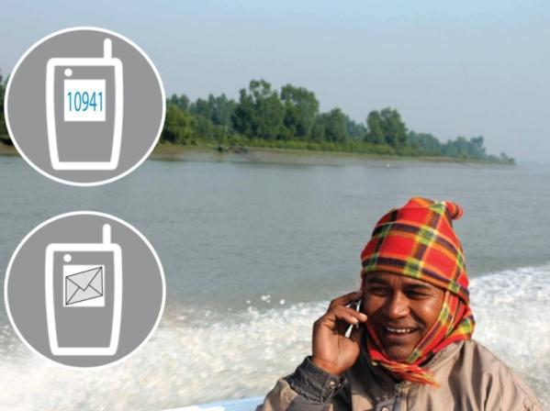

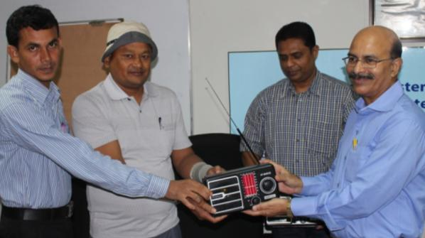
CDMP supported Early Warning Preparedness
.
District and Upazila Disaster Management Committee receive mobile phone database for bulk SMS with emergency management instruction
Capacity building support for Flood Forecasting and Warning Centre, Bangladesh Meteorological Department and Bangladesh Ansar to strengthen early warning systems and disaster preparedness
Flood forecasting lead time is now expanded to 5 days.

Slide 14
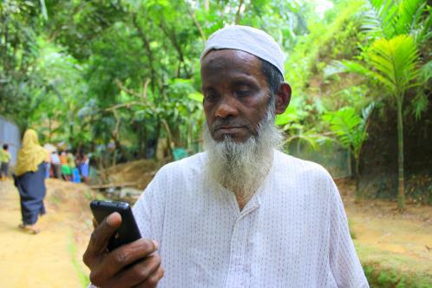
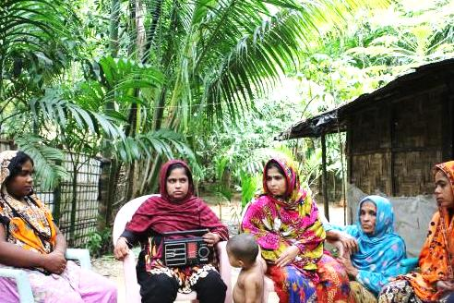
A high acceptance was evidenced during storm Mahasen
During tropical storm Mahasen (12 – 16 May 2013) more than 60,000 people accessed the Interactive Voice Response (IVR) with an additional 50,000 people accessing the IVR for other hazards during the year.
About 40,000 SMS were sent during 2013 to alert disaster management focal points and the disaster management committee members, across the country. All these demonstrated a very high acceptance of the system to the end users.

Slide 15
Results of this rapid information flow
during Mahasen
Around 55,000 volunteers disseminated cyclone warnings to the people of cyclone prone areas
This contributed to the safe evacuation of over a million people to cyclone shelters and their support with food, water and other emergency items. As a result, only 17 people died due to the tropical storm
Nearly 3,800 shelters remained open along with other public and private buildings. Over 1,300 medical teams were on standby in the affected districts, and 40 water treatment plants were ready to be mobilized.

Slide 16
CDMP’s IVR system has got recognition
This IVR based early warning won the international award: “ Serving Citizens: Best ICT Initiative in Climate Change and Disaster Management” in the e-ASIA 2011.

Slide 17
WAY FORWARD……
Disseminating IVR based Early Warning- 10941 through wider group of stakeholders and community to MAXIMIZE the use!

Slide 18
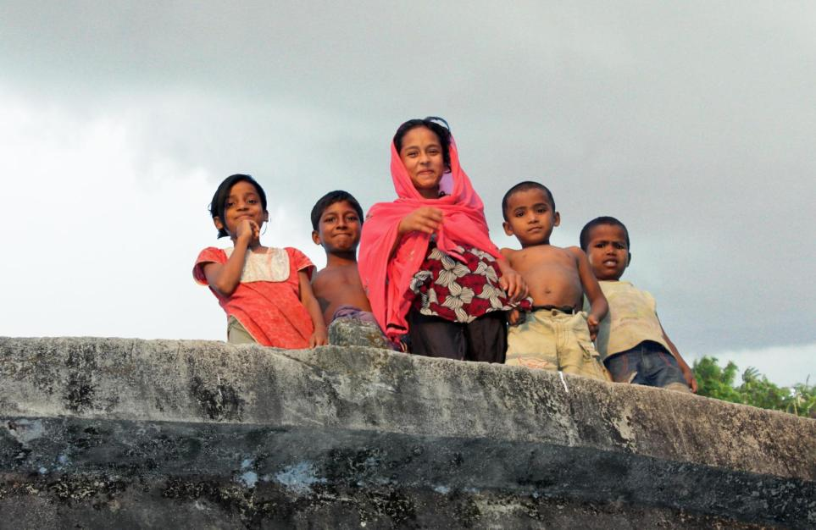

Thank You All
For more information contact: Comprehensive Disaster Management Programme (CDMP II) United Nations Development Programme (UNDP) Disaster Management & Relief Bhaban (6th Floor) 92-93 Mohakhali C/A, Dhaka-1212, Bangladesh, Tel: (+88 02) 989 0937, 882 1255 Website: www.cdmp.org.bd
Photo: Otin Dewan/CDMP

