Slide 1
Your Personal Statement
How to make it stand out
Alison Wilson
8th June 2023

Slide 2

What is the personal statement?
Your opportunity to tell your chosen universities:
Why you’re applying for your chosen subject
What you know about your chosen subject
Why you’re suitable for your chosen subject
Grades are important, but they aren’t enough on their own
It’s your first, and often only, opportunity to make a good impression
Your personal statement helps you stand out and differentiates you from others

Slide 3

How important is the personal statement?
Really important!
It helps a university decide whether to make you an offer or invite you to interview
If you’re interviewed, it is likely to prompt questions
It allows you to talk about your relevant experiences and skills
If you narrowly miss your offer grades, it may persuade a university to still accept you
Notes:
For the last 10 years the number of 18 year olds has been dropping and places have been easier to secure. The demographic is now turning and 18 year old numbers are increasing so it is going to be more important that your statement makes you stand out among other students with your grades, particularly for very competitive courses and universities.
It is very likely that only a few of you will be interviewed so your ps is the only way we can find out if we think you’re suited to our courses.
If we are going to interview you, your statement will help us find out more about you and ask questions for you to prove your understanding of the course and the issues surrounding it.
It is the only place in your application where you can talk to us about your experiences and what you’ve gained from these being able to tell us about your activities which could be school based, employment or other interests.
It may also be that after results day universities go back to look at your statement again. If you have narrowly missed your offer grades universities will be deciding whether to still take you and if they look at your statement and see a real dedication to your subject and an understanding of your knowledge and relevant skills they are more likely to still confirm your place with them.

Slide 4
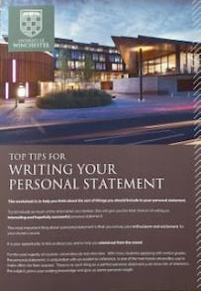
The important basics
4,000 characters (including spaces)
47 lines
70% academic – the course and why you’ve chosen it
30% personal – information about you and your skills
If you’re applying for Oxford or Cambridge or other very competitive courses, make it 90%/10%
Personal to you – reflect your abilities, understanding and personality
Only allowed to write 1 personal statement for all 5 choices
Notes:
There are a few things that make the personal statement hard to write and I think one of the hardest is the character limit. You can only write 4,000 characters including spaces and punctuation. That’s about 1 side of A4 text and once you start writing you are going to have way more than that to say. They also have a restriction of 47 lines so it’s balancing writing in paragraphs, making it easier to read but acknowledging that a blank line between them uses up on of your 47.
The balance of the statement is really important too. You need to be heavily weighting it around your academic ability and understanding. You should have approximately 70% of it talking about the course you’re applying to, and your understanding of it, your current study and any experiences that link with the subject. The other 30% is about you, so your hobbies and extra curricular activities that give your relevant skills or understanding. If you’re going to be applying to Oxford or Cambridge you would be looking at the balance to be more like 90% academic and just 10% personal.
Making your statement personal, ensuring it doesn’t sound insincere or generic can be the winning ticket. What makes you unique? Don’t be afraid to think a little bit outside the box. Admissions tutors read hundreds of personal statements so saying something a little different or having a less common experience to reflect on is likely to see your application dazzle from the masses.
Finally the other thing that makes it hard is that although you can apply for up to 5 courses which may be slightly different to each other you can only write one personal statement which must fit all your choices.

Slide 5

What are admissions tutors looking for?
Evidence of academic ability – from your grades, but also from the information you give us
A genuine interest in the subject and a desire to learn more about it
A commitment to the profession and an understanding of what it’s like to work in that industry
Qualities and skills that make you suitable for your chosen course/career
Well written – no spelling or grammar mistakes
Well rounded applications – don’t forget 70/30 (or 90/10) split

Slide 6


How you can evidence understanding and interest
Show off what you know and focus on the detail. Use technical language.
Have you studied the subject before? If so, what does it involve?
But what else?
Both for previous and new subjects, what have you done?
Documentaries
Trips
Journals or books
Lectures or TED Talks
MOOCS (Massive Open Online Courses)
Voluntary or paid work
What can you make links to – in society, news, trends.

Slide 7

Writing just one statement relevant to your choices
For combined honours:
Refer to both subjects (in degree balance)
Find common topics or skills for both subjects
For something like Philosophy, Politics & Economics or Liberal Arts where you may not find 5 universities offering that exact course, focus on your subject at other universities eg Politics, and link the other elements to it

Slide 8
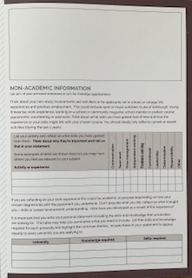
Including the right information
Make sure it’s relevant for every university you’re applying to
A table like this one may help
List the universities you’re applying to
List the skills and knowledge required based on their website information
Highlight the common elements
Include those in your statement
University | Knowledge required | Skills required

Slide 9

Plan before you write
Write about Why, What and How?
Resources to help you
UCAS personal statement builder in the HUB
Winchester personal statement worksheet
You might prefer a mind map
Our worksheet gives examples of points to include
You might prefer questions and answers
UCAS builder or Unifrog both give you question sections to complete

Slide 10
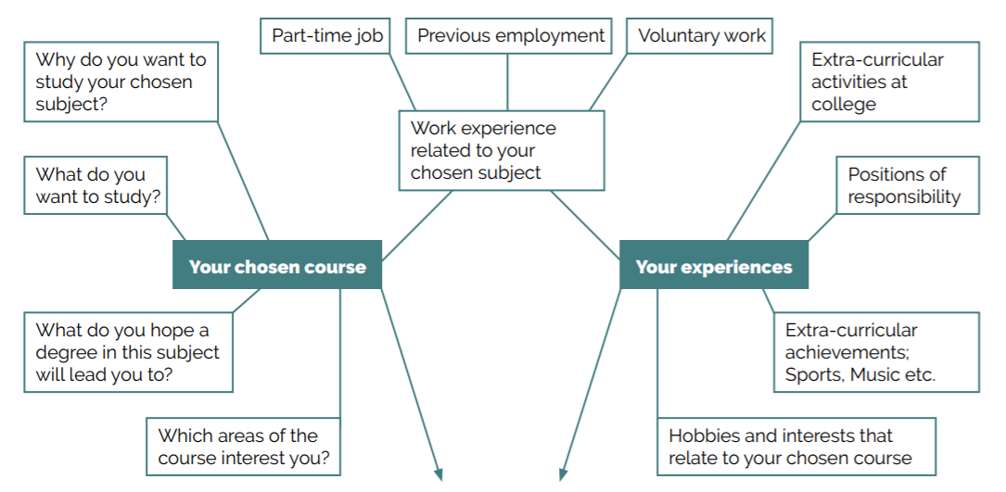

Slide 11

Skills you could talk about
Communication
Independent working
Teamwork
Flexibility
Determination
Computer literacy
Organisation
Entrepreneurial skills
Working to deadlines
Presentation skills
Reliability
Trustworthiness
Diplomacy
Problem solving
Initiative
Time management
Commitment
Responsibility
Leadership
Project management
Include the ones that link most closely to your course or career and those which will make you stand out
Notes:
You will have many skills which you could evidence in your statement but remember this is likely to only be 30% of your writing so a maximum of 1200 characters. You will really need to think about which you use in your final version. Think about which are most relevant to the course you’re applying to or the career it will lead into if it’s more vocational. If you still end up with a choice of skills think about those that may be less common. Everyone is likely to be able to talk about working in a team but they may not all have project management or entrepreneurial skills. Use the skills that are most relevant but are also going to make you stand out.

Slide 12

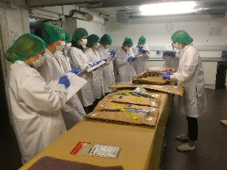
The right skills for you to talk about
University course pages
UCAS subject information
Professional bodies for your career
Prospects.ac.uk

Slide 13
Think about the detail
Working at a coffee shop, part-time making drinks and serving customers has increased my communication skills.
Part-time employment has developed my communication skills with a different audience, as I engage with customers but also my colleagues. Talking to members of the public can be challenging if there is a language barrier or when individuals were wearing face coverings. Developing ways of communicating including repetition and using non-verbal signals as enhanced my skills.

Slide 14
Structuring your statement
Grab their attention
Show you’re excited about and understand the course you’re applying for
Give evidence to prove your interest in the subject
Why are you suited to that course? What events led to your interest?
What do you know about the subject and are excited to learn more about?
Have you got subject relevant work experience? What did you learn from this?
Other activities that show your relevant qualities and skills
Activities that demonstrate your interest in your course or relevant skills.
Closing statement
Reaffirm your desire to study this course and what you may gain from it.
This could include where you hope a degree in this subject will lead

Slide 15

Most overused opening sentences
you can find these on the internet
From a young age I have (always) been interested in/fascinated by . . .
For as long as I can remember I have . . .
I’m applying for this course because . . .
I have always been interested in . . .
Throughout my life, I have always enjoyed . . .
Reflecting on my educational experiences . . .
Nursing is a very challenging and demanding career/course . . .
Academically, I have always been . . .
I have always wanted to pursue a career in . . .
I have always been passionate about . . .

Slide 16
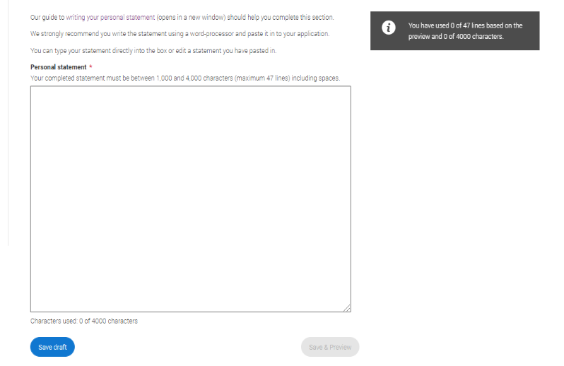
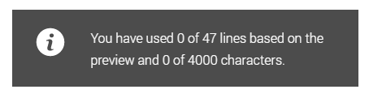


Adding your statement to UCAS

Slide 17
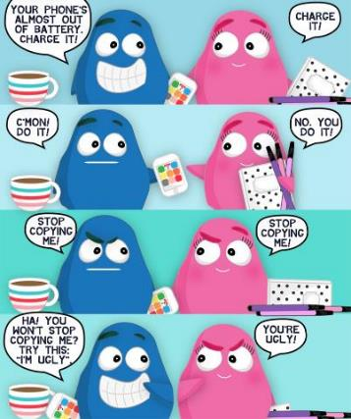
Similarity detection
All personal statements submitted to UCAS are checked by Copycatch
Any statements showing a level of similarity of 30% or greater will be reviewed by members of the UCAS verification team
The universities are then informed by UCAS and having checked the statement they will decide how to deal with it

Slide 18

Reasons given to unsuccessful applicants
linked to the personal statement
Your personal statement does not strongly support your desire to study your chosen degree
Your personal statement does not show sufficient understanding, relevance or knowledge about the course you’re applying for
Your personal statement does not show sufficient understanding of the role you are entering

Slide 19
Points to remember . . .
DON’T
Talk about your passion – show it
Use flowery language
Use lots of cliches or quotes
List your current subjects or grades
Mention specific institutions
DO
Write confidently about yourself
Support your skills & experiences with evidence
Make everything relevant
Check spelling and grammar
Ask others to read it

Slide 20
Finally
In everything you must REFLECT on your experiences and skills and RELATE them to your chosen course or career
A – Action – being part of a sports team, voluntary work in a care home, school prefect role
B – Benefit – what skills do these roles give you – teamwork, responsibility, etc
C – Course or career – relate these experiences and skills to the course or career you want to study
Better statement likely to = more offers = more choice
Notes:
Finally, remember these 2 words when you’re writing – REFLECT and RELATE and if everything you submit is reflective and relates to the course of the career your doing it right.
When you’re thinking of your skills it might help you to think of ABC – explain it.
I hope that if you’re applying to 5 course you get 5 offers! But this document is going to take you a while to write. Don’t think you can get it done in a couple of attempts. It’s not uncommon for me to be looking at draft statements and they are version 6 or 7. The longer you spend the better your statement is likely to be and the better it is the more offers you can expect to get. If you get 5 offers you can spend time really thinking about which course and university if the right one for you. If you rush your statement and consequently maybe only get 1 or 2 offers if you are certain you want to go to university you may end up having to accept the offer you receive rather than the one that is best for you.

Slide 21
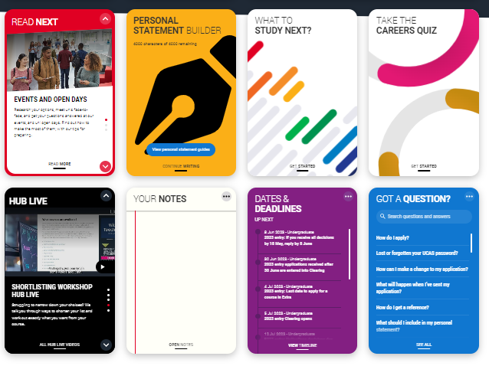
Hub Live session
Wednesday 14th June
4pm
Hub Live session
Personal Statement Hacks
Find out what unis are looking for
Debunk some myths
Ask experts what to include and what to avoid

Slide 22





Connect and ask Questions
Live Chat – use on our website winchester.ac.uk
Open Days
Tuesday 13 June 2023
Saturday 1 July 2023
Saturday 23 September 2023
Saturday 14 October 2023
Saturday 28 October 2023
Saturday 25 November 2023
@uniwinchester
@winchesteruni

Slide 23
Cracking the character limit
4,000 characters allowed. How can you reduce yours?
Attending a shadowing day at Lathom Physiotherapy Centre, I observed the appointments of a variety of patients. After years of attending my own physiotherapy appointments as the patient, it was fascinating to see it from an alternative perspective. Problems ranged from sprained ankles, whiplash injuries, torn Achilles and shooting pains with no obvious cause. With each appointment came an individual treatment technique and exercise plan for the patient. I was intrigued by the concepts of an ultrasound scan for an ankle, asking questions about a new car as a contribution to a patient's problem, and the effectiveness of massaging a particularly affected area to improve joint movements. I noticed how the patients each left the room so much more positive than they came in. One appointment really made a difference to each of them even in such a short amount of time, and this showed me just how much of a difference physiotherapists can make to a person's day to day life.

Slide 24
Attending a shadowing day at Lathom Physiotherapy Centre I observed the appointments of a variety of patients. After years of attending my own physiotherapy appointments as the patient, it was fascinating to see it from an alternative perspective. Problems ranged from sprained ankles, whiplash injuries, torn Achilles and shooting pains with no obvious cause. With each appointment came an individual treatment technique and exercise plan for the patient.
Attending a physiotherapy shadowing day I observed the appointments of a variety of patients. After many physiotherapy appointments for myself it was fascinating to see another perspective. Problems ranged from sprained ankles, whiplash injuries, torn Achilles and shooting pains with no obvious cause. Each appointment showed an individual treatment technique and exercise plan for the patient.

Slide 25
I was intrigued by the concepts of an ultrasound scan for an ankle, asking questions about a new car as a contribution to a patient's problem, and the effectiveness of massaging a particularly affected area to improve joint movements. I noticed how the patients each left the room so much more positive than they came in. One appointment really made a difference to each of them even in such a short amount of time, and this showed me just how much of a difference physiotherapists can make to a person's day to day life.
I was intrigued by the concepts of an ultrasound scan for an ankle, asking questions about a new car as a contribution to a patient's problem, and how massage improved joint movements. Seeing how patients left so much more positive than they came in showed me just how much difference physiotherapists can make to a person’s everyday life.
Reduces original paragraph from 977 to 735
saving 242 characters

