Slide 1
SLO Planning Workshop
August 3, 2011
Notes:
1 – Welcome
2 – Thank you for coming and for your contributions to our SLO assessment activities.
3 – This meeting is part of a larger series of discussions and events over the last semester to analyze:
(a) How does the campus view SLOs and assessment
(b) What does the institution need to do to become “proficient” as is expected by the ACCJC by fall 2012
(c) How do we add VALUE to the process
4 – To meet those aims:
(a) We hosted an SLO round table last spring to gauge the college’s view of assessment. (Barbara)
(b) Additionally, we have been able to pass an Outcomes resolution through the local academic senate, to seek training and resources from the administration to support and strengthen our assessment plan.
5 – The goal for today is to establish mechanisms that formalize our assessment plan as well as establish a long-term strategy for maintaining assessment and adding value to the process.

Slide 2
Agenda
Review “Guiding Principles for SLO Assessment” (ASCCC, 2010)
Review Assessment Pulse Roundtable results
Discuss and formulate our SLO plan
Create SLO Planning Map

Slide 3
Review of “Guiding Principles for SLO Assessment” (2010)
Prepared by the Academic Senate for California Community Colleges
Created as a result of Academic Senate Resolution 2.03
Called for guidance that would assist faculty in establishing effective processes for SLO assessment
“The Academic Senate views outcomes assessment as a productive activity that can improve teaching practices and thus enhance student learning” (p. 7)
Notes:
I would like for us to review this well written document to ensure we as a body have a uniform vision of assessment.
If anyone takes issues with a topic, wishes clarification, or has a comment, please speak out and let us know your thoughts!

Slide 4
1. As faculty have primary responsibility for developing assessments and using the data, their participation in SLO assessment is essential.
SLOs include assessing and improving student achievement, courses, and programs, they are instruments of curriculum development
Curriculum development, including SLO creation and assessment, is a professional obligation
If faculty abdicate this responsibility, the instructional program of the college and the educational experience of students will suffer
Faculty must lead the assessment process, including selecting the data recording instruments, interpreting results, and all subsequent decisions
Notes:
How are we doing in this area?

Slide 5
2. The outcomes assessment process should involve all appropriate participants at each level of the college, not just select individuals.
All faculty in all areas should take part in assessment design and implementation for their own programs
Part-time faculty should be included wherever possible
Researchers are key for assisting with assessment, creating instruments, analyzing data, and providing guidance
All faculty should be involved in SLO development, implementation, analysis, and using the results to improve curriculum or delivery
One of the greatest values of assessment is the collegial discussions it can generate among peers working to improve instruction and programs

Slide 6
3. SLO assessment should be connected to the college culture through the vision statement, ePIE, curriculum, planning, and budgeting.
Assessment “is not an end in itself but a vehicle for educational improvement” (AAHE, 1996)
Faculty will be more confident in process if the college provides appropriate resources to support the project, as well as ideas that arise from the assessment activities
Assessment results should inform program review (ePIE), and be connected to planning
After analyzing successes and areas for program improvement, data can direct strategies and resources for program improvement

Slide 7
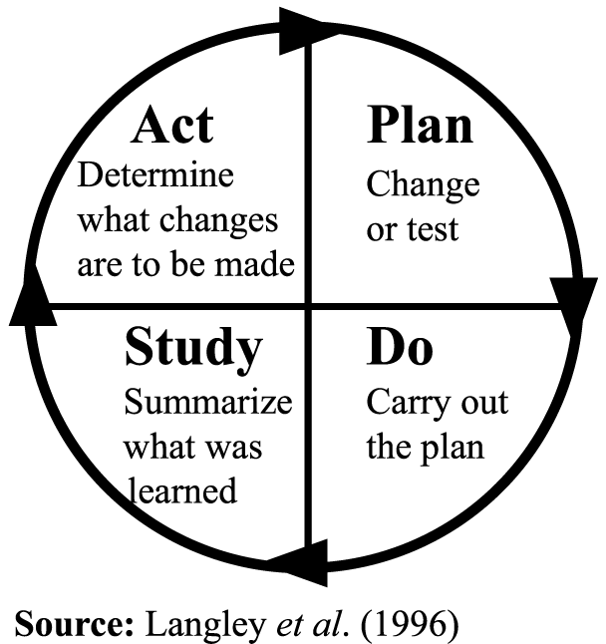
3. SLO assessment should be connected to the college culture through the vision statement, ePIE, curriculum, planning, and budgeting.
SLO assessment should be an ongoing activity rather than a periodic exercise
The assessment cycle needs to include “closing the loop”
A continuous cycle of collecting results, evaluating them, and using evaluations to identify actions that will improve student learning, implementing those actions, and cycling back to the beginning

Slide 8
4. SLOs should be clearly mapped and aligned at the course level and at the various institutional levels for maximum efficiency and effectiveness.
Alignment
It is important to determine that course outcomes align or match up with program outcomes and that institutional outcomes (GEOs) align with the college mission and vision
Capstone courses taken at the conclusion of a program could be utilized for program-level SLOs
GEOs should examine the overall educational experience that is founded on the course and program level

Slide 9
5. Assessment should be authentic & as minimally intrusive to the educational experience of students and the planning and performance of faculty.
Aspects of authentic assessment
Is meaningful and demonstrates students’ ability to apply knowledge rather than just reproduce decontextualized information
Allows students to demonstrate their progress in ways that reflect not simply memorization of materials, but comprehension
Ongoing and formative – instead of just end of course assessments (summative), improvement is best fostered when it “entails a linked series of activities undertaken over time” (AAHE, 1996)
Conducted with the least disruption possible to the students’ educational experience and the instructor’s preparation and delivery of the curriculum

Slide 10
6. Effective assessment benefits from a variety of methods that can respond to different learning outcomes, teaching styles, and student needs.
Any single assessment method is unlikely to satisfy the requirements of all instructional situations
Faculty must be allowed the freedom to develop and employ a variety of assessments based on a given situation
Formative vs. summative assessment
“Assessments become formative when the information is used to adapt teaching and learning to meet student needs” (Boston, 2002)
Summative assessments are “designed to determine a students’ academic development after a set unit of material” (Dunn & Mulvenon, 2009)

Slide 11
7. Assessment data do not exist in a vacuum and must be analyzed alongside all other factors that may impact achievement of outcomes.
Numerous factors can influence both the results of assessment practices and student performance
Faculty should openly discuss all variables that influence results
Assessment cannot answer all questions
Faculty who create assessment processes and analyze the results should recognize the limitations of the practices & instruments used
Faculty should work closely with research staff to enhance the effectiveness of their assessment plans

Slide 12
8. Assessment processes and grading are different but mutually compatible activities that should complement rather than conflict with each other.
Grading – evaluation of student work, but generally offers no explanation or analysis as to what the student could do to improve their work
Formative SLO assessment – evaluating student performance with the aim of providing feedback to enhance student learning through improved instruction
Both the student and the instructor discover what has been learned and what still needs to be learned
While grading and assessment are different, they should not invalidate or contradict each other

Slide 13
9. Effective outcomes assessment requires a college commitment of sufficient staff and resources.
Although faculty hold primary responsibility for assessment, they require adequate support to meet this responsibility
Technical resources – software programs
Human resources – support staff, training, research
Budgetary resources – enable all aspects of plan, allow participation of adjunct faculty, time for analysis and dialogue
The cost of a well-designed plan will yield rewards
Increased student success at the classroom level
Increased completion of certificates and degrees
Better prepared students for transfer
Improved allocation of resources to foster student learning

Slide 14
10. SLO assessment of student learning outcomes is a process that is separate from faculty evaluation.
ASCCC: SLO assessment data is not designed for and should not be used in the evaluation of individual faculty members
ACCJC: “Faculty and others directly responsible for student progress toward achieving stated student learning outcomes have, as a component of their evaluation, effectiveness in producing those learning outcomes”
Local Academic Senate: Encourages faculty members to document their involvement/success in the outcomes process as part of the Self-Evaluation and/or Supplemental Hours portion of the current faculty evaluation process

Slide 15
11. Faculty should engage in SLO development and assessment because it is a good professional practice that can benefit programs and students
While assessment is required of our accreditors, that should not be the principal motivation for the practice
It is the responsibility of faculty to provide the most complete and effective educational experience possible for our students
SLO assessment can provide informative and beneficial input for making curricular evaluations through collegial and authentic discussions and analysis of data
Should faculty not accept their responsibilities, they could lose control of the curriculum and their autonomy to outside forces

Slide 16
Conclusion
SLO assessment should be a collaborative process
The college must be committed to supply the resources and personnel required for the endeavor
Researchers are an essential component
Faculty have primary responsibility and should fulfill that role positively and collaboratively
SLOs should be clearly mapped and in alignment at the various levels of the college
It the assessment plan is done well, the college community will reap benefits and students will receive the most productive and complete learning experience possible

Slide 17
Assessment Pulse Roundtable Results
Barbara McNeice-Stallard

Slide 18
Mt. SAC SLO Plan
Our current plan is focused on numbers, our future plan needs to encourage participants to add value, moving towards the goals outlined in the “Guiding Principles for SLO Assessment” (ASCCC, 2010)
Discuss and formulate our SLO plan
Number of SLOs per course/program/unit
Connecting SLOs with curriculum process
Measureable Objectives
Methods of Evaluation
Ongoing planning process through 4-year review

Slide 19
SLO Planning Map
1-2 page document that answers
Why are we doing assessment?
Who is involved?
What is the motivation for participating?
What are the ramifications of abdication?
When do we assess?
How do we “close the loop?”
What are the benefits?

