Slide 1



All Kinds of Insurance and Opportunities Presented by: (Your name)

Slide 2


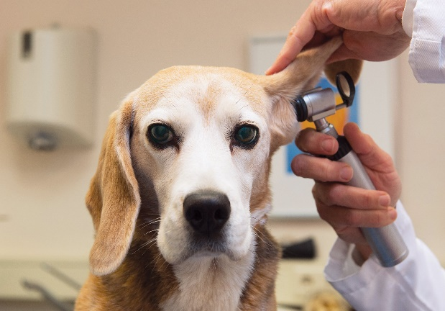
Pet Insurance

Slide 3
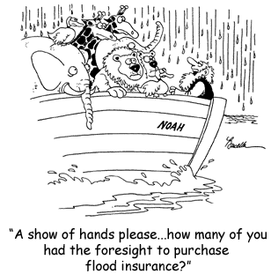

Flood Insurance

Slide 4


Cyber Liability Insurance

Slide 5



Travel Insurance

Slide 6
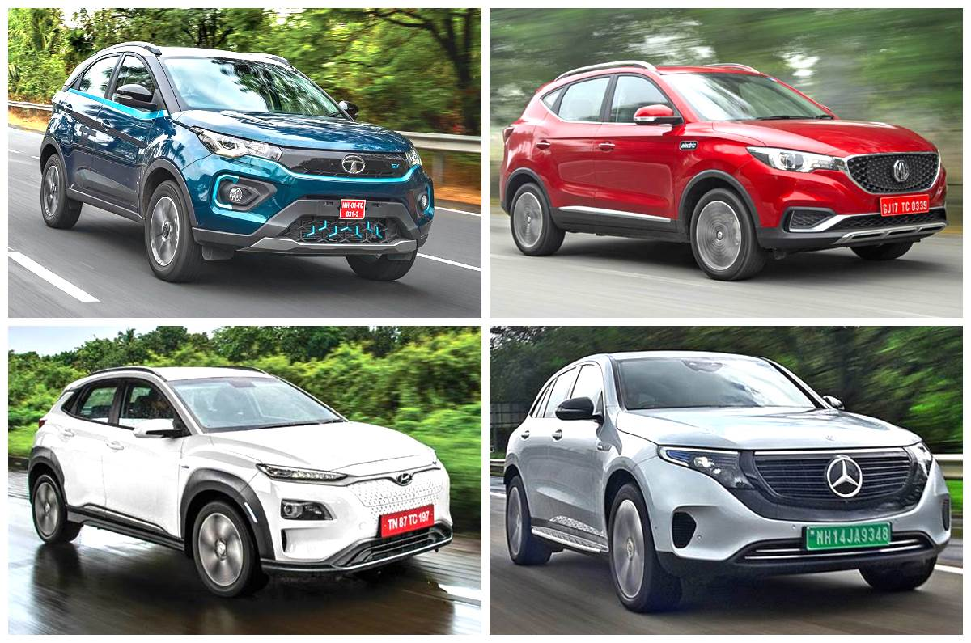

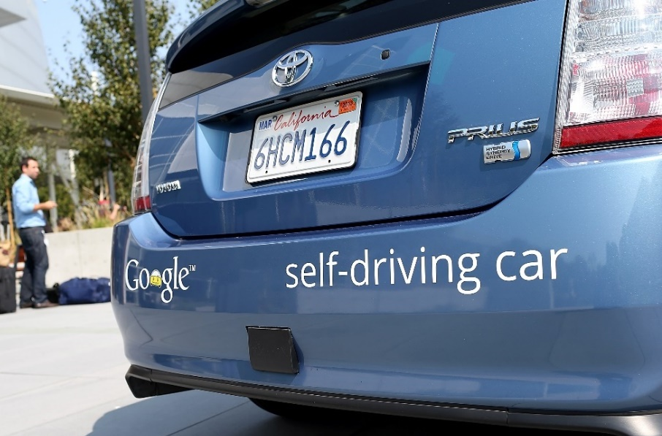
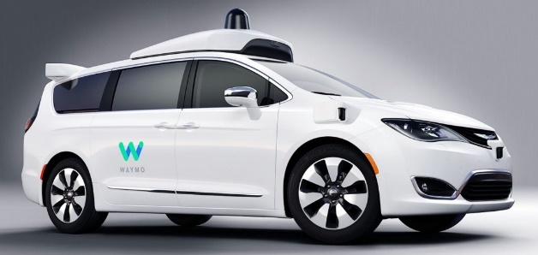
Driverless Cars, Electric Vehicles and Auto Insurance

Slide 7
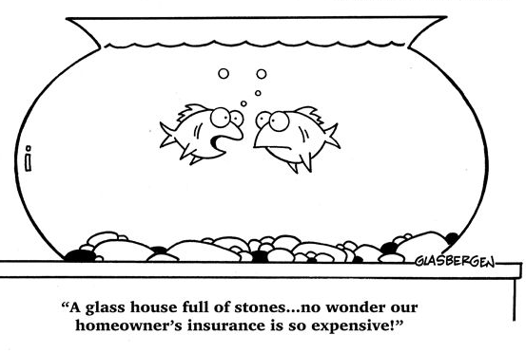


Insurance for your Home

Slide 8
Insurance Markets So Many Types
Architects & Engineers
Auto
Aviation
Builders Risk
Classic Cars
Cyber Liability
Employment Practices
Environmental Liability
Equine
Flood
Homeowners
Hotels & Motels
Life & Health
Liquor Liability
Marine
Product Liability
Public Entities
Publishers Liability
Restaurants & Bars
RVs
Special Event
Trucking
Umbrellas
Workers Comp

Slide 9

Lots of Career Choices in Insurance
Sales & Marketing
Insurance Agent or Producer
Customer Service
Account Executive
Analytics
Actuary or Analyst
Finance
Finance Professional
Catastrophe Adjusting
Claims Adjuster
Risk Analysis
Underwriter
Engineering
Risk Manager
Technology
Technical Support
Management
Director, Attorney
Communications
Public Relations, Social Media, Graphic Design
Office Administration
Office Manager
Other
Recruiter, Auditor, Investigator, Drone Pilot

Slide 10





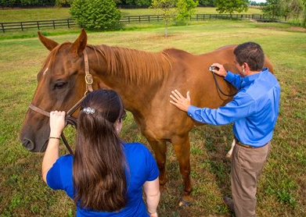
So Many Different Jobs

Slide 11
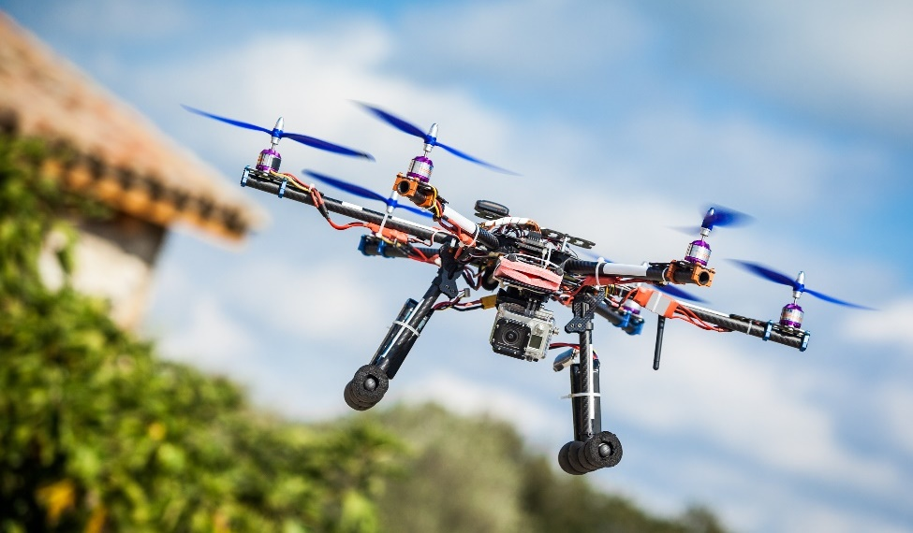
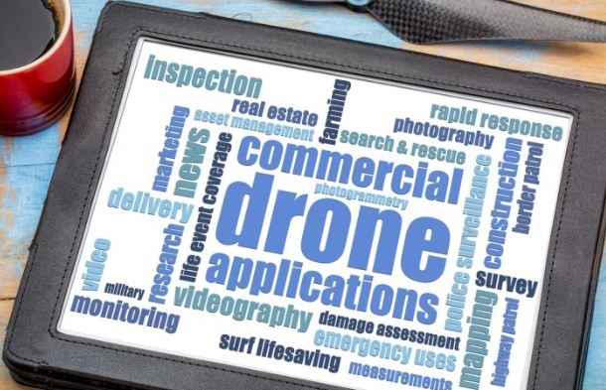
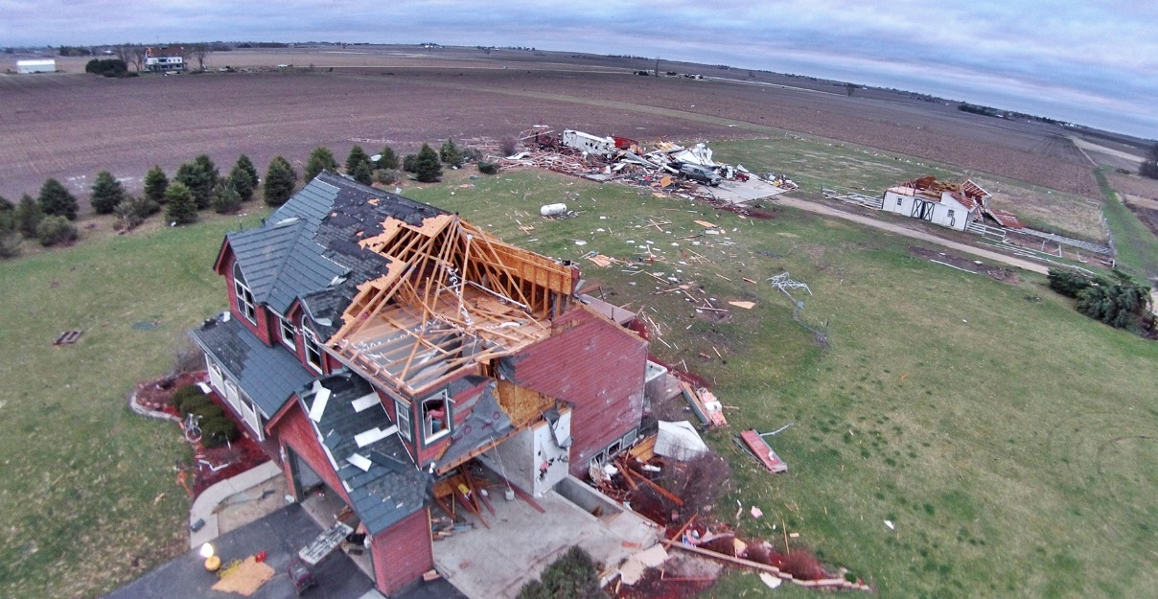
Using Drones in Insurance

Slide 12


Cyber Security Analyst Technology in Insurance
A wide variety of duties in the IT department to challenge you.
Monitor all company networks to see if there are any breaches, and if there are, you’ll investigate them.
Install the latest firewalls and data encryption software, and do updates to protect sensitive company information.
Provide reports on any security breaches.
Conduct fake cyber attacks to see how secure networks really are.
Research, recommend and implement new security practices.
Conduct informative security training for staff when needed.
Pleasant working office environment and the ability to also work from home.
Good-paying job within five years of education and work experience.
Excellent salary and positive job outlook.

Slide 13


Customer Service

Slide 14


10 Reasons Why Insurance Career is Great 4 Young People
The insurance industry is a great place to start (and grow) your career.
From underwriter to data scientist to claims adjuster, there are jobs for a variety of different skills, and these jobs need to be filled soon.
There’s a job for your skills.
Insurance careers are sustainable.
Career advancement provides opportunities to learn.
Diversity is welcome.
Teamwork is unavoidable.
The work is not boring.
You will shape what insurance looks like for years to come.
Insurance offers a flexible work schedule.
You’ll make a difference toward the common good.
Insurance is everywhere.

Slide 15


What a Career in Insurance Offers
From analytics to marketing and sales to information technology; from damage appraisal and investigation to customer service to human resources and finance to risk management — there's a place for you in insurance. It’s part of everything we do.
Variety — The work is as varied as the customers’ needs. Every day presents unique challenges.
Advancement — Potential for growth, professionally and personally, are endless.
Challenge — Make a difference by solving problems and helping others in their time of loss. Every day presents a new opportunity and a new challenge.
Lifelong Learning — Learn on the job and receive the training you need to reach your earning potential in a high-performance environment.
Stability — Insurance is a multi-billion-dollar industry with a long history of growth.
Community — It’s a relationship-driven and a close-knit family of professionals.
Personal Growth & Satisfaction — There’s a place for people who bring caring and commitment to their work. You can succeed professionally, while contributing something positive and necessary.
Inclusive — The industry strives to recruit and develop the broadest possible array of backgrounds from a diverse workforce.

Slide 16




ALL KINDS OF TECHNOLOGY in

Slide 17
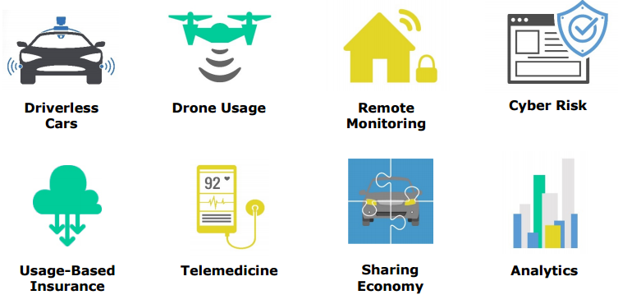
Innovation and Trends in Insurance

Slide 18

TELEMATICS Technology in Insurance
A term that combines telecommunications and informatics.
Onboard communications services in cars, trucks and buses through GPS receivers or apps.
The use of telematics in auto insurance soaring, and nearly 50% of the world’s vehicles expected to be using telematics by 2030.
It helps insurers more accurately estimate accident damages and reduce fraud by enabling them to analyze the driving data (such as hard braking, speed and time) during an accident.
Data collected by telematics can also speed up the claims process, automatically process repair bookings, and even support breakdown recovery.
Telematics also allow fleets of trucks determine the most efficient routes, saving them costs related to personnel, gas and maintenance.

Slide 19
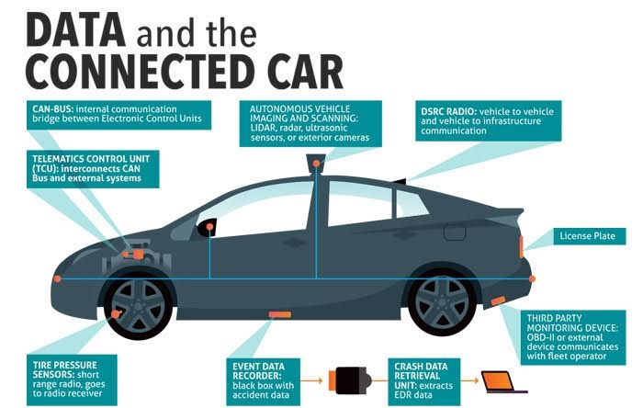

TELEMATICS

Slide 20
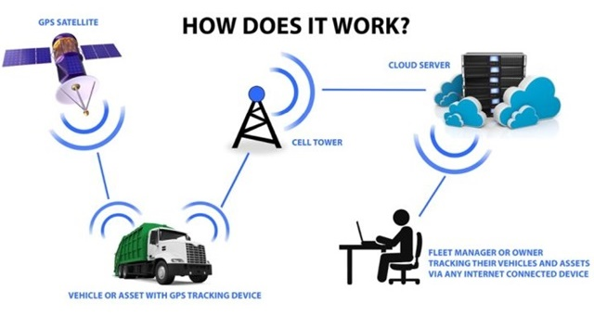


TELEMATICS

Slide 21


CHATBOTS Technology in Insurance
Artificial Intelligence (AI)
Like Siri for brands, ChatBots are quickly rising as a new "voice" in consumer communications. These chatty computer programs respond to texts or digital chats.
Insurance firms can organize distribution, claims, and customer support directly into a messaging app that supports millions of users and messages every day.
Provides users an easy way to get the information they need.
Can help an insurance customer register a loss, schedule a survey, provide loss prevention recommendations, arrange emergency assistance during accidents, and even offer disaster assistance.
Since chatbots are basically virtual robots they never get tired and continue to obey your command.
Can simultaneously have conversations with hundreds of people.

Slide 22
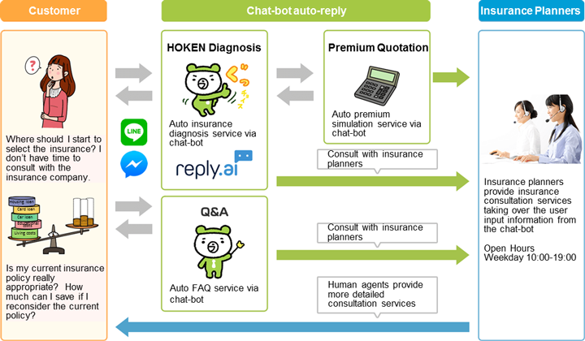
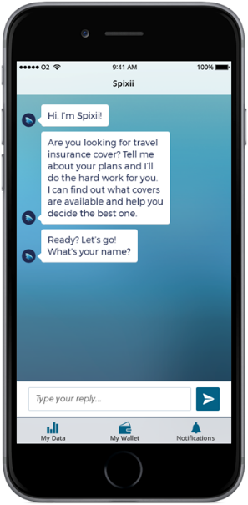
CHATBOTS Technology in Insurance
Insurers want to use chatbot technology to supplement their call centers and self-service portals.
Chatbots are a low-cost modern channel for consumer interaction.

Slide 23



The Transformer
What is InsurTech?
A movement to transform the insurance industry with new technology to improve customer experience, simplify policy management, and increase competition.
The most visible examples of InsurTech:
In-car monitoring devices.
Wearable activity trackers.
Customer-facing apps.
SaaS platforms that manage insurance coverage and payment.
In the small business insurance world, InsurTech is working behind the scenes to increase the options business owners have, keep costs low, and speed the delivery of insurance coverage.
Insurance + Technology = #InsurTech

Slide 24
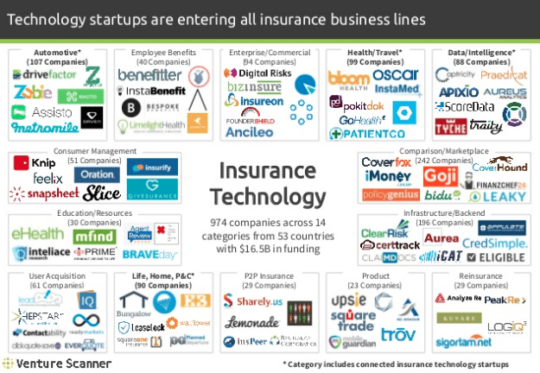


Slide 25

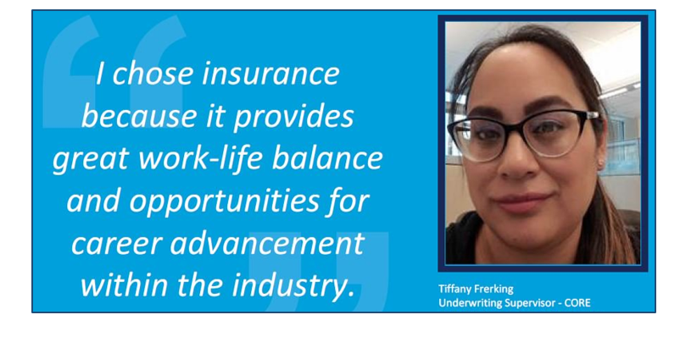

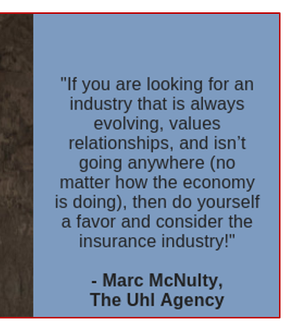


Slide 26



