Slide 1
Imperialism-
The policy by which strong nations extend their political, military, and economic control over weaker territories.
How and why did the US take a more active role in world affairs?
What lands did the US acquire to become more imperialistic
What were the Causes and Effects of the Spanish American War?
What were the United States relations with Asia, and Latin America?

Slide 2
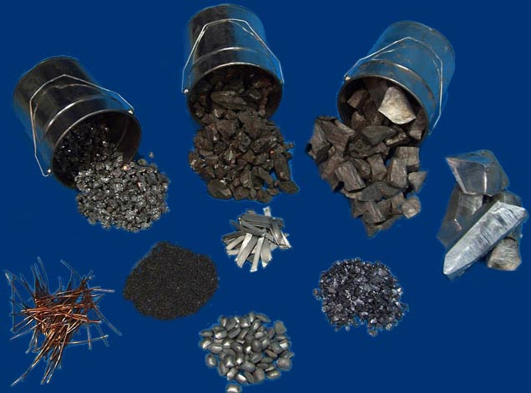
Raw Materials
Many countries were rushing to establish colonies due to a need for raw materials.
Tea, rubber, iron, petroleum
These nations are Extractive Economies-
Imperial countries that extract or remove raw materials from the colony and ship them to the mother land.

Slide 3
United States
Raw Materials were not the US’s problem
They were producing too many goods for American’s to consume
Farmers and Congressmen alike urged World trade in order to expand their market

Slide 4
Military Strength
Imperial nations needed a strong military in order to acquire its colonies
The United States built a larger and more efficient Navy in order to build bases world wide.
Needed to resupply their ships across trade routes
Had the 3rd largest navy in the world by 1900

Slide 5
Frontier Closed
At the turn of the century Frederick Jackson Turner proclaimed the Frontier Closed
People believed that in order to protect the US from internal Conflict we needed to seek lands outside our borders
Many were influenced by Social Darwinism and the ideas of Manifest Destiny to expand America’s influence

Slide 6
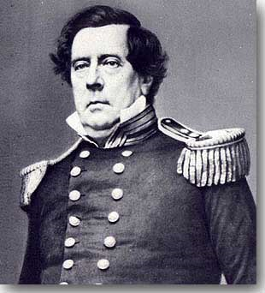
US Takes Steps Toward World Power
Commodore Matthew Perry negotiated open trade agreements with Japan in 1853
In 1867 Secretary of State William Seward bought Alaska from Russia for $7.2 million.
Doubled the countries size and gave the US access to vast resources
Pan-American Highway system was established linking US Businessmen with Latin America

Slide 7
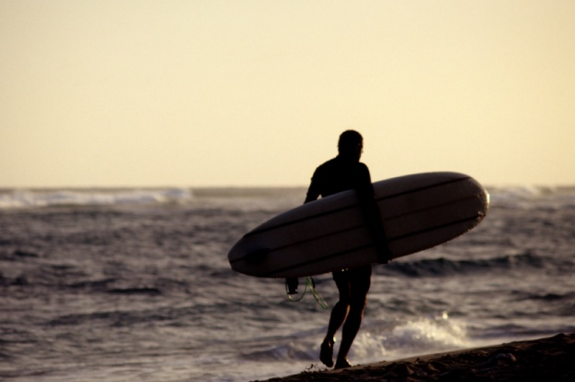
Hawaii
Since the 1790’s US merchants have stopped in Hawaii to re-supply ships
Christian missions and sugar plantations had been established as well
In 1891 the Queen of Hawaii abolished the Hawaiian Constitution and limited the rights of wealthy plantation owners
In 1893 planters overthrew the Queen and were assisted by US marines.
Hawaii asked for annexation to the United States and in 1898 it was approved.

Slide 8
Cuba
Late 1800’s American Businessmen had invested millions in Cuban Sugar cane plantations
Cubans wanted freedom and constantly rebelled against the Spaniards
Spanish military forced rebels into concentration camps
Thousands died of disease and starvation
Many Americans favored the Cuban cause

Slide 9
Yellow Press
William Randolph Hearst and John Pulitzer sensationalized reports from Cuba in order to sell more papers
President McKinley told Spain to settle the rebellion or the US would take steps to do so
After peace negotiations failed McKinley sent in USS Maine
A letter from the Spanish Ambassador leaked to the press which calls McKinley weak and stupid, which fueled nationalism throughout the country

Slide 10
Remember the Maine
Early in 1898 the USS Maine exploded in Havana Harbor killing 266
Naval investigation claimed a land mine had caused the explosion
Many blamed Spain
Spain had agreed to American demands regarding the Concentration camps, but war fever led McKinley to ask Congress to allow force against Spain

Slide 11
Spanish American War
Philippines: May 1898
Commodore George Dewey surprise attacked Spanish navy in Manila Bay and destroyed their fleet
Filipino nationalists led by Emilio Aguinaldo rose up against the Spanish Army in the Philippines and successfully defeated them by August and the Spanish surrendered to the US

Slide 12
Spanish American War
Cuba: June 1898
US Marines landed in Guantanamo Bay
The soldiers were ill equipped and trained for Cuba’s tropical climates
The Rough Riders
Westerners and upper class easterners fought alongside African American troops from 9th and 10th cavalry
Showed superb gallantry at Kettle and San Juan Hill
Spaniards surrendered Cuba after US forces destroyed naval Fleet and defeated Army

Slide 13
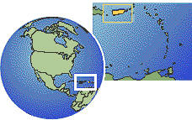
Spanish American War
Puerto Rico-
US troops took control of Puerto Rico and defeated Spanish Army
Spanish Troops surrendered territory

Slide 14
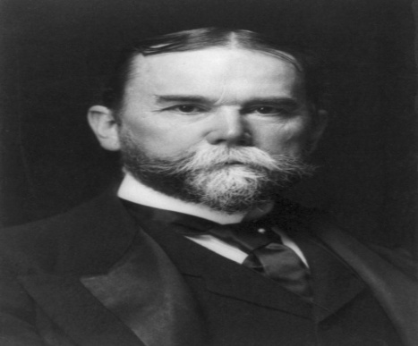
The “Splendid Little War”
3,000 American Deaths (380 due to combat)
Treaty of Paris
Signed in December 1898 officially ended the war
Spain gave up control of Cuba, Puerto Rico, and Guam
Sold Philippines to US for $20 million

Slide 15
The Philippines
Aguinaldo did not want Spanish rule or US rule so he formed a rebellion against the US
Gorilla warfare broke out throughout the Philippines
American military used extreme force against rebels
Concentration camps
Aguinaldo was captured in 1901 and fighting soon stopped
5,000 Americans died and 200,000 Filipinos died

Slide 16
Reforming The Philippines
William H. Taft took over as Governor following the rebellion
Built schools, roads, and bridges
Press was censored
Dissidents were put in jail to keep order
Congress passed the Jones Act in 1916 which promised Filipino independence eventually

Slide 17
China
China had fallen on hard time times economically, politically, and militarily
European nations and Japan carved China up into spheres of influence to gain access to Chinese trade
The US did not have a sphere and was worried they would not be able to keep trade relations in China

Slide 18
Boxer Rebellion
Chinese men and women joined secret societies against foreign influence
In May 1900 The Boxers or “ Harmonious Fists” killed foreign missionaries and rioted in the diplomat district of Beijing
20,000 troops (2,000 US) squashed the riot
Foreign nations demanded retribution from the Chinese Government
In 1911 the Chinese emperor was overthrown by nationalists

Slide 19
Open Door Policy
American Secretary of State John Hay sent a note to all Foreign influences in China
Said he did not want colonies in China just free trade
In order to keep on China’s good side the US used the retribution money to give Chinese students scholarships to study in America

Slide 20
Japan
Japan disapproved of the carving up of China, and really did not like Russia being in Manchuria
In 1904 without Declaration of War, Japan attacked Russia’s Pacific fleet
Russia had over 100,000 casualties
President Roosevelt encouraged a peace treaty between Russia and Japan, which became settled in 1905
Roosevelt Received the Nobel Peace Prize

Slide 21
Gentlemen's Agreement
Japanese and US tensions remained high due to American’s discrimination towards Asians
1906 San Francisco school board banned Japanese, Chinese, and Korean students from attending school with whites
Japan’s newspapers cried for retaliation due to the humiliation
Roosevelt encouraged the school board to reverse their decision while working with Japanese government to discourage immigration to the states

Slide 22
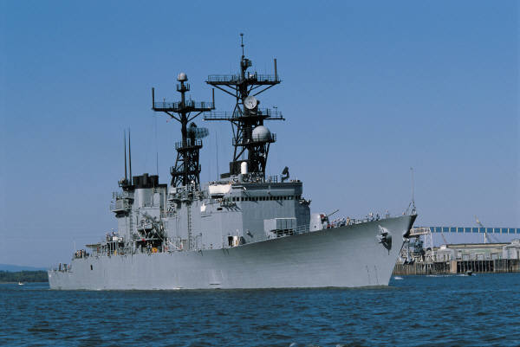
The Great White Fleet
Roosevelt wanted to use diplomacy to ease tensions
He got permission from Congress to send a navy fleet on a good will mission
16 white battleships sailed around the world
The trip proved America’s growing strength as a world power

Slide 23
Puerto Rico
Following the Spanish American War Puerto Rico became a territory of the US
Congress passed Foraker Act in 1900, allowing the President to appoint a governor to Puerto Rico.
In 1917 President Wilson signed Jones-Shafroth Act allowing Puerto Ricans more citizenship rights to the US but not complete citizenship

Slide 24
Cuba
Although Cuba was not a territory of the US, Americans still held influence in the country
In 1902 US encouraged Cuba to add the Platt Amendment to its Constitution
Restricted Cuba from signing any treaty with another country with US approval
Required Cuba to lease naval stations to the US
Gave US the right to intervene to preserve order in Cuba

Slide 25
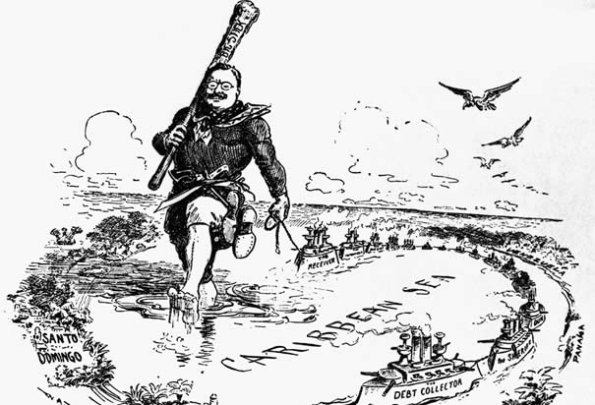
Big Stick Diplomacy
Roosevelt believed that it was US’s responsibility to uplift and “civilize” weaker nations
He felt it was necessary to have a strong military during the imperial age to protect the balance of powers
During the early 1903 many Latin American Countries could not repay debts to foreign nations and Roosevelt Worried about intervention
He issued the Roosevelt Corollary in 1904
Warning other nations to stay out of the Western Hemisphere but US intervention is sometimes justified
Known as an extension to the Monroe Doctrine

Slide 26
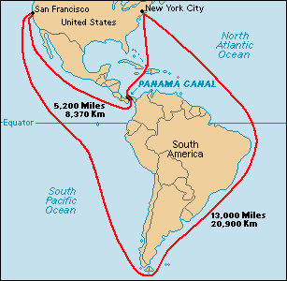
Panama Canal
Initially started by a Frenchmen in the 1800’s The Panama Canal was not successfully finished until 1914
US Bought the Panama route for $40 million in 1903
US needed support from Columbia (Panama belonged to Columbia at the time)
Roosevelt sent US warships to aid the Panama’s rebellion
Panama won independence and gave US the right to build the canal
US paid $10 million and a $250,000 annual rent
35,000 workers came to work on the canal
Over 5,000 died from malaria during the project

Slide 27
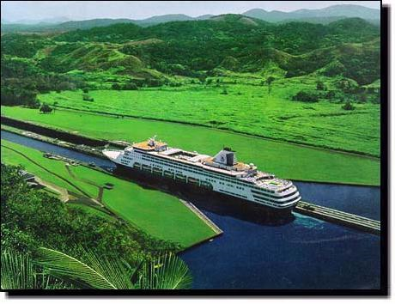
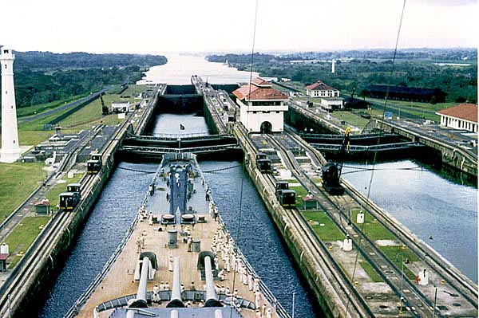
The Canal

Slide 28
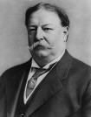
Dollar Diplomacy
William H. Taft took office after Roosevelt and switched the way US handled foreign diplomacy
He wanted to switch bullets to dollars
He encouraged US investments in plantations, mines, oil wells, and railways throughout Latin America
He did return to big stick diplomacy at times but dollar diplomacy did work in his favor

Slide 29
Wilson
Woodrow Wilson changed foreign diplomacy upon entering the White House
Choose William Jennings Bryan as Secretary of State
Anti-Imperialist
He wanted to work for promotion of human rights, national integrity, and opportunity”
However Wilson did use military might when needed, he sent Marines to Haiti, Dominican Republic and Mexico

