Slide 1
Tone Plan Design for Distributed RU
Date: 2024-03-13
Authors:
Name | Affiliations | Address | Phone | Email
Bo Gong | Huawei |  |  | gongbo8@huawei.com
Zhi Mao |  |  |  | maozhi3@huawei.com
Junghoon Suh |  |  |  | Junghoon.Suh@huawei.com
Jian Yu (Ross) |  |  |  | ross.yujian@huawei.com
Ming Gan |  |  |  | ming.gan@huawei.com

Slide 2
Introduction
March 2024
In [1], maximum power amplification and the same hierarchical structure with rRU has been discussed for DRU tone plan design.
Based on the above two principles, we propose 3 kinds of tone plans including
Opt-1 : Group based tone plan
Opt-2 : Pilot tone power boosted tone plan
Opt-3 : Unified DRU Tone Plan across the BWs

Slide 3
Opt-1 : Group based Tone Plan and Pilot Design
Main points of the group based tone plan can be summarizes as follows:
The pilots in the whole bandwidth should be separated enough with each other to avoid the effect of narrowband interference.
The pilots should be placed inside a group of tones to reduce the smoothing fitting error of the channel coefficients of the pilot tones. The reason is that for the interpretation of a PPDU, the pilot tones are more sensitive and more important, whilst the data tones are more robust due to the channel coding (e.g., LDPC).
Based on the above, group based tone plans have been designed. In the following, 20MHz group based tone plan is given as an example and 40M/80M/160M group based tone plan can be obtained in the same way.

Slide 4
An Example Tone Plan for 20M Bandwidth
For 256 FFT, there exists 242 tones with indexes [-122:-2, 2:122];
For 52-tone DRU design, one tone and two adjacent tones are allocated to four 52-tone DRUs in turn.
The 26-tone DRUs consist of the odd/even tones of the 52-tone DRUs.
The 106-tone DRUs are the combination of two 52-tone DRUs with additional 2 tones.
Maximum power amplification for DRU is achieved under the same hierarchical structure as rRU:
Nine 26-tone DRUs : 13/2 = 6.5 (8.13dB)
Four 52-tone DRUs : 13/3 = 4.3 (6.37dB)
Two 106-tone DRUs : 13/6 = 2.17 (3.36dB)

Slide 5
An Example Pilot Design for 20M Bandwidth
Each 52-tone DRU includes 17 pairs of tones. For the four 52-tone DRUs, the i-th pair of tones are continuous, referred as a block here. Beside the 9-th block which is near to the DC tones, each remaining block includes one pilot tone to avoid clustering of the pilot tones. There exist 16 remaining blocks, which correspond to 16 pilot tones.
To reduce the distance between the pilot tone and the guard tones and to keep the pilot
tones distributed evenly.
Utilizing the seventh or eighth tone in the 1st/5th/10th/14th block as the pilot tone, which locates in the fourth 52-tone DRU;
Utilizing the fifth or sixth tone in the 2nd/6th/11th/15th block as the pilot tone, which locates in the third 52-tone DRU;
Utilizing the third or fourth tone in the 3rd/7th/12th/16th block as the pilot tone, which locates in the second 52-tone DRU;
Utilizing the first or second tone in the 4th/8th/13th/17th block as the pilot tone, which locates in the first 52-tone DRU;
The pilot tones of 26-tone DRUs are split from 52-tone DRUs. The pilots of the 106-tone DRUs can be selected as the same as any included 52-tone DRU.

Slide 6
Simulation Results
Channel Bandwidth = 20MHz
LDPC Coding, MCS = 0/MCS = 7
SISO with Channel Model D, no impairment
Phase tracking is always used
Packet Size = 2000 bytes
The PER for the first 52-tone DRU is considered
The baseline scheme is a 52-tone DRU which is near-evenly distributed. The space between two adjacent subcarriers is 4 or 5 that alternately appears.
The simulation results show that under low SNR
The performance of the proposed group based tone plan is similar to the near evenly distributed tone plan with/without smoothing.
There exists obvious smoothing gain for the proposed group based tone plan and the near evenly distributed tone plan.

Slide 7
Simulation Results
The simulation results show that under high SNR
The performances of the proposed paired tone plan and the near-evenly distributed tone plan are almost the same if without smoothing.
(2) The performance of the near-evenly distributed
tone plan deteriorates with smoothing for the
larger fitting error.
(3) For the proposed group based tone plan, there still
exists obvious smoothing gain. The reason is that on
the one hand, the paired tones are close to each other and
are the dominant contributors for each other’s smoothed
channel coefficients; on the other hand, the pilot
tones are included by the paired tones.

Slide 8
Opt-2: DRU Tone Plan with Pilot Boost
March 2024
Motivation: Pilot power of some dRUs can be further boosted because of the power boost gap between the transmit power of a dRU and maximum power in a PPDU.
26-tone dRU in a 20 MHz PPDU; 52-tone dRU in a 40 MHz PPDU;
106 and 242-tone dRU in a 80 MHz PPDU; May have some dRUs in a PPDU with BW larger than 80 MHz.
Note 1: “N/A” means that there is no potential boost room because the dRU is totally distributed (i.e., one tone per MHz);
Note 2: The related dRUs with red items can be further boosted because there is a power boost gap between the dRU power and PPDU power;
Note 3: rRU Tx Power: 10*log10(NumTone*0.078125)-1.
Distributed Tone RU (dRU) for Power Boost in 6GHz LPI [1]
RU Size | rRU Tx Power (dBm) | dRU Tx Power
 |  | 20 MHz PPDU |  |  | 40 MHz PPDU |  |  | 80 MHz PPDU |  |  | 160 MHz PPDU
 |  | Tone Num. per MHz | dRU→BW20 (dBm) | Power Boost Gap (dB) | Tone Num. per MHz | dRU→BW40 (dBm) | Power Boost Gap (dB) | Tone Num. per MHz | dRU→BW80 (dBm) | Power Boost Gap (dB) | Tone Num. per MHz | dRU→BW160 (dBm) | Power Boost Gap (dB)
RU26 | 2.08 | 2 | 10.21 | 1.56 (11.77-10.21) | 1 | 13.22 | N/A | 1 | 13.22 | N/A | 1 | 13.22 | N/A
RU52 | 5.09 | 3 | 11.46 | 0.31 (11.77-11.46) | 2 | 13.22 | 1.56 (14.78-13.22) | 1 | 16.23 | N/A | 1 | 16.23 | N/A
RU106 | 8.18 | 6 | 11.54 | 0.23 (11.77-11.54) | 3 | 14.55 | 0.23 (14.78-14.55) | 2 | 16.31 | 1.6005 (17.91-16.31) | 1 | 19.32 | N/A
RU242 | 11.77 | / | / | / | 7 | 14.46 | 0.32 (14.78-14.46) | 4 | 16.89 | 1.0205 (17.91-16.89) | 2 | 19.90 | 1.02 (20.92 -19.90)
RU484 | 14.78 | / | / | / | / | / | / | 7 | 17.47 | 0.4405 (17.91-17.47) | 4 | 19.90 | 1.02 (20.92 - 19.90)
RU996 | 17.91 | / | / | / | / | / | / | / | / | / | 7 | 20.60 | 0.32 (20.92 -20.60)
RU2*996 | 20.92 | / | / | / | / | / | / | / | / | /

Slide 9
Proposed Tone Plan for BW20
March 2024
Design thoughts
Dividing tones into two subgroups: Subgroup1 for 26-tone dRU 1-5; Subgroup2 for 26-tone dRU 6-9;
Pilot tones in subgroup1 is surrounded by data tones in subgroup2;
In frequency domain between two pilot locations, repeat Subgroup1 and Subgroup2 alternatively for data tone design;
Tone plan structure (DC_leftPart or DC_rightPart)
[28DataTones(2*5, 2*4, 2*5), PilotTones1*4, 28DataTones(2*5, 2*4, 2*5), 26DataTones(2*4, 2*5, 2*4), PilotTones1*5, 26DataTones(2*4, 2*5, 2*4)]
Benefits of proposed 26-tone dRU
1 pilot tone per MHz. The tone distance between a pilot tone and a nearest data tone is larger than or equal to 13;
2 data tones per MHz.
Pilot Locations
DC_leftPart
DC_rightPart
Bo Gong (Huawei)

Slide 10
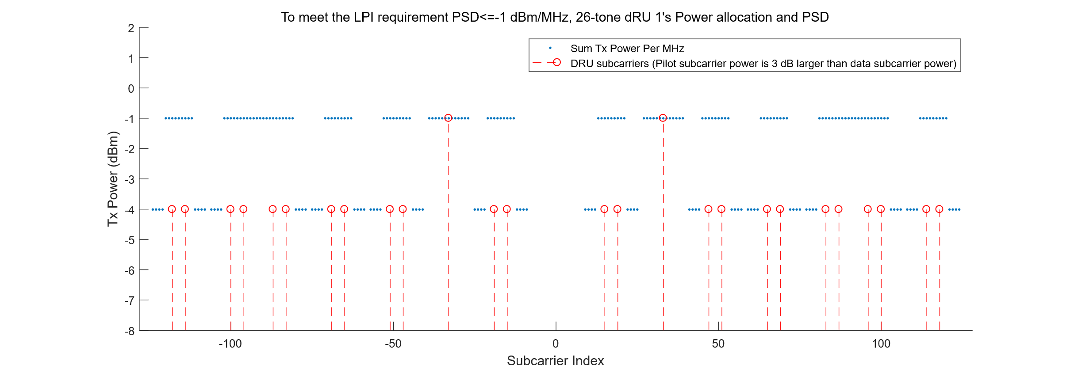
Proposed Tone Plan for BW20
March 2024
Power boost gain of proposed 26-tone dRU
Power boost gain of 52,106-tone dRUs
3 tones per MHz in 52-tone dRUs; 6 tones per MHz in 106-tone dRUs
 | Data Tone Num. per 1MHz | Power Boost per tone (dB) | Pilot Tone Num. per MHz | Power Boost per tone (dB)
26-tone dRU | 2 | 8.13 (-12.14 → -4.01 ) | 1 | 11.13 (-12.14 → -1.01)
3 dB power boost
Bo Gong (Huawei)

Slide 11
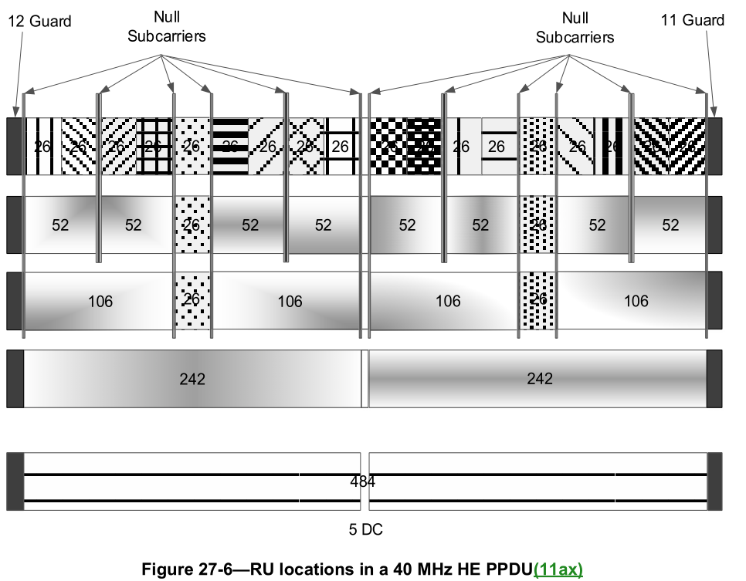
Proposed Tone Plan for Other BWs
March 2024
Tone plan structure (DC_leftPart or DC_rightPart)
[28DataTones(2*5, 2*4, 2*5), PilotTones1*4, 28DataTones(2*5, 2*4, 2*5),
26DataTones(2*4, 2*5, 2*4), PilotTones1*5, 26DataTones(2*4, 2*5, 2*4)]×N
N=2, if BW40; N=4, if BW80; N=8, if BW160; …
Note: “×N” denotes the N times repeating in frequency domain.
Other consideration
Distributing null tones in rRUs tone plan to the location near DC or guard in dRUs tone plan
Power boost gain of pilots.
Refer to the Appendix.
Summary
We propose a dRU tone plan with pilot power boost consideration as Opt-2. The power boost gap in some dRUs is narrowed.
Bo Gong (Huawei)

Slide 12
Option 3: Unified DRU Tone Plan across the BWs
12 Guard Tones
11 Guard Tones
-117
Guard Tones
-128
-2
2
117
127
20 MHz
…
5 DC
…
DC
12 Guard Tones
11 Guard
Tones
-245
-126
130
Null Tones
-256
-130
-11
11
126
245
255
40 MHz
…
5 Null
Tones
…
23 DC
…
5 Null
Tones
…
12 Guard
Tones
11 Guard
Tones
-501
-382
-126
130
386
511
-512
-386
-267
-245
-130
-11
11
126
245
267
382
501
…
5 Null
Tones
…
23 Null
Tones
…
5 Null
Tones
…
23 DC
…
5 Null
Tones
…
23 Null
Tones
…
5 Null
Tones
…
80 MHz
Guard Tones on one side are aligned with the larger BW
Guard Tones on the other side are aligned with the half of the DC tones in the larger BW
Null Tones are aligned with the Null Tones in the larger BW and the DC Tones are aligned with the same number of Null Tones in the larger BW
STAs with the different Operating BW can be mix-scheduled
— Ex. 20 MHz DRU can be mix-scheduled with the 40 MHz DRU in a 40 MHz OFDMA PPDU
— Ex. 40 MHz DRU can be mix-scheduled with the 80 MHz DRU in a 80 MHz OFDMA PPDU
— Ex. 20, 40 and 80 MHz DRU can be mix-scheduled in a 80 MHz OFDMA PPDU
DRUs (including data + pilots) occupy the rest of tones excluding the DC, Guard Tones and Null Tones
Additional Null tones may arise depending on the DRU design, in this case the additional null tones may be put beside the DC and Guard Tones

Slide 13
In case of preamble puncturing case, we can apply the sub-bandwidth DRU tone plan individually
— Ex. For 20+40 MHz puncturing case in 80 MHz PPDU, we can apply the 20 MHz DRU tone plan and 40 MHz DRU tone plan to the non-punctured frequency portion and schedule the PPDU to the same STA
— A mixed RRU and DRU mode can be applied to a preamble-punctured PPDU
Ex. For 20+40 MHz puncturing case, an RRU can be scheduled to 20 MHz portion and a DRU can be scheduled to 40 MHz portion
Main purpose of this Option 3 DRU design is to allow a mixed-schedule among the STAs with the different operating BW
— Ex. In case of four 20 MHz STAs and two 40 MHz STAs to be scheduled, one way to schedule is to apply 52-tone 20 MHz tone plan for the 20 MHz STAs and 106-tone 40 MHz tone plan for the 40 MHz STAs
— Let’s denote “STA1 through STA4” as 20 MHz STAs and “STA5 and STA6” as 40 MHz STAs
— One mixed-schedule is shown in detail in the following link as in the Excel spreadsheet below
STA1 through STA6 are scheduled together in one 40 MHz PPDU
STA1 and STA2 are scheduled in the 20 MHz portion of lower tone index (STA1 and STA2 are assumed to park in the primary 20 MHz)
STA3 and STA4 are scheduled in the 20 MHz portion of higher tone index (STA3 and STA4 are assumed to park in the secondary 20 MHz)

Slide 14
Summary
In this proposal, we propose 3 kinds of tone plans. Beside the maximum power amplification and the same hierarchical structure with rRU, they have the following properties.
For opt-1, the group based tone plan reduces the smoothing fitting error of the pilot tones by placing the pilot tone inside a group of tones. Simulation results show obvious gain of the proposed group based tone plan.
For opt-2, the pilot power boosted tone plan improves the power of the pilot tones, which guarantees higher phase tracking accuracy.
For opt-3, the unified DRU tone plan supports mixed scheduling across the BWs.

Slide 15
Straw Poll #1
March 2024
Do you agree to add the following text to the TGbn SFD?
- The DRU sizes include 26-tone, 52-tone, 106-tone, 242-tone, 484-tone, 996-tone.
Y/N/A: //

Slide 16
Straw Poll #2
March 2024
Do you agree to add the following text to the TGbn SFD?
The DRU tone plan for 20M/40M distribution bandwidth presents the same hierarchical structure as rRU tone plan, which means
- Each 52-tone DRU consists of two 26-tone DRUs;
- Each 106-tone DRU consists of two 52-tone DRUs and two additional tones;
- Each 242-tone DRU consists of two 106-tone DRUs and one 26-tone DRU and 4 additional tones;
Y/N/A: //

Slide 17
Straw Poll #3
March 2024
Do you agree to add the following text to the TGbn SFD?
The number of the pilot tones of a DRU is the same as the number of the pilot tones of a rRU with the same size
- Two pilots for 26-tone DRU;
- Four pilots for 52-tone DRU;
- Four pilots for 106-tone DRU;
- Eight pilots for 242-tone DRU;
- Sixteen pilots for 484-tone DRU.
- Sixteen pilots for 996-tone DRU.
Y/N/A: //

Slide 18
Straw Poll #4
Do you agree with the mixed-scheduling in DRU Tone Plan?
Mixed-scheduling takes place in a PPDU where the STAs with the different operating BWs are scheduled together
The BW of the PPDU is aligned with the largest operating BW among the scheduled STAs

Slide 19
Straw Poll #5
Do you agree with the Unified DRU Tone Plan?
Unified DRU Tone Plan is that the DRU Tone Plan of a larger size BW gets built up over the tone plan of the smaller size BW
e.g.) the 40 MHz DRU Tone Plan is built up over the 20 MHz DRU Tone Plan, so the 20 MHz operating STAs can be scheduled with the 40 MHz operating STAs in one 40 MHz PPDU

Slide 20
Straw Poll #6
Do you agree with the following DRU Tone Plan to support the Unified DRU Tone Plan?
The DRU sizes include 26-tone, 52-tone, 106-tone, or combination of these DRUs
Combination of DRUs is TBD

Slide 21
References
[1] 11-23-2021-00-00bn-principle-and-methodology-for-dru-tone-plan-design
[2] 11-23-2020-01-00bn-high-level-perspective-on-distributed-tone-ru-for-11bn

Slide 22
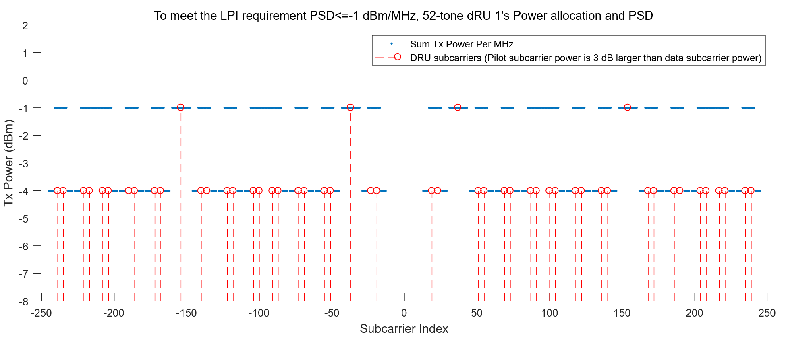
Appendix : Example of 52-tone dRU on BW40
 | Data Tone Num. per 1MHz | Power Boost per tone (dB) | Pilot Tone Num. per MHz | Power Boost per tone (dB)
52-tone dRU | 2 | 8.13 (-12.14 → -4.01 ) | 1 | 11.13 (-12.14 → -1.01)
Bo Gong (Huawei)

Slide 23
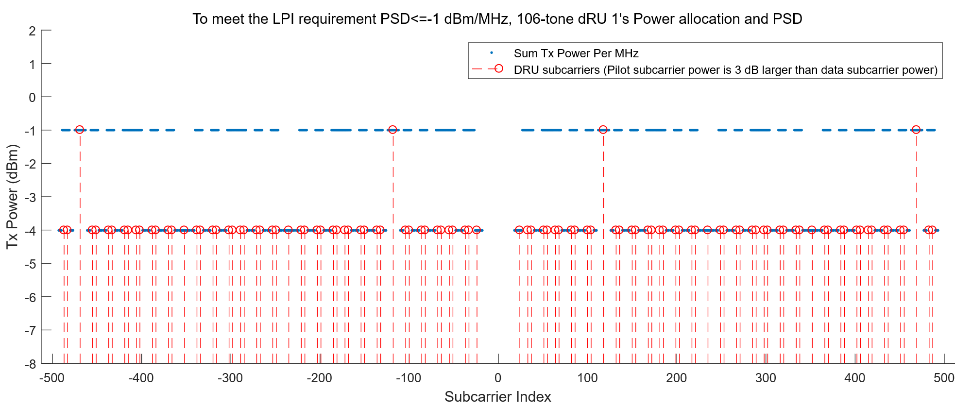
Appendix : Example of 106-tone dRU on BW80
 | Data Tone Num. per 1MHz | Power Boost per tone (dB) | Pilot Tone Num. per MHz | Power Boost per tone (dB)
106-tone dRU | 2 | 8.13 (-12.14 → -4.01 ) | 1 | 11.13 (-12.14 → -1.01)
Bo Gong (Huawei)

Slide 24
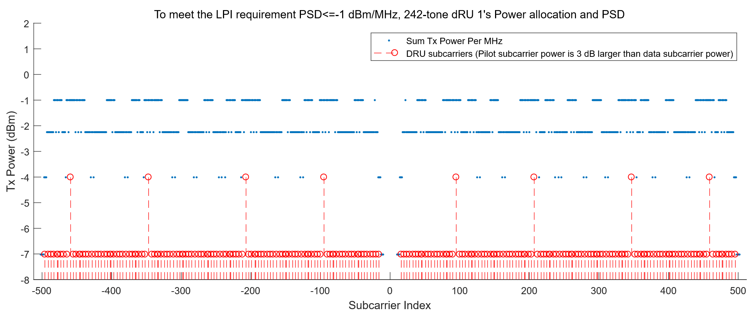
Appendix : Example of 242-tone dRU on BW80
 | Data Tone Num. per 1MHz | Power Boost per tone (dB) | Pilot Tone Num. per MHz | Power Boost per tone (dB)
242-tone dRU | 4 | 5.12 (-12.14 → -7.02) | 2(equivalent) | 8.13 (-12.14 → -4.01)
Bo Gong (Huawei)

Slide 25
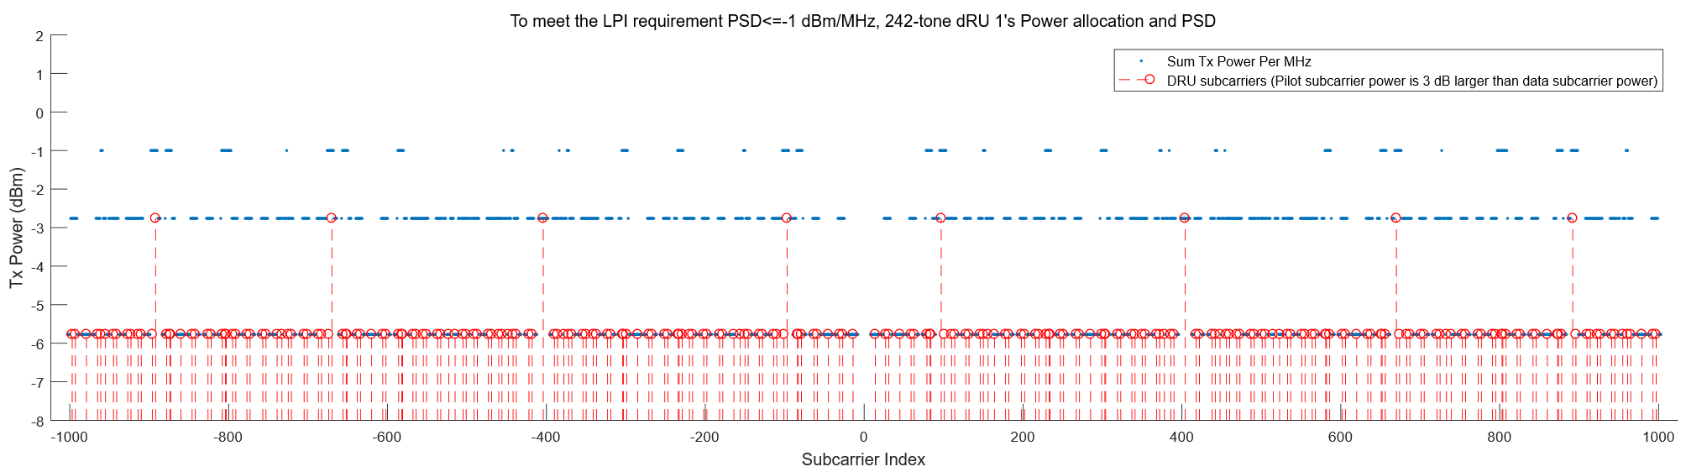
Appendix : Example of 242-tone dRU on BW160
 | Data Tone Num. per 1MHz | Power Boost per tone (dB) | Pilot Tone Num. per MHz | Power Boost per tone (dB)
242-tone dRU | 3 | 6.37 (-12.14 → -5.77 ) | 1.5 (equivalent) | 9.37 (-12.14 → -2.77)
Bo Gong (Huawei)

Slide 26
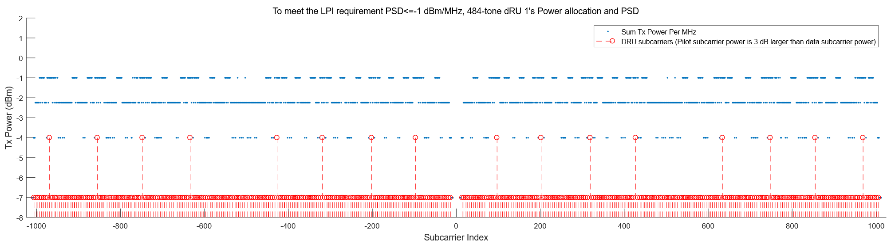
Appendix : Example of 484-tone dRU on BW160
 | Data Tone Num. per 1MHz | Power Boost (dB) | Pilot Tone Num. per MHz | Power Boost (dB)
484-tone dRU | 4 | 5.12 (-12.14 → -7.02 ) | 2 (equivalent) | 8.12 (-12.14 → -4.02)
Bo Gong (Huawei)

