Slide 1
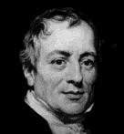
Ricardian Model
INTERNATIONAL ECONOMICS, ECO 486
David Ricardo
April 18, 1772 — September 11, 1823

Slide 2
Learning Objectives
Understand five more assumptions
Determine and understand comparative and absolute advantage
Find international trade equilibrium
Explain gains from trade
Derive range of wages that will permit trade

Slide 3
Learning Objectives
Understand five more assumptions
Determine and understand comparative and absolute advantage
Find international trade equilibrium
Explain gains from trade
Derive range of wages that will permit trade

Slide 4
Assumptions
#8 – Resources cannot move between countries
#9 – There are no barriers to trade
#10 – Exports must pay for imports

Slide 5
Assumptions
Assumptions 8-10 apply to both the Classical (chapter 3) and the Hechscher-Ohlin (chapter 4) Models
Assumptions 11 & 12 apply only to Classical Model

Slide 6
Assumptions
#11 -- Labor is the only relevant resource
#12 -- Production exhibits constant returns to scale, CRS, between labor and output.
If both inputs, K & L, are doubled, output doubles
Implies Linear PPF and complete specialization

Slide 7
Ricardian Theorem
A country exports that good which has higher comparative factor productivity and imports the commodity which has lower comparative factor productivity than the other country.
Page 48, Ravendra N. Batra, Studies in the Pure Theory of International Trade

Slide 8
Differing technologies and resource endowments
Labor productivity | Country A | Country B
Soybeans | 4 (kg./hr.) | 1 (kg./hr.)
Textiles | 2 (m./hr.) | 1.5 (m./hr.)
Labor endowment | 1000 (hr./yr.) | 800 (hr./yr.)
Notes:
Based on table 3.3, page 61.

Slide 9
Differing Opportunity Costs
Opportunity Costs | Country A | Country B
Soybeans (m./kg.)
Textiles (kg./m.)
Notes:
Based on table 3.3, page 61.

Slide 10
Differing Opportunity Costs
Opportunity Costs | Country A | Country B
Soybeans (m./kg.) | 2/4 = ½ = 0.5(m./kg.) | 1.5/1 = 1.5(m./kg.)
Textiles (kg./m.) | 4/2 = 2 (kg./m.) | 1/1.5 = 2/3 = 0.67 (kg./m.)
Notes:
Based on table 3.3, page 61.

Slide 11
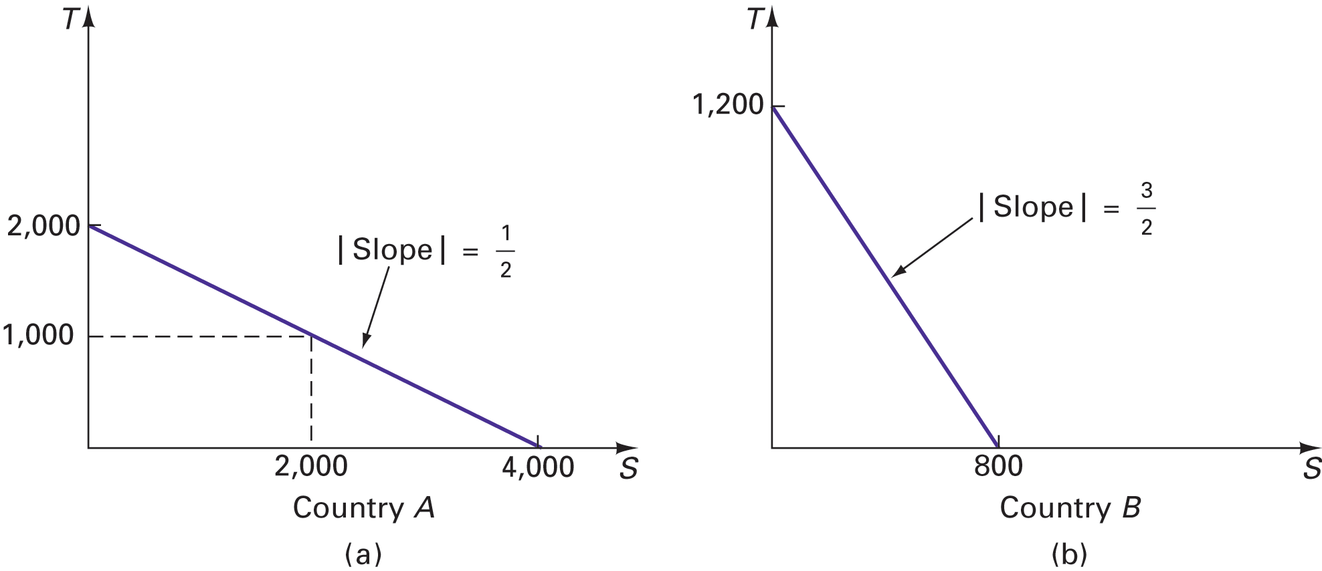
Production possibility frontiers: (a) country A; (b) country B.
Notes:
See Figure 3.1, page 68

Slide 12
Autarky
Given perfect competition,
P = MC
Autarky price of S (on x-axis) equals slope of PPF
Resource payments correspond to their productivity

Slide 13
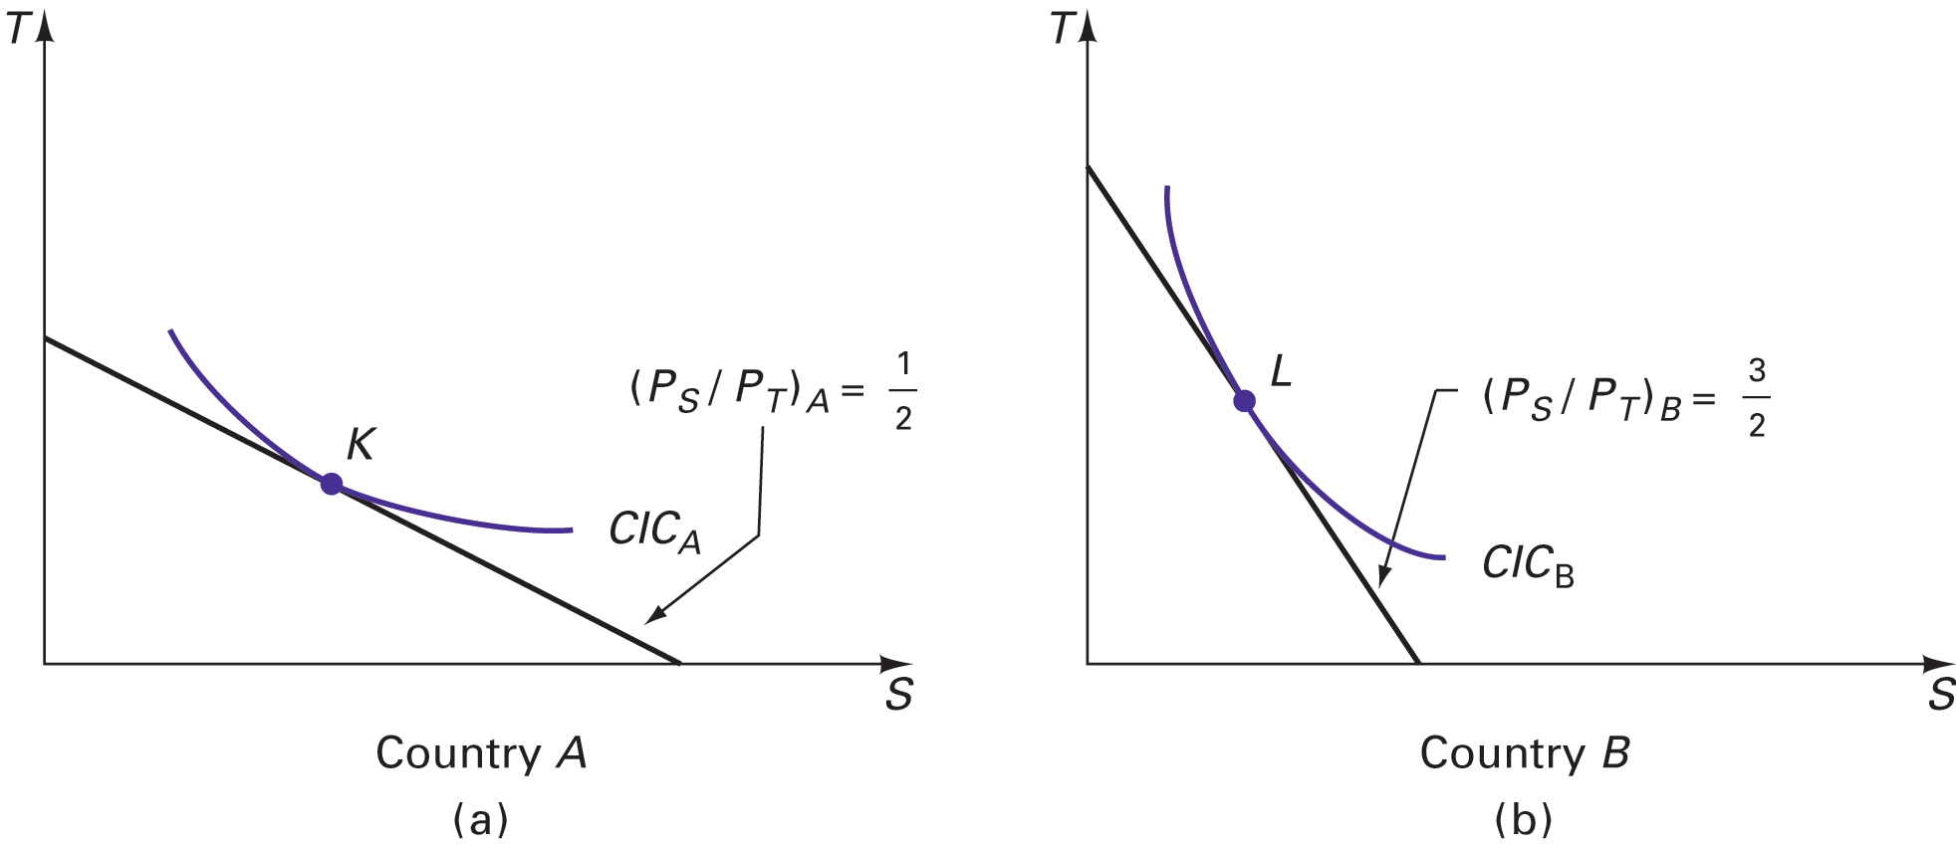
Pretrade equilibriums: (a) country A; (b) country B.
Notes:
See Figure 3.2, page 69
Given perfect competition

Slide 14
Learning Objectives
Understand five more assumptions
Determine and understand comparative and absolute advantage
Find international trade equilibrium
Explain gains from trade
Derive range of wages that will permit trade

Slide 15
Absolute Advantage
Compare one good across countries.
Country with greater output per labor hour has an absolute advantage in that good.

Slide 16
Comparative Advantage
Calculate opportunity costs.
Compare one good across countries.
Country with lower opportunity cost has a comparative advantage in that good.

Slide 17
Which Advantage?
Absolute advantage is a special case.
Comparative advantage is the general case.

Slide 18
Learning Objectives
Understand five more assumptions
Determine and understand comparative and absolute advantage
Find international trade equilibrium
Explain gains from trade
Derive range of wages that will permit trade

Slide 19
Terms of Trade
Once trade begins, an international equilibrium results
Results in one world price for a good

Slide 20
Terms of Trade
Once trade begins, an international equilibrium results
Results in one world price for a good
called the terms of trade
between the two autarky prices
determined by reciprocal demand

Slide 21
International Trade Equilibrium
Complete specialization in Comparative Advantage good
CIC & ToT tangent at consumption point
Congruent trade triangles imply balanced trade

Slide 22
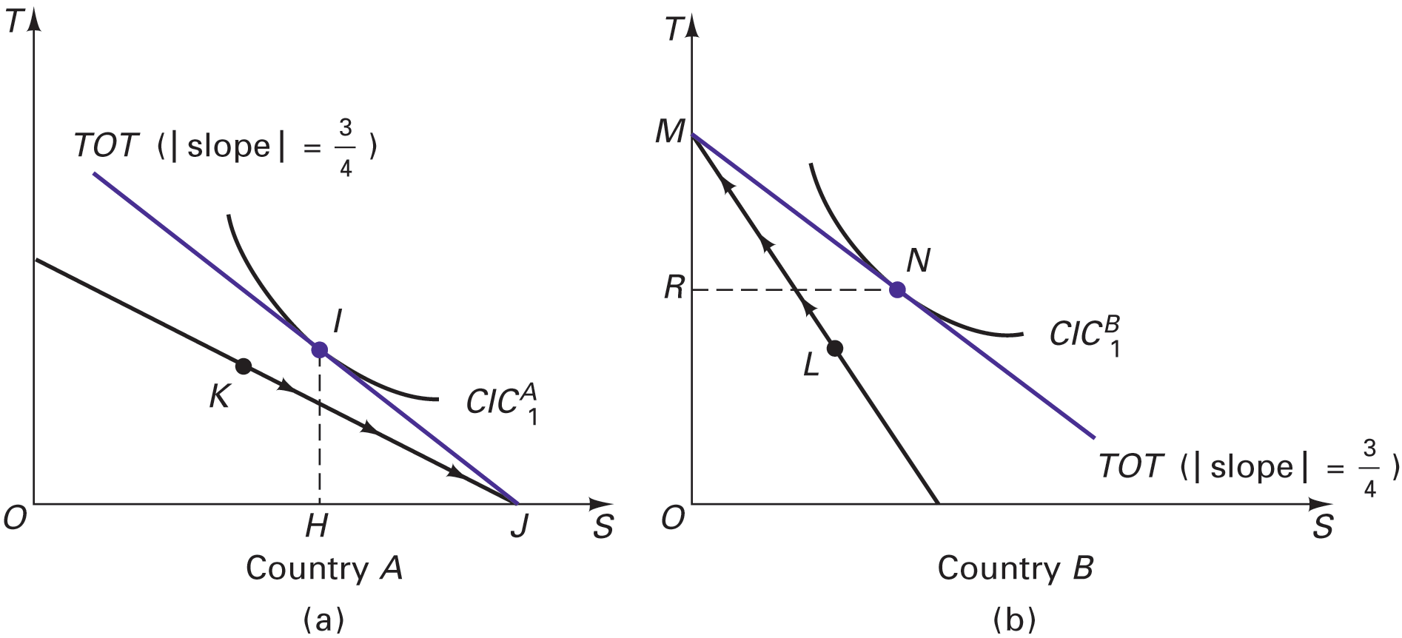
Posttrade equilibriums: (a) country A; (b) country B.

Slide 23
Learning Objectives
Understand five more assumptions
Determine and understand comparative and absolute advantage
Find international trade equilibrium
Explain gains from trade
Derive range of wages that will permit trade

Slide 24
Gains From Trade
More of both goods attainable
GDP increases at pre-trade prices
Higher CIC is attainable

Slide 25
Gains From Trade
More of both goods attainable
GDP increases at pre-trade prices
Higher CIC is attainable
CIC can isolate two sources of gain:
production (gains from specialization)
consumption (trade price better than autarky price)

Slide 26
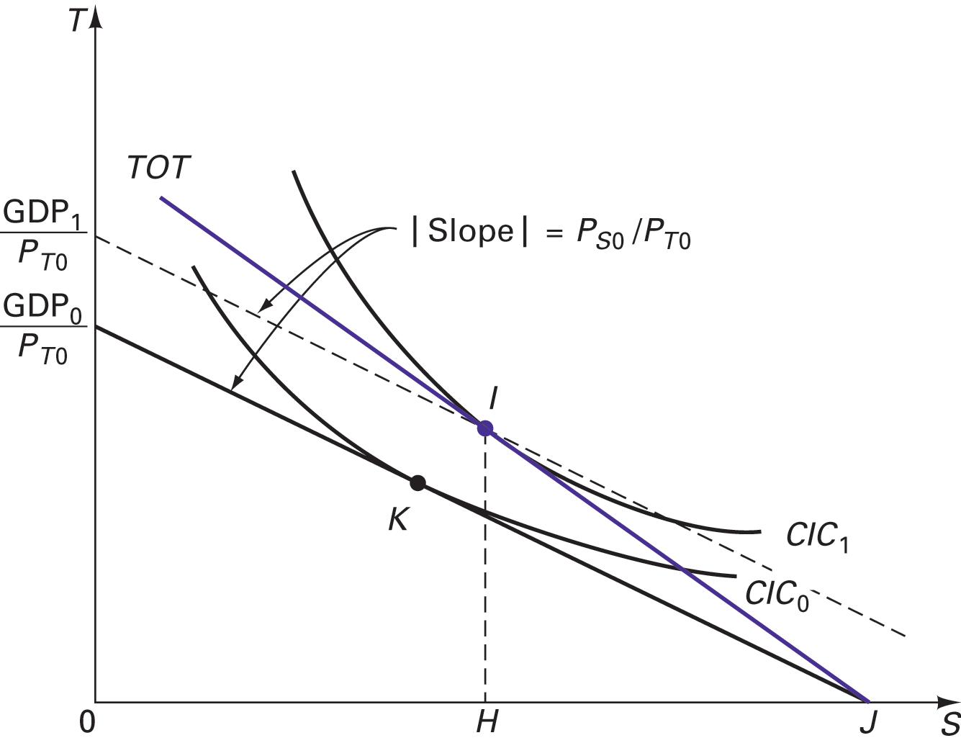
The gains from trade (country A).

Slide 27
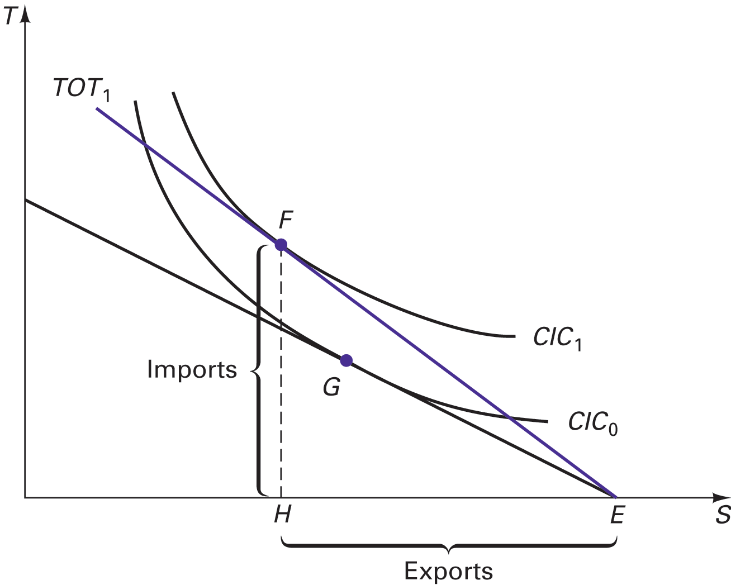
Country A’s trading equilibrium.

Slide 28
Learning Objectives
Understand five more assumptions
Determine and understand comparative and absolute advantage
Find international trade equilibrium
Explain gains from trade
Derive range of wages that will permit trade

Slide 29
Exchange Rates
State exchange rate, E, in US dollars per UK pound
say $2/£
A good will be imported if its foreign pre-trade price (x E) is less than the domestic price
P_{S} < E x P_{S}*

Slide 30
Buy Low . . .
Trade requires
P_{S} < E x P_{S}*
P_{T} > E x P_{T}*
autarky prices
Home (A) has comparative advantage in S
Foreign (B) has comparative advantage in T

Slide 31
Perfect Competition Review (Product & Resource Markets)
P_{X} = MC for a good, X
MC = w/MPP_{L} (Labor, L, is only var. input)
w=MRP_{L} =(MR) MPP_{L}=(P) MPP_{L}=VMP_{L}

Slide 32
Perfect Competition Review (Product & Resource Markets)
P_{X} = MC for a good, X
MC = w/MPP_{L} (Labor, L, is only var. input)
w=MRP_{L} =(MR) MPP_{L}=(P) MPP_{L}=VMP_{L}
MRP_{L} = Marginal Revenue Product MR = Marginal Revenue; MPP_{L} = Marginal Physical Product of L VMP_{L} = Value Marginal Product of L

Slide 33
Prices & Wages
P_{X} = MC = w/MPP_{L}
MPP_{L} is measured as units of X per hour, O_{LX}
Productivity may be stated as hours per unit of X, a_{LX}, or units of X per hour worked, O_{LX}.
a_{LX} = 1/O_{LX}
P_{X} = w /O_{LX}

Slide 34
Trade & Wages
Substitute P_{X} = W /O_{LX}
W/O_{LS}< E x W* /O*_{LS}
W/O_{LT}> E x W*/O*_{LT}
To solve
divide both sides by (E x W*)
multiply both sides by O_{LS} or O_{LT}

Slide 35
Trade & Wages (Cont.)

Slide 36
Trade & Wages (Cont.)
A’s relative wage must not exceed its relative productivity in its comparative advantage good.

Slide 37
Trade & Wages (Cont.)
A’s relative wage must exceed its relative productivity in its comparative disadvantage good (T).

Slide 38
Competitive Advantage
The ability to sell a good at the lowest price.
Usually results from comparative advantage
Alternatively, it may be the result of . . .
Government subsidies for inefficient industries
An undervalued exchange rate

Slide 39
Losing Competitive Advantage
If Home’s relative wage ratio (W/W*) exceeds its relative productivity (O_{LS}/O_{LS}*), its S will cost _______ than Foreign’s.
If a country’s currency is overvalued (say $1/£ instead of $2/£), comparative advantage may be lost -- both goods may be cheaper in ___________.

Slide 40
Losing Competitive Advantage
If Home’s relative wage ratio (W/W*) exceeds its relative productivity (O_{LS}/O_{LS}*), its S will cost more than Foreign’s.
If a country’s currency is overvalued (say $1/£ instead of $2/£), comparative advantage may be lost -- both goods may be cheaper in Britain.

Slide 41

Tony Auth, NY Times editorial cartoon, December 2, 1999

