Slide 1
What’s new in .NET Core & C# 8.0

Slide 2
.NET Core is the Future of .NET
Scott Hunter - Director of Program Management

Slide 3
Beyond .NET Core 3.0
.NET 5
Unification
CoreFx
Runtime Convergence
Interop
Java
Objective-C / Swift
Notes:
.net 5 om verwarring met full framework te vermijden

Slide 4
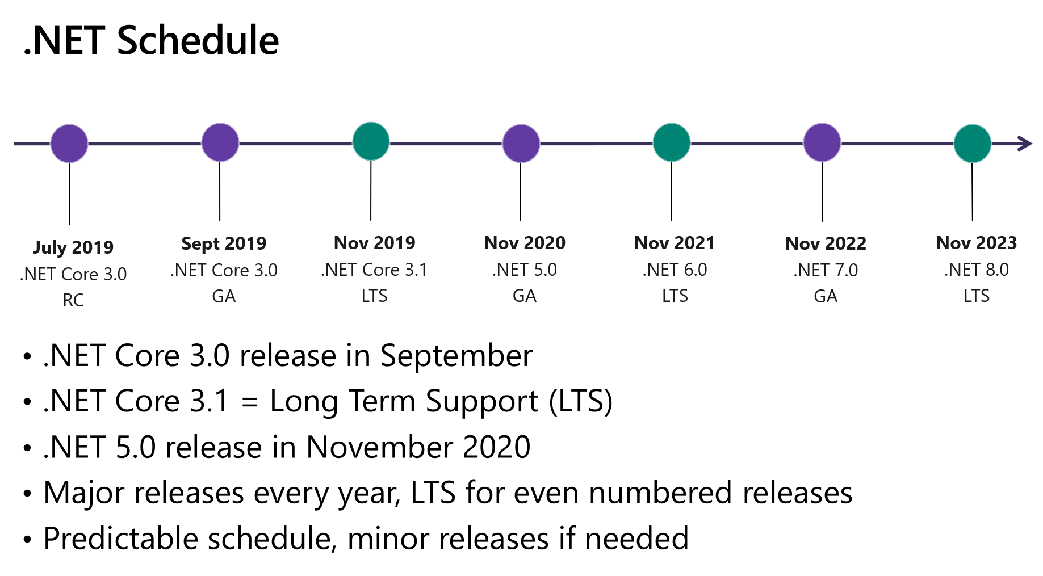

Slide 5
What’s new in .NET Core 3.0

Slide 6
.NET Standard 2.1
Features
Span<T>
ValueTask & ValueTask<T>
Reflection Emit
SIMD
DbProviderFactories
Quality of Life additions
Not Supported on .NET Framework 4.8!
Notes:
Span
Laat toe om managed & unmanaged memory op een unforme manier te gebruiken
Laat toe om te slicen zonder allocaties
Restricties op gebruik (stack only,…)
Zie ook Memory<T>
Valuetask & ValueTask<T>
Laten toe om allocation free asynchrone operaties uit te voeren
Restricties op gebruik
Geen multiple awaits
Geen concurrent awaits
Geen GetResult()
SIMD
Simd support was al beschikbaar sinds 2014 maar is nu ook effectief deel van .Net Standard
DbProviderFactories maken het mogelijk om verschillende types van data providers te creëren gebaseerd op string names.
Bestonden al lang maar waren uit de boot gevallen in .net standard 2.0
Quality of life features => teveel om op te noemen maar bestaan voornamelijk uit extra methods op bestaande classes
Supported on Mono, Xamarin, Unity en .Net Core
Framework 4.8
is de laatste versie van het full framework
Zal geen nieuwe features meer krijgen
Supported indefinitely

Slide 7
Build
Version Roll-forward
Configuration
Project file
Config file
Environment Variable
Commandline parameter
Options
Latest patch
Minor, Major
Latest minor, Latest major
Disabled
Copy dependencies on build
Notes:
Latest Patch
Roll forward to highest patch version in requested minor version
Minor/Major
Roll forward to lowest higher minor/major version if requested version not present
Latest patch behavior if it is
Latest minor/major
Roll forward to highest minor/major version, even if requested version is present
Copy dependencies on build also instead of only on publish

Slide 8
Compilation & Deployment
Single file executables
Includes native dependencies
Assembly linker for removing unneeded assemblies
ReadyToRun
Next generation of ngen
Only supported for single file exes
No cross-platform codegen, with some exceptions
Tiered Compilation
Faster startup
Replace hot path with more optimized bytecode at runtime
Notes:
Single File exes
Zip files that are unpacked on first run
Includes framework that the app was built for
Assembly linker not foolproof, may prune too much (bijvoorbeeld bij reflection, dynamic invocation)
R2R
Contains both IL and native code
Windows x64 can be used to compile Windows ARM32, ARM64, and x86 images.
Windows x86 can be used to compile Windows ARM32 images.
Linux x64 can be used to compile Linux ARM32 and ARM64 images.
Tiered compilation
Faster startup

Slide 9
Compilation & Deployment
Framework dependent executables
MSIX
Open source packaging standard & toolset
Containerized application installer
Clean Uninstalls
(Limited) support down to Win7
Notes:
Framework dependent executables
Applicaties die het framework niet bundelen worden nu ook als exes gebuild (dus dubbelklikbaar en startbaar via de commandline) ipv enkel via dotnet run
Msix
App runt in een sandbox gelijkaardig aan een UWP applicatie
Virtual filesystem en registry elke app heeft z’n eigen aparte sectie van het filesysteem en de verschillende registry hives Zolang de app gebruik maakt van de correcte apis worden file access en registry acces remapped naar de aparte secties
Fully supported on Win10 1809
Mostly supported on Win 10 1709 & 1803
MSIX Core for Win 7 & later

Slide 10
SDK & Runtime
Local Tools
SDK Installer
Smaller
Old versions automatically removed
GC optimizations
Optimized for memory constrained environments
Smaller heap sizes
Smaller memory footprint
Better alignment with modern cpu cache sizes for gen0
Large Page support
Notes:
Global tool voorbeelden (dotnet-ignore (ignore file voor git), dotnet-serve (start webserver met static pages in current dir), dotnet-cleanup (verwijdert package en build cruft)
Local tools
worden geinstalleerd in een directory en zijn enkel beschikbaar in die directory en z’n subdirectories
Zijn afhankelijk van een compatibele framework versie (veel tools nog gebuild op v2.1)
Tools worden in een manifest file (dotnet-tools.json) opgeslagen dat mee in source control kan
Sdk installer
Smaller
Door installeren van reference packages.
Deze bevatten wel de type definitions maar niet de implementatie zelf, waardoor ze veel kleiner zijn
Bij installeren van nieuwe versies worden oude versies in zelfde feature band verwijderd
Feature band is honderdtal van patch nummer.
Major.minor.patch
Vb: 3.0.100 – 3.0.199 is zelfde feature band
3.0.199 en 3.0.200 zijn verschillende feature bands
Large page support

Slide 11
Windows
Windows only desktop technologies
WinForms (with HDPI support)
WPF
Entity Framework 6.3
Managed COM Components
Native interop
COM apis (CoCreate)
WinRT apis

Slide 12

Windows
WCF
WWF
WebForms
Remoting

Slide 13
Linux
ARM64 Linux support
SerialPort support

Slide 14
Security
TLS 1.3 support (on OpenSSL 1.1.1)
AES-GCM & AES-CCM support
Import & Export of keys
X.509
PKCS#8
PKCS#1
PFX/PKCS#12
Notes:
GCM => Galois Counter mode
CCM = > Counter with CBC-MAC (Cypher block chaining message authentication code)

Slide 15
Varia
GPIO support for Raspberry PI
IEEE 754-2008 conformance
Platform dependent SIMD intrinsics
Notes:
GPIO
2 packages voor GPIO (general purpose IO), GPIO, SPI (Serial Peripheral Interface), I2C (Inter-Integrated Circuit), and PWM (Pulse Width Modulation)
IEEE conformance
Zorgt ervoor dat floats correct geparsed en afgerond worden volgens de standaard
Extra methods op System.Math om afrondingsfouten te minimaliseren
Platform dependent simd intrinsics
Bestaande simd featureset is gebaseerd op vector type dat geldt voor alle numerieke types
Niet alle simd instructies zijn beschikbaar voor alle numerieke types
Of er worden verschillende sets van numerieke types ondersteunt in verschillende versies van hetzelfde platform vb AVX vs AVX 2
In deze gevallen kunnen deze als PDS geïmplementeerd worden, meest hardcore, to the metal implementatie

Slide 16
What’s new in ASP.NET Core 3.0

Slide 17
Kestrel
New Defaults
HTTP/2 enabled by default
AllowSynchronousIO disabled by default
New request event counters
Requests-per-second
Total-requests
Current-requests
Failed-Requests
Pipes on HttpContext
Forwarded Header middleware improvements
Notes:
Pipes on HttpContext
Allows using PipeReader on Request body and Pipewriter on ResponseBody.
Why pipes
Performance is heavily dependent on allocations
Reading and writing from and to network streams requires buffering (to enable pulling fully formed pieces from the stream for example)
Pipelines are
Very low allocation stream readers, provide support for peeking, reading and rereading
Full control over when content gets discarde out of the pipe
Very low allocation stream writers
That enable buffering data to compensate for latency, provide backpressure to prevent congestion…
Pipes decouple parsing logic from the actual network reads enabling easier testing
Forwarded headers
De default instellingen voor hosting op Linux & achter niet IIS reverse proxies waren niet optimaal
In die gevallen werden niet altijd alle nodige headers doorgegeven.
Dit is nu gefixed waardoor er geen manuele interventie meer nodig is.

Slide 18
Hosting & Routing
Generic Host Replatform
Unifies web & non-web hosting model
Kestrel is now a hosted service
Startup constructor injection limited to
IHostEnvironment
IWebHostEnvironment
Iconfiguration
Endpoint Routing
Exposes routing to middleware
Enables policy application across frameworks

Slide 19
Json
Json.NET removed
New Json reader & writer
Written from scratch
Optimized for UTF-8
Faster
Not a general replacement for Json.NET
How to re-add Json.NET
public void ConfigureServices(IServiceCollection services){ services.AddNewtonsoftJson(options => ...); }

Slide 20
Frameworks
Razor
@attribute
@implements
SignalR
Automatic reconnection support
HubInvocationContext for authorization handlers
HubCallerContext
Method
Arguments
Client to server streaming

Slide 21
gRPC
High performance RPC framework
Contract First
Platform & programming language neutral
Authentication
Bidirectional streaming

Slide 22
gRPC
Tooling for generation server & client
Grpc.AspNetCore
Framework for hosting gRPC services
Grpc.Net.Client
Create clients for gRPC services based on contract
Builds on HttpClient
Grpc.Net.ClientFactory
gRPC client integration with HttpClientFactory

Slide 23
What’s new in C# 8.0

Slide 24
C# 8.0
Depends on .NET standard 2.1
Not supported on framework 4.8
Main Features
Nullable reference types
Async streams
Ranges & Indices
Default implementation for interface methods
Recursive patterns
Switch expressions
Notes:
Main dependency is spans en valuetasks voor performance
Async streams
Difference between async Ienumerable and IAsyncEnumerable is that in the first case the enumerable itself is produced asynchronously while in the second case the values are produced asynchronously
Ranges and Indices are regular structs
Syntactic sugar for a..b and ^x constructs
Bcl classes have been extended to accept ranges and indices where useful
Default implementations
Only visible through a reference of the interface type (as if explicitly implemented)
Static fields, properties and methods are now also allowed on interfaces
Recursive patterns
Pattern whose output serves as the input for another pattern
Property patterns
Tuple patterns
Positional patterns (via deconstruction)

Slide 25
C# 8.0 – Nullable ref types
Removes ‘null’ as valid value for reference types
Warning only!
Can be applied granularly
Project level, file level
New generic constraint: notnull
Attribute based pre- and postconditions
Notes:
Preconditions
Allownull, disallownull
Postconditions
Maybenull, NotNull
ConditionalPostConditions
NotNullWhen (bool), MaybeNullWhen (bool) => for tryparse type methods (where return value is bool)
NotNullWhenNull (string), MaybeNullWhen(string) => for return values that have a relation with a parameter

Slide 26
C# 8.0
Minor features
Target typed new expressions
Using declarations
Static local functions
Null coalescing assignment ??=
IAsyncDisposable
Quality of life enhancement for interpolated verbatim strings

Slide 27
C# 8.0
Esoterica
Disposable ref structs
Readonly members on structs
Unmanaged constructed types
Nested stackalloc expressions
Notes:
One of the Ref struct (struct that can only live on the stack) restrictions is that they can’t implement interfaces.
This change applies duck typing for disposal (if the struct has a dispose method it can be used where an Idisposable is expected)

Slide 28
Resources
.Net Core is the future of .NET
What's new in .NET Core 3.0
What's new in ASP.NET Core 3.0
What's new in C# 8.0
Try out Nullable reference types

