Slide 1

Dayananda Sagar College of Engineering
Department of Computer Science & Engineering
Project Synopsis (2024-2025)
Title : Breaking the Carbon Curve: Advanced Forecasting of Global CO2 Emissions Using CNN-GRU
Project Guide : Prof. Annapoorna B.R
Domain : Data Science
DAYANANDA SAGAR COLLEGE OF ENGINEERING

Slide 2
ABSTRACT
Carbon dioxide emissions are a major concern in the 21st century, contributing to rising global temperatures and climate change.
To tackle this, it's crucial to identify and monitor critical CO2 levels.
The study predicts that by 2047, CO2 levels will reach 500 ppm, a dangerous threshold.
DAYANANDA SAGAR COLLEGE OF ENGINEERING

Slide 3
PROBLEM STATEMENT
Predicting CO2 emissions is tough because so many factors—like economic changes, energy use, and new policies—are constantly shifting. Current models often struggle to keep up, leading to forecasts that aren’t always accurate.
DAYANANDA SAGAR COLLEGE OF ENGINEERING

Slide 4
LITERATURE SURVEY
SL.NO | TITLE | AUTHORS | YEAR
1 | Predicting future global temperature and greenhouse gas emissions via LSTM model | Ahmad Hamdan, Ahmed Al‑Salaymeh , Issah M. AlHama | 2023
2 | Utilizing time series data from 1961 to 2019 recorded around the world and machine learning to create a Global Temperature Change Prediction Model | Seyed Matin Malakouti | 2023
3 | Forecasting and mitigation of global environmental carbon dioxide emission using machine learning techniques | Harsh Bhatt a , Manan Davawalaa , Tanmay Joshi a , Manan Shah | 2023
4 | Development of regression models to forecast the CO₂ emissions from fossil fuels in the BRICS and MINT countries | Izzet Karakurt, Gokhan Aydin | 2023
5 | A comparative study of statistical and machine learning models on carbon dioxide emissions prediction of China | Xiangqian Li, Xiaoxiao Zhang | 2023
DAYANANDA SAGAR COLLEGE OF ENGINEERING

Slide 5
OBJECTIVE
Develop a Hybrid Model - Create CNN-GRU model to enhance the accuracy of forecasting
Improve Forecasting Precision - Achieve more reliable predictions
Analyze Emission Trends - Understand trends and patterns in CO2 emissions
Support Climate Policy - Provide actionable insights
DAYANANDA SAGAR COLLEGE OF ENGINEERING

Slide 6
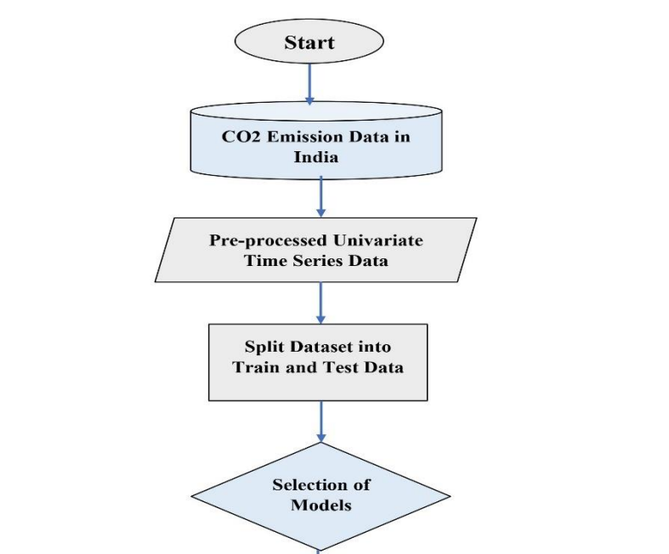
ARCHITECTURE BLOCK DIAGRAM
ARIMA
LSTM
CNN
CNN & GRU
DAYANANDA SAGAR COLLEGE OF ENGINEERING

Slide 7
APPLICATIONS
1. Shaping Climate Policies - Help to set achievable goals for reducing those emissions
2. Guiding Urban Development - Use to make decisions about traffic, and create green spaces
3. Supporting Corporate Sustainability - To predict how different strategies might impact their CO2 output
4. Informing Energy Choices - Guiding them toward cleaner energy investments
5. Raising Public Awareness - Data to create compelling stories and visuals
DAYANANDA SAGAR COLLEGE OF ENGINEERING

Slide 8
Breaking the Carbon Curve: Advanced Forecasting of
Global CO2 Emissions Using CNN-GRU
Team Members
1. Lohish – 1DS21CS110
2. Pranav Arya - 150
3. Pranav J S - 152
4. Prudhvi Raj - 160
Under the Guidance of
Prof. Annapoorna B.R
Assistant Professor,
Dept of Computer Science and Engineering
DAYANANDA SAGAR COLLEGE OF ENGINEERING

